Slide 1
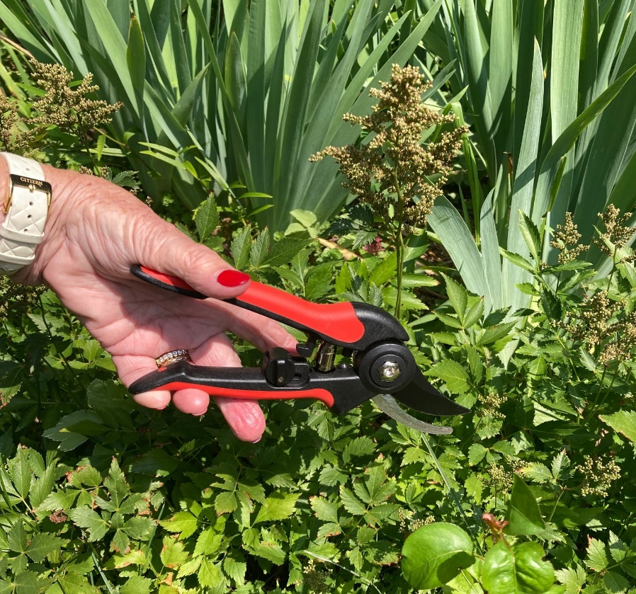
Prune your text
and it will
yield more fruit

