Slide 1
Higher Logic Thrive Upgrade

Slide 2
ASCE Collaborate has upgraded to Thrive. This new platform has improved functionality and new features including Informz (an email marketing tool similar to Constant Contact). As of August 4th, ASCE HQ will no longer support Constant Contact.
Notes:
ASCE Collaborate has upgraded to Thrive. This new platform has improved functionality and new features including Informz (an email marketing tool) that will be replacing Constant Contact on August 4^{th.}

Slide 3
Platform Review: Thrive (Collaborate 2.0)
Upgrades to existing functionality
New Activity Feed. Social media-like feel.
Updates to profile pages
New Ribbons and Badges
Featured Cards for easy editing by site and microsite admins
Additional Modules with Thrive
Informz – Marketing Automation
Activity Sync (Data integration)
Volunteer Manager
Expert/Speaker Directory
Sub-Communities
Group Manager

Slide 4
Project Goals
Improve data security, data governance, and compliance.
Support volunteer leaders by providing a useful, convenient, and affordable platform to support member communications and event registration.
Provide a more consistent messaging, brand and user experience across the member experience.
Access analytics for local member engagement and contribute to the 360-degree member view.
Ensure a sustainable level of support for the platform/system.
Notes:
A core group of ASCE staff started evaluating platforms in the summer of 2022 before deciding to make this switch. The goals of these platform included the following five goals:
Improve data security, data governance, and compliance.
Support volunteer leaders by providing a useful, convenient, and affordable platform to support member communications and event registration.
Provide a more consistent messaging, brand and user experience across the member experience.
Access analytics for local member engagement and contribute to the 360-degree member view.
Ensure a sustainable level of support for the platform/system.
The next five slides are a matrix of functionality considered for each goal. For the sake of time, I will not go through each element on each slide, but I will be sharing my slide deck for you to review at your convenience.

Slide 5
Goal 1: Improve data security, data governance, and compliance.
 | INFORMZ |  | CONSTANT CONTACT
Integration with email preference center. | P | Can be integrated with Eloqua EPC. | O | Locally managed in Constant Contact
Member data stored and updated through existing Personify integration | P | Personify sync occurs every 30 minutes. | O | Volunteers have to manually download and upload lists from Cerberus site.
Controlling admin permissions |  | Permission levels can be assigned to various roles | O | Single admin profile.
Unlimited admin accounts | P |  | O

Slide 6
Goal 2: Support volunteer leaders by providing a useful, convenient, and affordable platform for member communications and event registration. .
 | INFORMZ |  | CONSTANT CONTACT
Simple user interface | P | Informz and Constant Contact use similar user interface | P | Informz and Constant Contact use similar user interface
Management of email lists | P | Segmented lists based on Personify criteria | O | List management is manual
Single tool for all functions | P | Consolidates email distribution, member data, content library in one platform | P | Requires maintenance and use of multiple platforms

Slide 7
Goal 3: Provide a more consistent messaging, brand and user experience across the member experience. .
 | INFORMZ |  | CONSTANT CONTACT
Branded templates | P | Allows multiple, custom templates; creates more uniform member experience | O | Offers standard template only
Integrated calendar | P | All events created in the platform will populate on integrated calendar | O
Shared content | P | Content library and APIs allow editors/admins to easily access content | O

Slide 8
Goal 4: Access analytics for local member engagement and contribute to the 360-degree member view. .
 | INFORMZ |  | CONSTANT CONTACT
Data integration with other systems | P | Committee, mentoring, engagement, Personify integration available. New activity sync module offers addl capabilities. | O | Local data not integrated to enterprise-level systems.
Dashboards/standard reports available | P |  | P
Benchmarking data | P |  | P

Slide 9
Goal 5: Ensure a sustainable level of support for the platform/system. .
 | INFORMZ |  | CONSTANT CONTACT
Enables embedded ad server | P |  | O
Ongoing support and upgrades | P |  | P
Cost (annual) | P | $55,000 (exclusive of underlying Higher Logic contract and one-time implementation fee of $XX,000) | O | $111,000

Slide 10
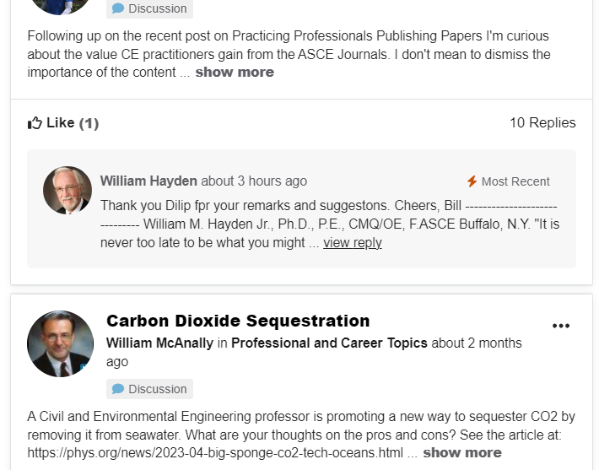
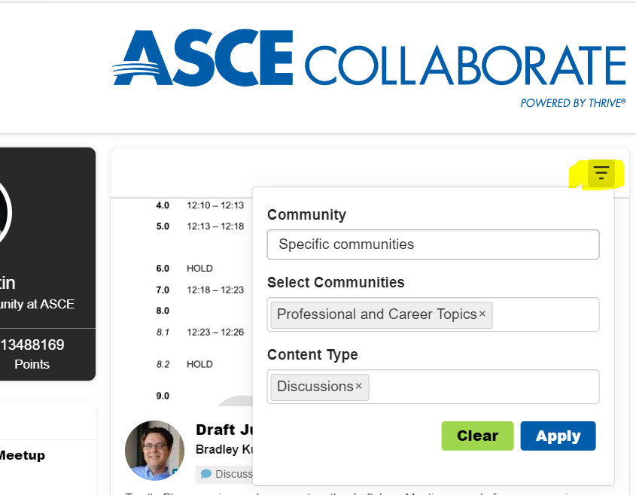
Activity Feed
Notes:
The new activity feed on the new member home page is a more user-friendly feed that will show you more content types of information relevant to you. It also has an infinite scroll feature. You can search based on specific communities and content types by using the search feature you see highlighted in yellow on the left.

Slide 11
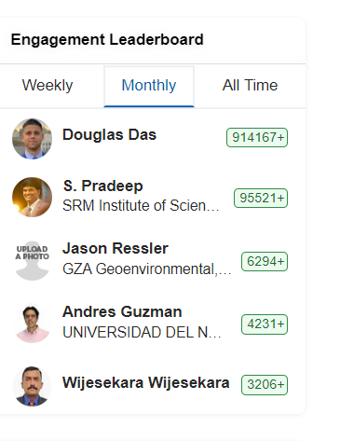
Leaderboard
Notes:
The leaderboard displays most active members on a weekly, monthly, or all time. You will see Douglas Das from the Metropolitan Section in first place over the last month. This is a fun, new feature our Topic Moderators were very excited about.

Slide 12
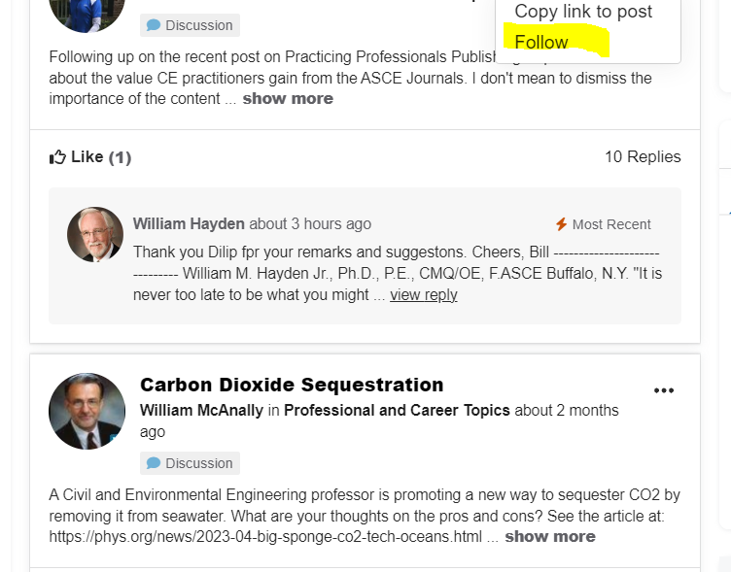
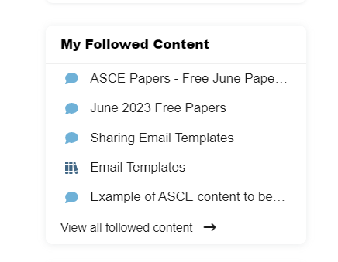
Followed Content
Notes:
You can follow content and then view content you are following on the new member home page. This helps you focus on topics you find most interesting.

Slide 13
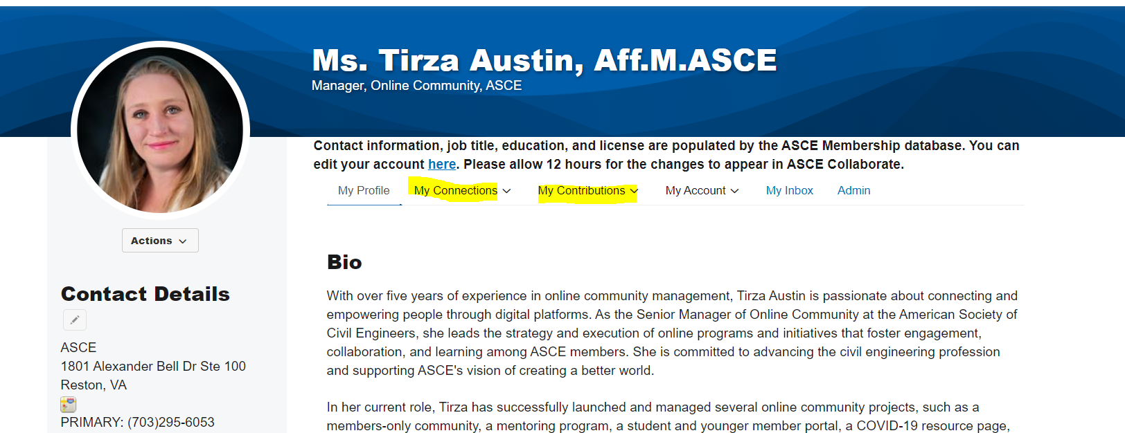
Enhanced Member Profiles
Notes:
Profile pages have been enhanced to offer a contribution and connections tab so you can more easily manage your interactions on the platform. The pages have also been refreshed to improve the look and feel of profile pages.

Slide 14
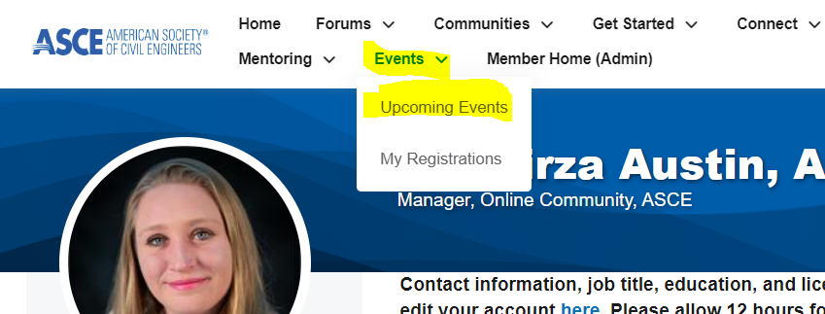
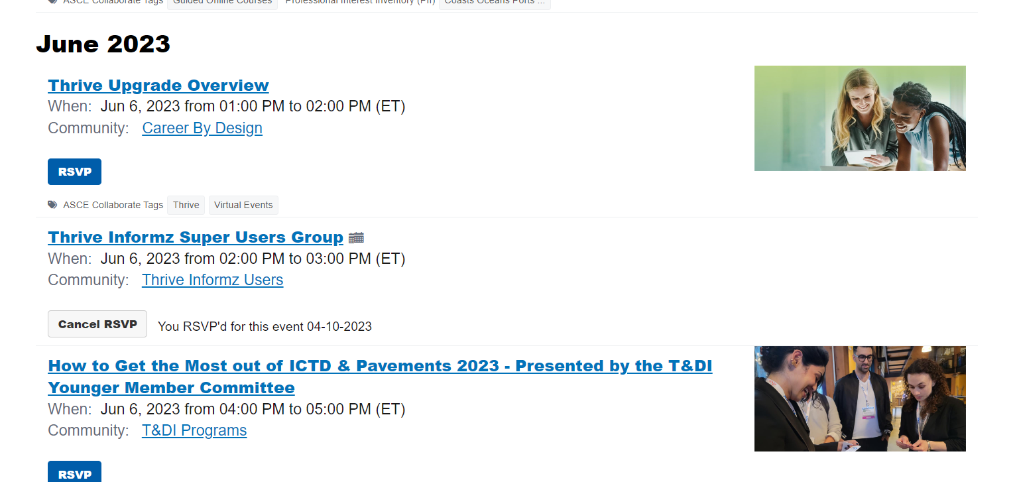
Consolidated ASCE Calendar
Notes:
The upgraded platform offers a consolidated calendar. This calendar includes Society and Institute events stored in our database, continuing education events stored in our database, virtual events, and now Section and Branch events for groups who use the event registration option in ASCE Collaborate. Committees have the ability to use this feature as well and their events will only appear to members in those committee groups.

Slide 15
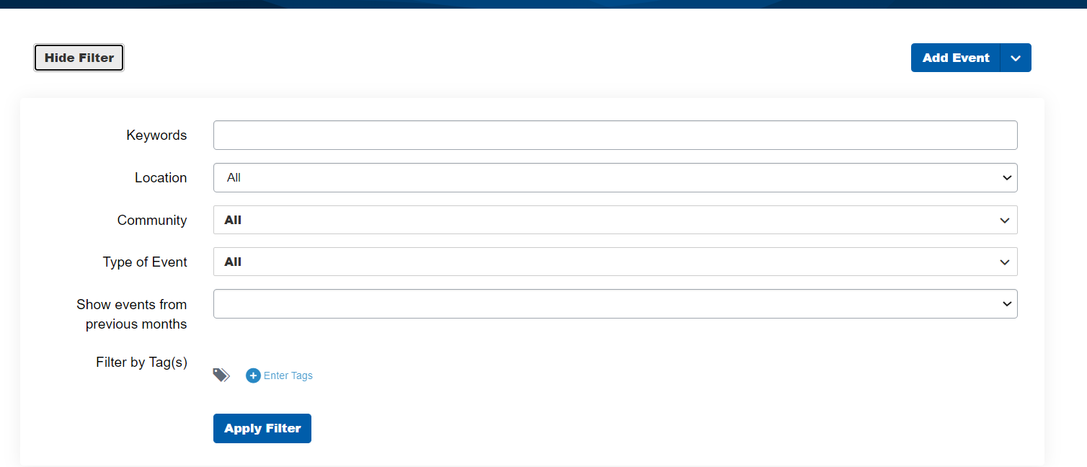
Event Filter
Notes:
Because the calendar can store many events across the globe and organization, it also has an option to filter events based on location, keywords, community, and even tags.

Slide 16
ASCE Member Directory
Search based on
Name
Location
Company
Professional Interest
ASCE or SEI Fellows
Notes:
Thrive has also updated the ASCE Member Directory. You can search for ASCE members you have met at events and contact them through the platform. You can also toggle to an advanced search to find members in your local area. You can search for members by professional interest or even find ASCE or SEI fellows by selecting the appropriate tab in the directory.

Slide 17
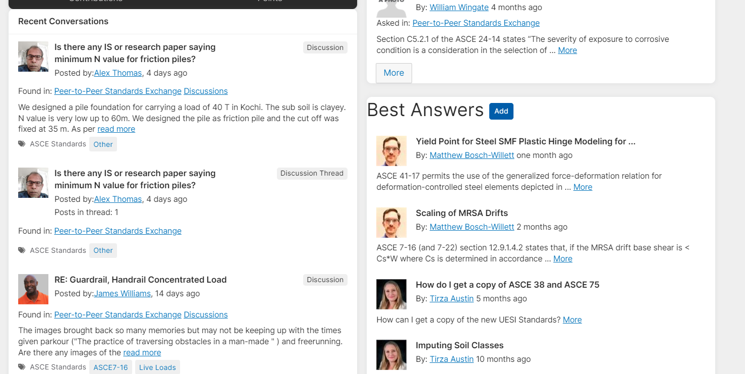
Peer-to-Peer Standards Exchange
Notes:
We’ve added a new forum to the Thrive platform. Come join the discussion about ASCE Standards! The Peer-to-Peer Standards Exchange is a new ASCE Collaborate forum to discuss technical issues about ASCE standards. Dive into your technical area with questions and issues with your community. Members can ask and answer questions. Non-members will have view-only capability.
You can access the forum here: https://collaborate.asce.org/standards-exchange/home

Slide 18
Event Manager
Integrated with the ASCE membership database
Member/nonmember/student registration prices based on ASCE record
Events appear on ASCE consolidated calendar
Streamlined reporting
Automated event emails
No additional charge for the use of the platform
Integrated with Stripe, Checkpoint and PayPal to process payments
Notes:
Thrive offers event registration features. Some Sections and Branches, Institutes, and Society level virtual events have been using this functionality since the start of the pandemic. Some highlighted features include:
Registration system is integrated with the ASCE membership database
Member/nonmember/student registration prices based on ASCE record
Events appear on ASCE consolidated calendar
Streamlined reporting
Automated event emails
No additional charge for the use of the platform
Integrated with Stripe, Checkpoint and PayPal to process payments

Slide 19
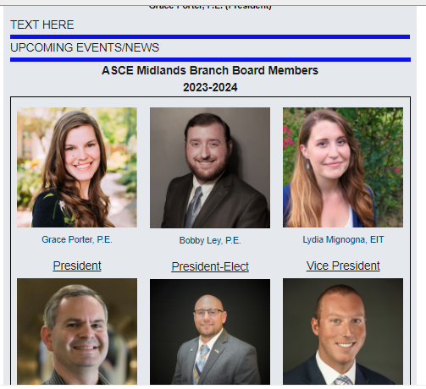
Informz
Notes:
Informz is an email marketing tool that is a new feature in Thrive. The system helps you tailor every email or automated campaign with dynamic content, segmentation, and personalization. The system is integrated with the ASCE membership database so there is no need for you to pull or manage separate lists outside of the system. However, you can upload prospect lists if you would like. This is an example email template that the Midlands Branch has built in the new system.

Slide 20
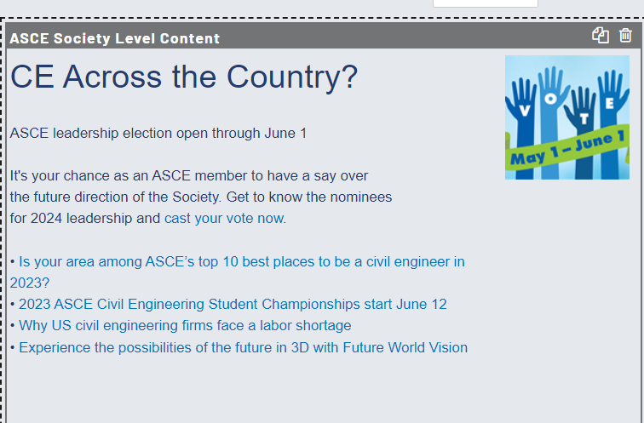
Additional Features
Unlimited administrator accounts
ASCE branded templates
ASCE Asset Library in the system
ASCE content layouts
Improved reporting that will contribute to a 360-membership view
A/B Testing
Targeted segment groups for emails and email content
Event Campaigns
Improved data security, deliverability, and compliance
Notes:
In addition to being integrated with the ASCE database, Informz provides additional features including:
Unlimited administrator accounts
ASCE branded templates
ASCE Asset Library in the system
ASCE content layouts
Improved reporting that will contribute to a 360-membership view
A/B Testing
Targeted segment groups for emails and email content
Event Campaigns
Improved data security, deliverability, and compliance

Slide 21
Transition
This change was communicated at all three of the ASCE Multi-Region Leadership Conference.
Early adopters started receiving login credentials and weekly training sessions in February.
Section and Branch Leaders who request login credentials from Tirza Austin at taustin@asce.org will receive login credentials immediately
Users will meet weekly and offer feedback throughout the summer
August 4th the Constant Contact contract ends
Notes:
ASCE started communicating this change at all three of the ASCE Multi-Region Leadership Conference. At the conference early adopters identified themselves and started receiving login credentials and attended weekly training sessions starting in February.
Today, Section and Branch Leaders who request login credentials from Tirza Austin at taustin@asce.org will receive login credentials immediately. ASCE is hosting weekly user group sessions and is collecting feedback throughout the summer.
ASCE’s contract with Constant Contact will be ending on August 4, 2023. Local groups can continue to use Constant Contact, but the monthly costs associated with the account will be the responsibility of the local group.
We encourage all local groups using Constant Contact to contact Tirza Austin at taustin@asce.org to receive login credentials. We would like the transition to be as seamless as possible. Granting each user early access so they can get used to the site will be a huge part of that success.

Slide 22
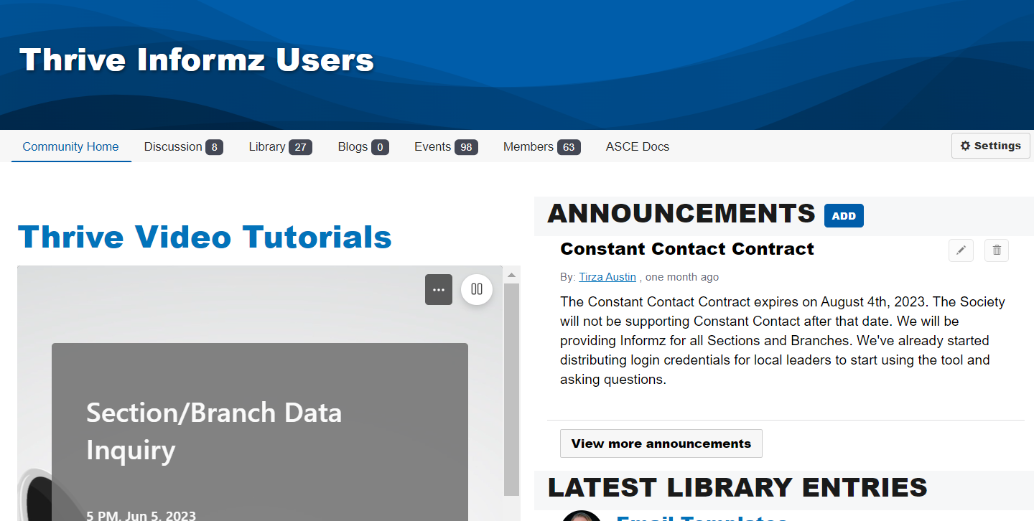
User Group
The user group meets every Tuesday at 2pm ET
We have a community with resources, recordings and training videos
Users can also use this space to communicate with each other
Notes:
I encourage you to join the ASCE user group. The group meets every Tuesday at 2pm ET. Please contact Tirza Austin at taustin@asce.org and you will be forwarded the meeting invite.
We also have a community with resources, recordings and training videos. You can request to join this community or Tirza Austin can add you. The link is: https://collaborate.asce.org/communities/community-home?CommunityKey=6eb5ef45-0549-4878-9887-0185f5b147bd
We are also encouraging users to use this space to communicate with each other. We hope you find it helpful.

Slide 23
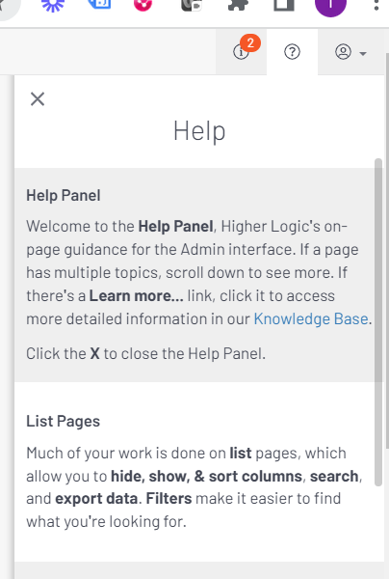
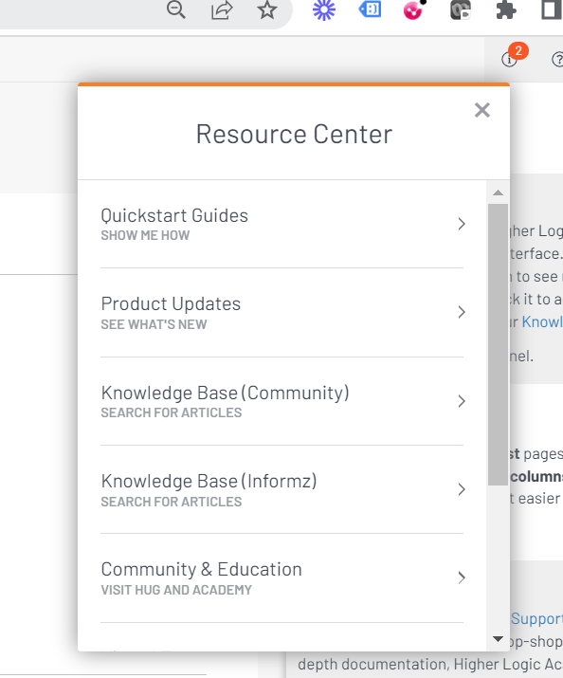
Training Resources
Notes:
In the Informz platform you will see a help section if you click on the question mark in the upper-right-hand part of the screen. You will also see an information section if you click on the “I” in the upper-right-hand side of the screen. These are great resources from the vendor for you to leverage. ASCE is also creating video tutorials for you to access at https://collaborate.asce.org/welcome-thrive. I hope you take advantage of these resources. If you notice topics that you would find helpful or gaps in training, please contact taustin@asce.org

Slide 24
Questions?
Contact: Tirza Austin
taustin@asce.org
Notes:
Thank you for joining us today. Do you have any questions?
Please contact Tirza Austin at taustin@asce.org if you have any questions. Thank you for your participation in this project.

