Slide 1
WELCOME TO

Slide 2
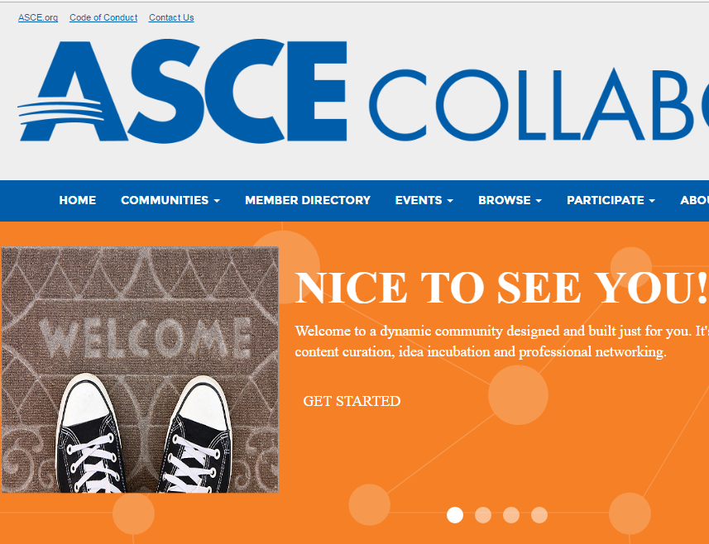
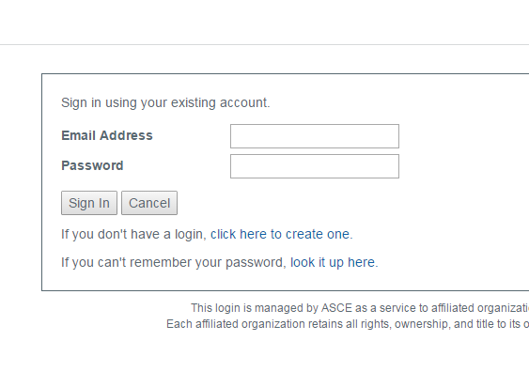
Logging into your account
http://collaborate.asce.org/home
(yay no new username or password to remember!)
This is your email and password for ASCE Account

Slide 3
CREATE OR UPDATE YOUR PROFILE - profile option 1- enter in manually OR import from LinkedIn - don’t forget your picture! Studies show that your profile will be perceived as less “trustworthy” without a photo

Slide 4
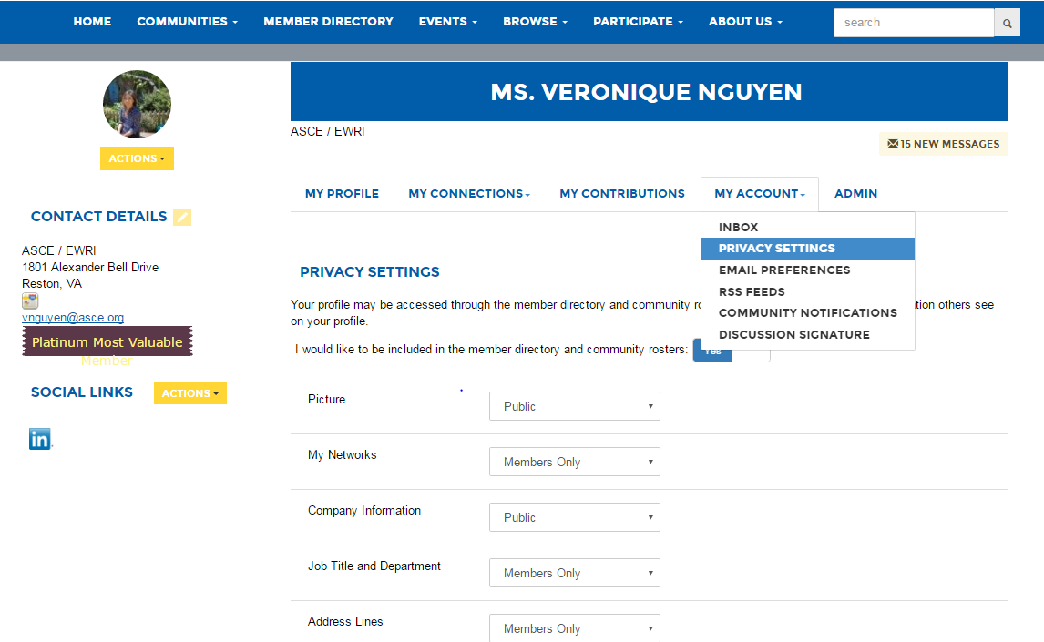
PRIVACY - control who sees your information under Privacy Settings

Slide 5
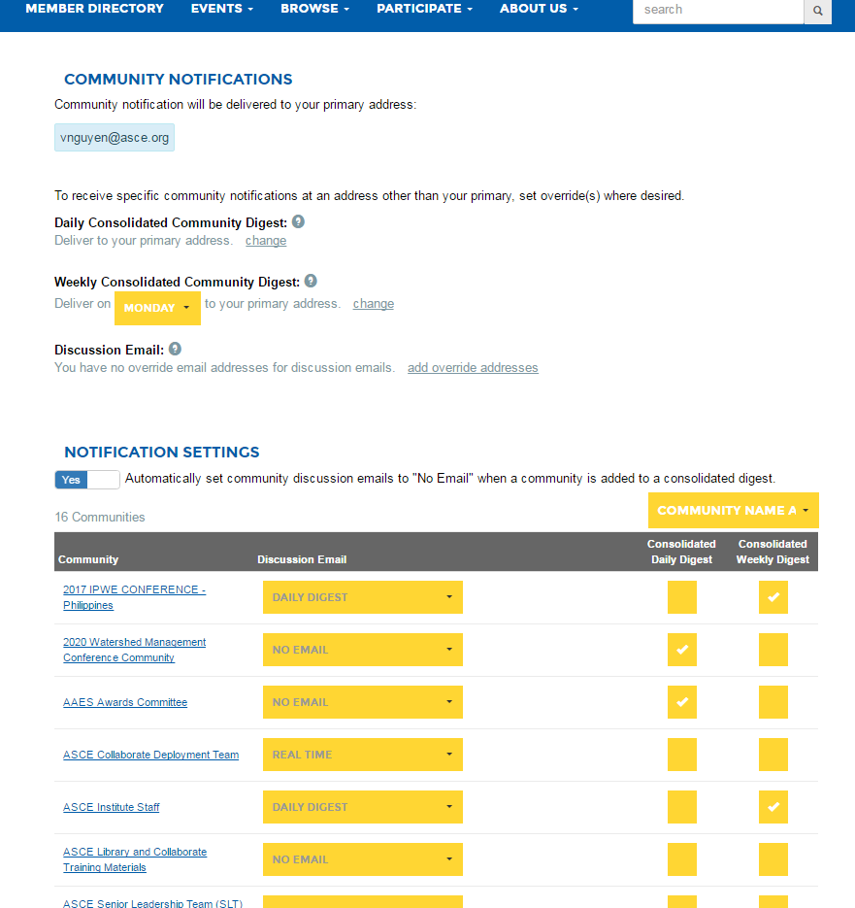
EMAIL NOTIFICATIONS - Everyone wants the least amount of emails, right? Control how often you’d like to be notified by activity on ASCE Collaborate under Community Notifications - You can still say up to date with your communities & receive fewer notifications by consolidating your digest (you will receive 1 email with activities from all your communities) - option for daily and weekly
UNDER MY PROFILE >
MY ACCOUNT>
COMMUNITY NOTIFICATIONS

Slide 6
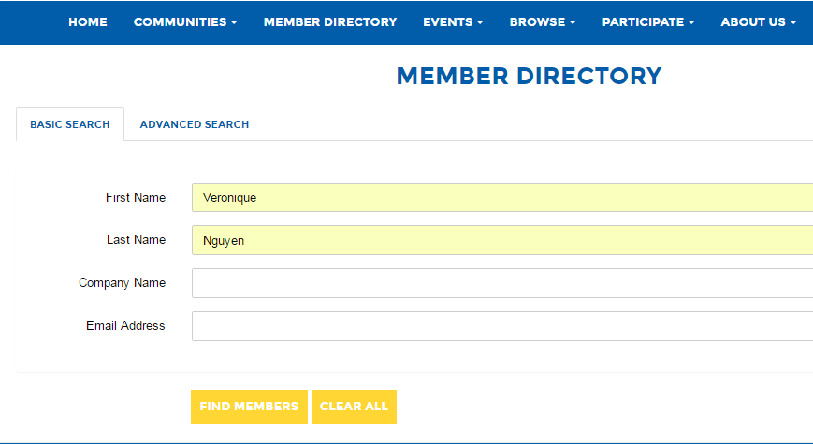
DIRECTORY Find members/ colleagues and “Add as Contact” Member Directory > Search > Find Members >

Slide 7
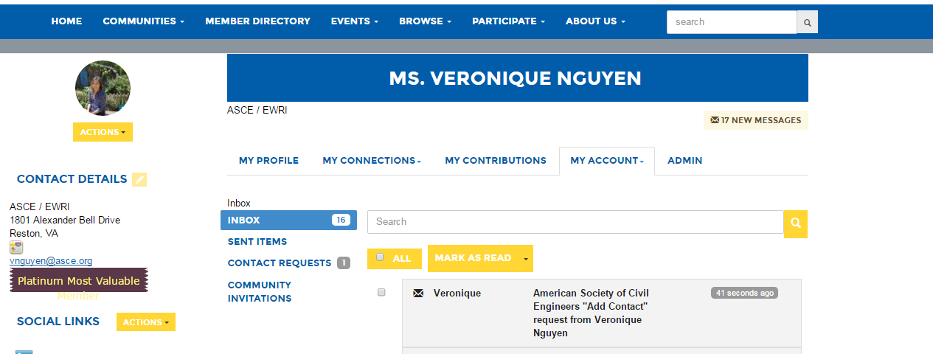
How to Accept Requests Profile>Unread Messages> Contact Requests Or you will receive an email notification based on your profile setting

Slide 8
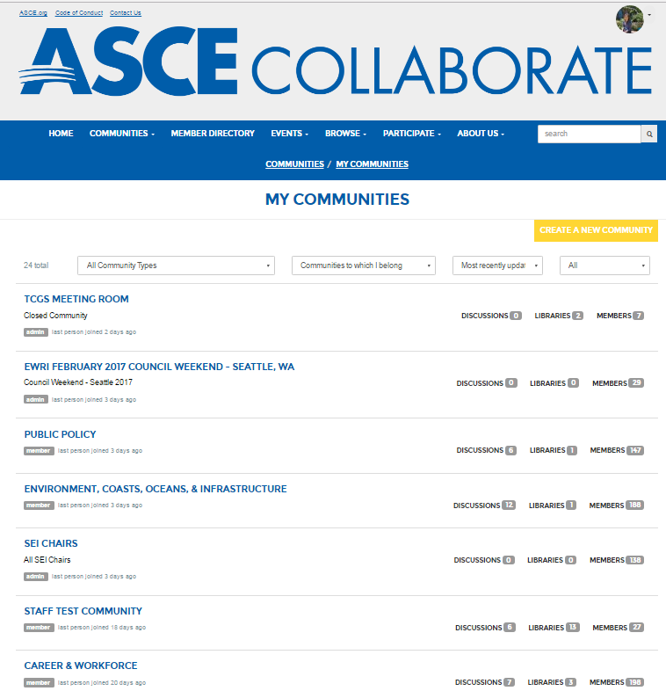
Your Communities -Communities tab - My Communities

Slide 9
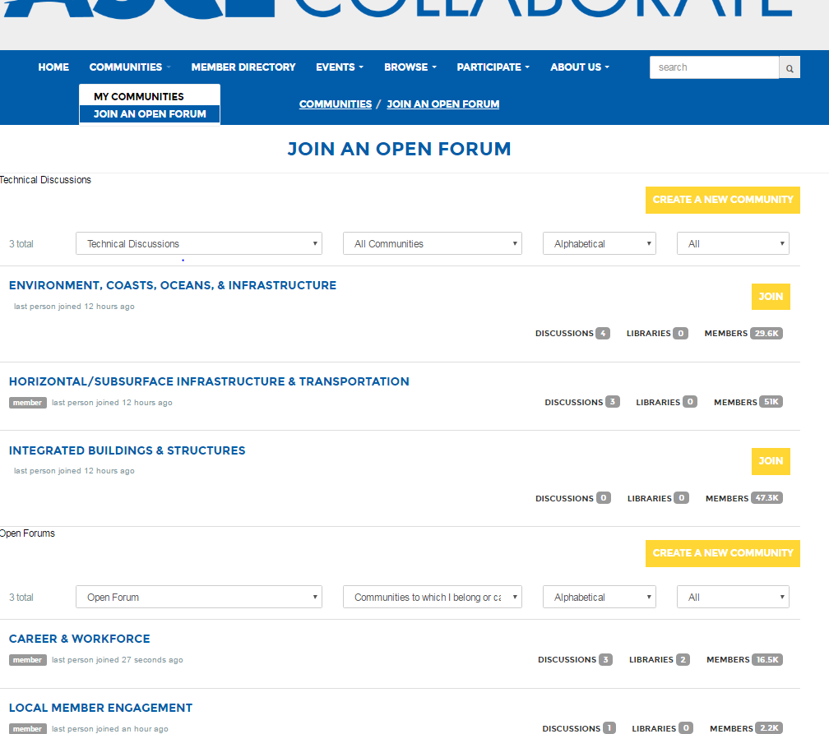
Join an Open Forum Communities >Join An open Forum > JOIN

Slide 10
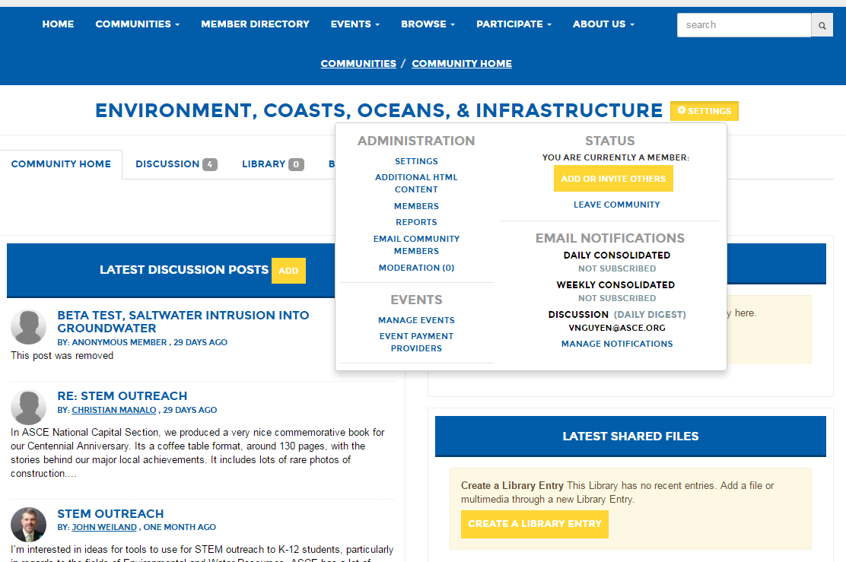
Leave a Community My Communities > Choose community you want to leave>Settings> Leave Community

Slide 11
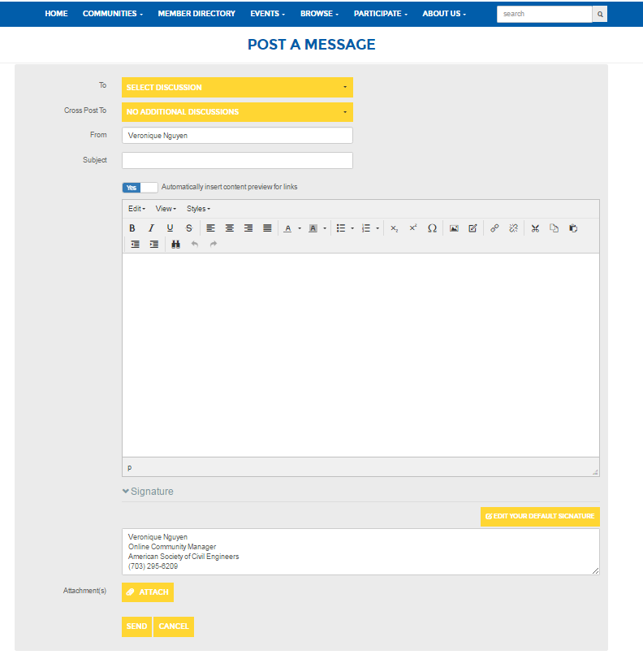
Start Discussions about Relevant Society of Open Forum Topics
Home > Latest Discussions > MORE > POST A NEW MESSAGE
OR Reply to a existing post
Click on Post >

Slide 12
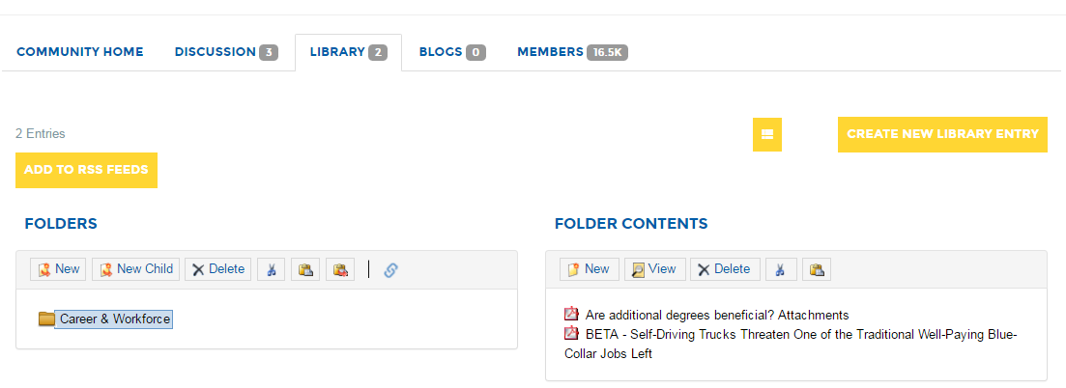
Library click on Library Tab in your community, then View Folder Contents
View Library Documents

Slide 13
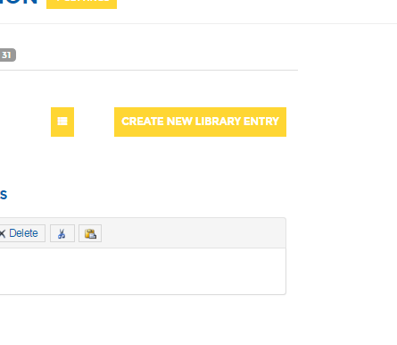
Create New Library Entry
Add Title & Description
Next > Choose the file you want to upload and FINISH
Share useful resources within community groups

