Slide 1
UNIVERSITY OF CENTRAL FLORIDA
American Society of Civil Engineers Student Chapter
Notes:
Use your own theme and layout (View-slide master or similar). Add photos, logos and graphics. Throughout this template file, text in italics should be replaced with more specific titles.

Slide 2
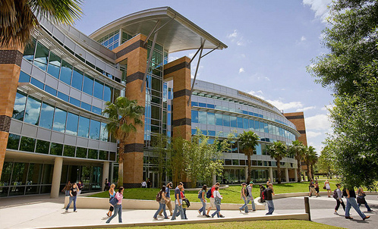
Contact Information
College of Engineering and Computer Science
4000 Central Florida Blvd., Orlando FL, 32816
Asce.ucf@gmail.com
www.asceucf.org

Slide 3
Student Officers
2013 - 2014
Andrew Hall – Fundraising Chair
asce.ucf.fundraising@gmail.com
Gilbert Corral - Historian
gcorral@knights.ucf.edu
Catherine Felter – Conference Chair
felter_c@knights.ucf.edu
Reid Kirkpatrick – Corr. Secretary
rkirkpatrick3@knights.ucf.edu
Jaclyn Molfetto – Recruitment Chair
jaclynmolfetto@knights.ucf.edu
Travis Henriques – President
asce.ucf.president@gmail.com
Armando Perez - Vice President
Mitch Kilpatrick - Secretary
asce.ucf.vp@gmail.com
Mkilpatr44@knights.ucf.edu
Cole Buck – Treasurer
coletbuck@knights.ucf.edu
Julia Felter – Service Chair
asce.ucf.community@gmail.com
Notes:
Photos!

Slide 4
Student Officers
2013 - 2014
Noelle Crosby – Social Chair
noellecrosby@knights.ucf.edu
Edwin Ramos – Graduate Advisor
edwin.89@knights.ucf.edu
Matthew Reker – Underclassman Rep
Vincent Stippler – Marketing Chair
vrstipp@knights.ucf.edu
m.reker13@knights.ucf.edu
Christopher Sotomayor – Webmaster
stmyrchris@knights.ucf.edu
Bernie Hofmeister – Past President
bernstir352@gmail.com
Ryan Petersen – Shop Manager
ryanjpetersen@knights.ucf.edu
Michael Herman – Student Liaison
mherman@Knights.ucf.edu
Lars Swanson – Concrete Canoe Captain
larsswanson1991@knights.ucf.edu
Robert Thomas – Concrete Canoe Captain
rjthomasiii@knights.ucf.edu
Kent Bailey – Steel Bridge Captain
kent.bailey@knights.ucf.edu

Slide 5
Student Officers
2014 - 2015
Kent Bailey - President
asce.ucf.president@gmail.com
Catherine Felter – Vice President
asce.ucf.vp@gmail.com
Lauren Rhodes – Secretary
laurenrhodes@knights.ucf.edu
Julia Felter – Treasurer
juliafelter@knights.ucf.edu
Thomas Anzelone – Community Service Chair
asce.ucf.community@gmail.com
Vincent Stippler – Fundraising Chair
asce.ucf.fundraising@gmail.com
Carlin Dunlop – Conference Chair
cdunlop@knights.ucf.edu
Drenard Jones – Correspondence Chair
djones10@knights.ucf.edu
Matthew Reker – Recruitment Chair
m.reker13@knights.ucf.edu
Travis Henriques – Social Chair
travis.ucf@gmail.com
Dayna Duffy – Underclassmen Representative
daynalynn95@knights.ucf.edu
Rubina Kandiah – Marketing Chair
rubykandiah92@knights.ucf.edu

Slide 6
Student Officers
2014 - 2015
Travis Henriques – Past President
travis.ucf@gmail.com
Max Nichols – Shop Manager
max_nichols@knights.ucf.edu
Alex Hinkle – Student Liaison
AWHinkle@gmail.com
Paul Heagney – Concrete Canoe Captain
heagney@knights.ucf.edu
Jaclyn Molfetto – Concrete Canoe Captain
jaclynmolfetto@knights.ucf.edu
Gabriel Romanach – Steel Bridge Captain
romanach@knights.ucf.edu
Gregory Cimeno- Steel Bridge Captain
gcimeno@knights.ucf.edu

Slide 7
Student Officers

Slide 8
Advisors
Dr. Amir Behzadan – Faculty Advisor
Amir.Behzadan@ucf.edu
(407) 823-2480
Alex Hinkle – Practitioner Advisor
AWHinkle@gmail.com
(407) 246-0044 Ext. 121
Sarah Martin
smatin@chenmoore.com
(407) 536-7970 Ext. 1124
Notes:
Photos!

Slide 9
Financial Summary
Dues:
$30 for undergrads/Academic year
$15 for grad students/Academic year
As of December 31, 2014
Total income: $ 37,168.38
Total expenditures: $ 30,106.70
Current Cash balance: $6,952.58

Slide 10
Goals and Objectives
Reach 100 members in 2014
Become more of a multifaceted club
Increase communication/teamwork to become a stronger officer corps
Become more involved with the ASCE East Central Branch and Younger Members Forum
Notes:
Three goals are suggested, add more if you wish

Slide 11
Reach 100 members in 2014
To have at least 100 paying ASCE-UCF members for 2014
Action plan
Brought in new professional presenters
Resume workshop held during the Fall semester
Organized more student socials
Assessment
11 new members in Spring 2014
111 paying members by the end of Fall 2014
Student socials helped keep members interested in ASCE-UCF
Follow-up plan for the future
Continue to be socially active in order to attract more potential members

Slide 12
Become more multifaceted
To become a multifaceted club that helps connect students to various UCF resources.
Action plan
Connect members and officers with local internships
Participate in more community service events
Assessment
ASCE-UCF has connected many former and active members to local engineering firms for obtaining internships and jobs after graduation.
4 community service events and 6 social events within the Fall semester
Follow-up plan for the future
Continue to maintain a healthy and professional relationship with local engineering firms

Slide 13
Become a stronger officer corps
To become a stronger officer corps to function better as a club
Action plan
Created community service, local, and social committees to elevate work from officers
Higher attendance at officer meetings
Assessment
Increased communication between officers allowed for more events to be held and an overall better experience for the club's general members.
Follow-up plan for the future
Officers will continue to communicate effectively and express concerns in a timely manner.

Slide 14
Be more involved with the ASCE East Central Branch
To become more involved with the ASCE East Central Branch and Younger Members Forum
Action Plan
Change practitioners
Invited YMF to panel discussion and resume workshop
Attend ASCE East Central Branch meetings
Keep ASCE East Central Branch updated on sponsors
Assessment
There was UCF representation at most ECB and YMF board meetings in 2014 and multiple events coordinated between ASCE-UCF and the branch members.

Slide 15
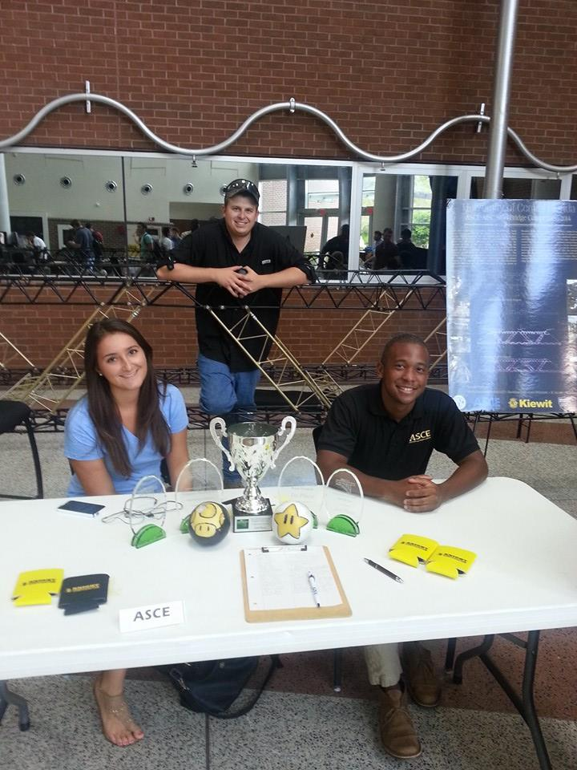
Membership Statistics
111 total members
53 total ASCE National Society-level members
47% of members are Society-level members
80 members with Junior and Senior status
~ 500 Juniors and Seniors eligible to join ASCE (CE declared majors)
16% of eligible Juniors and Seniors that are members (Jr&Sr members / Jr&Sr eligible)
Notes:
Fill in numbers (from Statistical Data tab in excel sheet) where words are underlined.

Slide 16
Meeting Statistics
9 professional meetings with an invited speaker in 2014
3 professionally hosted ASCE section or branch meetings that students attended in 2014
1 professional licensure and ethics topic presented this year
7 social functions this year
4 field trips
Notes:
Fill in numbers (from Statistical Data tab in excel sheet) where words are underlined.

Slide 17
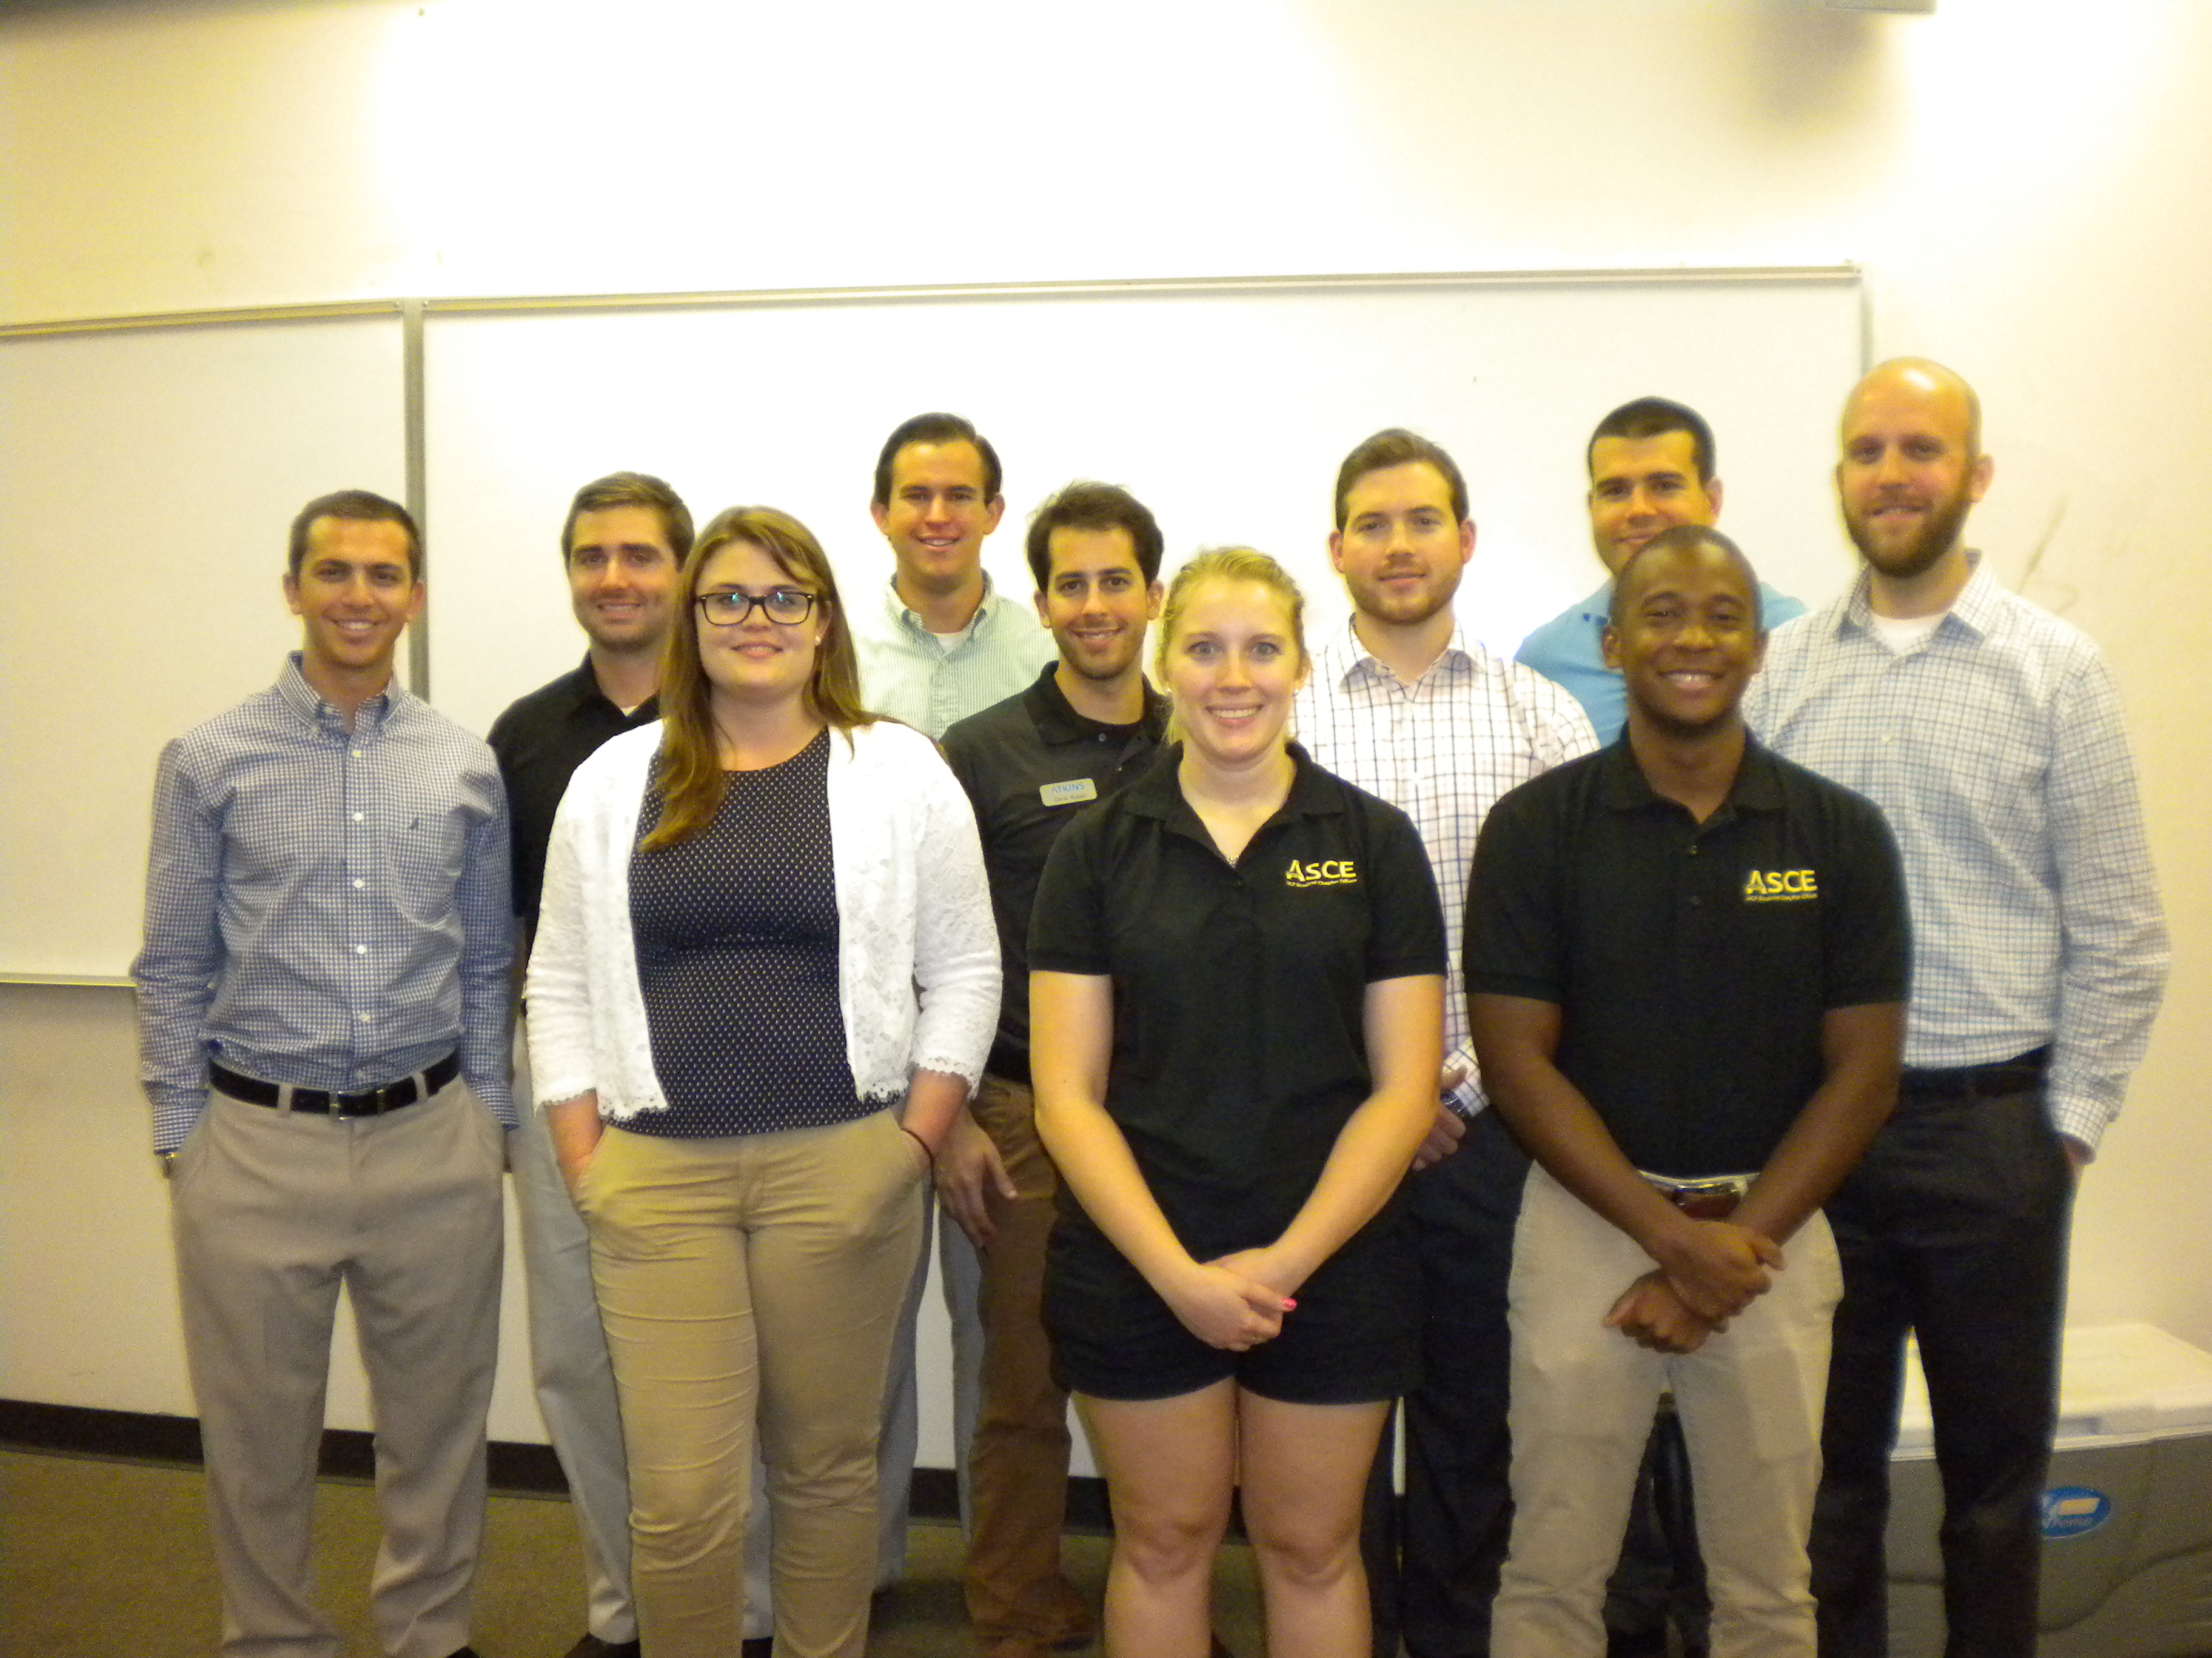
Atkins Training Team
Employees of Atkins Inc. in Orlando, Florida spoke with ASCE-UCF members about the Atkins Training Team and the various projects Atkins undertakes as one of the top engineering firms worldwide.
30 members attended
Atkins was popular because of the various disciplines they specialize in.

Slide 18
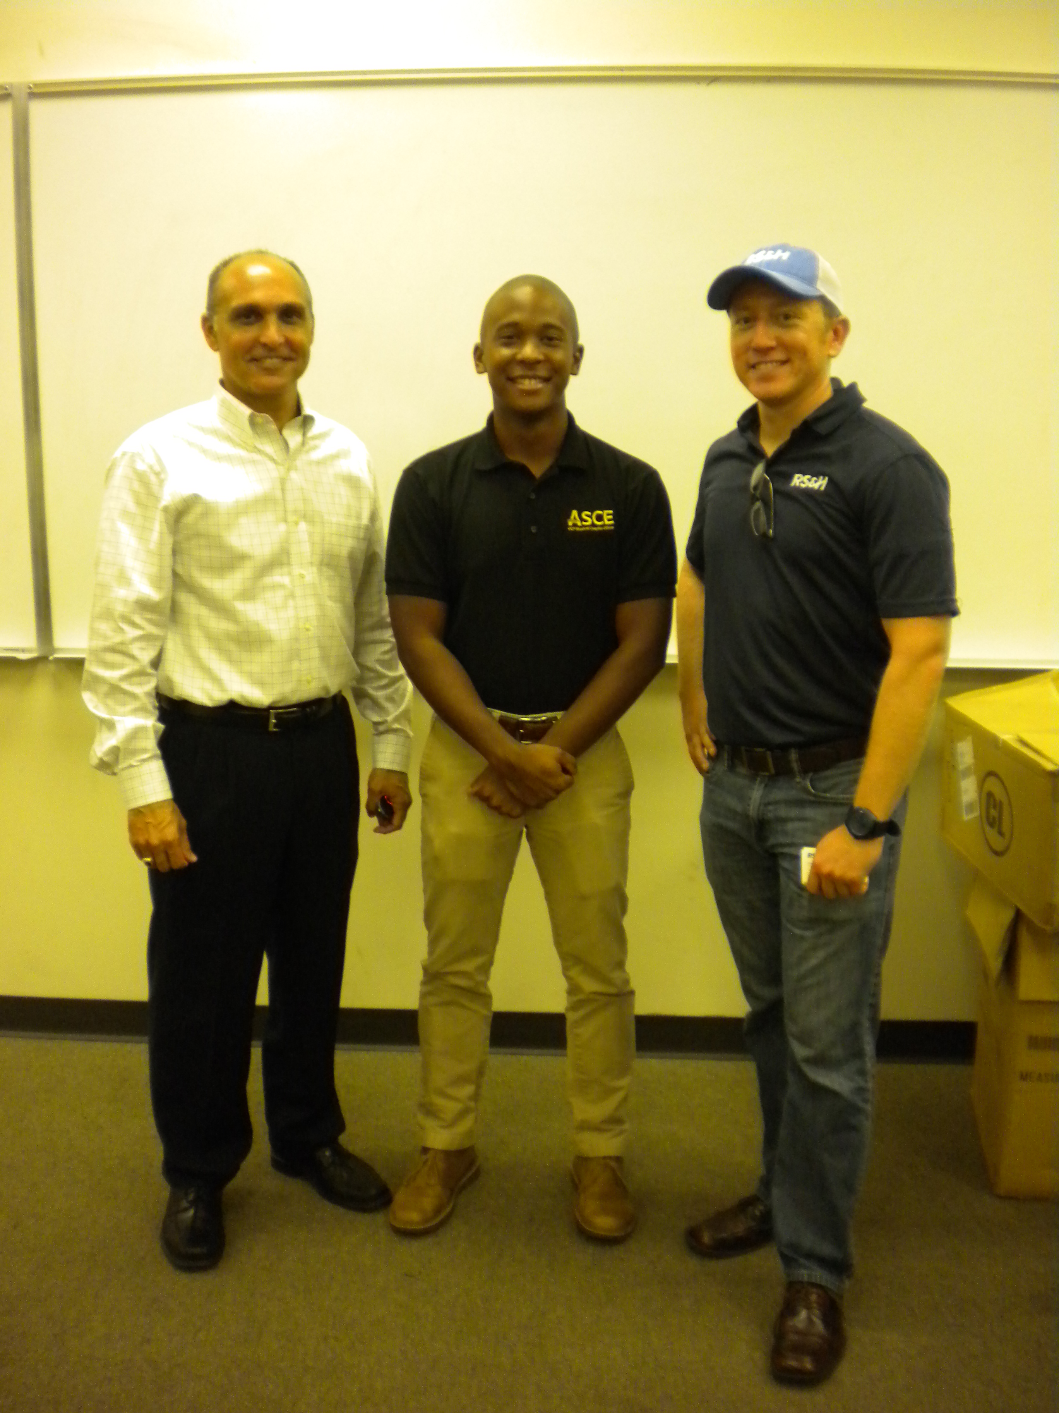
RS&H
Edward Gonzalez, P.E. and Steven Byars from RS&H Orlando presented to ASCE-UCF members about construction management and transportation infrastructure.
22 members attended
The transportation focus was appealing to many members.

Slide 19
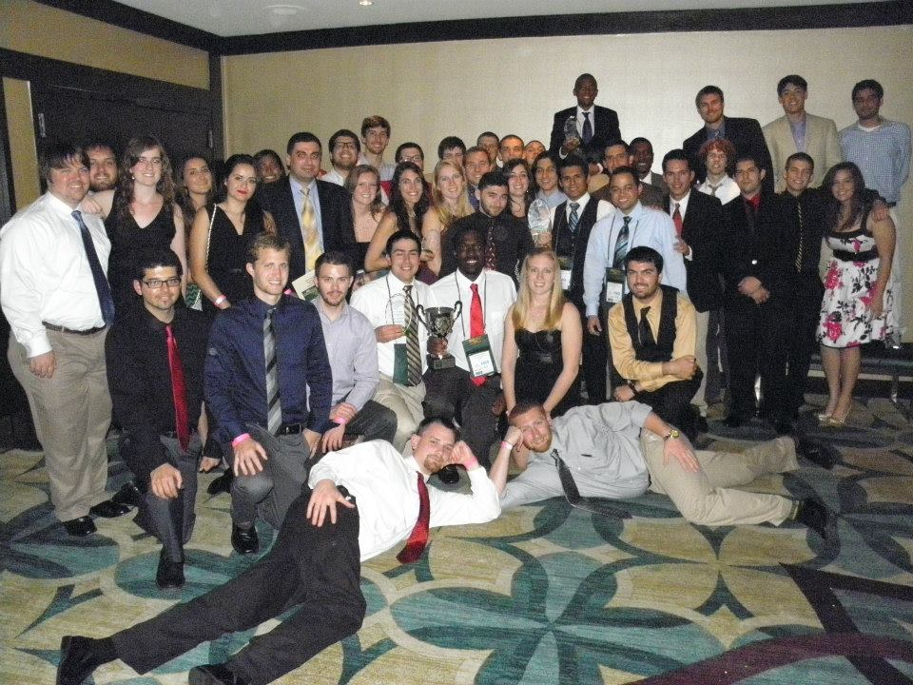
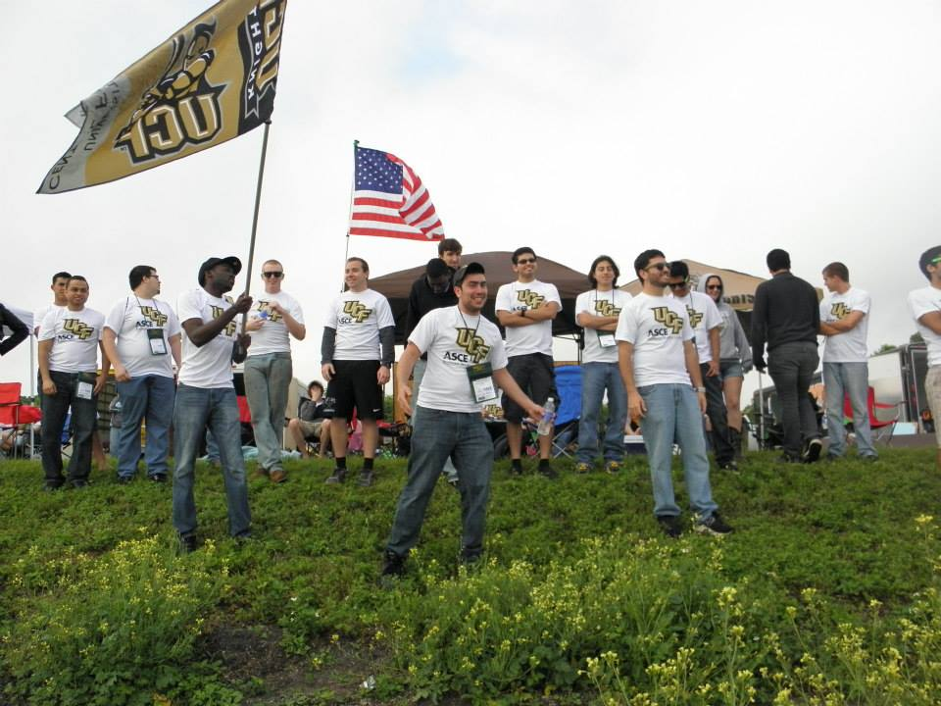
Student Conference
2014 ASCE Student Southeast Conference
Tampa, Florida
Hosted by the University of South Florida
March 27-29, 2014
43 members attended
Notes:
Add slides as necessary to highlight results

Slide 20
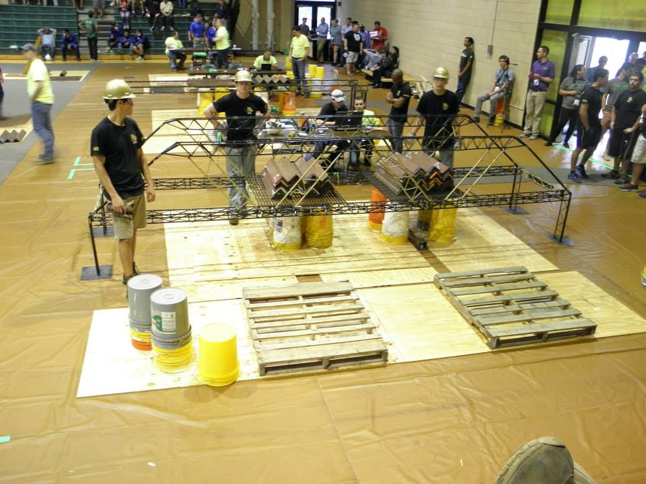
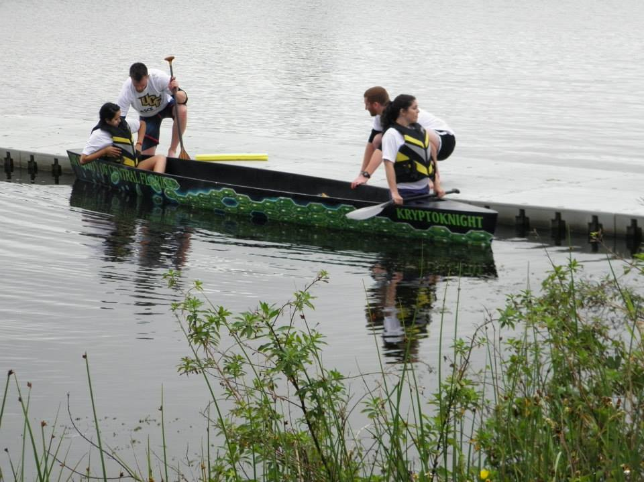
Student Conference
2014 ASCE Student Southeast Conference
Concrete canoe placed 7th out of 24
Steel bridge placed 4th out of 24
Visual display placed 3rd out of 24
Geotechnical placed 5th out of 24
Plans Reading placed 4th out of 24

Slide 21
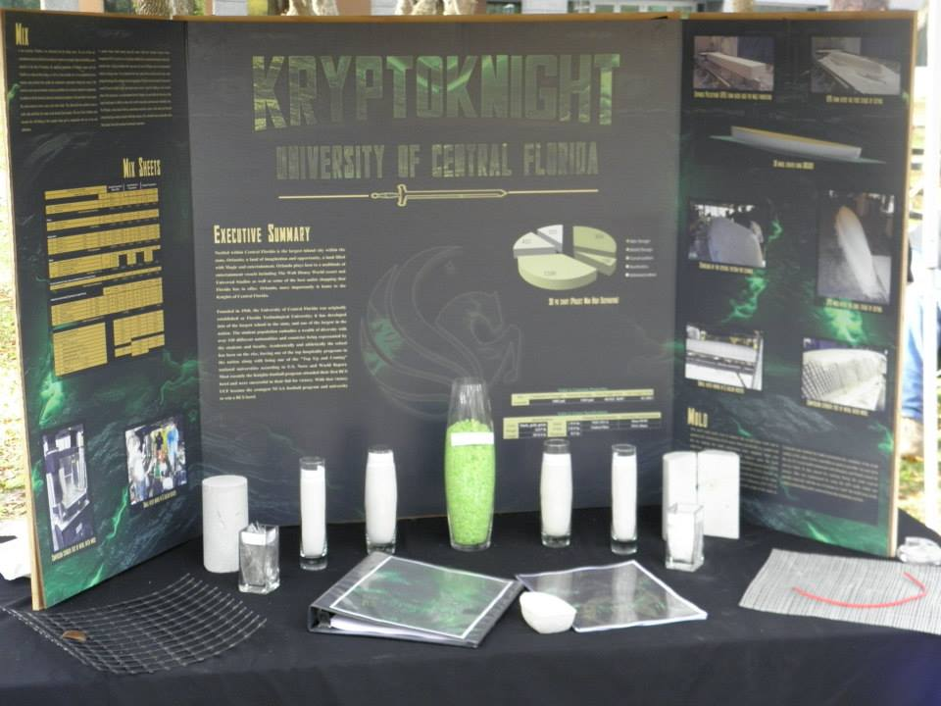
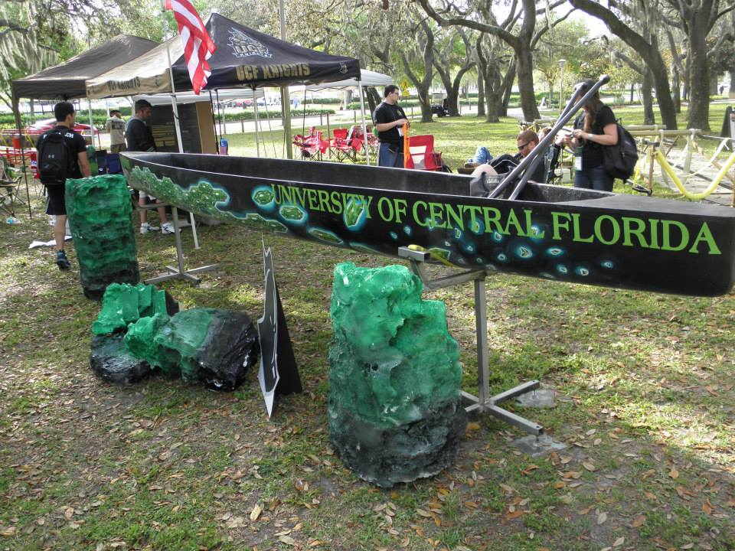
Student Conference
2014 ASCE Student Southeast Conference
Concrete Canoe

Slide 22
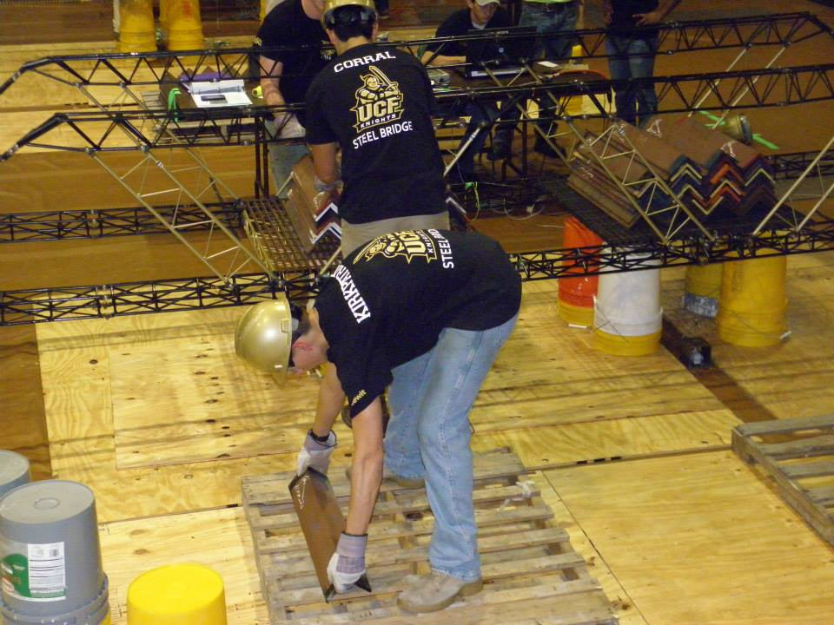
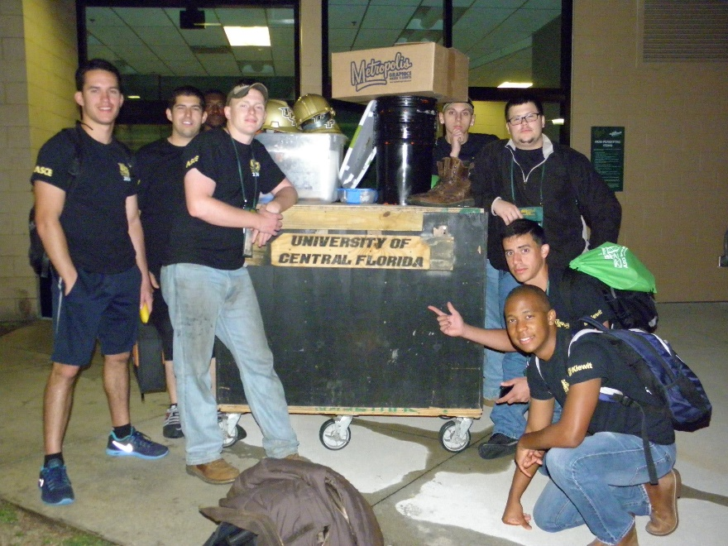
Student Conference
2014 ASCE Student Southeast Conference
Steel Bridge

Slide 23
Leadership Development
Anti-Hazing Workshop
University of Central Florida Student Union
September 25th, 2014
30 students and 2 advisors
Notes:
Add a slide for each activity or conference attended. Other activities besides WSCL may be presented as well.

Slide 24
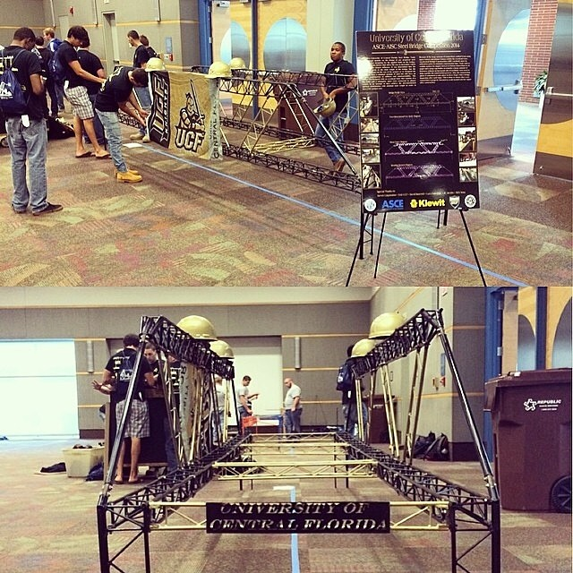
National Conferences
ASCE/AISC Student Steel Bridge Competition
Akron, Ohio
Hosted by the University of Akron
May 23 – May 24, 2014
11 members of the Steel Bridge team attended.
Notes:
Add a slide for each conference attended

Slide 25
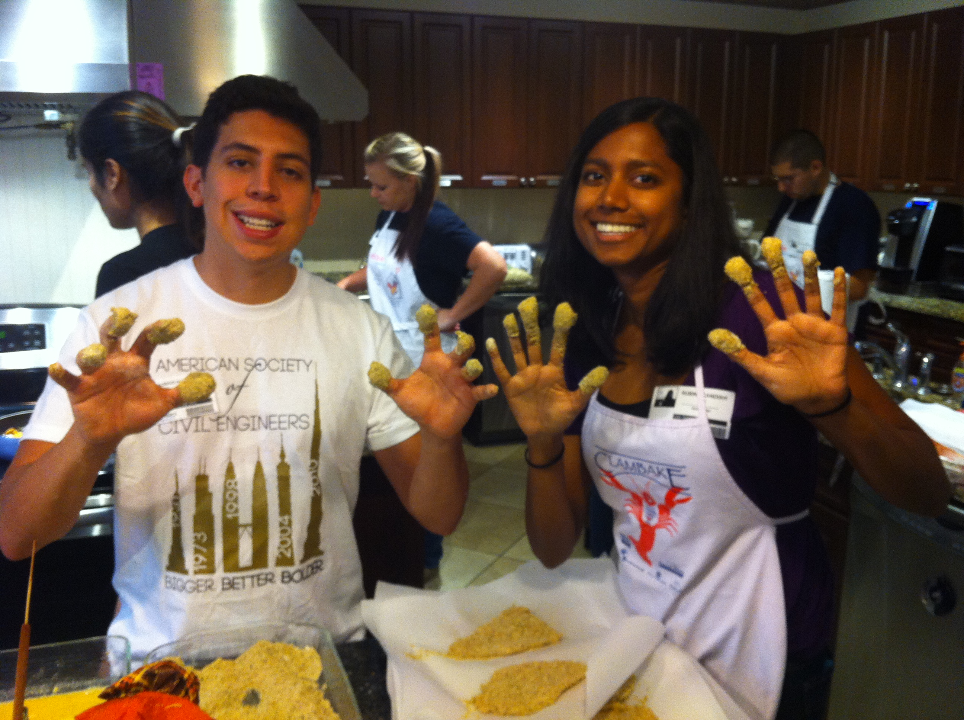
Ronald McDonald House
Around 10 – 12 ASCE members come out to this event to serve the community throughout the academic year.
Ronald McDonald House of Orlando provides a home away from home for families with seriously ill children. Ronald McDonald House provides comfort and care for families looking for healing.
ASCE-UCF members helped Ronald McDonald House of Orlando by preparing a home cooked meal for the children and families currently living in the residence.
Notes:
Use as many slides as necessary to adequately describe each special project

Slide 26
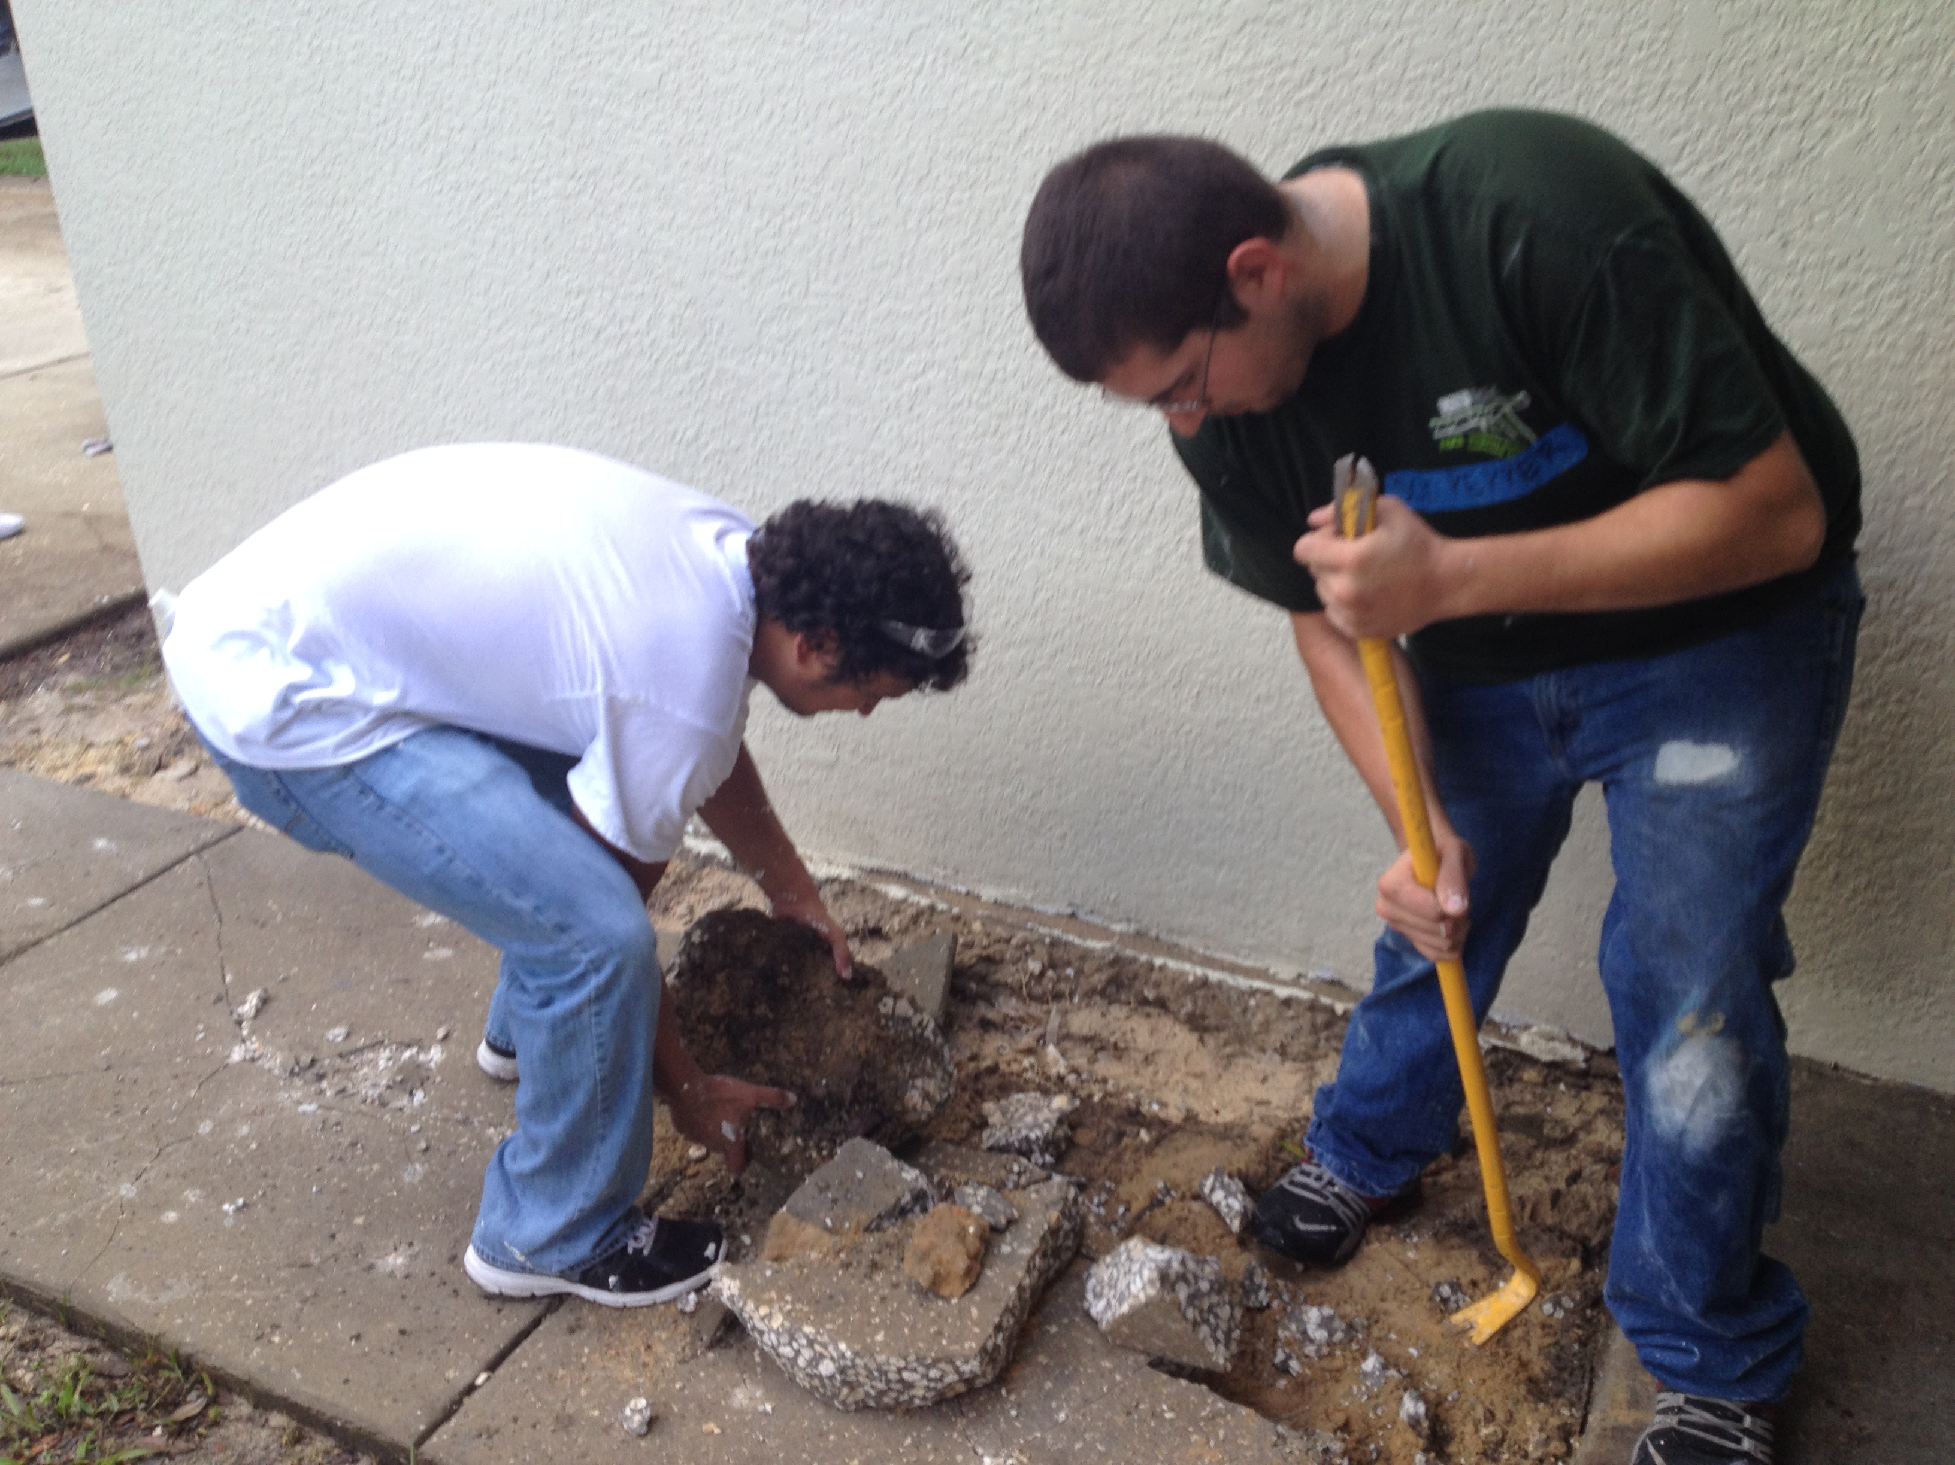
Habitat for Humanity
20 members of ASCE-UCF volunteered to help Habitat for Humanity of Greater Orlando.
Habitat for Humanity of Greater Orlando is a dedicated nonprofit housing organization helping eliminate substandard housing for the local community.
ASCE-UCF members assisted Habitat for Humanity by painting and removing a cracked sidewalk on the property of a deserving family.

Slide 27
Summary and Questions
The most significant event of the year was the Southeast Regional Student Conference.
ASCE-UCF placed well in multiple competitions such as 4th and 7th overall for steel bridge and concrete canoe competitions, respectively.
ASCE-UCF is committed to building upon our recent success at the Southeast Regional Student conference by working hard and recruiting the best engineering students UCF has to offer.
Biggest challenge of the year was the lack of professional sponsorships.
In an effort to correct this problem, ASCE-UCF has reconnected with former sponsors and developed new professional relationships with potential sponsors throughout the Central Florida area.
Notes:
We would prefer that you limit to 60 slides or less, but if you have more that’s ok. When actually presenting to other groups, reorder the slides (instead of deleting, move extras to the end so you have them if questions come up) to only present a reasonable amount in the time you are given.

