Slide 1
FAMU-FSU College of Engineering
American Society of Civil Engineers Student Chapter
Notes:
Use your own theme and layout (View-slide master or similar). Add photos, logos and graphics. Throughout this template file, text in italics should be replaced with more specific titles.

Slide 2
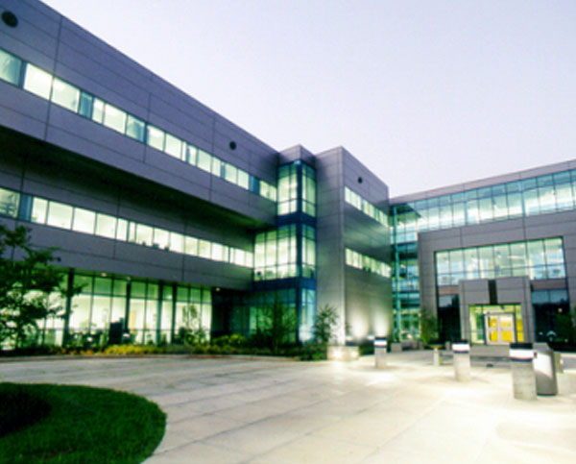
Contact Information
Address:
2525 Pottsdamer Street,
Tallahassee, FL 32310
Email: asce-fes@eng.fsu.edu
Website
Facebook

Slide 3
Student Officers
Officer Name | Position | E-mail | Phone Number
Kyle Faby | President | ksf11b@my.fsu.edu | (954)-643-5988
Vanesa Moreno | VP-ASCE | vm10f@my.fsu.edu | (407)-733-4081
Amanda Wilson | VP-FES | aw11j@my.fsu.edu | (386)-338-1348
Annemarie Riecken | Secretary | ar09ab@my.fsu.edu | (407)-739-7063
Dylan Greenspan | Treasurer | dg10k@my.fsu.edu | (561)-402-2496
Lindsey Griffin | Funding Chair | lbg11@my.fsu.edu | (904)-521-0488
Robert Romanoff | Conference Chair-FSU | rpr11b@my.fsu.edu | (305)-731-3924
Rose Frawley | Volunteering Chair | rcf11c@my.fsu.edu | (305)-282-8270
Mike Fisk | Social Chair | maf12g@my.fsu.edu | (305)-968-4463
Stephanie Doro | Historian | sd09h@my.fsu.edu | (954)-304-3473
Ruslet Baronvil | Conference Chair- FAMU | ruslet1@gmail.com | (305) 890-2148
Notes:
Photos!

Slide 4
Student Officers
Officers at our Mellow Mushroom watch party.
Top Row: Stephanie Doro, Lamar Case, Rose Frawley, Amanda Wilson
Bottom Row: Dylan Greenspan, Lindsey Griffin, Annemarie Riecken, Vanesa Moreno,Rob Romanoff, Kyle Faby
Not Pictured: Ruslet Baronvil, Michael Fisk

Slide 5
Advisors
Dr. Primus V. Mtenga, PhD, P.E.
Faculty Advisor
Email: mtenga@eng.fsu.edu
Phone: 850-410-6130
David L. Crombie, E.I.
Practitioner Advisor
Email: dave.crombie@egs-us.com
Phone: 850-386-1253
Notes:
Photos!

Slide 6
Financial Summary
Dues: $1,080 /semester
As of December 31, 2014
Total income: $16,183.84
Total expenditures: $17,660.98
Cash balance: $9,181.83
Accounts receivable: $200
Accounts payable: $988.34

Slide 7
Goals and Objectives
The FAMU-FSU student chapter aims to spark interest in both leadership and involvement within the civil engineering major.
Goal 1: Increasing student involvement
Goal 2: Networking with professionals
Goal 3: Giving back to the local/engineering community
Goal 4: Increasing K-12 outreach
Notes:
Three goals are suggested, add more if you wish

Slide 8
Goal 1: Increasing student involvement
Student involvement is one of the driving forces of our organization. Our mission is to increase participation in the various events that we organize. We want to create a fun environment while also equipping students with professional skills to aid them in their engineering career.
Action plan: Organize appealing events to the student body ranging from general body meetings to socials.

Slide 9
Goal 1: Increasing student involvement
Assessment: During 2014 we organized events such as
Cancun’s FIFA World Cup watch party/fundraiser
ITE Bowling Tournament
General Body Meetings (every other week)
CIVES steel company tour
Volleyball Social
Faculty and Staff BBQ
FSU-Louisville watch party
Order of the Engineer
We received positive feedback from the student body for each event. One of the students’ favorites was the FSU-Louisville watch party because they networked with professionals while rooting for their favorite team. As a result, we accomplished goal 1.
Follow-Up Plan: We will continue to offer students with numerous events throughout the semester in order to foster comradery and increase interest in professional/ networking events.

Slide 10
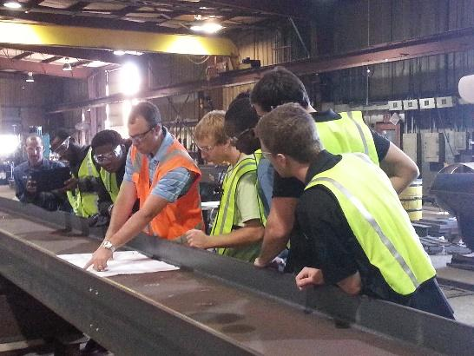
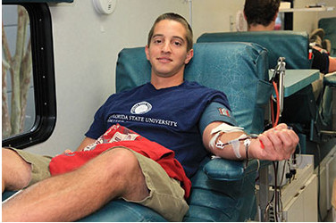
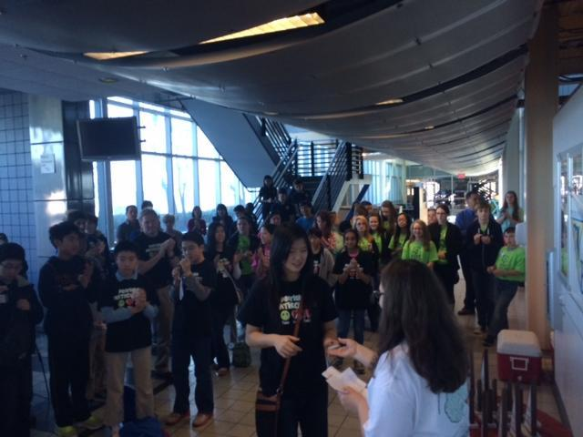
2014 Events
CIVES Steel Company Tour
Semester Blood Drive
MATHCOUNTS Competition

Slide 11
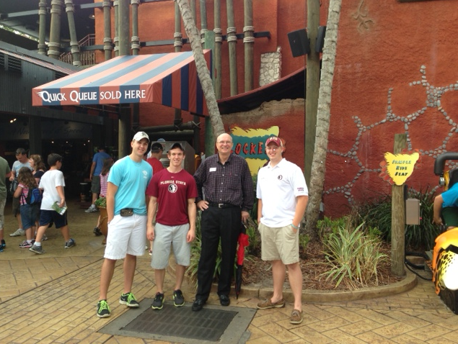
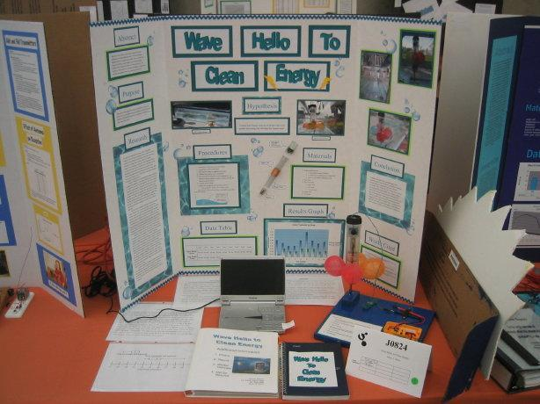
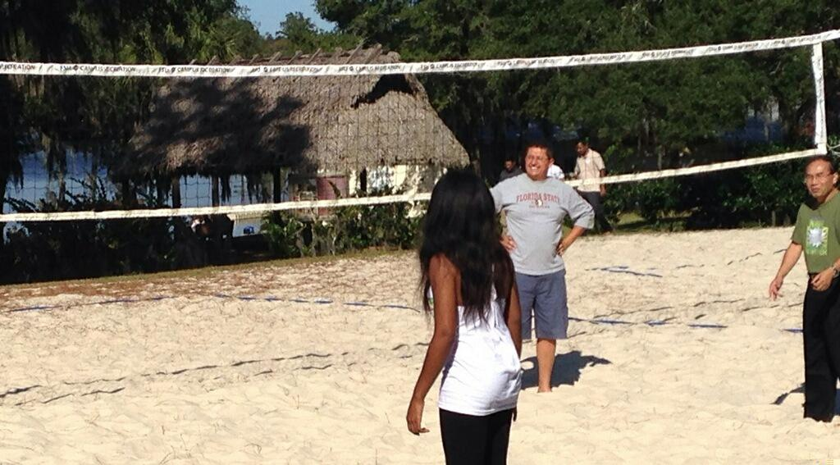
2014 Events
Busch Gardens Tour with head engineer
Conley Elementary School Science Fair Judging
Civil Department BBQ

Slide 12
Goal 2: Networking with professionals
Networking with professionals is an added bonus to joining our society. We are fortunate enough to have a strong network of professionals willing to reach out and provide internships to our students. Our parent chapter is also very involved and provides us with invaluable resources.
Action plan: We provide students with social and career-oriented opportunities throughout the semester to interact with professionals.

Slide 13
Goal 2: Networking with professionals
Assessment: During this past year students had the opportunity to participate in the following events
Engineering Day
Resume workshops
Legislative Days
E-Week Banquet
Busch Gardens tour event
FES and ASCE monthly luncheons
Annual conferences
ASCE-FES tailgate with parent chapters
Quarterly meetings
Billy Bishop golf tournament
Students enjoyed networking with professionals and some even received internships as a result of these events. Consequently, goal 2 was accomplished.
Follow-up plan: Continue to foster a strong relationship with our parent chapters and professional community. Increase student participation in these networking events.

Slide 14
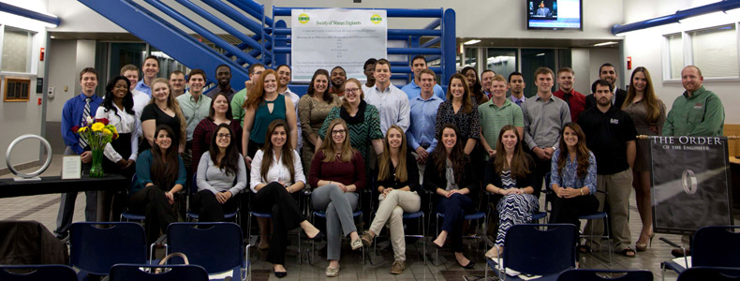
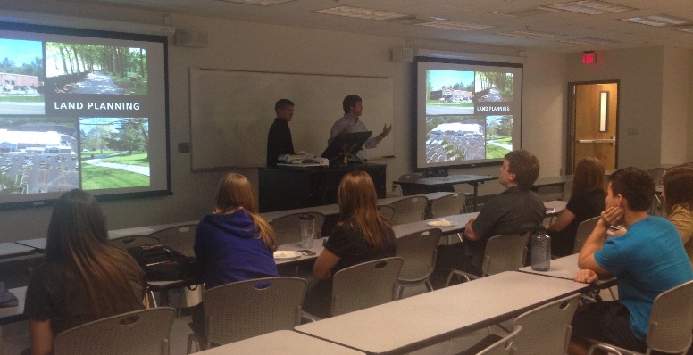
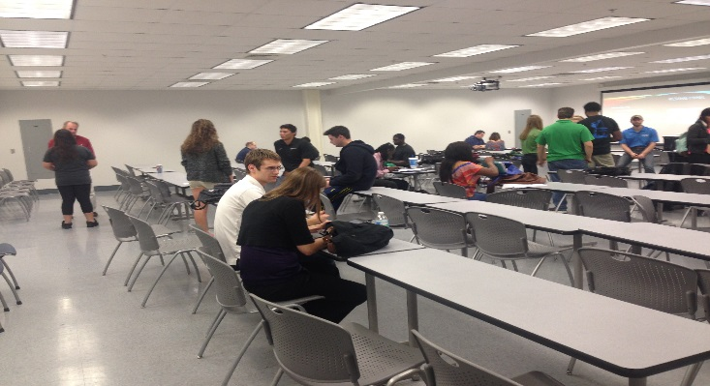
Networking Events 2014
Order of the Engineer ceremony
Gresham Smith & Partners presenting at our GBM
Fall Resume Workshop

Slide 15
Goal 3: Giving back to the engineering/local community
As a chapter, we emphasize the importance of community outreach and application of our engineering skills for the greater good. We also aim to increase interest in the STEM fields through K-12 involvement.
Action plan: We organize events to facilitate student outreach to the community.

Slide 16
Goal 3: Giving back to the engineering/local community
Assessment: During this past year students had the opportunity to participate in the following events
Semester blood drives
Adopt-A-Road clean-ups
Billy Bishop golf tournament
Trash Dash 5K
Judging science fair projects at Conley Elementary School
MATHCOUNTS
Transportation Day
Our members enjoyed giving back to the Tallahassee community while also sparking interest in the civil engineering field. As a result, our chapter achieved goal 3.
Follow-up plan: We will continue our participation in local events such as the Trash Dash 5k and Billy Bishop golf tournament as well as other local community events.

Slide 17
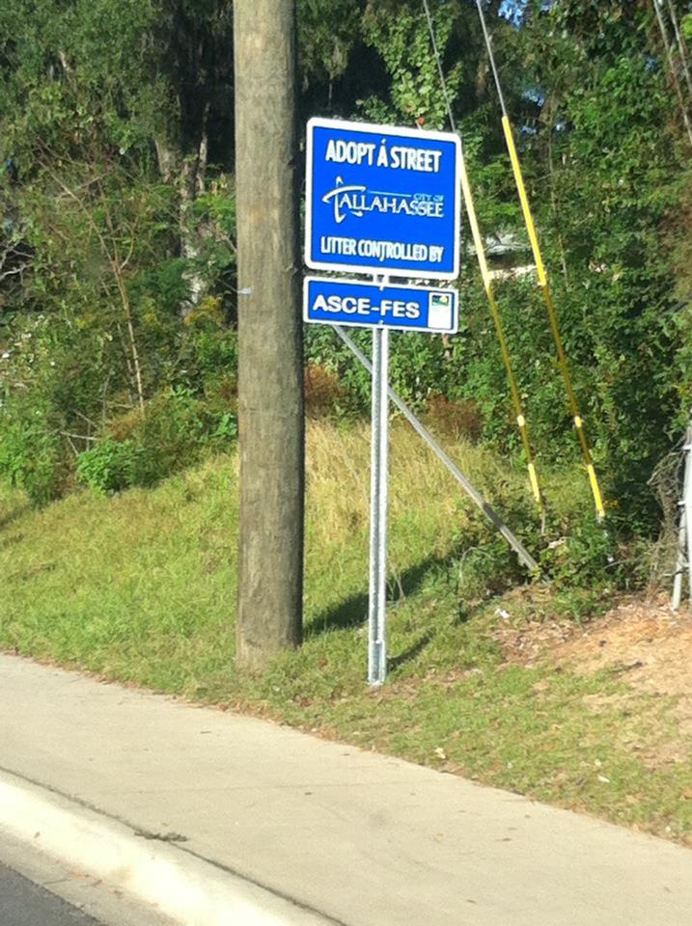
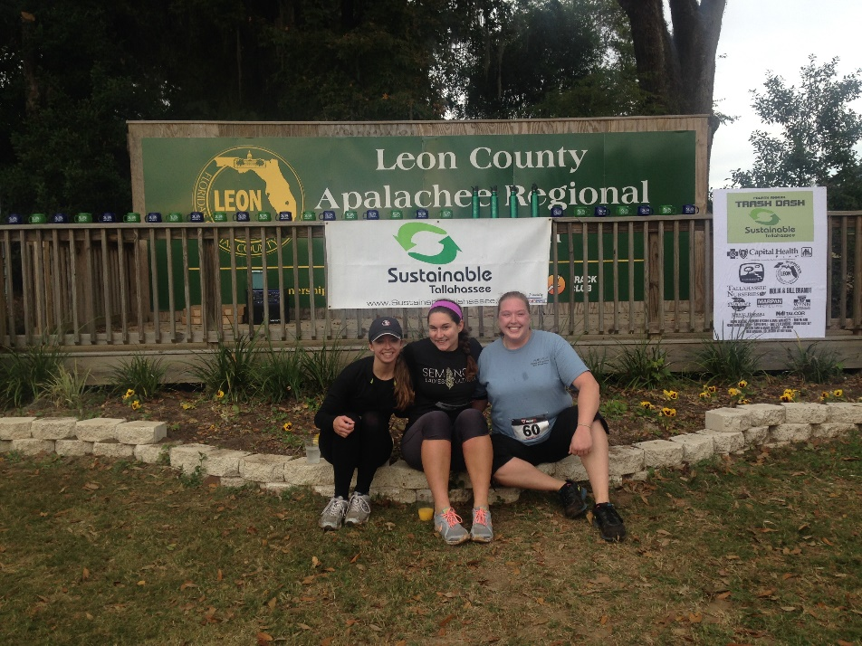
Giving Back 2014
Students participating in the Trash Dash 5K
ASCE-FES Adopt-A-Road

Slide 18
Membership Statistics
76 members
33 ASCE National Society-level members
43% of members are Society-level members (Society-level/total members)
71 members with Junior and Senior status
221 Juniors and Seniors eligible to join ASCE (CE declared majors)
32% of eligible Juniors and Seniors that are members
Notes:
Fill in numbers (from Statistical Data tab in excel sheet) where words are underlined.

Slide 19
Meeting Statistics
7 professional meetings with an invited speaker
4 student talks and papers
1 professional licensure and ethics topics presented
4 field trips
13 social functions
Notes:
Fill in numbers (from Statistical Data tab in excel sheet) where words are underlined.

Slide 20
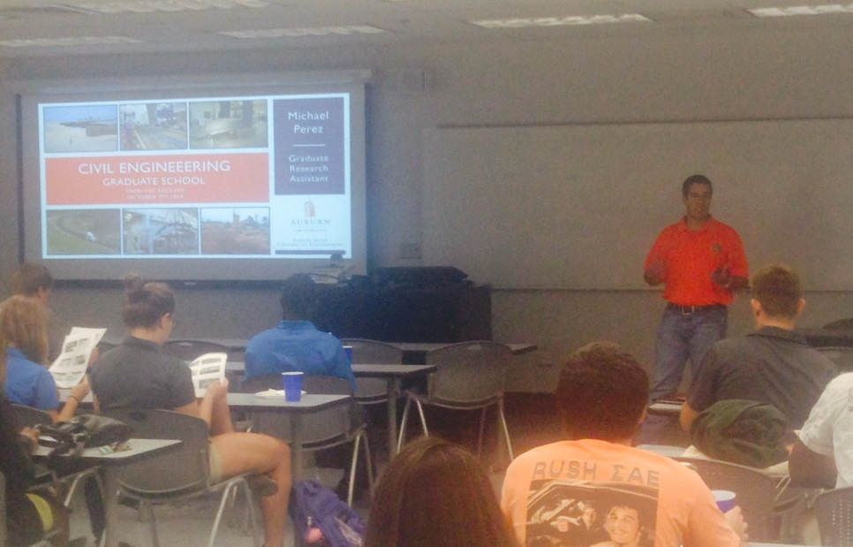
Graduate School Informational Meeting
Former ASCE Officer Mike Perez spoke about what to expect in graduate school such as what to look for in a program, what is expected of you, program costs, program tracks, and the benefits of receiving a master’s degree.
Number of Attendees: 51
This meeting was popular because the majority of the members are either interested in graduate school or are deciding if graduate school is right for them. A large crowd of recent graduates who were in ASCE when Mike Perez was an officer attended the meeting as well
Notes:
Use photos, logos, etc and describe each meeting

Slide 21
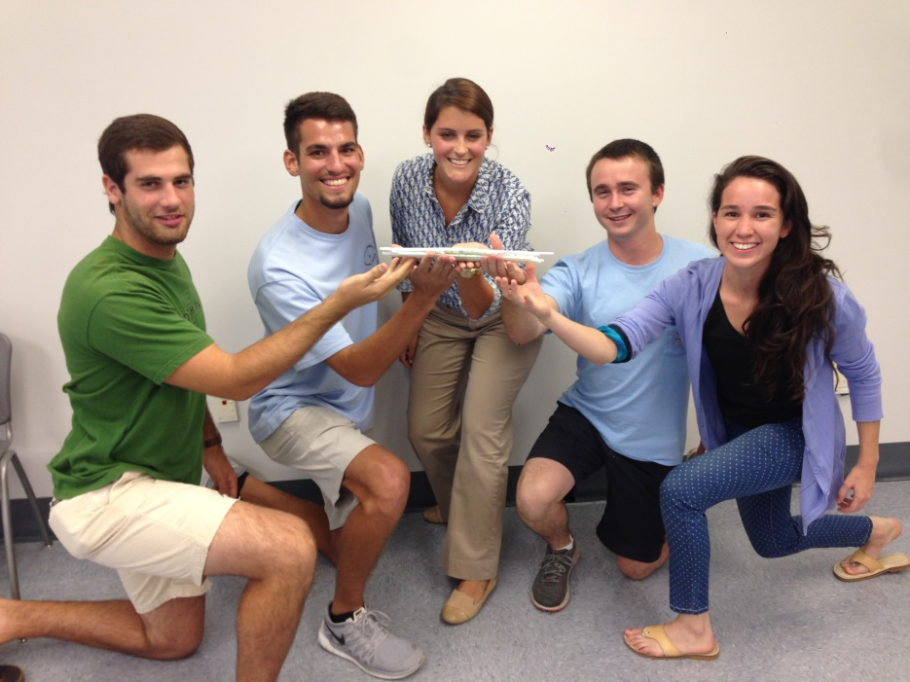
First Meeting of the Fall Semester
This meeting served as an ice breaker among the members for the new school year and an officer introduction to the members. The meeting started off with the officers introducing themselves and stating how being a part of the student chapter positively influenced their experiences. After the officer introductions, our practitioner advisor Dave Crombie introduced himself and gave his reasoning on how being an active member can have great benefits. The events and competitions the chapter participates in were presented to introduce the organization to the newer members. The meeting was concluded with our ice breaker challenge: To build a bridge out of straws and tape that can sustain the most amount of weight on a fixed span length in 15 minutes.
Number of Attendees: 57
This meeting was popular because there were many new students that wanted to learn what ASCE is all about and to participate in the mystery ice breaker event. Everyone enjoyed the spirit of friendly competition and the bridges were tested with all of the members as an audience.
Winners of the straw bridge competition. This bridge held all the weight that we had
Notes:
Use photos, logos, etc and describe each meeting

Slide 22
Gresham Smith & Partners Presentation
Former graduates and current Gresham Smith & Partners associates Nick Clavelo and Seth Dobyns presented about transportation and drainage design. They provided insight about the challenges they encounter day to day and what their typical workday is like as an engineer. At the end of their presentation, they stressed the importance of passing the FE exam and working towards obtaining a Professional Engineering License.
Number of Attendees: 40
This meeting was popular because there were many students that wanted to learn about transportation and drainage design and what life is like as an engineer as transportation and water resources some of the more popular disciplines among the members.
Notes:
Use photos, logos, etc and describe each meeting

Slide 23
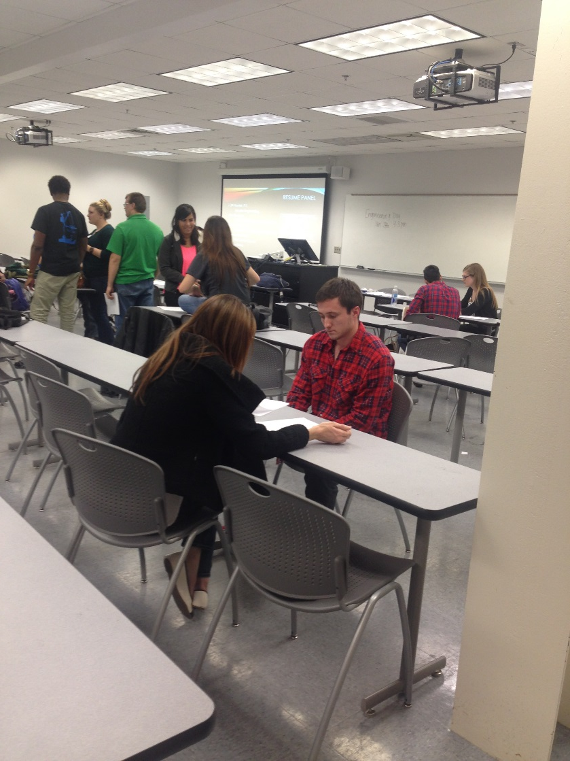
Resume Workshops
At the beginning of each semester, the ASCE student chapter hosts a resume workshop the week before the career fair (Engineering Day). A total of 3 engineers and 1 professional resume reviewer were critiqued over 20 students’ resumes.
Number of Attendees: 22
This workshop was popular because it was held the week before Engineering Day when a majority of the student body is creating and tweaking their resumes. Having a workshop where professionals reviewed and marked up their suggestions proved to be very convenient for the student members.
Notes:
Use photos, logos, etc and describe each meeting

Slide 24
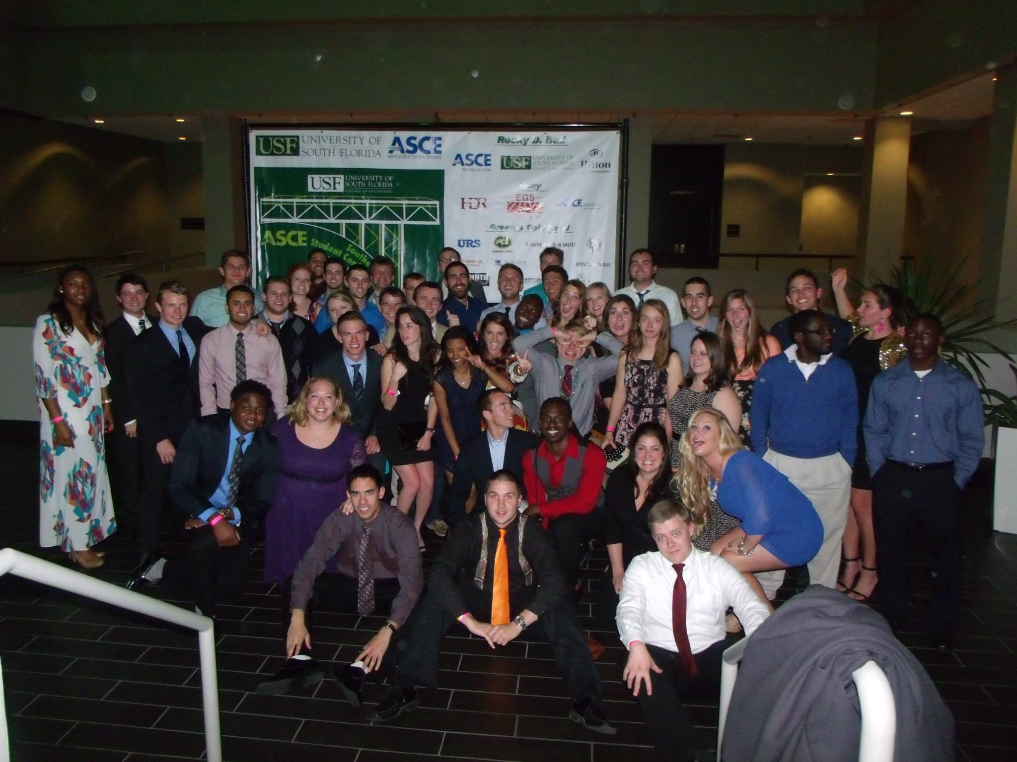
Student Conference
2014 ASCE Southeast Student Conference
University of South Florida in Tampa
March 28th – 29th of 2014
62 students attended
Notes:
Add slides as necessary to highlight results

Slide 25
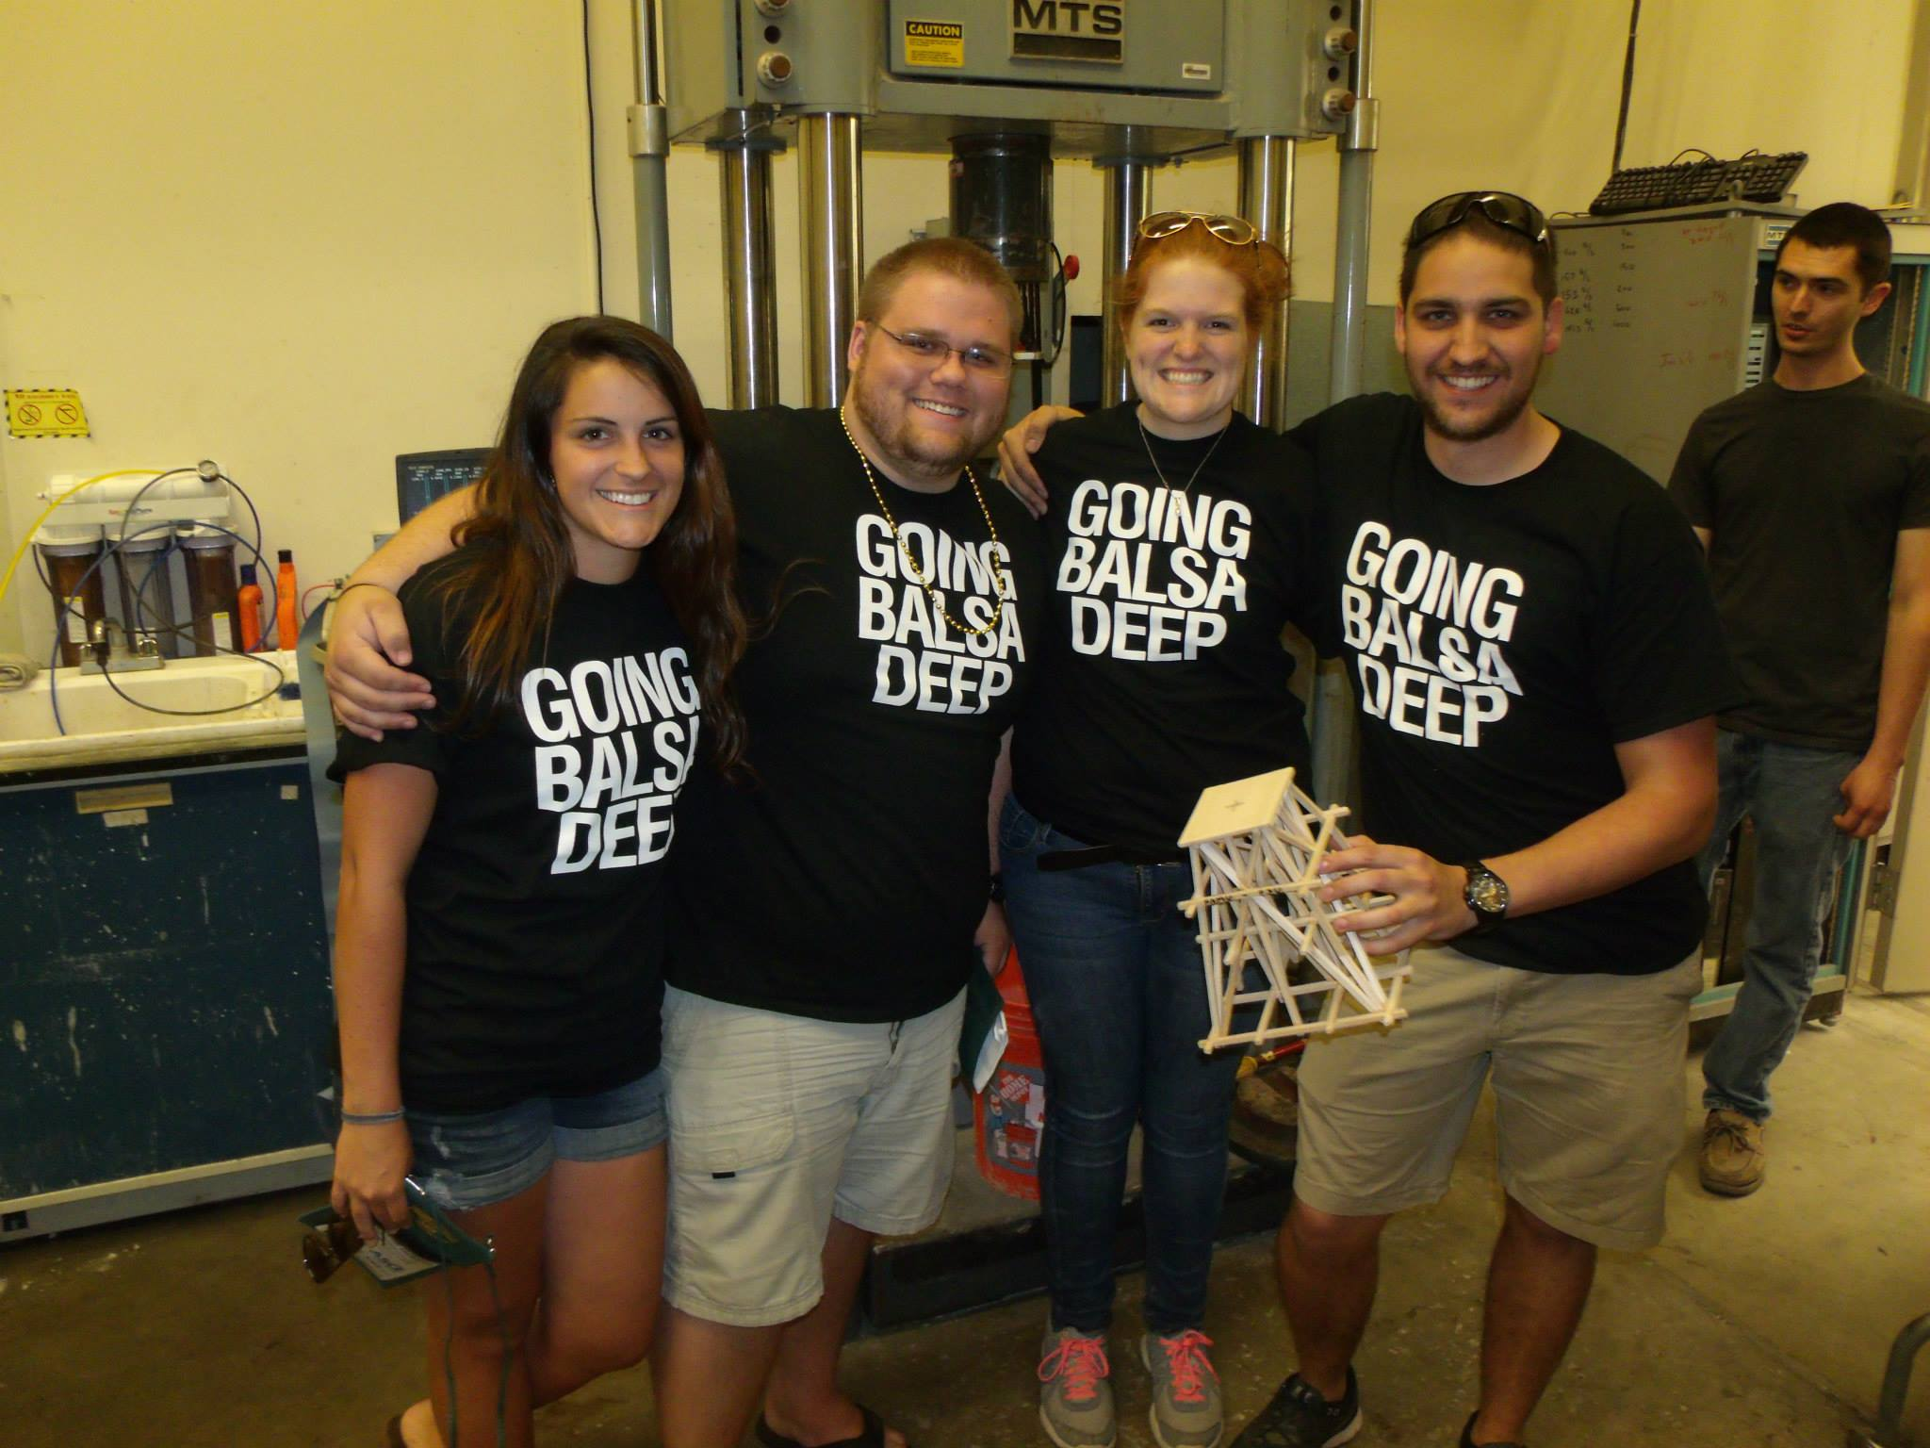
Balsa Pyramid
1st place
Held 1100 pounds
Weighed less than 30 grams

Slide 26
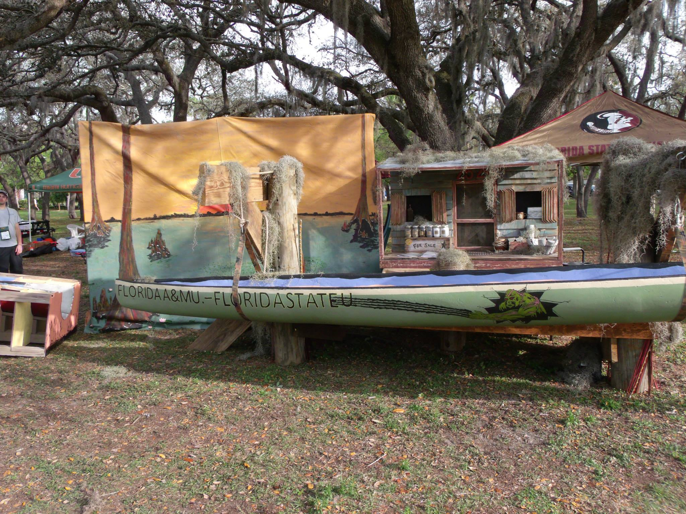
Concrete Canoe (Ziracony)
17th place
Old Florida theme
Highest involvement of any competition for our chapter

Slide 27
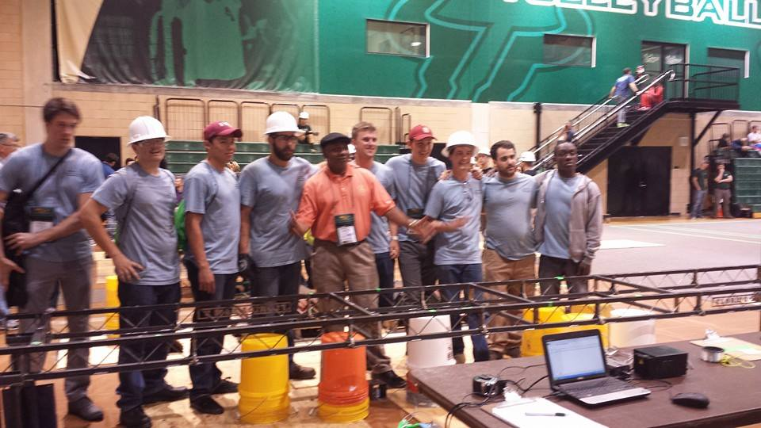
Steel Bridge
8th place
1 of 2 non-superstructure bridges that did not fail
Supported 2500 lbs.

Slide 28
Overall Conference Results Summary
Finished 4th Overall
1st in Balsa Pyramid
20th in Concrete Shuffleboard
8th in Environmental
4th in Geotechnical
11th in Hydraulic Jump
7th in Mortar Cubes
20th in Mystery
4th in Plans Reading
18th in Professional Paper
10th in Surveying
5th in T-Shirt
5th in Visual Display
8th in Steel Bridge
17th in Concrete Canoe

Slide 29
The 2014 Annual Conference of the Florida Section ASCE
ASCE Florida Section Annual Conference
Deauville Beach Resort, Miami Beach, FL
July 17th – 19th of 2014
Two students and one advisor were in attendance
Notes:
Add a slide for each activity or conference attended. Other activities besides WSCL may be presented as well.

Slide 30
Florida Section ASCE Board of Directors Meeting
ASCE Quarterly Board of Directors Meeting
University of Florida, Gainesville, FL
October 4th of 2014
Two students and one advisor were in attendance
Notes:
Add a slide for each activity or conference attended. Other activities besides WSCL may be presented as well.

Slide 31
Florida Section ASCE Board of Directors Meeting
ASCE Quarterly Board of Directors Meeting
Hyatt Regency Hotel, Miami, FL
January 10th of 2015
One student and one advisor were in attendance
Notes:
Add a slide for each activity or conference attended. Other activities besides WSCL may be presented as well.

Slide 32
Math Counts Competition
Participation
15 student chapter members helped run the competition
3 practioners helped with the competition
75 person-hours spent on this competition
Description
Math Counts is a competition in which local elementary school students participate in a mathematics based competition in which correct answers and speed are taken into account
This competition provides elementary school students with an opportunity to apply their knowledge of mathematics in a direct-competition and testing setting to improve their skills and serve as a source of entertainment for the participants.
Project impact
The event is hosted at the FAMU-FSU College of Engineering and the ASCE Student Chapter members help to ensure the competition runs smoothly such as administering materials and proctoring exams, moving materials to their prospective locations, and grading the exams.
Notes:
Use as many slides as necessary to adequately describe each special project

Slide 33
Adopt-A-Road
Participation
8 student chapter members helped pick up trash from the side of the roadway
8 person-hours spent for this Adopt-A-Road
Description
The student chapter adopted Lipona Street from Pensacola Street to Jackson Bluff in Tallahassee, FL
The roadway adoption helps to maintain a segment of roadway by keeping it free of trash and debris to visually enhance the local community
Project impact
The roadway adoption maintains the cleanliness of the roadway and its adjacent sidewalks to prevent an eyesore for the community and to keep kids safe at the local aftercare center from the roadside trash and debris
Notes:
Use as many slides as necessary to adequately describe each special project

Slide 34
Campus Blood Drive
Participation
Over 30 students donated blood
3 person-hours spent on the preparation and coordination for the event
Description
The blood drive was held on the FAMU-FSU College of Engineering Campus
The blood drive attracted many students and was on the campus for 4 hours to support a great cause
Project impact
The roadway adoption maintains the cleanliness of the roadway and its adjacent sidewalks to prevent an eyesore for the community and to keep kids safe at the local aftercare center from the roadside trash and debris
Notes:
Use as many slides as necessary to adequately describe each special project

Slide 35
Summary and Questions
The most significant event of the year was the 2014 ASCE Southeast Student Conference
FAMU-FSU placed 4th overall and placed first in Balsa Pyramid. These placements, among our other competitions continue to show how our members are well-rounded and striving individuals.
The most significant challenge of the year was raising funds to have a competitive edge in competition at the student conference.
Our officers reached out to companies at Engineering Day and through networking events such as conferences parent chapter events
Notes:
We would prefer that you limit to 60 slides or less, but if you have more that’s ok. When actually presenting to other groups, reorder the slides (instead of deleting, move extras to the end so you have them if questions come up) to only present a reasonable amount in the time you are given.

