Slide 1
Embry-Riddle Aeronautical University
American Society of Civil Engineers Student Chapter
Notes:
Use your own theme and layout (View-slide master or similar). Add photos, logos and graphics. Throughout this template file, text in italics should be replaced with more specific titles.

Slide 2
Contact Information
600 South Clyde Morris Blvd. Daytona Beach, FL 32114 Civil Engineering Department
clearys@my.erau.edu
https://connection.erau.edu/organization/americansocietyofcivilengineers

Slide 3
Student Officers
President - Stephanie Cleary : clearys@my.erau.edu, (609)617-3404
Vice President - Matthew Gallup: gallupm@my.erau.edu, (352)272-2719
Secretary - Nadia Correa: correan@my.erau.edu (386) 451-4028
Treasurer - Kyle Morgan: morgank6@my.erau.edu, (321) 626-4093
Recruiting Officer - Mohammed Qahwaji: qahwajim@my.erau.edu, (320) 223-9248
Notes:
Photos!

Slide 4
Student Officers
From Left to Right: Mohammed Qahwaji, Matthew Gallup, Nadia Correa, Stephanie Cleary and Kyle Morgan

Slide 5
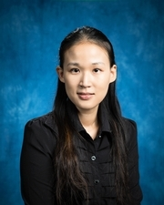
Advisors
Advisor - Hongyun Chen: hongyun.chen@my.erau.edu, (386) 226-7918
Notes:
Photos!

Slide 6
Financial Summary
$0 in dues
As of December 31, 2014
Total income: $2442.47
Total expenditures: $3213.96
Cash balance: $-771.49

Slide 7
Goals and Objectives
For the 2014-15 school year, Embry-Riddle’s Student Chapter utilized different resources to improve and develop unique skills in the civil engineering field. The main goals are:
Increase student memberships and involvement
Develop Leadership Skills
Increase participation in Local, State, and National ASCE Event
Notes:
Three goals are suggested, add more if you wish

Slide 8
Increase Student Involvement
With the use of Department Events as well as Sanctioned Events, Embry-Riddle’s Student Chapter has put forth strong efforts to recruit students:
Use projects and guest speakers to spark interests within ASCE members
Engineering projects created strong interests for hands-on activities within club meetings/events
Creating smaller, more-competitive activities will increase the desire in club participation

Slide 9
Development of Leadership Skills
The integration of hands-on, competitive activities provides key leadership opportunities necessary for the individual members to develop
Providing enough opportunities for leadership skills to be utilized by in-house competitions as well as regional and national competitions
The implementation of leadership skills will/has improved the overall performance and climate of the club meetings
The continuation of miniature competitions as well as additional challenges will provide ample opportunities for leadership skills to be enhanced or developed

Slide 10
Increase Participation in Local, State, and National ASCE events
As part of the National ASCE Organization, it is necessary to attend professional meetings and conferences.
Attend local- and national-sanctioned events and/or meetings
As of January, Embry-Riddle has attended one Florida-Sanctioned meeting and plan to attend 2015 the Southeast Student Conference
As more meetings and conferences are available, Embry-Riddle will attempt to participate in.

Slide 11
Membership Statistics
29 total student members
19 Total number of ASCE National Society-level members
66% of members are Society-level members (Society-level/total members)
29 members with Junior and Senior status
18 Juniors and Seniors eligible to join ASCE (CE declared majors)
62% of eligible Juniors and Seniors that are members (Jr&Sr members / Jr&Sr eligible)
Notes:
Fill in numbers (from Statistical Data tab in excel sheet) where words are underlined.

Slide 12
Meeting Statistics
1 professional meeting with an invited speaker
12 student talks and papers
0 professional licensure and ethics topics presented
2 field trips
5 social functions
Notes:
Fill in numbers (from Statistical Data tab in excel sheet) where words are underlined.

Slide 13
Meeting Title
Highlight a FEW of the best-attended meetings, using one slide per meeting
Briefly describe the program and speaker
Report the number of attendees
Explain why it was popular
You DON’T need a slide for every meeting throughout the year
Notes:
Use photos, logos, etc and describe each meeting

Slide 14
Truss Building Competition
We held an competition spanning 2 meetings where 4 groups were made (each with 2 underclassmen and 2 upperclassmen). Each group had to design and build a truss using only balsawood and glue. Then the trusses were load tested during the next meeting. Each member of the winning team won a gift card.
15 members competed

Slide 15
20th Anniversary of ERAU Civil Engineering Program and ASCE Fall Social Event
Celebrated the 20th Anniversary of Civil Engineering at Embry-Riddle on the West Lawn. Students from all majors joined in the festivities. Around 40 students and 10 professors attended.

Slide 16
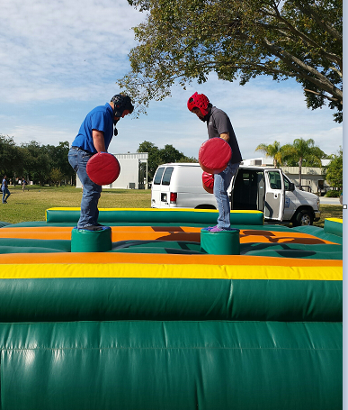
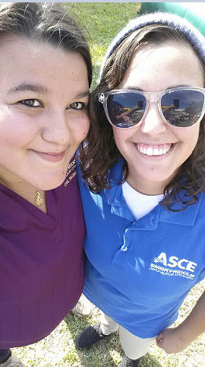
20th Anniversary of ERAU Civil Engineering Program and ASCE Fall Social Event

Slide 17
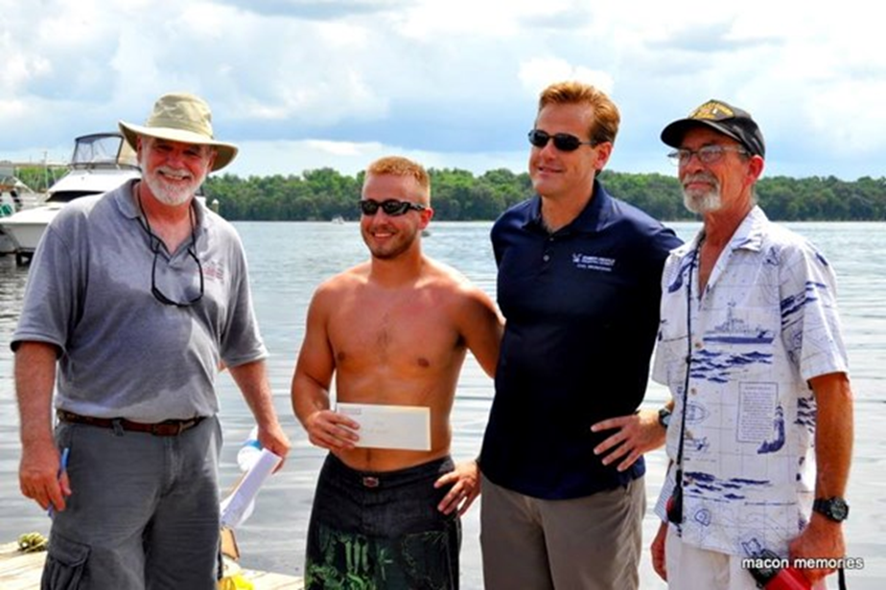
Anything Floats Competition
Competed in a competition in Deland, FL where teams build a water craft and race it. The water craft can be built out of almost anything. Our ASCE chapter won 3rd place.

Slide 18
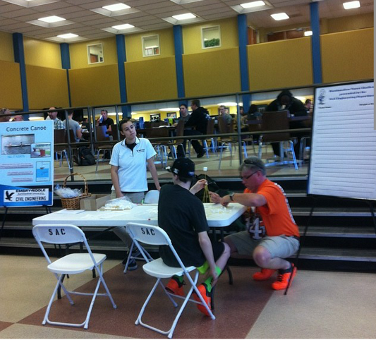
Engineer’s Week
We hosted a competition in our Student Center for the entire school to compete in a contest to see who can build the largest structure using spaghetti and marshmallows. 20 students came out to compete for gift cards to Amazon.

Slide 19
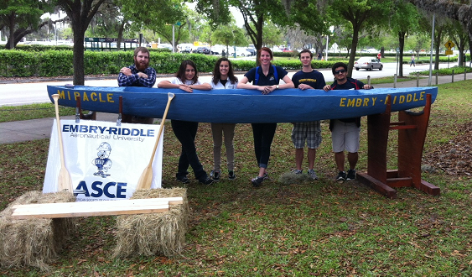
2014 Southeast Regional Conference
Tampa, FL
March 27-29, 2014
6 students attended
Notes:
Add slides as necessary to highlight results

Slide 20
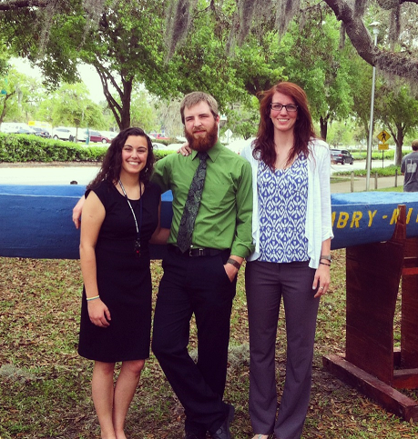
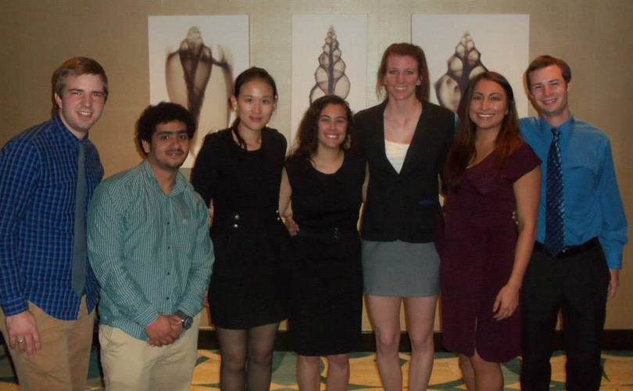
2014 Southeast Regional Conference
First time going to conference in over 7 years

Slide 21
Summary and Questions
What were the most significant events of the year?
Participating in the Southeast Regional Conference. It was our first time in over 7 years.
Attending the FL section Board of Director meetings
The number of membership has significantly increased in the past year.
What were the most significant challenges?
Since low enrollments in the past three to four years, recurring students memberships and getting the them actively involved in ASCE events is a big challenge facing the Chapter.
Funding constraints and limited resources
Notes:
We would prefer that you limit to 60 slides or less, but if you have more that’s ok. When actually presenting to other groups, reorder the slides (instead of deleting, move extras to the end so you have them if questions come up) to only present a reasonable amount in the time you are given.

