Slide 1
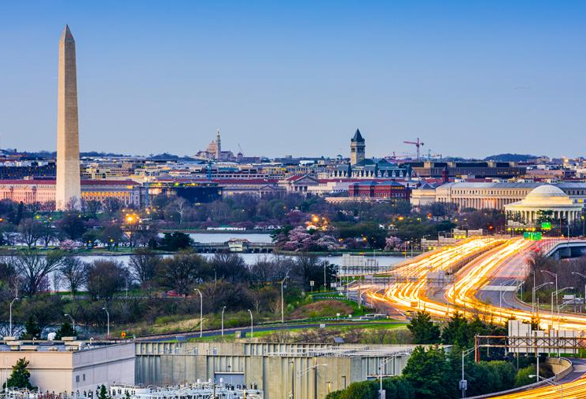
[Replace this image with a local image]
Architectural Engineering Institute:
Founding of the AEI XXX Chapter

Slide 2
Committee Members
List committee member names, positions, companies, etc.

Slide 3
First Event
[Insert an advertisement and/or the information from your first event following ASCE and AEI approval.]

Slide 4
First Event
List information on the attendees from your first event. This can include a breakdown on the number of people, the companies that they work for, their positions, if they expressed interest in joining the AEI Chapter, etc.

Slide 5
Next Event
Have a plan for the next event and add the information here.

Slide 6
Future Events
Start to create a general idea of the types of events that your chapter plans to host in the future.
Consider having an organized event every other month with a social event in between to start get started.
Events
Networking
Educational
Service
Sporting

Slide 7
Future Events
Display pictures from your first event here or inspirational photos for future events.

Slide 8
Goals
Outline your short and long term goals for your chapter.

Slide 9
Goals
Research what other ASCE committees are doing/have done and how they are supported through the local ASCE chapter.

Slide 10
[Replace this image with a local image]
Thank You!

Slide 11
Committee Questions
Come prepared with questions for the Local ASCE Chapter and to find out how they can support you, but also how you can support them.
Will the new Local Group start as a chapter or a committee under ASCE?
How will the bylaws be determined for the AEI Chapter?
Is there initial funding available to start the chapter?
Once established, what resources are available for the Chapter from ASCE?
What is the timeline of events for starting a Chapter?
What can ASCE help us with?
What can we help ASCE with?
What are ASCE’s goals for this chapter?
Will members need to join ASCE to be a part of the local chapter?

