Slide 1
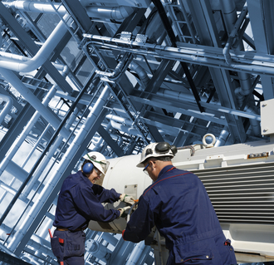
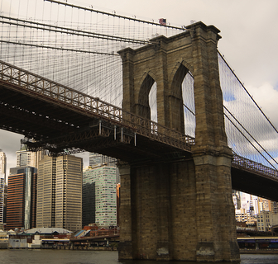
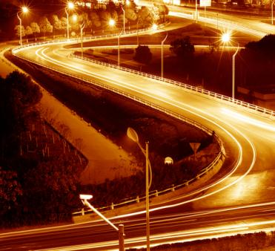
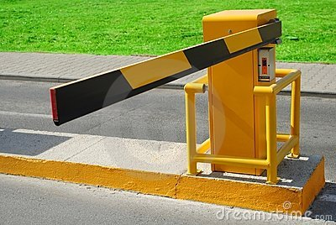
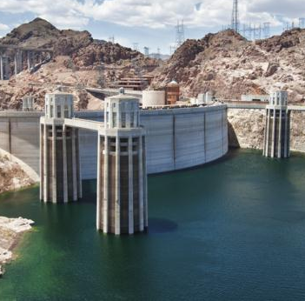
Engineering the Future
Florida Section
Notes:
It is a great honor to be here with you today.
My sincere thanks to the Florida Section for your invitation.
Thank you for your years of service to ASCE and your continued loyalty and interest in the Society.
Today, I am going to give you an overview of ASCE and what we are accomplishing on your behalf.

Slide 2
Do You Remember When?
Notes:
Let’s start with a little stroll down memory lane.
Your memory lane.
I have a simple question for you.
Do you remember when you first realized you were interested in engineering?
Maybe you were playing in the dirt in your backyard - or making mud pies after a rain - or building sand castles at the beach when you first realized you had a natural curiosity to learn more about how things work.
Your curiosity and desire to be a problem solver is what we all have in common as civil engineers.
2

Slide 3
American Society of Civil Engineers
Notes:
And now a little about ASCE’s history:
Established in 1852 – New York City
Current offices in Reston, VA and Washington, DC
Roots in Technical Issues / Exchange
Current Membership – more than 145,000
75 Sections / 279 Student Chapters
Global Membership - outside the USA:
18, 597 Members – about 13% of the total membership
18 Sections and 15 Groups
21 Student Groups
78 Agreements of Cooperation
More than 50% of ASCE publications are sold internationally
Over 50% of journal authors are international
The Board of Direction has developed a global strategy for the future.

Slide 4
The Vision
Entrusted by society to create a sustainable world and enhance the global quality of life, civil engineers serve competently, collaboratively, and ethically as …
Civil Engineering in
2025
Notes:
Where are we today and what do we have planned for tomorrow?
ASCE’s strategic initiatives are our future.
When you leave today, I hope you will think of these issues as sign posts along your future professional path.
As a society, we need to know where we are going and the path to get there.
Back In 2008, ASCE held a summit with more than 60 experts from the public, private and academic sectors who pondered our profession’s future.
The outcome of that summit was a document called The Vision for Civil Engineering in 2025 which defines the role of civil engineers in the world of tomorrow. [click – text appears]
Visit the ASCE website and read the Vision for yourself.

Slide 5
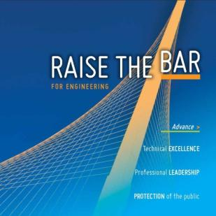
ASCE’s Strategic Initiatives
Sustainability
Infrastructure
Raise the Bar
Notes:
5
From the Vision (50,000), ASCE is focusing our energies on three strategic priorities – long term efforts to strengthen our members role in society and help advance the profession. (SIR)
Sustainability – to help position civil engineers as stewards of the environment
Infrastructure - to help promote civil engineers as leaders in public policy
Raise the Bar – to prepare engineers to be leaders beyond just skill in technical expertise
These three priorities are about driving forward the agenda for our profession’s future. As strategic priorities, we are making progress and you can help.

Slide 6
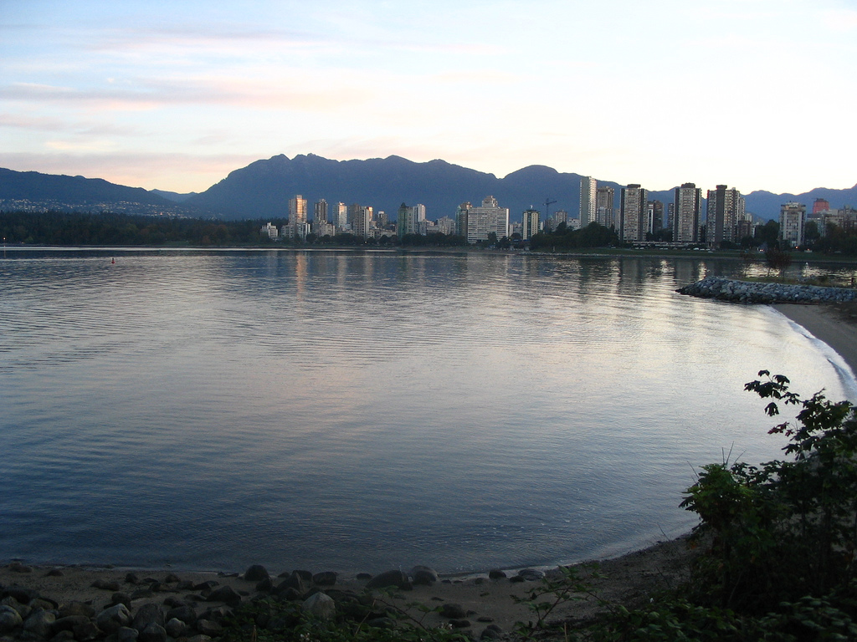
Sustainability
Environmental
Economic
Social Well Being
Notes:
Sustainability an important strategic priority at ASCE.
One of the purposes for adopting sustainability as a strategic priorities was the recognition of the increasing role that sustainability is playing in our civil engineering practice…..
And to help Civil Engineers do two things:
Incorporate sustainability principles into their daily practice and
Use the sustainability principles to their competitive advantage (not let others tell us what’s sustainable or not or define sustainability for infrastructure)
Sustainability is a concept that is often used but not always well understood.
At ASCE, we believe true sustainable civil infrastructure [Click ]
provides environmental, economic and social benefits now and for the future.
We have adopted this “triple bottom line” approach because we believe that the infrastructure challenges presented are multi-pronged and the solutions must be too.

Slide 7
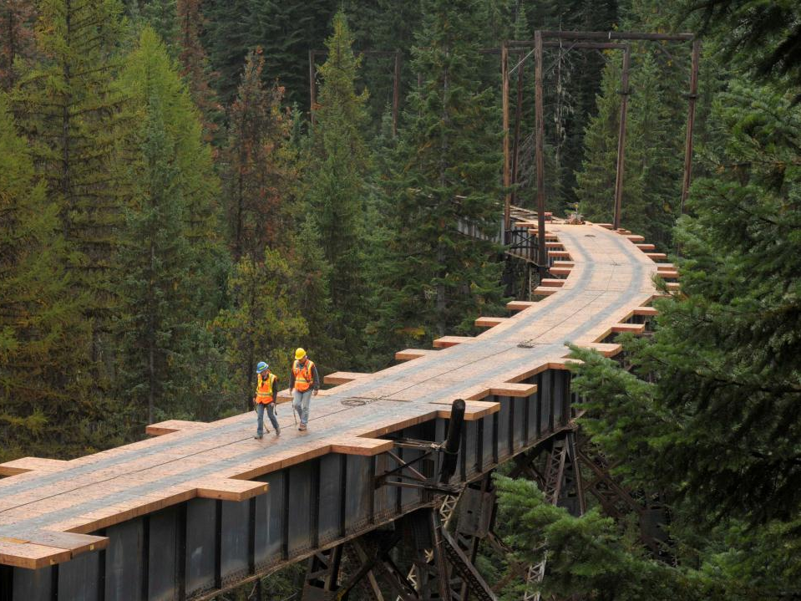
Sustainability
Canon 1
Engineers shall hold paramount the safety, health and welfare of the public and shall strive to comply with the principles of sustainable development in the performance of their professional duties.
asce.org/sustainability
Notes:
Our initiative on sustainability focuses on achieving a more sustainable natural and built environment. That’s why we included it in our Canon of Ethics [Click ] .
We believe civil engineers need to embrace their evolving role as environmental stewards, life-cycle planners, and policy leaders and become significant contributors to a sustainable world.
We are working to foster sustainable practices in civil infrastructure through integrating sustainability into engineering education, advocating for research, sharing knowledge worldwide, and fully integrating sustainability into ASCE policies.
To help our members learn more, we have a library of sustainable project profiles, articles from CE magazine, publications on sustainability, and more resources in the sustainability section [Click ] of our website.

Slide 8
Rating Infrastructure Sustainability
Notes:
And, as a key part of our Sustainability initiative, ASCE joined with the American Council of Engineering Companies and the American Public Works Association to form a new organization called the Institute for Sustainable Infrastructure.
In early 2012, ISI released Envision, the first national sustainable infrastructure rating system.
In the year since Envision debuted to the public, more than 2,200 professionals have become certified to apply the sustainability rating system.
Credentialed individuals can work with a design team to help achieve the highest level of sustainability for an infrastructure project, and guide the project through the Envision verification process.
And now, ISI is offering a credential for college students and recent graduates. More than a dozen have now been credentialed.
8

Slide 9
Sustainable Infrastructure
Notes:
More than two and a half years after ASCE co-founded the Institute for Sustainable Infrastructure, four projects have now been verified using ISI’s Envision sustainable infrastructure rating system. The Sun Valley Watershed in California earned Envision platinum in August.
The William Jack Hernandez Sport Fish Hatchery in Alaska was the first project to earn an Envision Gold designation.
It was followed by the Snow Creek Stream Environment zone restoration in California earned the Envision Platinum award.
The third project was the South Los Angeles Wetland Park which received the Envision Platinum award.
An additional 30 projects are in the pipeline for verification and 350 other projects are using Envision as a self-assessment tool.

Slide 10
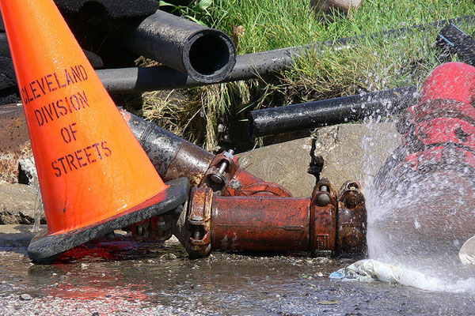
Infrastructure
Notes:
Another major Society initiative is infrastructure.
As you know, infrastructure has a lifespan. Good maintenance can extend that lifespan, but not forever, and a lack of maintenance can shorten it.
Far too many of our infrastructure systems lack the funding needed for proper maintenance.

Slide 11
Grading Our Infrastructure
InfrastructureReportCard.org
Notes:
To help raise awareness of the plight of our nation’s infrastructure, we developed the Report Card for America’s Infrastructure . We release a new report card every four years.
It has become a highly effective advocacy tool which helps underscore our role as leaders in society influencing public policy.
It makes the issue clear because it evaluates the conditions and investment needs for 16 major sectors of infrastructure -- including roads, bridges, drinking water systems, mass transit, the electric grid – and put these grades into an easy to understand format that you’ll find familiar – the report card.
We just released our newest report card in March of 2013.
It’s now a digital reference bringing you up to the minute infrastructure news – both as a tablet app and a smart phone app – with videos and other important information you can share through social media.

Slide 12
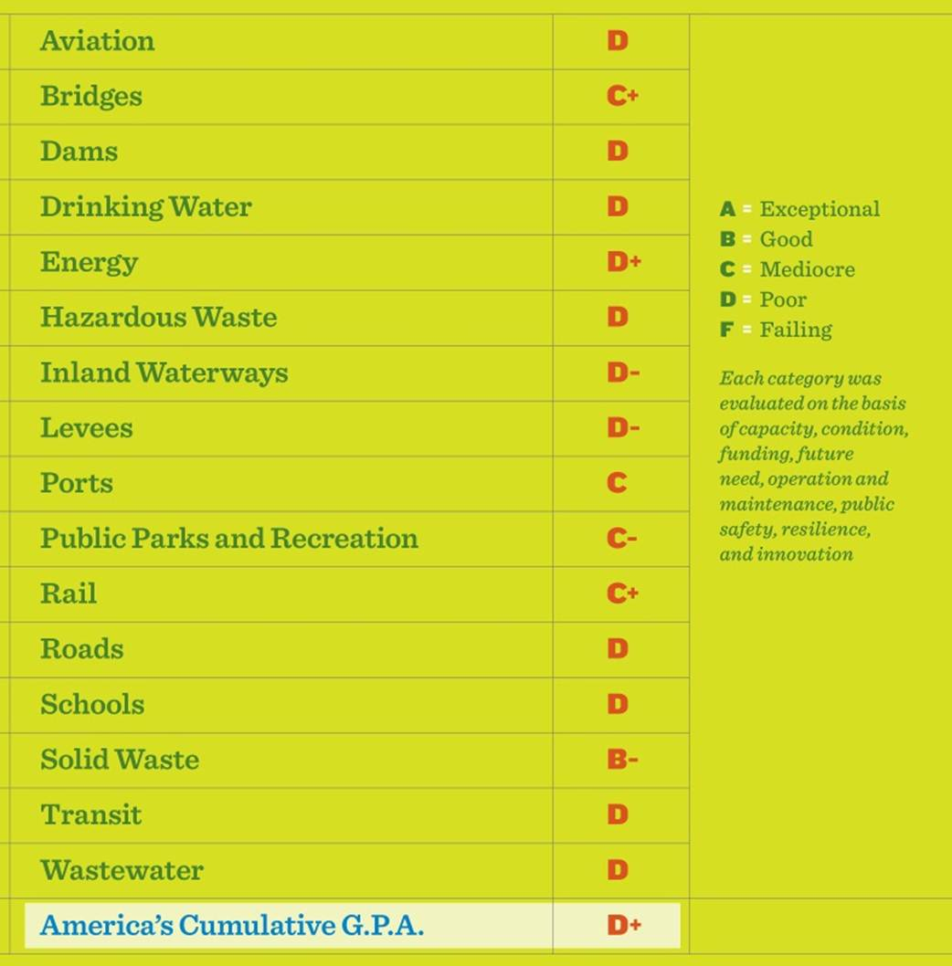
Notes:
So what did we learn from the report card?
America’s infrastructure received an overall grade of D+ in ASCE’s 2013 Report Card, up slightly from a D in 2009.
We’re excited to see a small, but unmistakable, improvement in the overall condition of America’s infrastructure.
Grades in six sectors went up – solid waste, drinking water and wastewater, roads, bridges and rail.
The 2013 report card demonstrates that we can improve and modernize our nation’s infrastructure.

Slide 13
Notes:
Why did some sectors improve, while others continued to fall behind?
The simple answer is that where investment was made and projects moved forward, we saw the grades rise.
We also saw innovative partnerships between different levels of government – cities and states working together to prioritize and implement projects.
We saw significant private investment in categories like rail, as well as a short-term boost in federal funding for several infrastructure sectors.
And yet in many sectors, we do not invest enough to maintain our infrastructure, let alone to improve and modernize these systems to reflect a changing world.

Slide 14
Infrastructure Solutions
Increase leadership in infrastructure
renewal.
Promote sustainability and resilience.
Develop and fund plans to maintain
and enhance America’s infrastructure.
www.infrastructurereportcard.org
Notes:
In addition to grading our infrastructure, ASCE also proposed these infrastructure solutions:
Increase leadership in infrastructure renewal. [Click ]
Promote sustainability and resilience. [Click ]
Develop and fund plans to maintain and enhance America’s infrastructure. [Click ]
Help us keep the momentum going by reading our report card and sharing the information with your classmates, family and friends.
[Click ] (URL appears)

Slide 15
Highway Trust Fund Crisis
Government provides:
95% of transportation funding
52% highway/bridge funding
Notes:
One of the reasons our nation’s infrastructure is not in good shape has to do with how we fund the projects. And the situation is about to get a lot worse.
According to the American Road and Transportation Builders Association:
More than 95% of the transportation work in the US is funded by government
The largest market segment is roads and bridges
On average, 52% of the funding for state and local roads and bridges comes from a federal program that is supported by the Highway Trust Fund
Without action by the US Congress before October 1, 2014, that 52% of funds will be gone from new projects in 2015
What will your commute look like with even less funding for road and bridge repair? What impact do you think it will have on our nation’s economy?

Slide 16
RaiseTheBarForEngineering.org
Notes:
Our initiative on Raise the Bar is straight forward - increased formal education before professional licensure to effectively protect the public health, safety and welfare.
Why is that important?
Better prepared engineers will have the enhanced technical, leadership, communications and business skills to deliver increased value to clients.
16

Slide 17
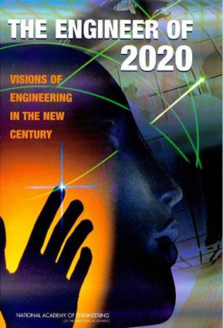
The World of Tomorrow
“It is evident that the exploding body of science and engineering knowledge cannot be accommodated within the context of the traditional four-year baccalaureate degree.”
Notes:
It’s also no secret that the practice of civil engineering and the world has changed dramatically with advances in technology and cutting-edge new building materials.
According to a study by the National Academy of Engineering, [click button – text appears]
“It is evident that the exploding body of science cannot be accommodated within the context of the traditional four-year baccalaureate degree.”
In Vision 2025, we identified increased education as a key tactic.
Why?
17

Slide 18
How do we compare?
9
8
7
6
5
4
3
2
1
0
Engineering
Medicine
Law
Architecture
Pharmacy
Accounting
Years of Formal Education
Occupational Therapy
Engineering
Engineering Technology
1900
1920
1950
1980
2000
2010
Engineering builds the foundation for a better future
Notes:
Engineering is a profession.
And like other professions, we need to evolve educationally.
Today, your doctors, lawyers, accountants, pharmacists and architects don’t stop their education at the minimum number required.
These professions understand that knowledge is exploding, and to compensate, they increased the number of years of formal education many years ago.
[click button] (Engineering arrow goes across screen)
[click button] (Technologist arrow goes across screen)
Engineering has not changed the basic requirements for professional certification, and we need to do this.

Slide 19
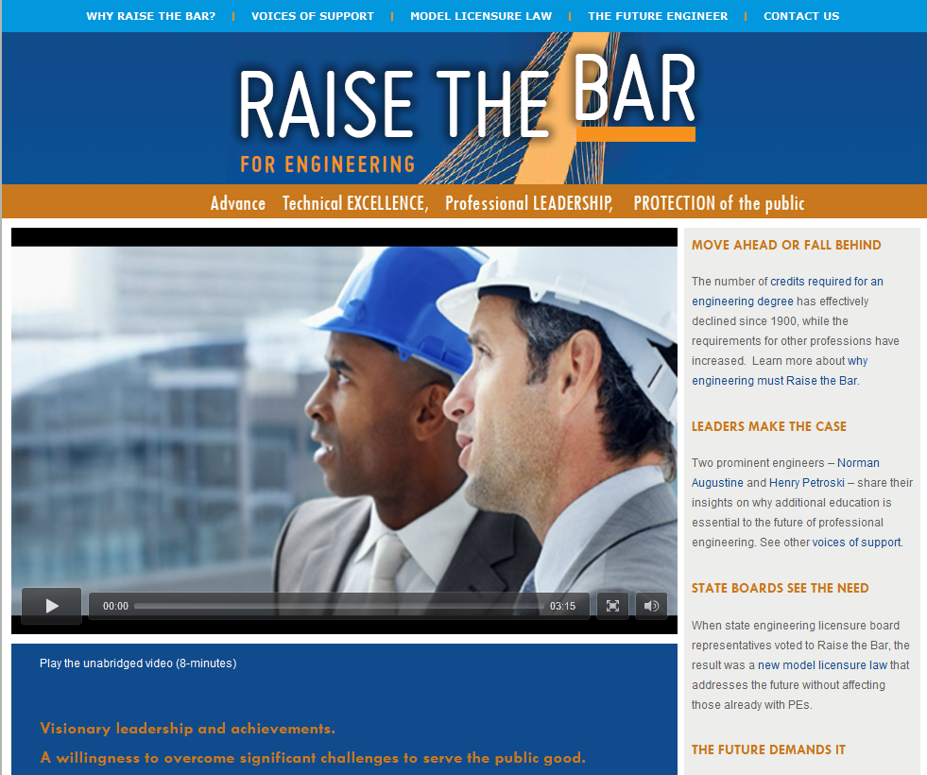
A Plan for Tomorrow
RaiseTheBarForEngineering.org
Notes:
That’s why, ASCE is working with other interested groups to encourage a national standard for licensure to be adopted by all 50 licensing jurisdictions.
The model law defines a new standard in which future professional engineers are required to have either a master’s degree or an equivalent 30 upper level credits in addition to the current requirements of an engineering bachelor’s degree, appropriate experience, and passing the PE and FE exams.
This standard has already been endorsed by the National Council of Examiners for Engineering and Surveying, which represents the state licensure boards.
To read more about our Raise the Bar efforts, we have an entire website full of information and videos with Voices of Support from leaders across the nation.

Slide 20
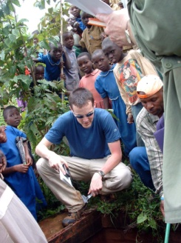
Notes:
ASCE established a 5-year partnership with EWB-USA because we share the goal of wanting to provide sustainable solutions to global problems, especially in disadvantaged communities worldwide.
EWB-USA chapters make a five year commitment to a community.
Carry out small-scale infrastructure projects, initiated by the community in need, within an overall community framework.
Projects are socio-culturally appropriate and community-owned to ensure long-term sustainability.
EWB-USA provides a non-traditional education through its program service model.

Slide 21
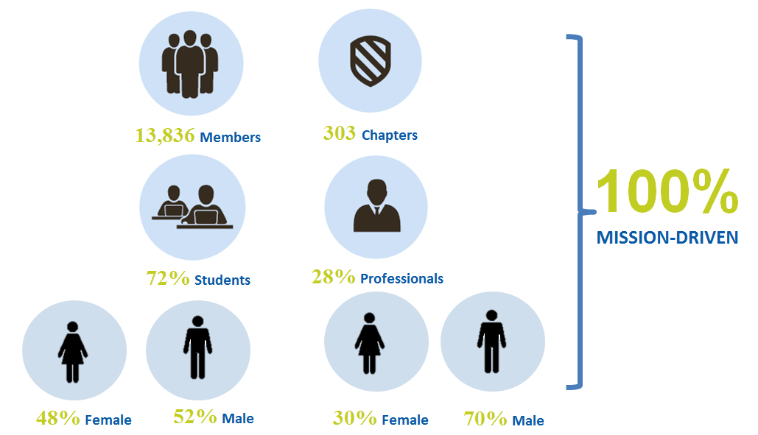
EWB-USA Profile
Notes:
ASCE provides financial and administrative support, as well as management guidance through two seats on the EWB-USA board.
With our support, EWB has grown dramatically and now has over 14,000 members.
Projects:
Number of projects: 390
Demand exceeds delivery capacity
Projects in 40 countries
Sponsors:
Large Multi-national Firms (AECom, Black & Veatch, etc.)
Professional Societies (ASME)
Non-traditional Corporations (like Google)
One of the goals was to develop a community development service model that could be used in the United States. And this year, we achieved that goal.

Slide 22
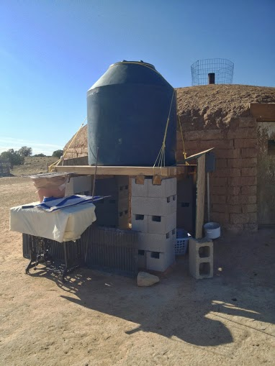
Domestic Humanitarian Opportunities
Notes:
In February, I’m proud to say we launched a new organization.
The Community Engineering Corps is an alliance of:
American Society of Civil Engineers (ASCE)
American Water Works Association (AWWA)
Engineers without Borders – USA (EWB-USA)
CE Corps provides engineering services to underserved communities in the USA
CE Corps does not:
Fund projects
Construct projects
Work on non-engineering projects

Slide 23
How Can You Get Engaged?
Notes:
Sections can work on individual projects
Project must be an official project
Section has been approved to work on the project
Individuals can work in the quality management system
Application Review Committee (ARC)
Technical Review Committee (TRC)
Through the ASCE /EWB-USA partnership, ASCE members are able to join EWB-USA at an exclusive rate and volunteer as mentors on critically important engineering projects in the U.S. and developing communities around the world.

Slide 24
Looking to the Future
Notes:
Vision 2025 outlined the future role of civil engineers - and that future is a mere 11 years away.
ASCE‘s three strategic initiatives will help us achieve that vision by:
achieving a more sustainable natural and built environment
raising the grades on America's infrastructure
and raising the educational bar for future entry into professional engineering practice
The path is clear.

Slide 25
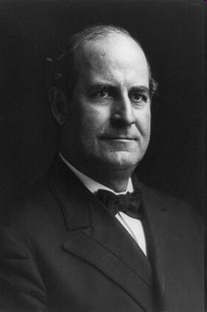
“Destiny is not a matter of chance; it is a matter of choice.”
- U.S. Statesman
William Jennings Bryan
Notes:
To achieve Vision 2025 in which civil engineers are leaders in the global world of tomorrow, we must work together.
All of us need to be engaged.
So I leave you with this thought from a famous statesman who once said, Destiny is a matter of choice.
How will you choose to help engineer a better future?
Thank you.

Slide 26
QUESTIONS?

