Slide 1
Get Involved

Slide 2
Different Functions
Discussion Forums
Connection Platform for Young Professionals
Mentoring
Committee Management

Slide 3
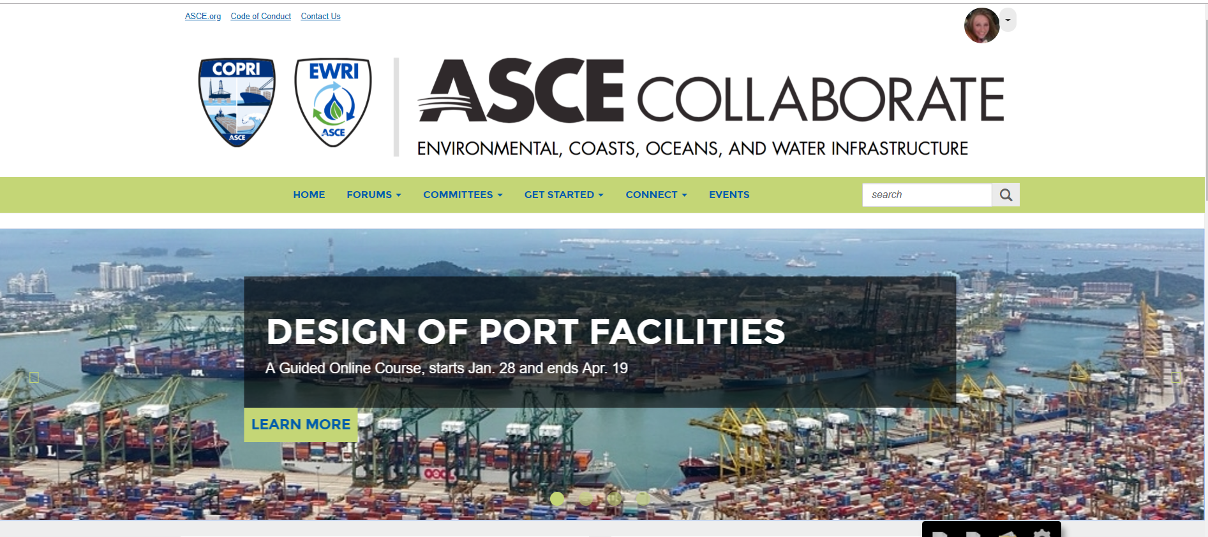
Environmental, Coasts Oceans, and Water Forum
All COPRI members are auto-subscribed to this technical forum.
Members can ask questions and share their research, best practices, and innovative ideas.
You can unsubscribe to specific discussion threads.

Slide 4
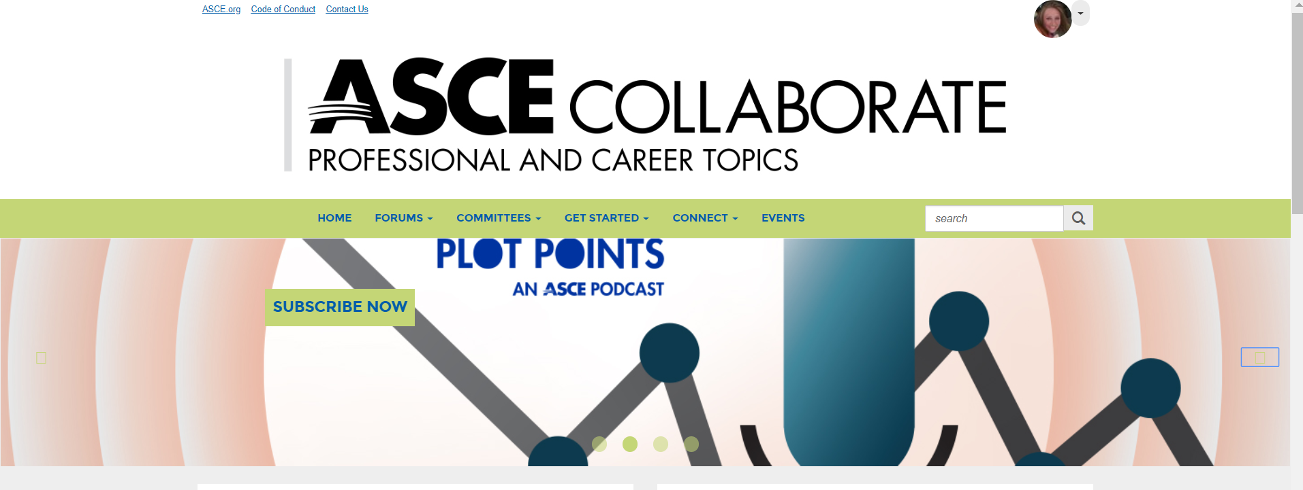
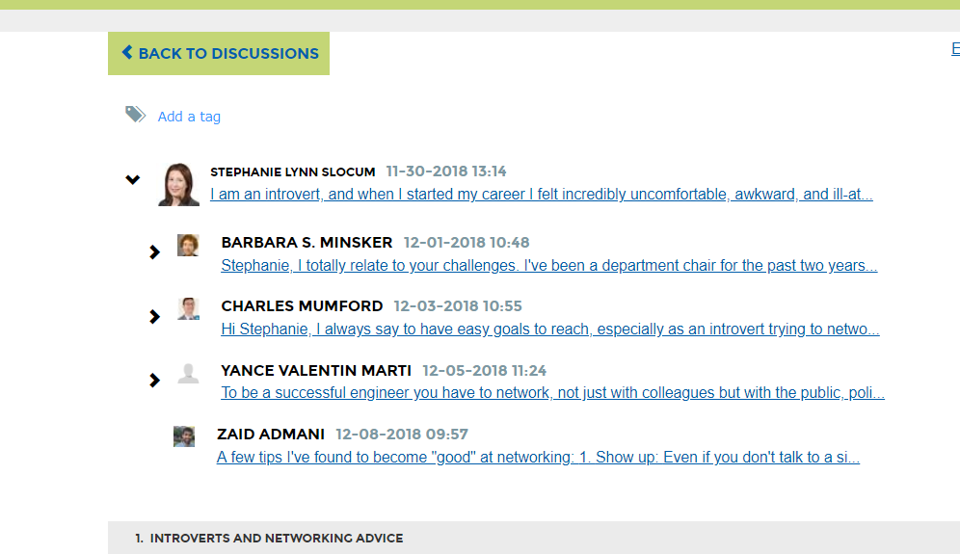
Professional and Career Topics
Forum to discuss the “soft skills” engineers encounter throughout their career. Topics include licensure, ethics, education, client relations and career development.
All members are subscribed to the forum.

Slide 5
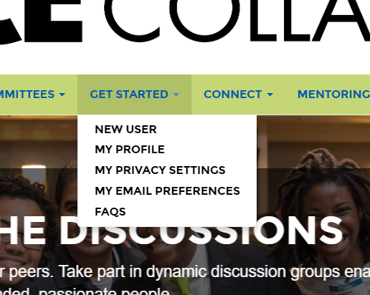
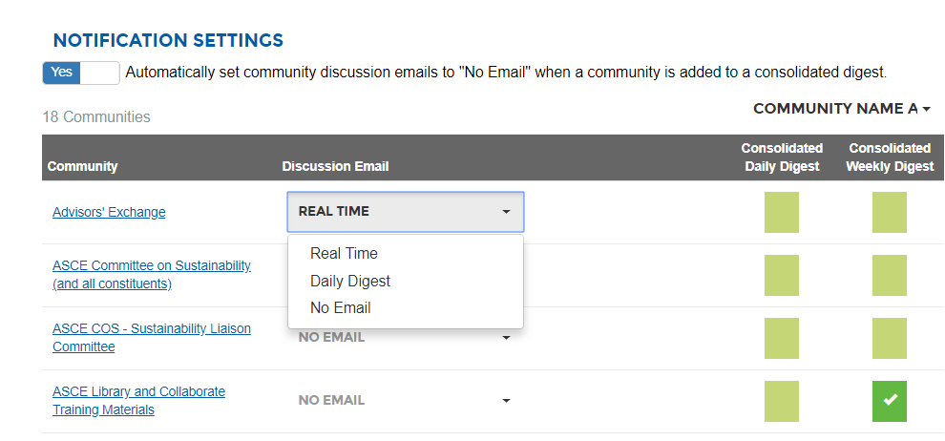
Change Subscriptions
You can edit subscriptions to each group. We recommend committee members subscribe to consolidated digests for their committee groups
Get Started > My Email Preferences
Options:
Real Time
Daily Digest
No Email
Daily Consolidated Digests
Weekly Consolidated Digests
*** Note if you post on a discussion thread you are automatically subscribed to “Real Time” for that thread.

Slide 6
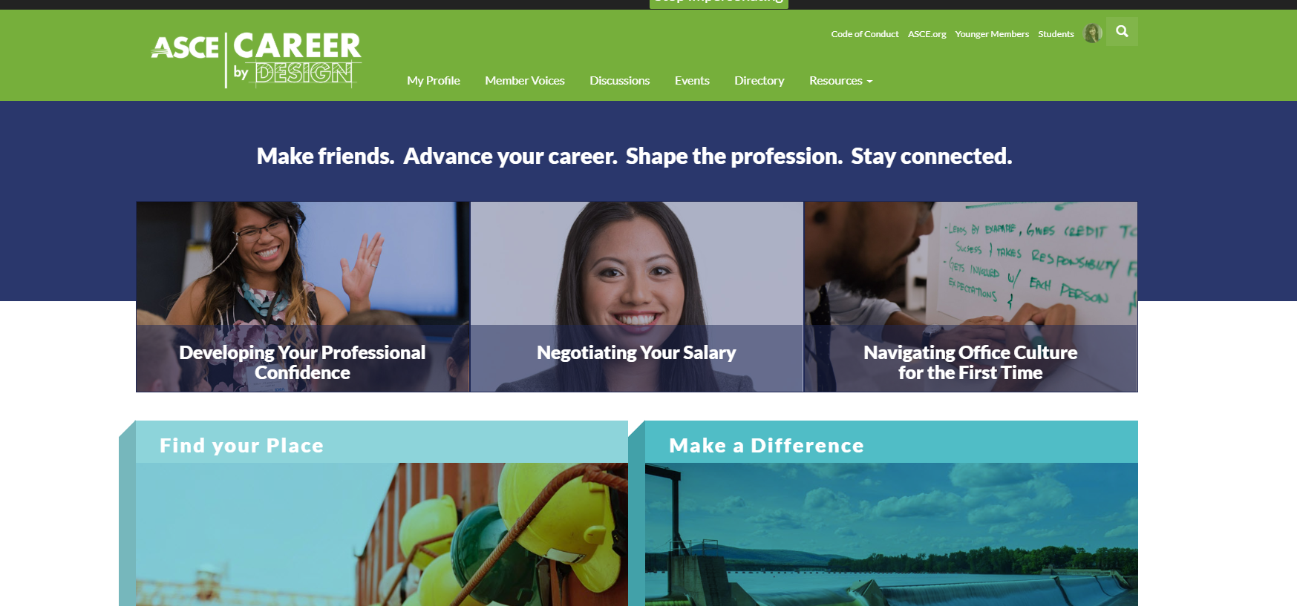
Career By Design
Plug in to ASCE’s new online community for young civil engineers.
Get the tools, tips, resources, and opportunities you need to advance your career and develop into the civil engineering leader you know you can be.
Connect and network with friends and colleagues to share your passion for changing the world through civil engineering.
https://collaborate.asce.org/careerbydesign/home

Slide 7
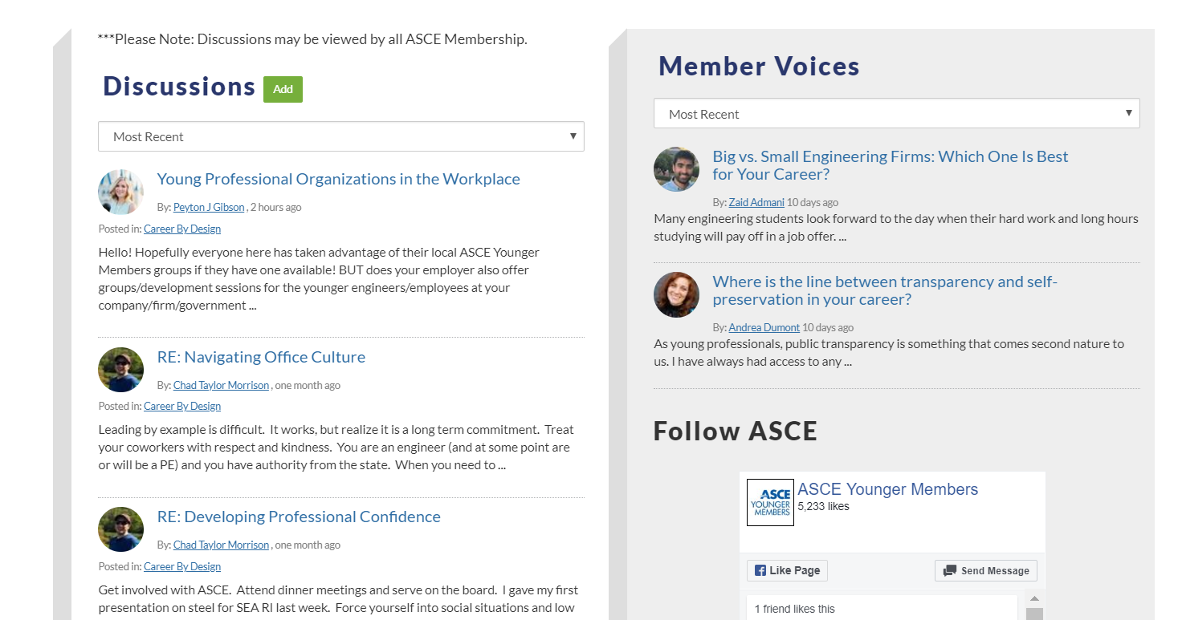
Young Professional Leaders
We need young, passionate engineers to lead and facilitate the discussions in this new group.
Opportunities:
Initial Testing and Starting Conversations
Be a Topic Moderator
Contribute to the “Member Voices” Column
Please let me know if this is something you would be interested in. taustin@asce.org

Slide 8
Topic Moderators
Topic Moderators add value to the discussion, increase the body of knowledge, and nurture the ASCE Collaborate Community.
We ask that you post two to three times a week.
You will receive email notifications on posts that are in your area of expertise.
You will have a Topic Moderator Profile.
Please contact me if you are interested in serving.

Slide 9
ASCE Mentor Match
Mentor Match connects ASCE members based on topics of interest and experience level.
Three types of relationships:
Coach (3-6 months)
Guide (6-9 months)
Mentor (9 months to a year)
Choose from nine demographics that match members through a mentoring directory.

Slide 10
Guide to Mentorship
1. Enroll. Setup Your Mentee/Mentor Profile. 2. Search Mentees/Mentors. 3. Request a Discovery Call. 4. Introduce Yourself.
5. Agree on Terms of Mentorship. 6. Meet as Agreed. 7. Evaluate Mentorship.
8. Renew agreement or start the cycle again.

Slide 11
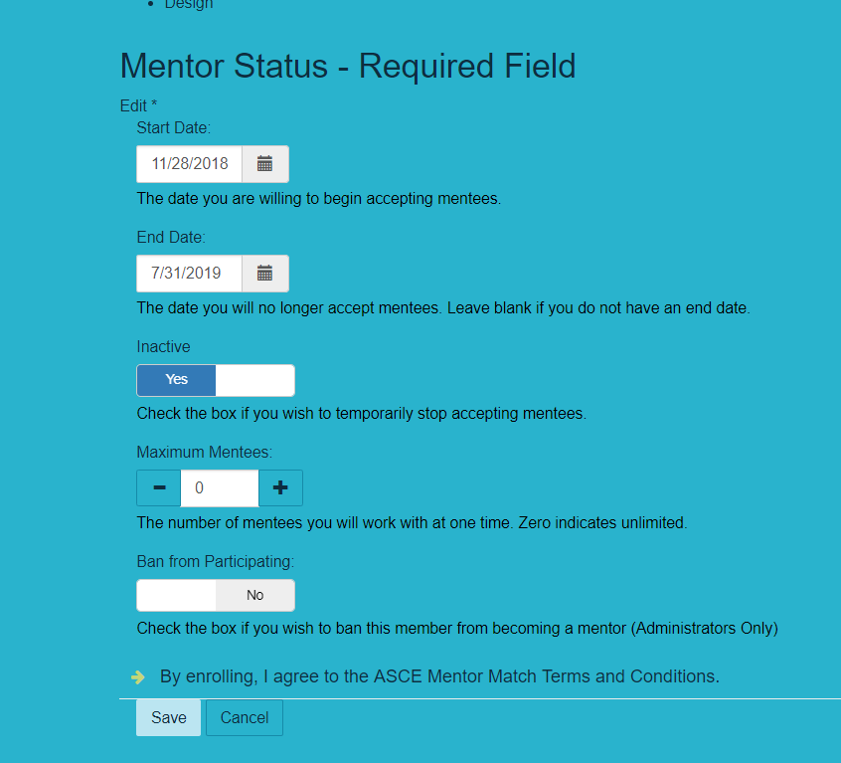
Mentor/Mentee Status
Mentor and Mentee status is a required field.
The start and end date controls when you appear in the mentoring directory.
If you want to remove yourself from the directory for a certain time you toggle the “Inactive” button to “yes.”
Mentors need to decide on a maximum number of Mentees. Once this number is reached they will be removed from the directory.

Slide 12
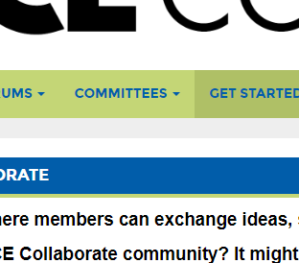
Committee Management
Each committee has its own ASCE Collaborate homepage with a space to start conversations, store documents, and view events.
These spaces are often referred to as “Communities” in ASCE Collaborate.
You can view your committees by clicking Committees > My Committees.
Click on the committee name to view the page, or you can directly view the library, discussions, or other members by clicking the green buttons in the same bar.

Slide 13
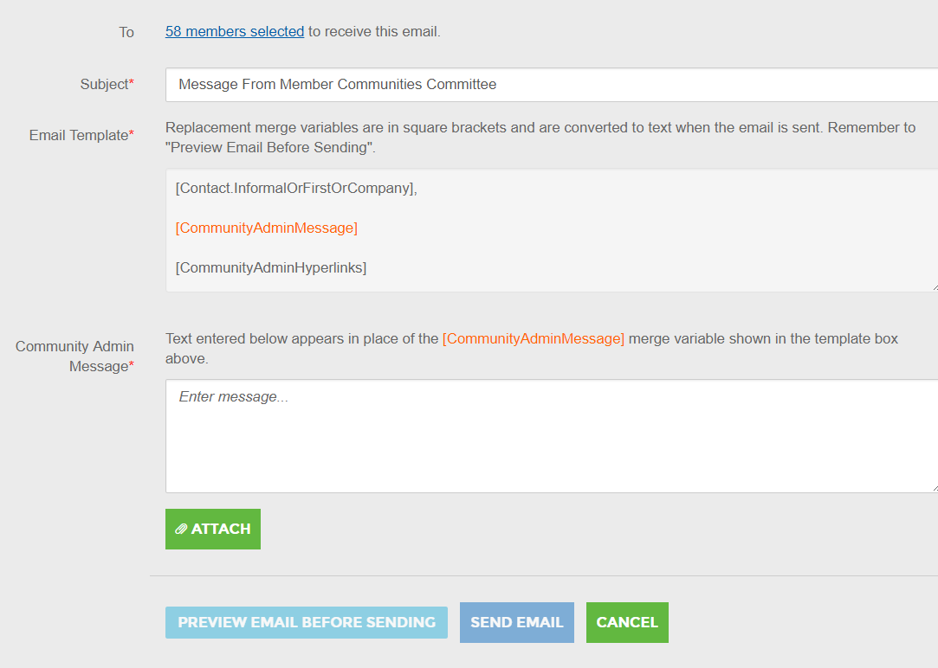
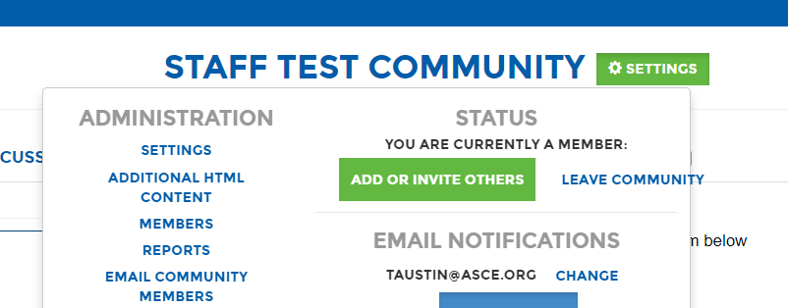
Send a group email
You can email your entire committee through ASCE Collaborate.
Go to Settings > Email Community Members.
The email will look like an email sent from you personally, and you will receive replies in your inbox.
You can attach a file to the email.
Once a message is sent, it will be documented in the Community Member Emails Report that you can export.

Slide 14
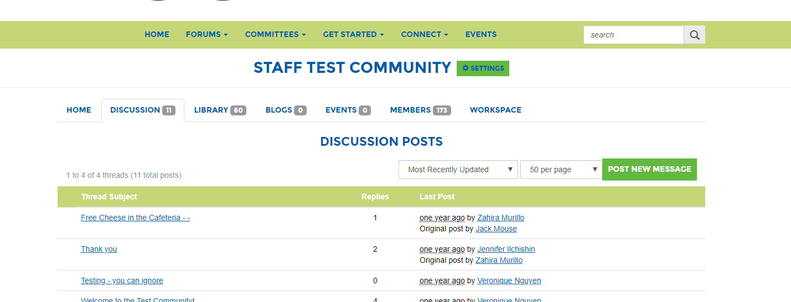
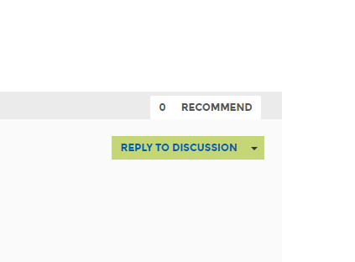
Group Communication
The discussion space allows you to start conversations about topics you may not have been able to discuss in a meeting. It allows you to discuss these topics at your own convenience in one centralized place. No one has to search through a messy email chain.
Click on the discussion tab to view the thread list.
Click the green “Post New Message” to start a new discussion.
Reply to a discussion by clicking the subject thread and click “Reply to Discussion” on the right.

Slide 15
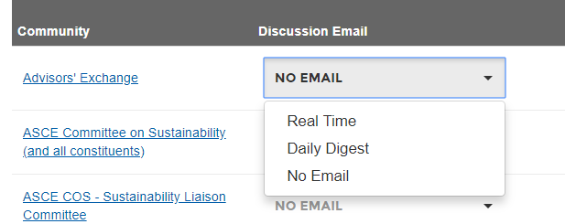
Set your Email Preferences
Posting in a discussion will generate emails through ASCE Collaborate to other committee members. You can control how often you get notifications from the committee by clicking Get Started > Email Preferences.
We recommend committee members select “consolidated digests.” Notifications will be sent when there are any updates in the community/committee group (announcements, new calendar events or new documents are posted). You can receive these notifications on a daily or weekly basis.
If you do not want to receive emails select the drop down Discussion Email > No Email.

Slide 16
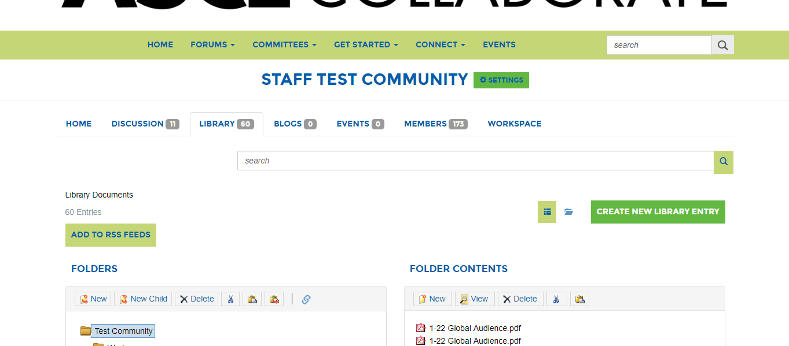
View Documents
Every committee has a “Library” to archive and share documents.
You are able to share the links from the files with your committee members, so they can download the documents.
To view your committee’s folders click on the “Library” tab at the top of the “Home” page.

Slide 17
Finding Documents
When you open the Library you will see the folder structure to keep your committee organized. Talk to your committee about how you collectively want to store documents, so they are easy to find.
There is a “Search” feature to easily access documents
Talk with your committee about how the folder structure for your committee should be organized.
To switch between the list view and the folder view click the green square icon.
You can filter the list results by selecting the arrow next to most recent.

Slide 18
Download a Document
Click the green “Download Now” button to download the document.
If there are multiple files in an entry (within the folder) you will see a green “Download All” button. You can only select “Download Now” if the files are stored in the same entry.
Click on the name of the entry if you would like to select a specific document to download.

Slide 19
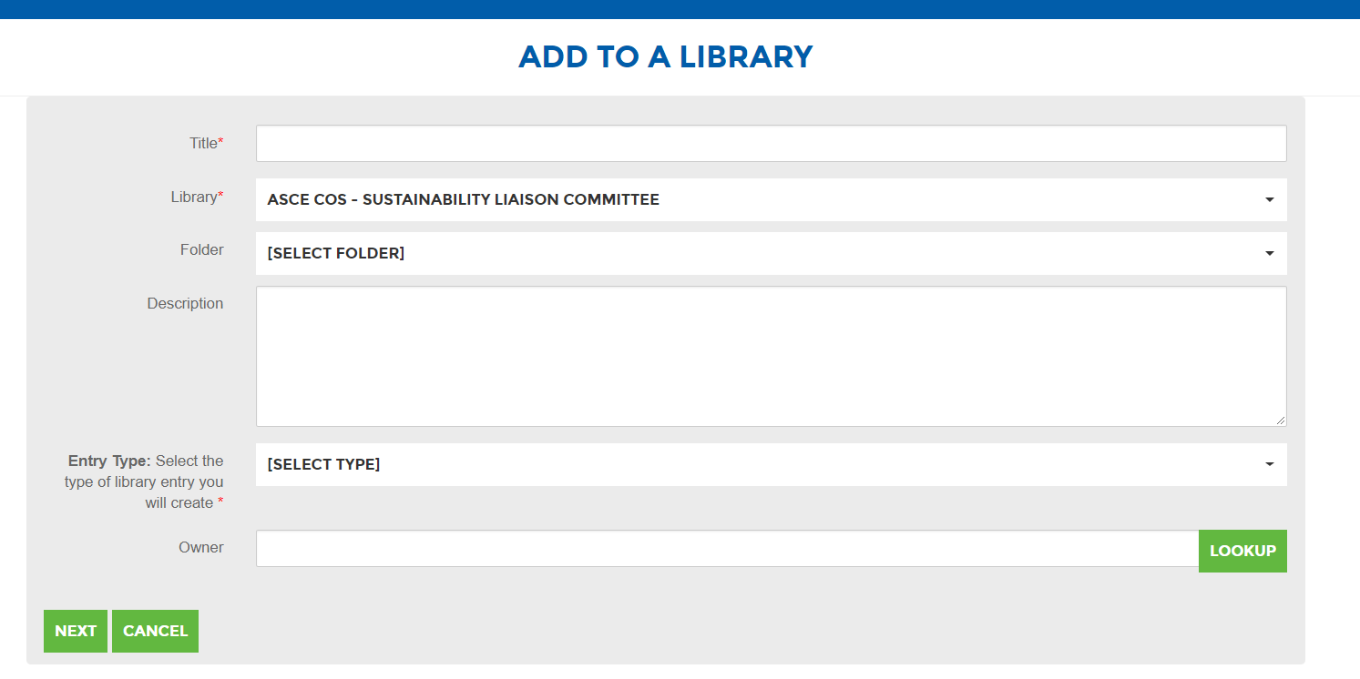
Upload a Library Document
Click the green “Create New Library Entry” button.
Add the title of the document.
The committee library will already be selected.
Pick an existing folder within the library.
Select entry type. Most files will be a “Standard File Upload.”
Add your email address as the owner if you wish. You will be automatically added as the owner.
Click the green “Next” button.
As you work with a committee, you will need to share documents such as award applications, agendas, minutes, policies and supporting documents.
You can store them in one central place by uploading a document. This makes all records easier to find.

Slide 20
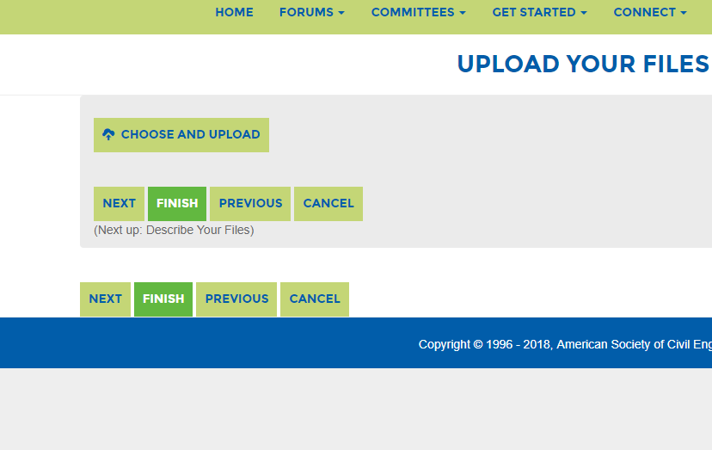
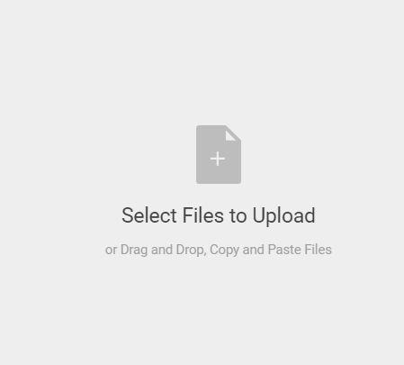
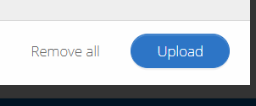
Upload Multiple Files
You are able to upload multiple files into the same entry. This is recommended if you are loading documents for the same meeting or project so others can download the files at the same time.
Click the green “Choose and Upload” button.
Click the blue “Choose Files” button.
Choose and drag the files you would like to upload in the gray box.
Click the blue “Upload” button to upload your documents once they have been added to the screen.

Slide 21
Download an Event to Outlook
The event tab is a centralized place for your committee to record important dates for your committee tasks or dates of interest.
Talk to your committee to see if storing events in Collaborate will help you stay organized.
Click the event tab to view your committees events.
Double click on an event to add it to your Outlook calendar.
Click the green “Download To Your Calendar” button.

Slide 22
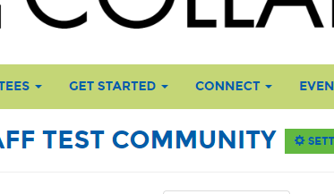
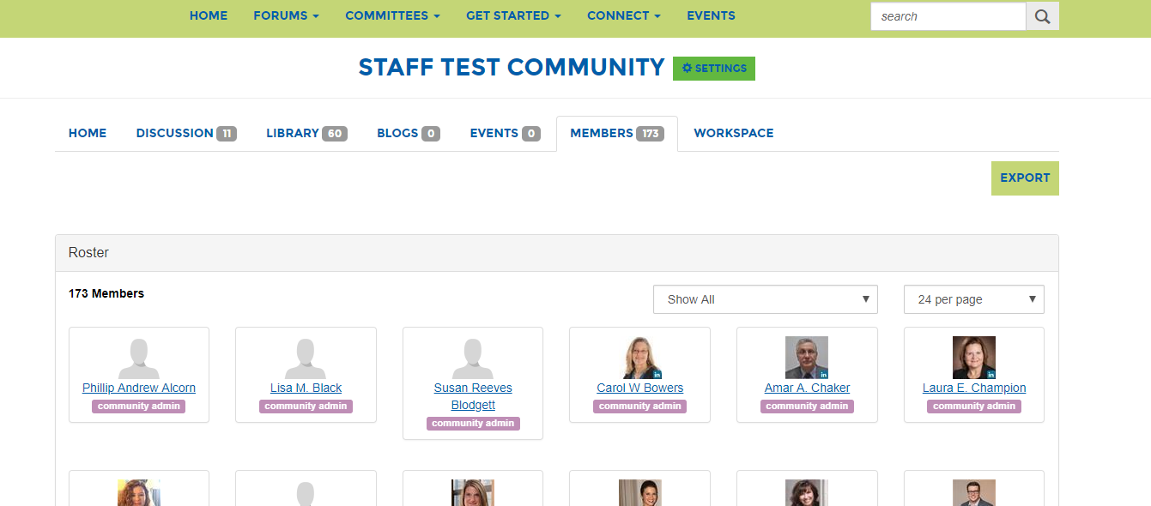
Contact other committee members
Data privacy is important at ASCE. We do not share committee members contact information with the committee. However, you are able to contact other committee members through ASCE Collaborate. Members can control what information they share with others by clicking Get Started > Privacy Settings
Click the members tab to view committee members.
Click the green “Send Message” button to send a message to that member through Collaborate.
You can also scroll to the bottom of the committee home page to see a full list of committee members.

Slide 23
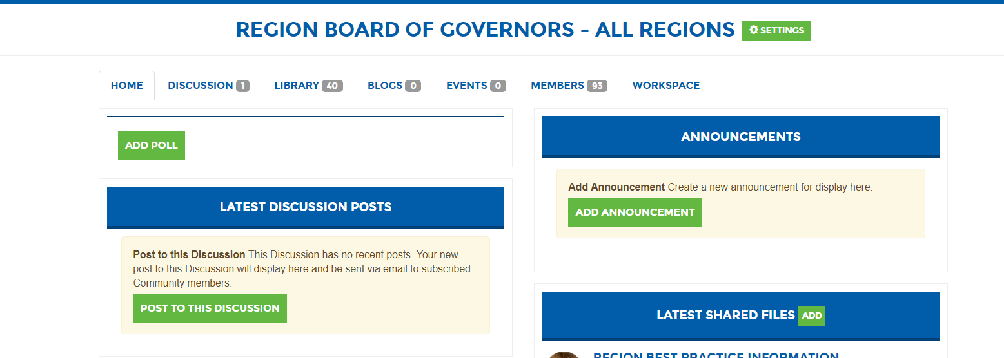
Workspace – Centralized Communication
Workspace is its own section of your committee page. Once you are in Workspace you can complete committee tasks in one centralized location – keeping committee work more organized then messy email chains. You can automate notifications to the working group through Workspace as well.
Action Items
Ballots
Comments
Sharing Documents
Creating and Revising Documents

Slide 24
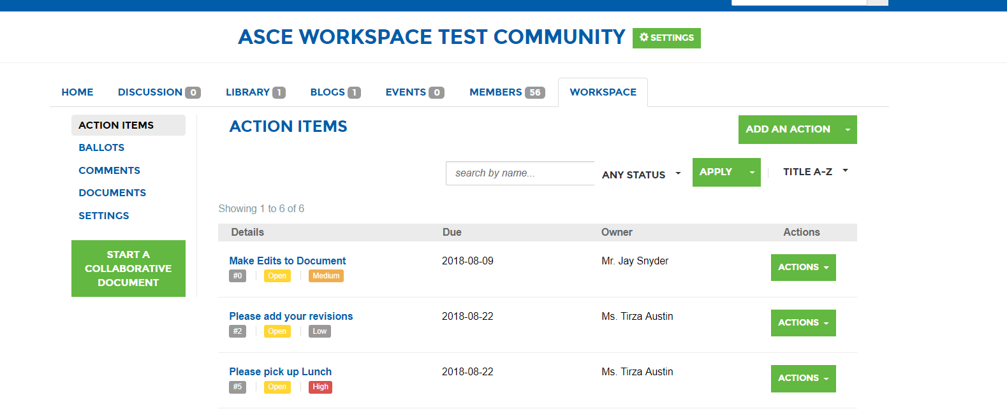
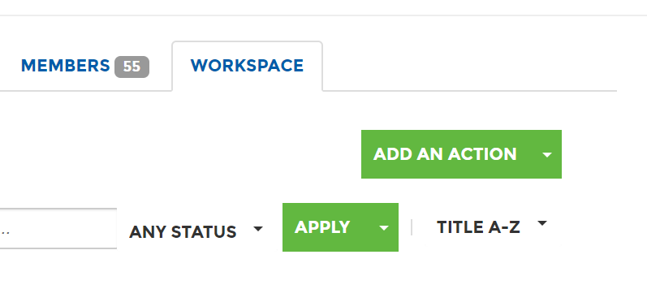
Action Items
Action items appear on the home screen of Workspace as the framework for completing your committee tasks.
Click “Add an Action” to assign tasks to a single member of your team.
You can add the following to each action item:
Subject
Description
Priority
Date Due
Reference Documents
Notifications

Slide 25
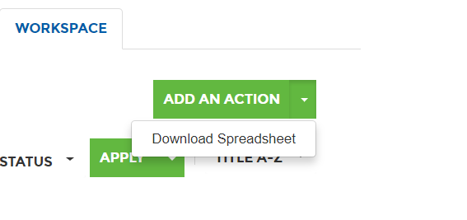
Keeping Track of Tasks
Keeping action items organized is a challenge. You are able to download a detailed list to keep everyone organized and on track.
Click the “Arrow” next to “Add an Action” > “Download Spreadsheet dropdown.”
This will export as an Excel spreadsheet with the following information.

Slide 26
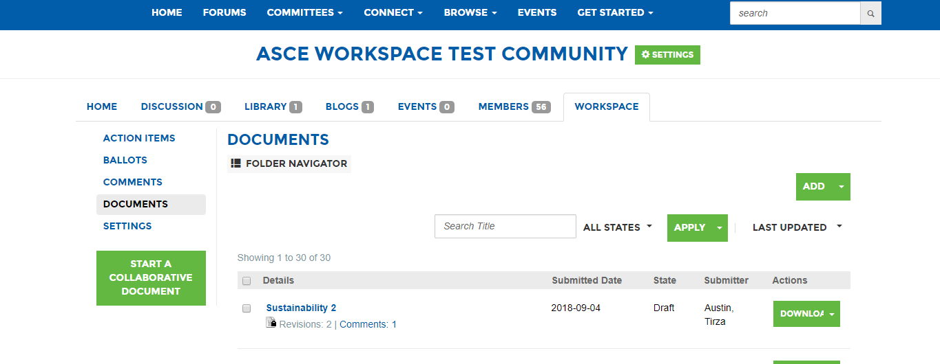
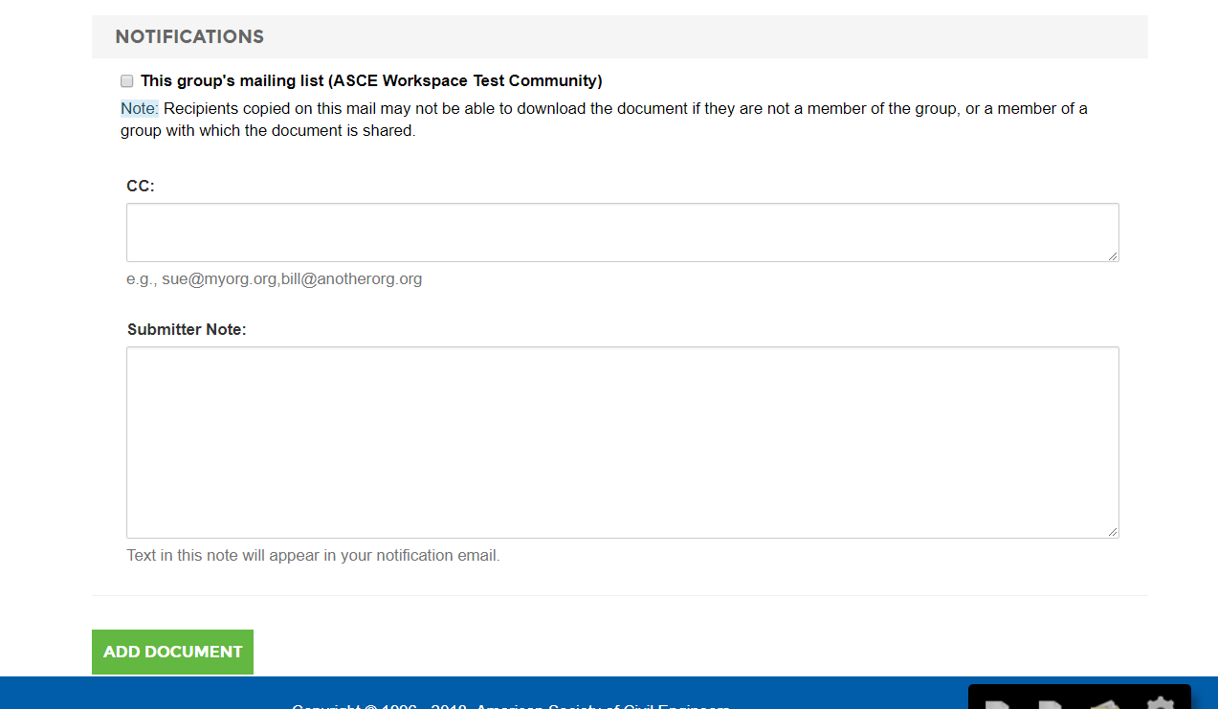
Uploading a Document
In the documents tab, Click “Add” to upload a document.
You will be able to add the following:
Display title
Document revision number
Download name
Description
Submitter
Submission Date
Choose folder, state, and comment permissions.
The notifications section allows you to notify the group.

Slide 27
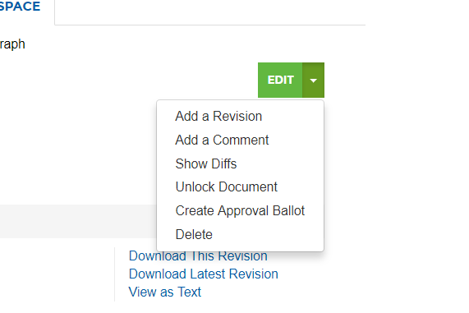
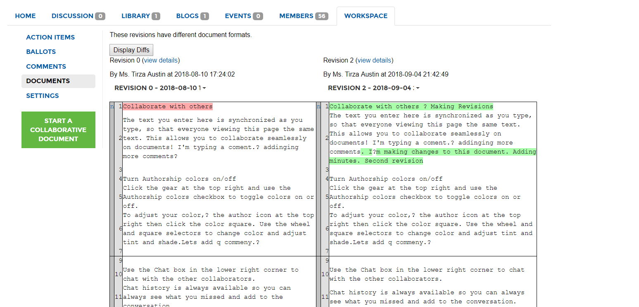
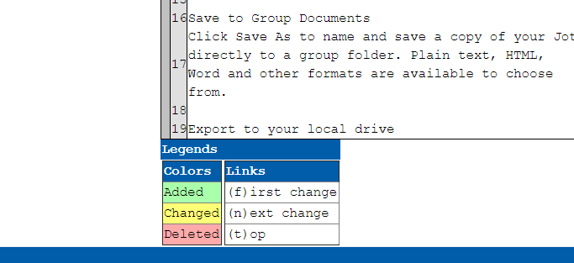
Tracking Revisions
Every revision that is added as a document will be recorded as track changes to review later.
You can view them for each document by clicking Edit > Show Diffs.
You can view and compare each revision.
All track changes will be shown through color coding.

Slide 28
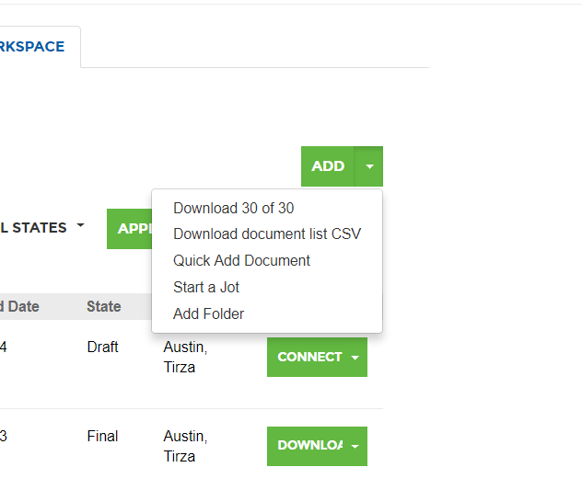
Keeping Documents Organized
There are certain situations where you might want to download all the documents in a particular folder.
You can do that by clicking Add > Download 30 of 30.
You can also download a list of all the documents in a folder by clicking Add > Download Document list CSV.

Slide 29
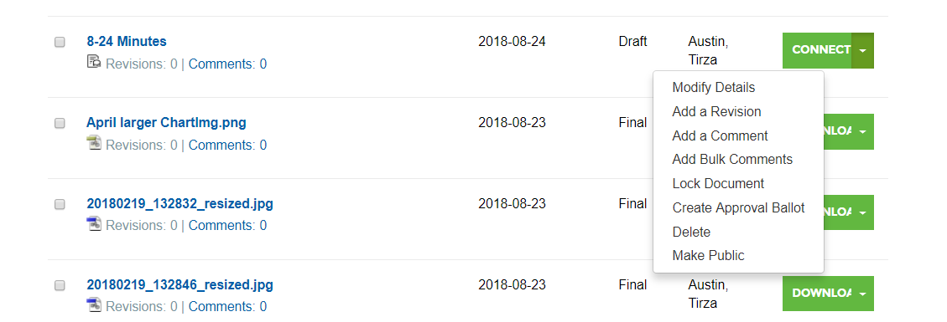
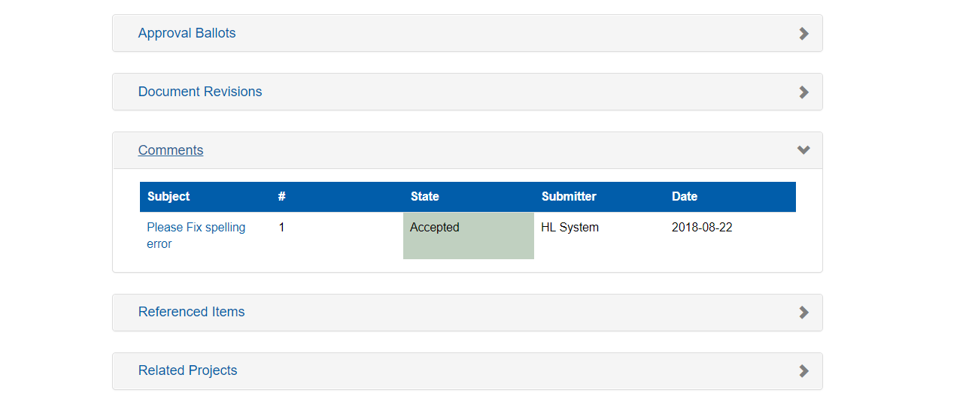
Document Changes
Comments allow you to communicate about changes to a document in one central place without searching through emails.
To add a comment, click the “Dropdown Arrow” next to “Connect” or “Download.” Click “Add a Comment.”
To view the list of comments, click on the document page then click on “Comments.” You will see a list of all the comments for the document and will be able to track the progress for each comment by clicking on the subject line.

Slide 30
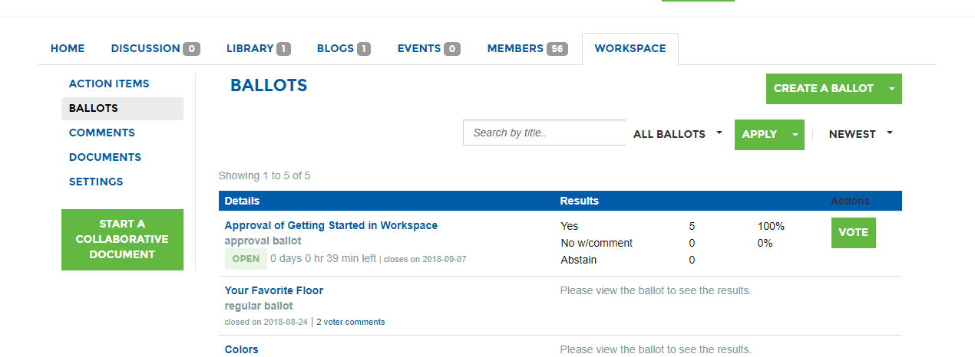
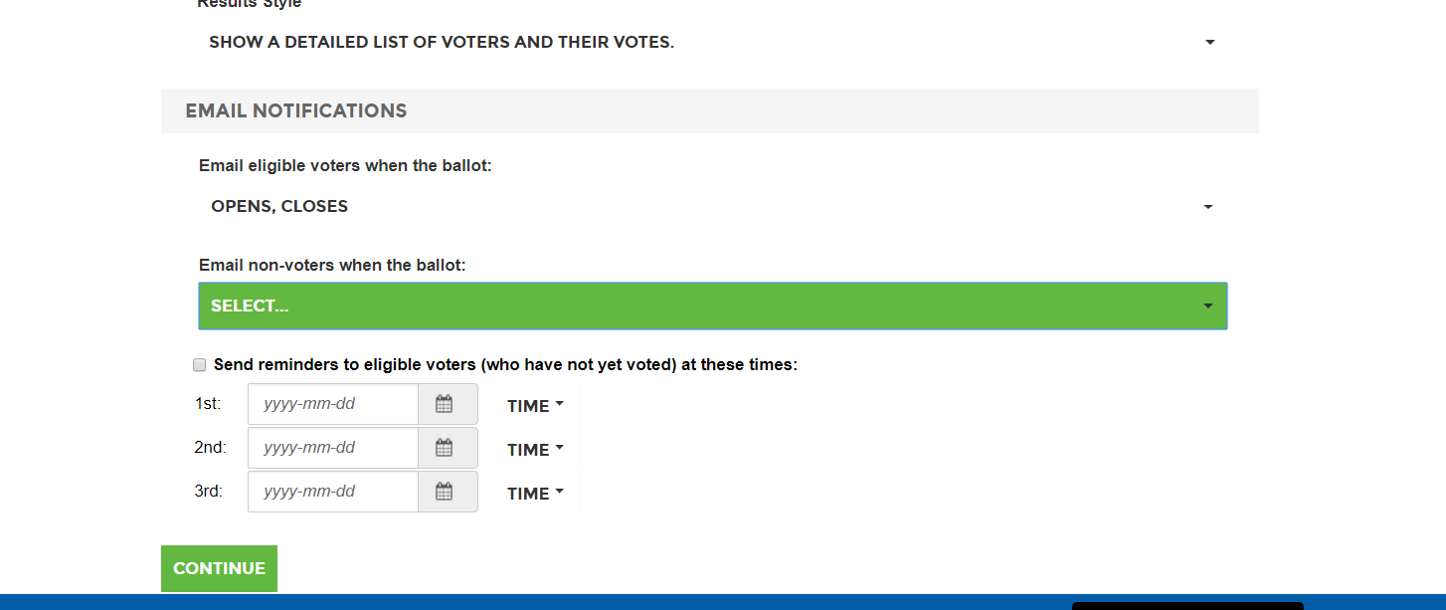
Ballots
Ballots allow document approval or polling for a general consensus.
Click on the “Ballot” > “Create a Ballot.”
You can create a custom ballot or a simple yes, no ballot.
You can allow commenting if you choose.
You can chose what type of results your voters can view.
You can select when email notifications about the ballot will be sent.

Slide 31
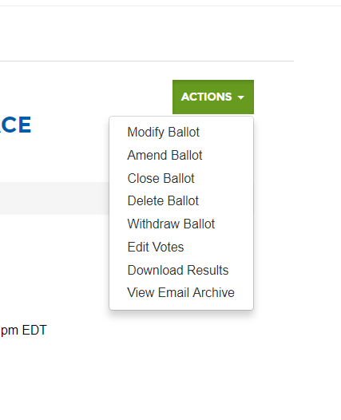
Ballot Records
Instead of relying on multiple email chains to receive results you are able to record and refer to all ballot data in ASCE Collaborate.
You can view the ballot results by clicking on Actions > Download results. This will export as a Excel spreadsheet.
You can view when automated notifications have been sent by clicking Actions > View Email Archive.

Slide 32
Thank you!
Please contact taustin@asce.org with any additional questions.

