Slide 1
Hurricane Ida extreme weather and flooding in the United States and disaster risk mitigation measures
3rd International Webinar Series
Latest Advancements in Geoenviro-Structural Confluence
September 15, 2022
Presentation by
April J. Lander, JP, MEM, EN V SP, AM ASCE
Independent Contractor, Christchurch, New Zealand
Notes:
Good afternoon. It is my pleasure to be here today.
Today I will discuss Hurricane Ida extreme weather and flooding in the United States and disaster risk mitigation measures.

Slide 2
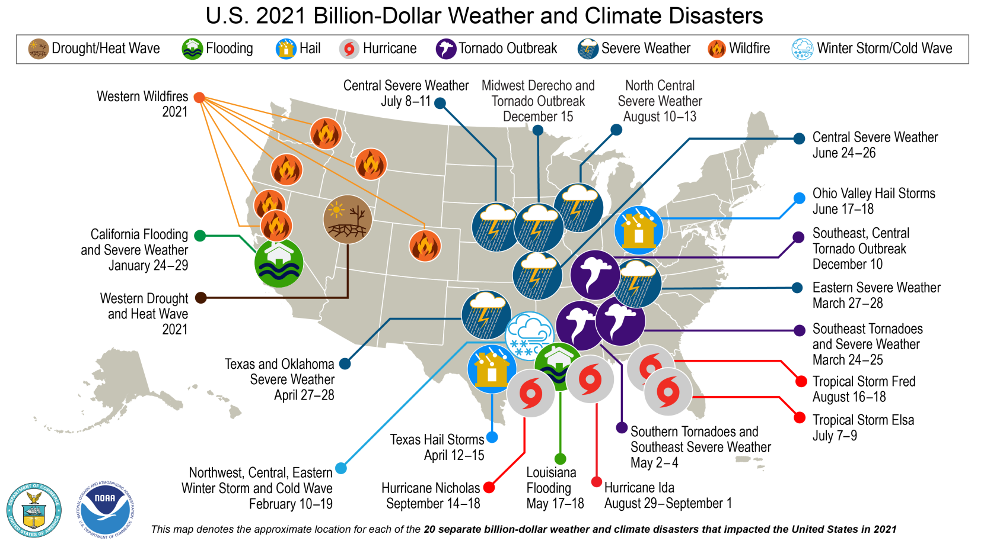
2021
Number of billion-dollar disasters: 20
Cost: $105 billion
Deaths: 538
Most damaging: Hurricane Ida
Cost: $75 billion
Deaths: 96
2020
Record number of billion-dollar disasters: 22
Cost: $95 billion
Deaths: 262
Record number of tropical cyclones: 30
Hit land : 12
Record number become billion-dollar disasters : 7
Notes:
First, I’d like to give an overview of weather and climate disasters in the US.
This figure shows just the disasters causing over $1 billion US dollars of damage in 2021.
There were 20 disasters of this magnitude almost as high as the 2020 record of 22 disasters causing over $1 billion US dollars of damage.
The cost of these 2021 disasters was $145 billion dollars. more than 2020’s cost of $95 billion.
Hurricane Ida was the most damaging disaster It caused more than $75 billion dollars of damage, 96 deaths, and left over 1 million people without power.
It however, did not cause the most deaths. The most deaths, were caused by ongoing drought and heatwave in the western part of the US.
In 2022, through mid-July there have been 9 disasters causing more than a billion dollars. Many from damaging winds and tornados.
From 1980 to 2021 there was an average of 7.7 billion-dollar weather disasters per year. But looking at just the past five years, that number goes up to 17.8.
---------
On the western side of the US, there were wildfires, drought, and flooding; severe weather in central parts of the country; and hurricanes, tropical storms, and flooding in the southeast part of the US.
In 2021, the United States experienced recor
In d-smashing 20 weather or climate disasters that each resulted in at least $1 billion in damages. NOAA map by NCEI.
https://www.climate.gov/news-features/blogs/beyond-data/2021-us-billion-dollar-weather-and-climate-disasters-historical
www.ncdc.noaa.gov/billions www.ncdc.noaa.gov/billions
Month-by-month accumulation of billion-dollar disasters for each year on record. The colored lines represent the top 6 years for most billion-dollar disasters. All other years are colored light gray. NOAA image by NCEI.

Slide 3
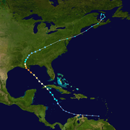
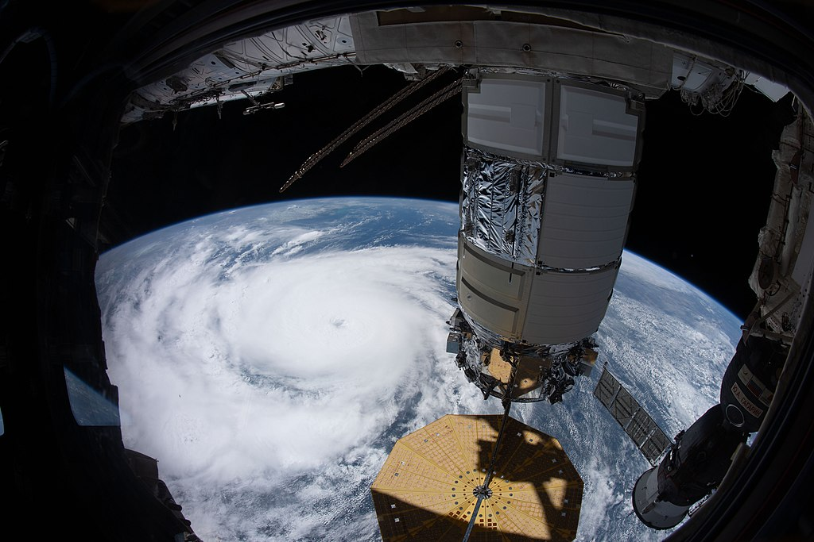
Hurricane Ida 2021 Track Map & as seen from International Space Station
Source: Created by FleurDeOdile using WikiProject Tropical cyclones/Tracks.
The background image is from NASA. Tracking data is from NHC.
Source: NASA Photo ID ISS065-E-32705 Hurricane Ida as a Category 4 Hurricane, August 29, 2021
Notes:
Here you can see a map tracking Hurricane Ida’s movements. Hurricane Ida entered the US mainland on August 29th over the State of Louisiana, where it causes extensive flooding then makes it way across many other states including Pennsylvania, New Jersey, and New York where it also caused catastrophic damage.
The second photo shows Hurricane Ida from the International Space Station which gives one an idea of the scale of it.

Slide 4
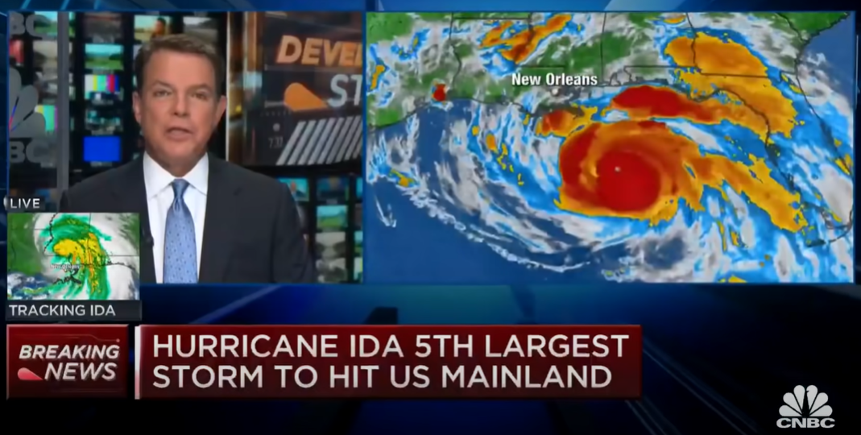
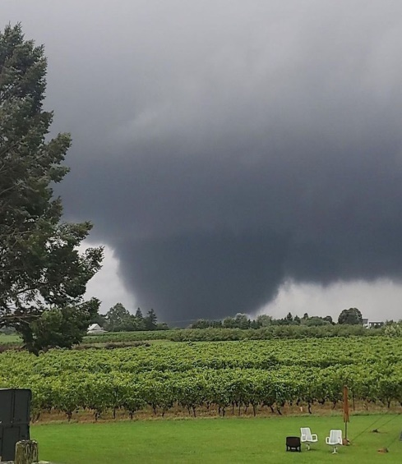
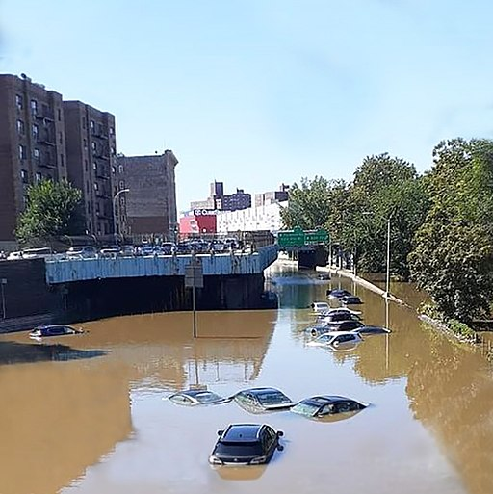
Category 4 Atlantic hurricane with maximum sustained winds of 240 km/hr 5th largest hurricane to hit the US mainland 6th costliest hurricane on record - US $75 billion dollars in damage US $16-24 billion in flooding damage in the Northeastern US 1st flash flood & EF-3 tornado emergency recorded in Northeastern US Flooding kills 43 people in 4 states: New York, New Jersey, Pennsylvania & Connecticut
Hurricane Ida
Source: Bluestocking Redneck,
EF-3 tornado near Mullica Hill, NJ
Source: Jim Griffin, Flooding in the Bronx, Kings Bridge, Sep 2, 2021
Notes:
Hurricane Ida was an extremely devastating Category 4 hurricane that is the 5th largest hurricane to hit the US mainland.
It also is the 6th costliest at US $65 billion dollars in damage with close to half of the damage caused by flooding in the Northeastern US.
It also produced the 1st flash flood and EF-3 tornado recorded in the Northeastern US.

Slide 5
New York City example FEMA maps flawed
13 people died in New York City (NYC)
11 in basement apartments due to record rainfall & flash flooding
FEMA (Federal Emergency Management Agency)
flood maps flawed as deaths in areas having minimal flood hazard
FEMA maps did not account for storm sewer systems
FEMA maps used by communities to guide development and prevent or limit building in flood-prone areas & used to determine property owners required to have flood insurance
The First Street Foundation Flood Model identifies 2.6 times more properties at risk of flooding than FEMA estimates
The First Street model shows 121,200 properties in NYC at risk (14%)
The number of properties is anticipated to increase by 45,673 (38%) to 166,875 by 2050
Notes:
Disaster management planning

Slide 6
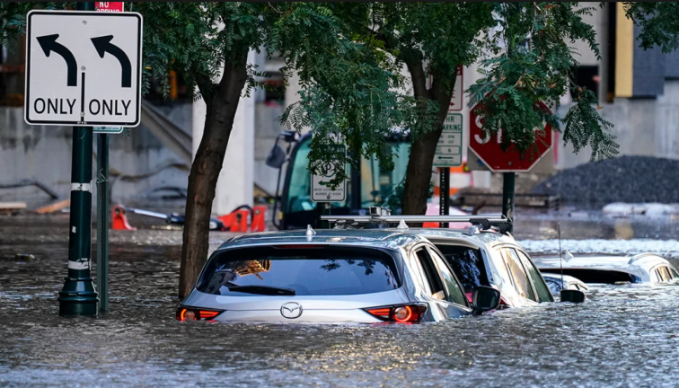
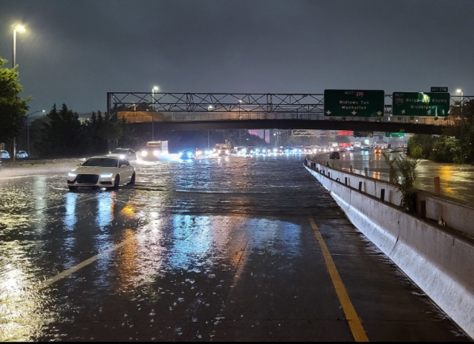
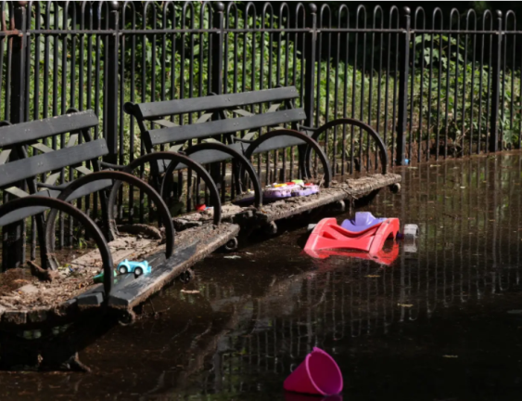
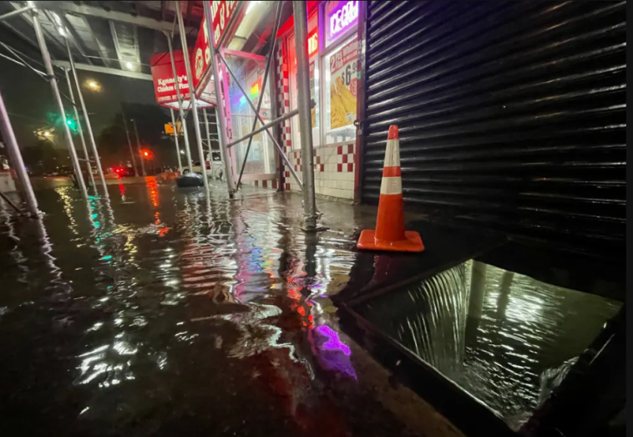
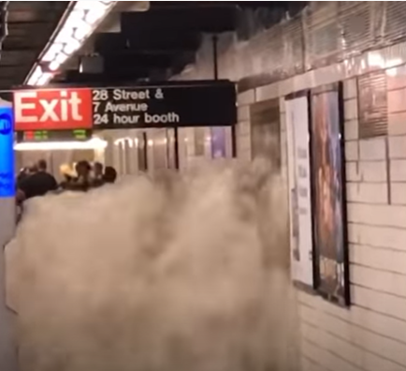
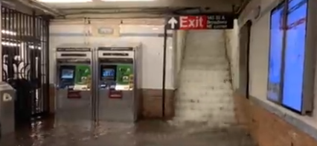
New York City Flooding
Source: Source www.nbcnewyork.com
Source: Tony Gao, Long Island Expressway
Source: Camille Squires, New York City park
Source: David Dee Delgado/Getty Images, Rainfall floods the basement of a fast-food restaurant in the Bronx
Source: Twitter, Flash flooding 28th St subway station
Source: NTD News, 145th St subway station
Notes:
3 inches of rain fell in one hour
75% of the city is build on imperious surfaces
75 million gallons of water had to be pumped out of tunnels

Slide 7
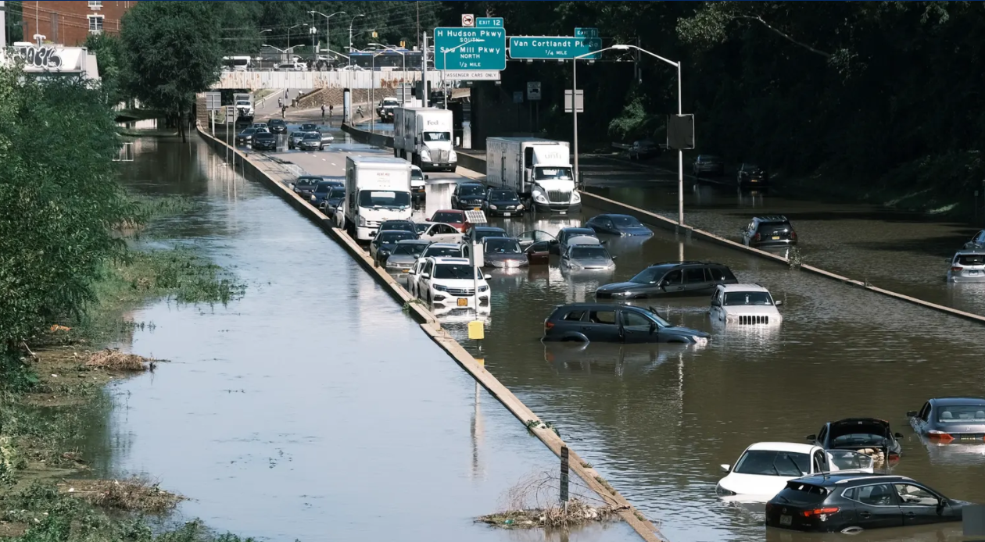
New York City Infrastructure
75 mm of rainfall fell in one hour (a record amount)
75% of the city is built on impervious surfaces
75 million gallons had to be pumped out of tunnels
NYC’s infrastructure can handle only about half of rainfall caused by Hurricane Ida
There is no quick fix
Source: Spencer Platt/Getty Images, Major Deegan Expressway in the Bronx
Notes:
3 inches of rain fell in one hour
75% of the city is build on imperious surfaces
75 million gallons of water had to be pumped out of tunnels
Source: Spencer Platt/Getty Images, Major Deegan Expressway in the Bronx

Slide 8
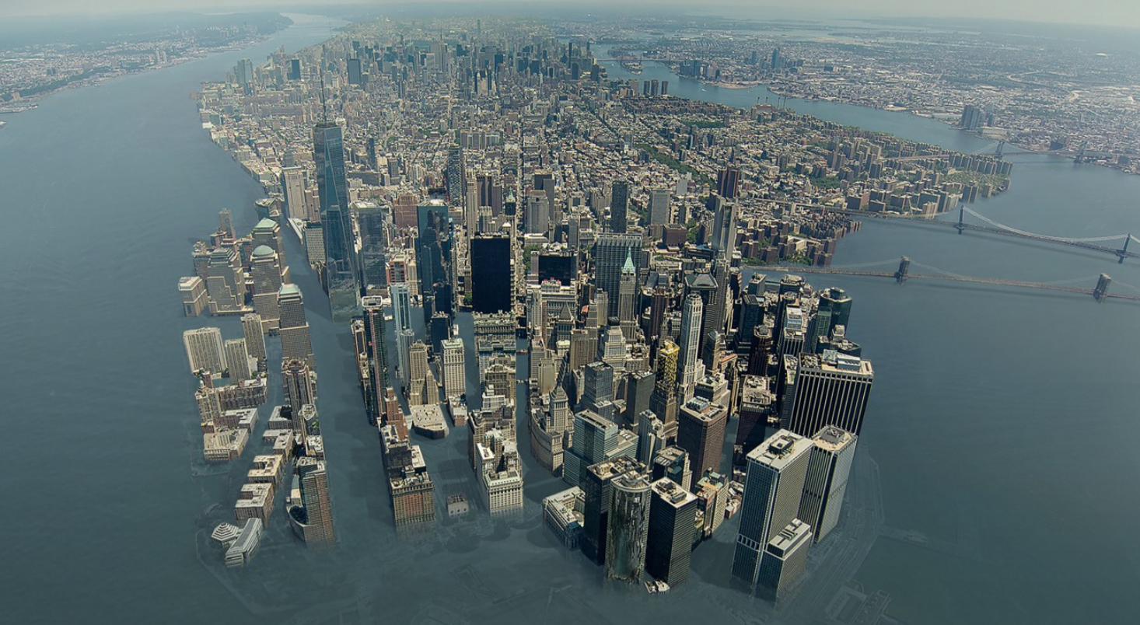
New York City Flood Risk and Climate
Notes:
The climate crisis is here now and is only going to get worse. Here’s a photo of what NYC could like in the future.
Close to 9 million people live in New York City and there are 20 million people in the greater NYC region.

Slide 9
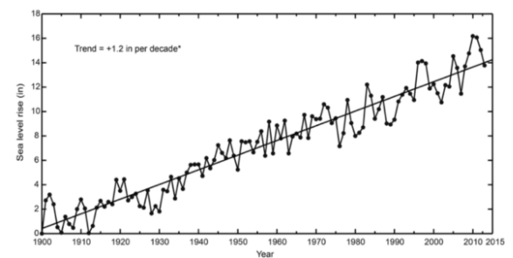
NYC Sea Level Rise Nearly Double the Global Trend Rate
Source: New York City Panel on Climate Change
Notes:
This graph form the NYC Panel on Climate Change shows that the Sea Level Rise in NYR has steadily increased since 1900 and is nearly double the global trend.

Slide 10
NYC a Leader in Climate Change
New York City (NYC) has had climate plans since the mid-2000s
Mayor’s office responsible for implementation
PLANYC2030, ONENY2050
October 7, 2021
The New York City (NYC) council voted to focus more on protecting the city
Mayor’s office and the entire city government to be held to a higher standard
Climate Adaptation Plan to be executed regardless of who is the Mayor
Requires evaluation of “climate hazards” including extreme weather
Requires identification of strategies to make the city more resilient

Slide 11
US Federal Government Agency Climate Action Plans
January 28, 2021
President Biden signs US Executive Order 14008
Whole-of-governmental approach to climate change
Major US federal government agencies required to develop climate adaptation and resilience plans – Example agencies:
Environmental Protection Agency US Army Corps of Engineers
Department of Transportation US Agency for International Development
Housing and Urban Development National Aeronautics and Space Administration
October 7, 2021
20+ major US Federal agencies release Climate Adaptation Plans
Has implications for cities

Slide 12
US Federal Government Agency Climate Action Plan examples
Department of Housing and Urban Development
Will assess the effectiveness of current building efficiency codes and recovery programs
Will strengthen floodplain management regulations
Department of Transportation
Identified climate change impacts including more frequent and severe flooding of underground tunnels and low-lying infrastructure
Will incorporate resilience into DOT grant and loan programs
Environmental Protection Agency
Will modernize its financial assistance programs to encourage climate-resilient investments

Slide 13
Disaster Risk Mitigation Measures
NASA will launch satellites to understand tropical cyclones and support NASA’s TROPICS program (Time-Resolved Observations of Precipitation structure and storm intensity with a Constellation of Smallsats)
NYC has new zoning rules to protect coastal areas from climate change
Buildings can elevate or relocate mechanical, electrical, and plumbing equipment to avobe the expected heights of floodwaters
Existing infrastructure being replaced with green and climate safe infrastructure
Doubling of curbside rain gardens
Economic recovery program to clean up NYC block by block (50,000+) and create 10,000 jobs

Slide 14
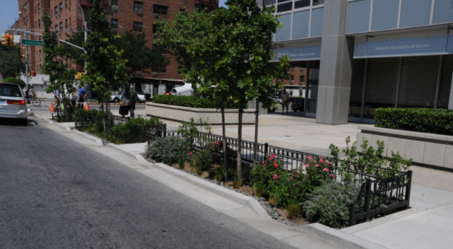
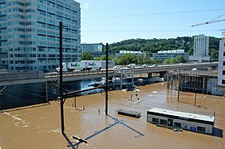
Summary
Climate change is here and is causing more frequent extreme weather events
Hurricane Ida’s extreme weather in 2021 caused extensive flooding and deaths
US infrastructure is not designed for current and future climate conditions
Biden Administration has a whole governmental approach to climate change
Federal agencies required to prepare Climate Action Plans affecting cities
Disaster mitigation strategies are being implemented in NYC and across the
Hydraulic engineering is particularly important to solve these flooding problems
Source: stormwater.wef.org, NYC builds curbside rain gardens
Source: Michael M Stokes, Flooding from TS Ida in Conshohocken PA

Slide 15
For more information on this presentation please contact me at april.j.lander@gmail.com or Tel. +64 (27) 584-3421
Thank you
April J. Lander, JP, MEM, EN V SP, AM ASCE
Independent Contractor, Christchurch, New Zealand
Notes:
Good afternoon. It is my pleasure to be here today.
Today I will discuss Hurricane Ida extreme weather and flooding in the United States and disaster risk mitigation measures.

