Slide 1
The University of Miami
American Society of Civil Engineers Student Chapter
Notes:
Use your own theme and layout (View-slide master or similar). Add photos, logos and graphics. Throughout this template file, text in italics should be replaced with more specific titles.

Slide 2
Contact Information
Mailing Address:
325 McArthur Engineer Building, CAE Department Attn: UM ASCE 1251 Memorial Drive Coral Gables, FL 33146
Email Addresses:
asce.studorg@miami.edu
umasce@gmail.com
umasce.com
UM ASCE Facebook
@UMASCE
Telephone: (305) 284-2477

Slide 3
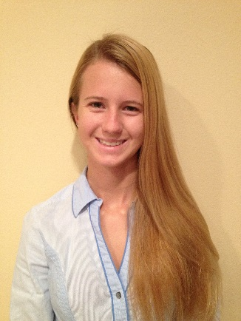
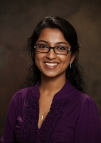
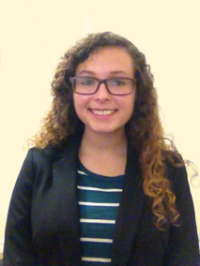
Current Student Officers
President Mackenzie Cerjan
Email m.cerjan@umiami.edu
Phone (970) 948-8751
Vice President Internal
Sathvika Ramaji
Email s.ramaji@umiami.edu
Phone (954) 558-1144
Vice President External
Maria Arguelles
Email m.arguelles@umiami.edu
Phone (954) 261-8936
Notes:
Photos! Officer names, email phone numbers

Slide 4
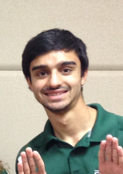
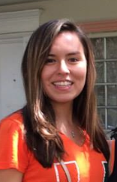
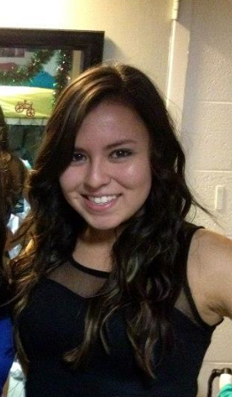
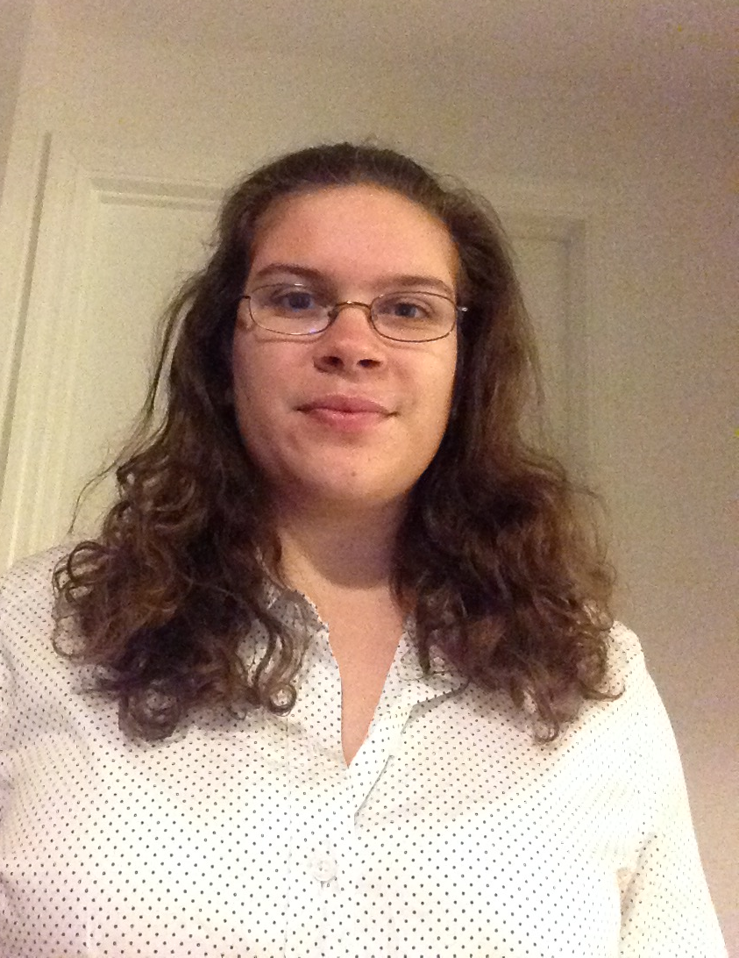
Current Student Officers
Treasurer Kunal Kapadia
Email k.kapadia1@umiami.edu
Phone (407) 575-5685
Secretary Crystal Leon
Email c.leon7@umiami.edu
Phone (631) 455-4768
Annual Report Chair
Aurora Ephraim
Email a.ephraim@umiami.edu
Phone (848) 218-2730

Slide 5
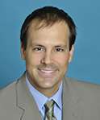
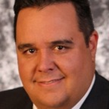
Advisors
Faculty Advisor
Dr. Matthew Trussoni
Email trussoni@Miami.edu
Phone (305) 284-3461
Practitioner Advisor
Jose Acosta
Email jacosta@chenmoore.com
Notes:
Photos! Faculty and Practitioner names, email, phone numbers

Slide 6
Financial Summary
Dues: $20 per year
As of December 31, 2013
Total income: $13,601.96
Total expenditures: $14,931.00
Cash balance: $730
Accounts receivable $24,083.51
Accounts payable $14,131.80

Slide 7
Goals and Objectives
UM-ASCE seeks to improve its strengths and amend its weaknesses through a continual close evaluation of the goals set by our officers for the 2014 calendar year. These goals stem from our desires to improve UM-ASCE’s internal structure, to generate greater interest and benefits for our members, and ultimately to represent ourselves successfully within different communities. The following six goals embody separate parts of each desire. We hope that the details presented in each goal will aid our current and future officers.
Community Outreach
Networking and Industry Connection
Recruitment and Retention of Membership
Conference Success
Internal Organization
Social Events and Awareness
Notes:
Three goals are suggested, add more if you wish

Slide 8
Goal 1: Community Outreach
To reach out to the community and involve our organization in service activities to give back to all generations
Our local branch involves the student chapters in many social events. We plan to support them in their yearly Mini Golf Event.
Excellent: We were able to attend the Miami Dade ASCE Mini Golf Event and promote ASCE as well as talk with contacts.
Engineers Week is a nationally recognized dedication to engineering. Through the College of Engineering, we plan to participate in a fun way that involves a civil engineering component.
Good: As an organization, we did the event of “Giant Jenga” a supersized version of the game Jenga. The civil engineering component was captured through the construction of the Jenga pieces; however, the publicity and turnout could have been greater.
In an effort to welcome the new students to the College of Engineering, we hope to display and advertise UM-ASCE through: the McArthur Mixer, an engineering fair for student organizations on campus.
Good: UM-ASCE was on display at the event and was able to generate a large list of people interested in getting involved. However, it was difficult after the fact to generate the same amount of interest for actual events.
Overall: Excellent

Slide 9
Goal 2: Networking and Industry Connection
To show CAE students the importance of networking and constant connection to industry in different settings.
To give students the opportunity to learn about the different fields within civil engineering, we plan on having at least one company presentation in the fall semester, and one in the spring semester.
Good: We were able to have one two presentations in the fall. Next year it would be more prudent to split them up.
For the growth and development of our chapter, we would like to highlight the importance of interaction with our local professional branch.
Excellent: Overall, we were able to attend a majority of the branch events, including their younger member group socials and monthly meetings. Unfortunately, some of the events coincided with our chapter events, limiting attendance at events.
As an organization, we network and strongly encourage everyone to participate in internships available in order to better understand what a career in engineering is.
Excellent: A majority of students held an internship with a company contact through ASCE which we hope to continue providing for members.
Overall: Excellent/Good
Notes:
Detailed description
Action plan
Assessment
Follow-up plan for the future

Slide 10
Goal 3: Recruitment and Retention
To retain our current members and increase the recruitment efforts of new members to remain sustainable and growing.
In an effort to keep UM-ASCE sustainable, we would like to retain 90% of our membership.
Good: A significant portion of members graduated, but those that did not, stayed remain involved.
The beginning of the school year is a great time to stress recruitment, especially of freshmen. By participating in the McArthur Mixer we hope to bring in new faces.
Good: With our presence strong at the events, we were able to reach out to new students and exchange students.
To make a personal effort in recruitment, we plan to visit the freshmen classes to personally invite them to our meetings and events.
Good: We were able to visit a couple classes in the spring and another few in the fall, the message was passed along. Looking forward, we hope to reach out to the professors and residential colleges to advertise our events.
With our office hidden by the structural and graduate labs, we found that many students have trouble finding it. We want to make our office more visible to more people.
Good: By posting signs around the College of Engineering and physically bringing people by, more students were able to find our office and began coming by more often.
Overall: Good
Notes:
Detailed description Action plan Assessment Follow-up plan for the future

Slide 11
Goal 4: Conference Success
To be successful at the 2014 Southeast Student Conference, through preparation and overall results.
Having had past success at conference, we would like to continue our efforts and place among the top 6 schools overall in the region.
Fair: We were able to place amongst the top ten teams with our hard work and dedication.
We continue to improve on our steel bridge design and construction every year.
Fair: We implemented a new method that allowed more hands on experience but did not place as well.
Every year our product for the canoe has been improved upon. We would like to focus on continued improvement as well as the other components to the competition.
Good: Due to weather, the canoe races were minimal, but the overall presentation was an improvement.
Conference is made up primarily of small competitions, which we intend to focus on in order to place in the top 10 overall.
Good: We were able to place first in Professional Paper and third in Mystery. We placed 9th overall.
Overall: Good
Notes:
Detailed description
Action plan
Assessment
Follow-up plan for the future

Slide 12
Goal 5: Internal Organization
To increase internal organization and develop a system of passing down information between executive boards
Communication between the old and new Eboard is also very important so that information can easily be passed down.
Excellent: We were able to have a dinner with the old and new Eboard and discuss all important and relevant information that needed to be passed down.
Our website is kept up-to-date with officer information, upcoming events, and conference and membership information.
Good: Overall maintenance of the website is up to date; however, information about upcoming events should be posted sooner and more frequently in the future.
In order to reach a pool of students who may not be on the listserv, we plan to update the Facebook page with different events and information.
Fair: Facebook was used to communicate different events to the members of the page. Unfortunately, this was not done for enough events or soon enough on the events that were created.
We must keep our office clean and functional for continued use in the future.
Good: Our office is a study place, a conference work space, a meeting area, and a place to hang out. Overall, it is kept clean and functional for all but could be cleaned more frequently by members.
Overall: Good
Notes:
Detailed description
Action plan
Assessment
Follow-up plan for the future

Slide 13
Goal 6: Social Events
To increase the amount of social events in an effort to bring students closer together on a non-academic level
On a given Friday, UM-ASCE is known to go to the T.G.I Fridays across the street from campus (Friday at Friday’s) and catch up with members and local alumni. We intend to continue this tradition semester to semester.
Excellent: This event was a huge success in the Spring with a turnout of around 20 people.
Vents designated Rat Tuesday also occurred as on-campus alternative to Fridays at Friday’s
Excellent: The events occurred in fall and spring at were wildly popular as a way to connect alumni and students socially.
A great way to blow off steam is to play sports. UM-ASCE plans to have intramural teams for different sports throughout the school year.
Good: A flag football team and a soccer team were both created during fall semester. We were able to reach the quarterfinals for flag football and the semifinals for soccer.
Overall: Excellent
Notes:
Detailed description
Action plan
Assessment
Follow-up plan for the future

Slide 14
Membership Statistics
65 members
47 ASCE National Society-level members
72% of members are Society-level members (Society-level/total members)
34 members with Junior and Senior status
89 Juniors and Seniors eligible to join ASCE (CE declared majors)
38% of eligible Juniors and Seniors that are members (Jr&Sr members / Jr&Sr eligible)
Notes:
Fill in numbers (from Statistical Data tab in excel sheet) where words are underlined.

Slide 15
Membership Statistics

Slide 16
Meeting Statistics
3professional meetings with an invited speaker
0 student talks and papers
0professional licensure and ethics topics presented
0field trips
4social functions
Notes:
Fill in numbers (from Statistical Data tab in excel sheet) where words are underlined.

Slide 17
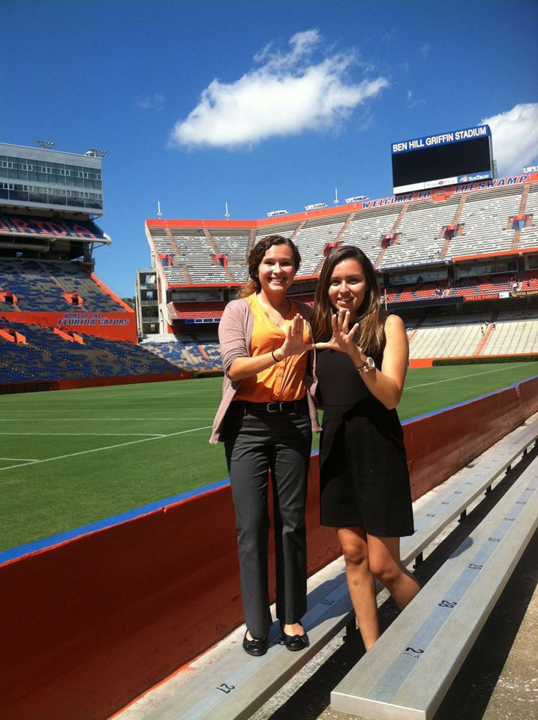
FL Section Meeting - Gainseville
The Quarterly ASCE-FL Section Meeting is a great opportunity to meet other engineering students from across the state as well as network with professionals in the industry. Attending students included Maria Arguelles and Crystal Leon. Business was conducted and groups were updated with the going-on’s of fellow groups. The implementation of the plan for student chapters to not break off provided everyone with the opportunity to converse and see the progress of other level groups.
Previously, the student meetings were more of an idealistic summary of chapter accomplishments rather than a forum for student chapter assessment or improvement. With the break-outs being dropped it can be seen that the professionals are understanding what the students are handling while the students really get an idea of what ASCE is like after graduation.
The UM-ASCE chapter needs to send more representatives to this event in the future and take advantage of the ability to obtain sponsorship and further promote the organization as only two students were able to attend.

Slide 18
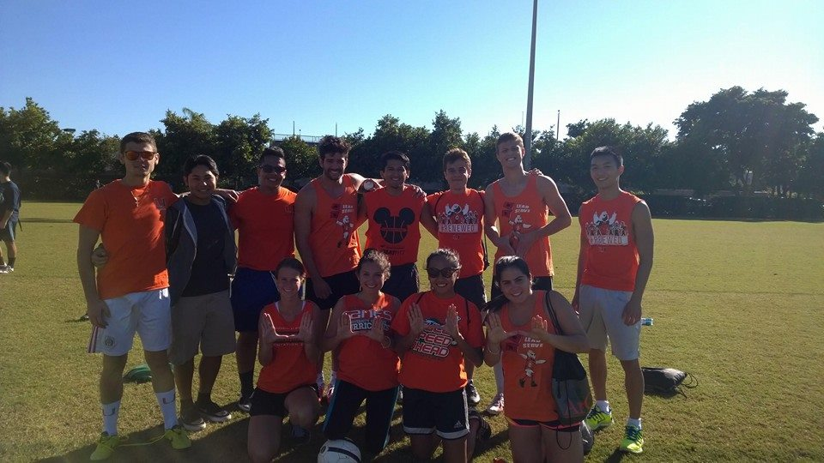
Intramurals
As a team bonding and morale activity, we brought together several students to play Intramural Flag Football and Soccer. Throughout a majority of the semester we played two matches per sport. We were able to reach the quarterfinals for flag football and the semifinals for soccer. With a relatively small team in comparison to those we competed against, we were a standout team and received the praise of many officials.
The events were a great success. We were able to recruit international students that recently joined our chapter and provide them with an activity that they really enjoy. It also promoted the physical fitness of our chapter and relieved the stress of the semester
Our relationships with current members allowed up to reach out to more people to play but we need to reach out to our younger members. This will allow everyone to play less frequently as to not tire everyone out but still allow for team bonding and enjoyment of the game.

Slide 19
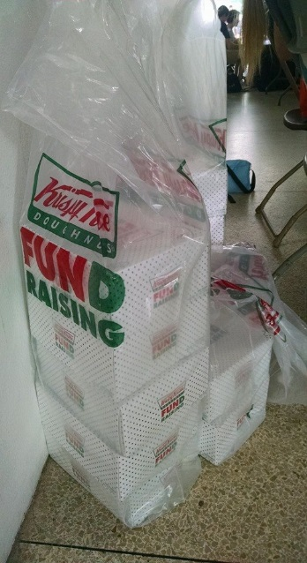
Krispy Kreme Fundraiser
A Krispy Kreme Fundraiser was performed in the Fall Semester to raise funds for the 2015 Southeastern Student Conference. By coordinating with Krispy Kreme, we were able to sell discounted donuts for $1 each and whole boxes for $10. We publicized the event on all our social media accounts as well as our College of Engineering newsletter. Along with reaching out to our friends, we brought were able to sell every box of donuts.
The fundraiser was considered a great success and all boxes of donuts were sold. We also had many flyers concerning our upcoming meetings and contact information. Even faculty and staff from our college passed by and picked up a donut to support the chapter.
The fundraiser could be more successful if we could sell in more locations that just the University Breezeway. For example, an open location like the green space in front of our college of engineering would allow for people from the School of Arts and Sciences and general education rooms find us as well.

Slide 20
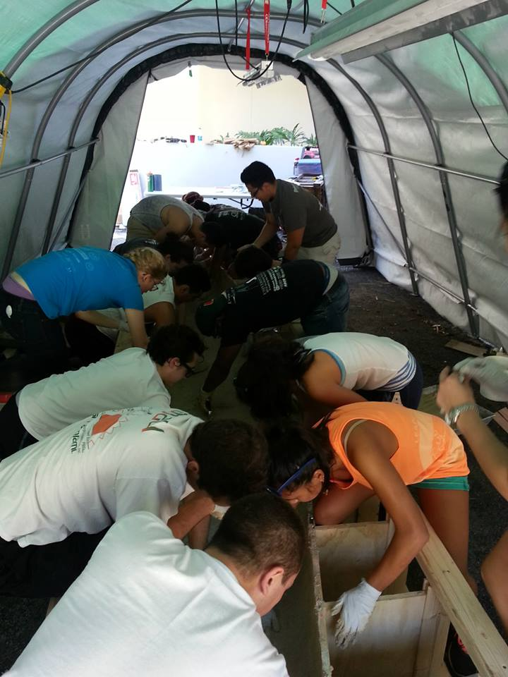
Canoe Pour Day
After weeks of putting the mold together and finalizing the concrete design, a large group organized at the “ASCE Tent” to layout the concrete on the mold. With the direction of our captains, we changed the depth throughout the layout in order adhere to the design. We established several teams to work on the different aspects, including mixing concrete, pouring on the mold, checking the work and cleaning the containers. Once the pour was complete, we were able to cover the mold and let it cure.
The activity was considered a success. With a relatively large turnout, we were able to measure, mix, and pour the concrete in just a few hours. With the guidance of a local professional, we were able to make the process more efficient.
Organizational problems occurred as we tried to get together the necessary materials. Our organization is dependent on another person to open our storage facility. By acquiring a copy of the key, through our facilities department, we would be able to access it as we please.

Slide 21
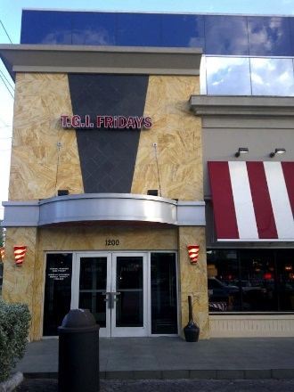
Friday’s at Fridays
A group of the University of Miami American Society of Civil Engineers’ chapter met at the T.G.I.Friday’s near campus to share time outside of school in a more amiable and relaxing environment. New and younger members of the group were able to meet new people as we hope to make the experience of joining the organization more pleasant and enjoyable. By providing fun activities like this, we strive to promote friendship among members and thus create a great atmosphere for new members commitment and strengthening old members commitment.
Overall it was a great event for the organization to take a part of. The older and younger members of the group got to meet each other and find that they share many of the same interests. The older members got to share their experience and pass on suggestions to the younger members, including typical things such as teacher suggestion, passing on used textbooks, and sharing in the pain of some classes.
The logistics and execution of the event followed through flawlessly. The only other possible suggestion would be for a higher percentage of the organization to participate. By moving the time from 5pm to 7pm we may be able to have more alumni participate.

Slide 22
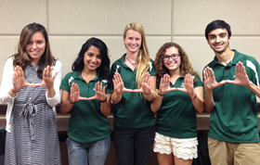
New Officer Elections
The University of Miami Chapter changes officer positions ever school year with elections typically taking place after conference. This year the elections were held in conjunction with the wrap-up conference presentation “PowerPoint of Shame” presented by the Internal Vice President. The PowerPoint consists of a collection of the members’ favorite pictures and reflections of how all the competitions went. After the presentation and pizza, final nominations were accepted for officer positions (President, Vice President External, Vice President Internal, Treasurer, and Secretary) and the speeches, questions and voting commenced, abiding by Robert’s Rules. Those who were not elected had the option to run for the remaining open positions as well. The elections concluded the final spring meeting and started the transition into the next year.
The meeting was very involved; members had the opportunity to ask each candidate questions they felt were most important for the position and discuss the candidates amongst themselves. Additionally the conference PowerPoint is always a favorite for the chapter.
The meeting was well timed between conference and finals so that it was not stressful on the students and they got to relive their memories from USF and competing. Everyone was actively engaged and the elections ran smoothly. This same format can be used for future elections.

Slide 23
CAE Round Table
Every semester the College of Engineering provides students with the opportunity to voice their complements and concerns to their department chairs. This ensures that the students are getting the best possible experience during their education. The student organizations in turn are responsible for organizing the date, time, and agenda for the meeting that best meets the student body’s availability. Topics can range anywhere from internal problems with courses to accessibility of 11x17 printing paper. Each issue is discussed amongst the attendees to either determine the best solution or find a way to incorporate desired course aspects into broader ranges of the department. This is also the time that students are informed about what updates are happening in the Department and the student organization leaders can alert the department chair of their events and progress as well.
The time slot reserved was adequate for the agenda, no major issues were found. There was good student engagement and the department chair was very receptive to the students’ opinions. Any recommendations were brought to the faculty meeting.
Perhaps a week earlier in the year would have better suited the students as it would not have been as close to finals. Given that there were conflicts with student and department chair schedules, the best accommodation was made. Include more advertising to the entire College of Engineering.

Slide 24
ASCE Florida Section and Board of Directors Meeting
Four ASCE representatives attended and presented at the summer Florida Board of Directors meeting. They shared with other students and the board about the typical events the chapter puts on throughout the year, including professional seminars, company presentations, alumni and social networking events, and E-Week awareness events. The Miami-Dade Branch also gave a presentation on some of their projects and successes. Additionally, students heard a speech from the incoming president and took part in welcoming the new board members. Outside of the meeting, students had the opportunity to meet with company representative, learn about innovative new projects, and discuss tools for running an effective chapter with ASCE alumni and students from other chapters.
The Florida Section Meetings and ASCE Board of Directors Meetings are always useful to meet new ASCE members and learn about ongoing professional opportunities. It is important to keep a link between the student chapters and the national society so that members can continue to participate in ASCE after graduation.
All participants seemed to enjoy their time at the section meeting. In particular, the opportunity to meet with the companies showcased outside of the event was a valuable feature. ASCE should continue to provide this opportunity as well as the broad range of topics covered for the breakout sessions.

Slide 25
Chen Moore Presentation
Two representatives from Chen Moore and Associates visited the University of Miami and gave a presentation to the ASCE chapter on their day to day activities at the firm. After the introductory presentation, students were able to have an open dialogue with the visiting engineers and ask them about everything from how to obtain internships to the challenges that they face on a daily basis.
I enjoyed attending the meeting and listening to what the practicing engineers had to say. It was very informative to see what challenges lie ahead and the opportunity to network with professionals and potential employers was very valuable.
Being able to interact with professionals and learn about what happens in professional practice is just as important as what is taught in the classroom. Having more of these presentations will allow ASCE members to be successful both academically and professionally.

Slide 26
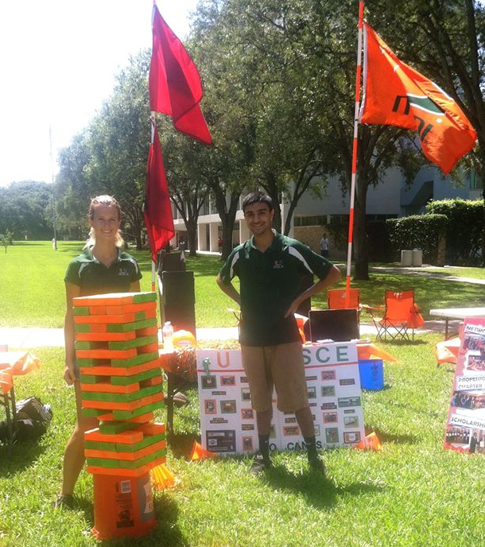
Fall Engineering Expo
We set up different displays that represent UM ASCE. We had giant jenga, posters, and spirit gear. We invited any interested students over and gave them a summary of what our organization is about and what we do. We talked about SESC and upcoming events and meetings. We also advertised our upcoming meeting the following week. There were give away items as well which helped advertise our organization even more.
The activity went well. There was a good turn out. There was a large rain delay, which deterred a lot of students from coming. The weather also limited our ability to display our concrete canoe.
Check the weather before going in to make sure there are clear skies and have a back up location ready incase there is weather problems.

Slide 27
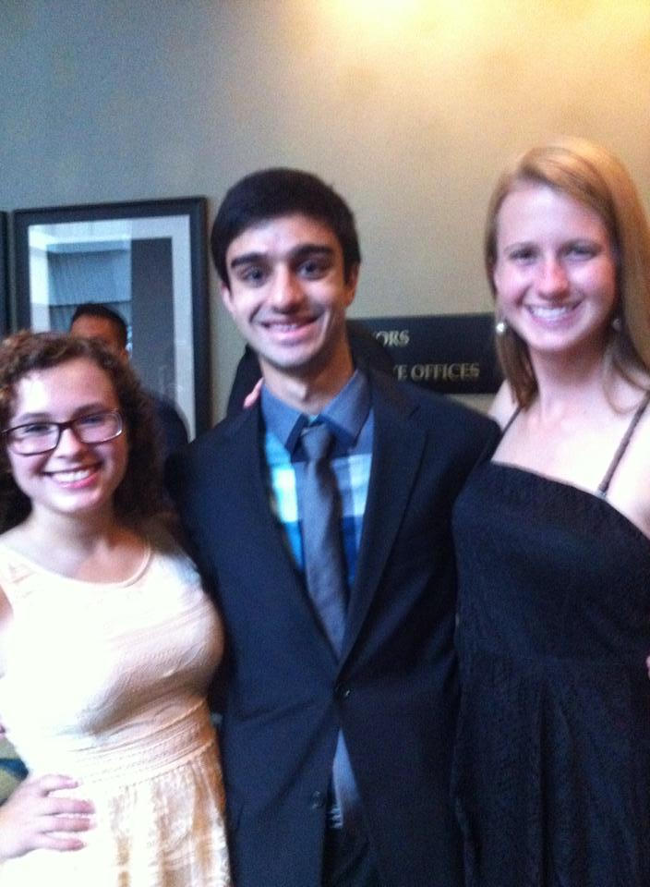
How to Get a Job Presentation
Two members of Miami Branch of ASCE, both of whom were alumni, came and gave a presentation on the basics of getting a job. This included resume writing, interview skills, what to look for in a job, and many other topics. There was a large interest from those who attended and all information presented was up to date and helpful.
The event went well. There was a good turnout for the meeting. There were practice interviews and the two presenters were able to go through individuals’ resumes.
There needs to be more advertising for meetings. The turnout was big, but based on how well the presentation went, there could have been more benefits for more people. 23 students and 3 faculty attended.

Slide 28
Kimley-Horn Presentation
Kimley-Horn and Associates is a key supporter of the University of Miami ASCE student chapter, providing financial support, job opportunities to members, and support with various conference events. Kimley-Horn visited an ASCE student chapter meeting to present about their role in the local Civil Engineering industry, present some highlights of their recent projects, and discuss life as an employee or prospective employee. They provided advice and guidance on crafting a resume and the job search process, and were a great contribution to the student chapter’s professional programming. The presenters, Angelo and Daniel, also encouraged student members to become involved with the local professional chapter of ASCE, and were great additions to our student chapter’s community.
The event was generally successful and had average meeting attendance. Due to the scheduling of evening classes and other matters not all student chapter members were able to attend. Despite this, there was a good group present to meet and interact with Angelo and Daniel, and the meeting was a mutually rewarding experience.
Increased promotion of the meeting as one with a professional presenter would have been appreciated. Doing so may have provided greater motivation for students to take or make time to participate, and made for a larger group and better group dynamic for the meeting.

Slide 29
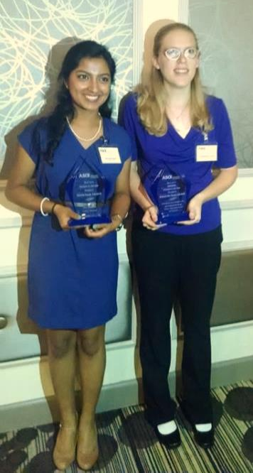
Miami-Dade Branch Annual Banquet
Nominees for the Miami Dade Branch awards, as well as volunteers and faculty members, attended the Miami Dade Branch Annual Banquet. During this event, we networked with industry professionals, accepted awards, and witnessed the installation of the new board for the year. Both the graduate student of the year and student of the year were members of the University of Miami ASCE. Students also volunteered to assist in the sign in process, thereby meeting many professionals. The food was great and the company even better. There was also a brief discussion of other events that the Miami Dade branch would be holding and reports on charitable activities such as the mini golf.
It was a great way to network with potential employers as well as young alumni and faculty. One could learn many things from their experience as recent graduates. It was also a great way to learn how to get and stay involved after graduation and to see the benefits the longtime membership in ASCE.
In the future, the students and faculty should all definitely register well in advance as there is always a shortage of seats during the dinner. This may also be an issue with the Branch in general as there are probably many last minute attendees.

Slide 30
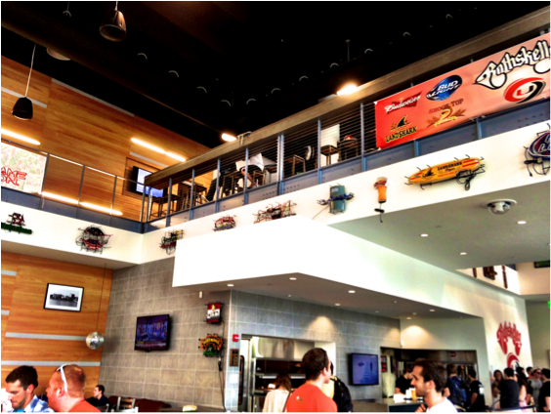
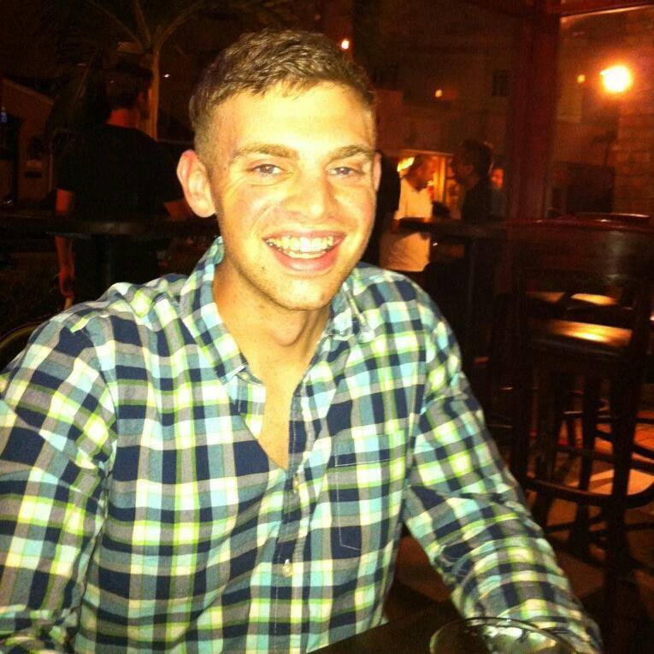
Rat Tuesdays
Rat Tuesday is an important social event for ASCE members as it is an opportunity to network, socialize and have an enjoyable evening with other ASCE members, students and alumni. This gives students the opportunity to meet personally with other people and cultivate new relationships.
Attendance was great and we received positive responses from all members and alumni. Reserving the top floor so that we would be able to play games was definitely a great idea as it allowed for a private area for the event as well as entertainment.
For the future, obtaining a sponsor for the event for at least snacks would be a bigger draw for younger students possibly. This event should be held at least twice a semester.

Slide 31
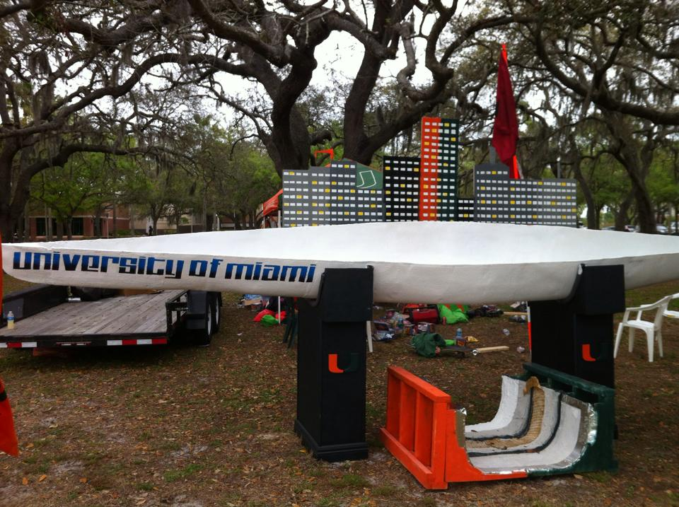
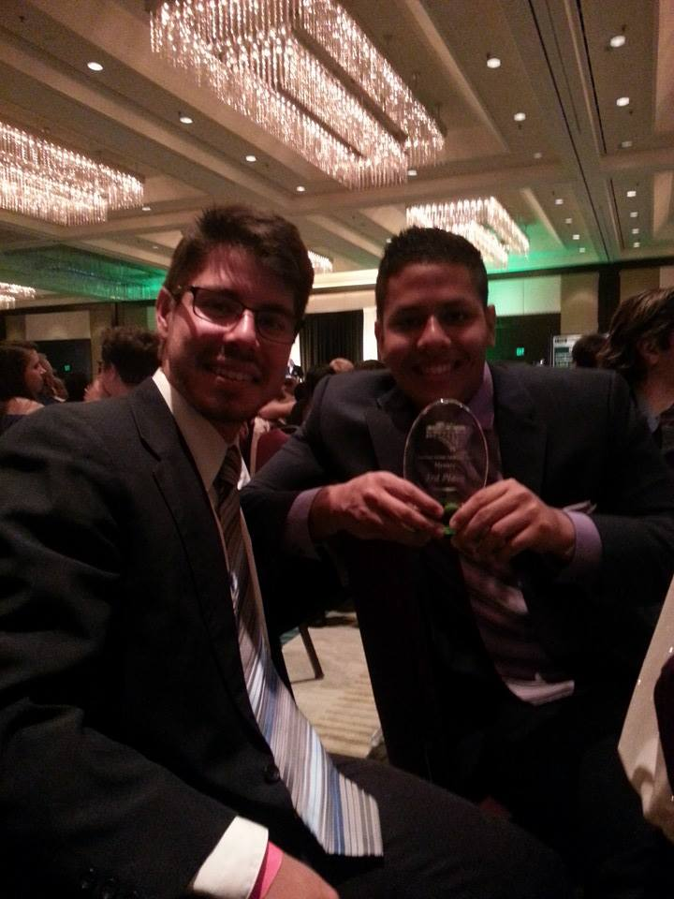
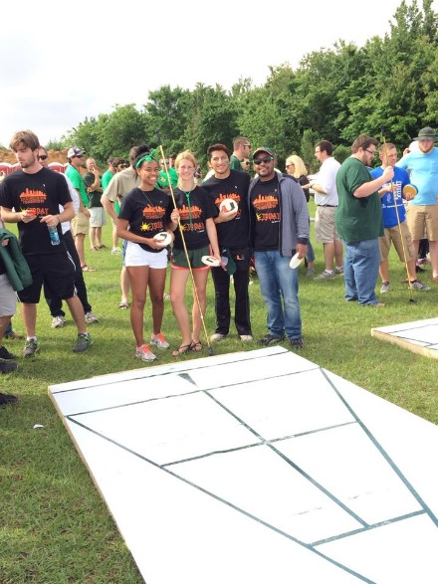
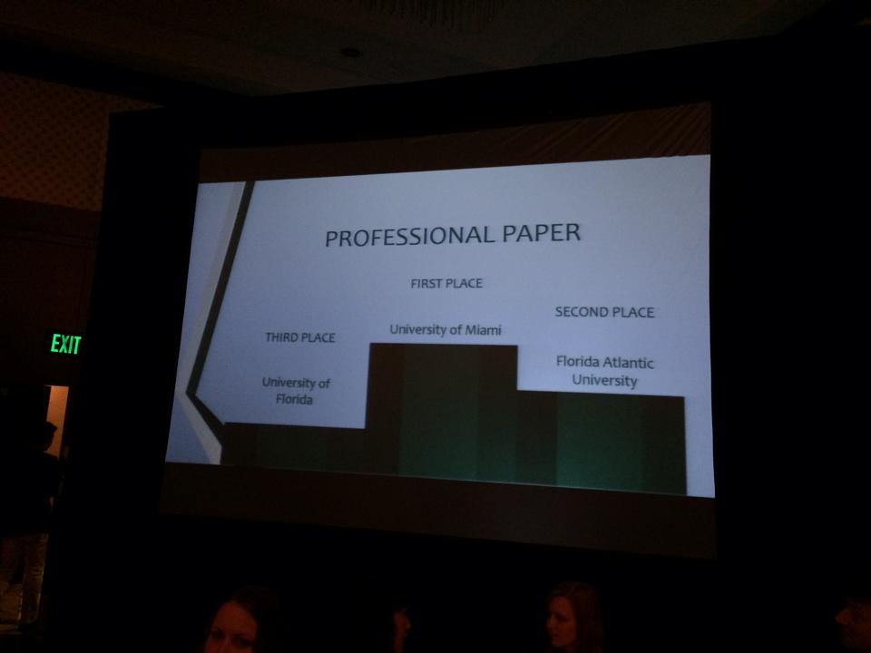
2014 ASCE Southeast Student Conference at the University of South Florida Tampa, Florida
March 27, 2014 to March 30, 2014
35 students attended
Highlights of results
1st Place in Professional paper!
3rd Place Mystery Competition!
9th Place overall!
Notes:
Add slides as necessary to highlight results Title of student conference Location Dates Number students attended
Highlights of results (additional slides)Concrete canoe Steel bridge And more…

Slide 32
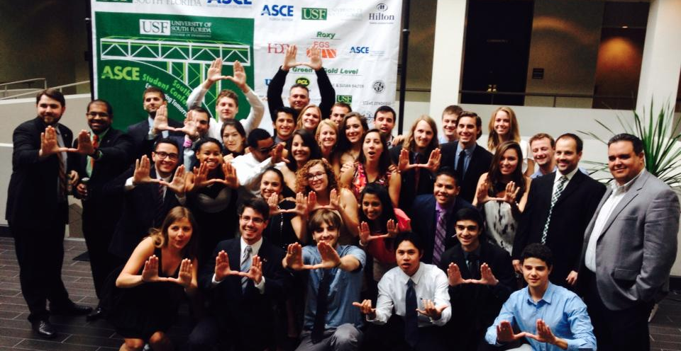
SESC at USF
Students from UM ASCE traveled to the University of Tampa in Tampa, Florida to attend the Southeast Student Conference. Students competed in 14 different civil engineering related events against 24 universities in the Southeast Region. Events were judged on site based on previously released rules and guidelines that include skill, strategy, and aesthetics. Awards are granted for each event and UM ASCE achieved first place in Professional Paper and 3rd place in the Mystery Competition. Additionally, UM ASCE received ninth place overall.
The Southeast Student Conference has continually been a successful activity for UM ASCE and this year was no different. Younger members were able to get hands on experience in civil, architectural, and environmental engineering. Attendees also gained valuable networking experience with professionals and other student members. All of those who attended had a great time and made lasting memories.
Each year UM ASCE continues to strive to bring more students to conference and the numbers have slowly been climbing. As UM ASCE will be the 2015 SESC in Chattanooga, TN upcoming and we intend to increase the number of participants greatly. Focusing on the future more internally, we will be implementing a new task for the Conference Competition Chair position to act as a different set of eyes to double check the rules for the competition prior to leaving, this should help ensure little mistakes are not made. With this in place, we may see a rise in our ranking!

Slide 33
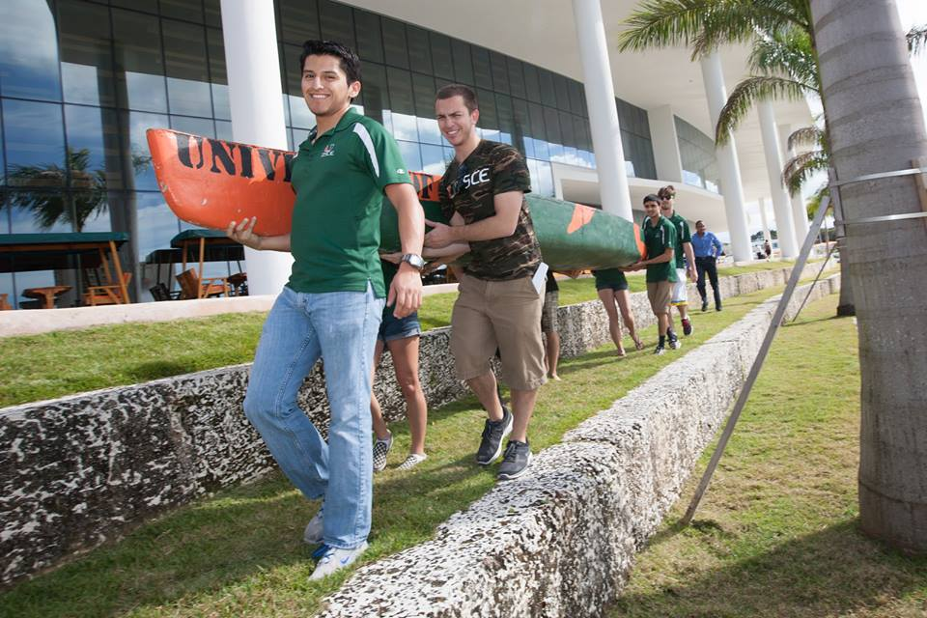
National Engineers Week-High School Outreach and Canoe on Lake Osceola
Twelve ASCE Member and 23 local high school students came together for a day to learn about civil engineering.
In order to promote civil engineering throughout the University and to the visiting high school students, we brought out two of our previous concrete canoes for everyone to race. With the supervision of previous competitors, the students were able to row the canoe around our landmark lake, Lake Osceola. Throughout the day, we also explained how something made out of concrete can float and be made light enough to race. We also covered the different aspects of civil, architectural and environmental engineering; how the program has developed and prepared us for our careers, and how ASCE has enhanced our educational and professional development.

Slide 34
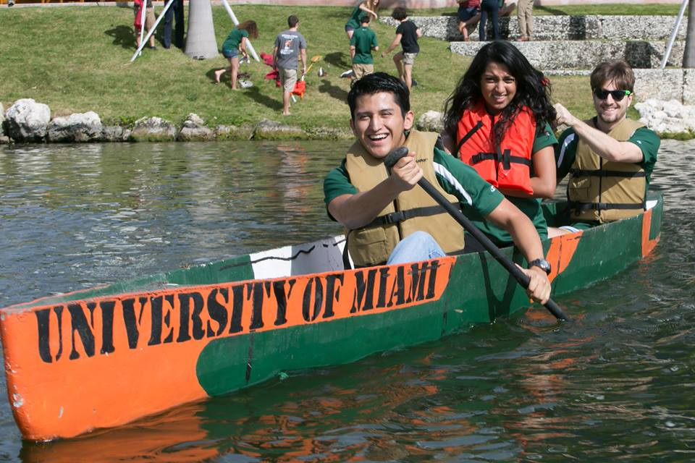
National Engineers Week-High School Outreach and Canoe on Lake Osceola
The activity was a success and drew one of the larger crowds during Engineering Week. Our ASCE chapter was also exhibited in the top of our University newsletter. The following picture was also featured in the University’s graduation ceremony.
Towards the future, we are working with the Engineering Advisory Board to help provide a “docking station” so that the participants can safely and easily enter the canoe and be pushed into the lake. Also, although we stationed our Miami flags, we should acquire “UM ASCE” flags so that people interested can spot us easily.

Slide 35
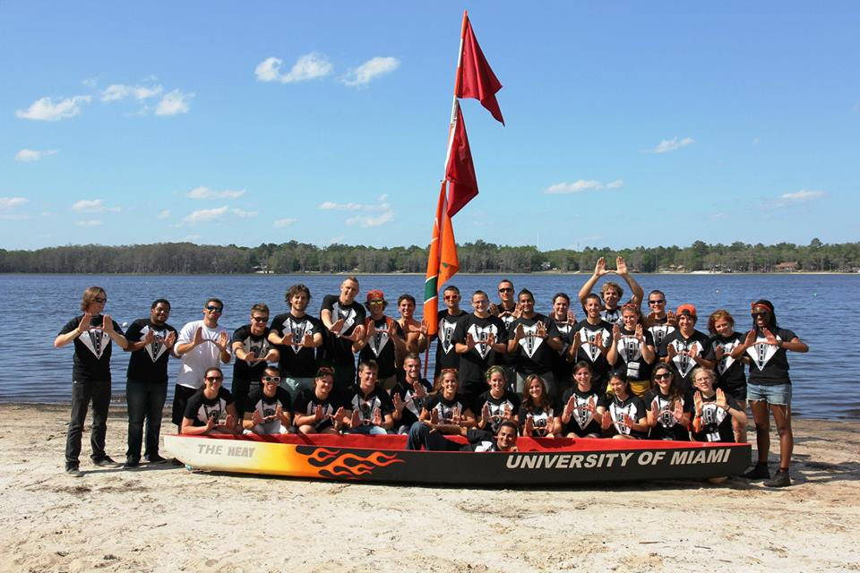
National Engineers Week-High School Outreach and Canoe on Lake Osceola
Overall, this project exemplified the goals of community outreach as well as social events. ASCE Members had a lot of fun reminiscing about past conference experiences as well as racing canoes.
The high school students learned about a new career path and the tools necessary to get there.
This project allowed ASCE members to share knowledge of engineering skills as teachers.
This project also gave ASCE a spot
light in the engineering community as an advertising opportunity

Slide 36
In a nut shell…
The most significant events of this year were SESC, National E-Week and the Board of Directors Meeting.
The most significant challenges were getting people to meetings and events. CAE majors involve rigorous academics and therefore ASCE events understandably take a backseat.
Any Questions?
Notes:
We would prefer that you limit to 60 slides or less, but if you have more that’s ok. When actually presenting to other groups, reorder the slides (instead of deleting, move extras to the end so you have them if questions come up) to only present a reasonable amount in the time you are given.

