Slide 1
The Florida Institute of Technology
American Society of Civil Engineers Student Chapter
Notes:
Use your own theme and layout (View-slide master or similar). Add photos, logos and graphics. Throughout this template file, text in italics should be replaced with more specific titles.

Slide 2
Contact Information
Mailing Address:
Civil Engineering
Florida Institute of Technology
150 W. University Blvd
Melbourne, Florida 32901
Email Contacts:
Joseph Hereau (President): jhereau2011@my.fit.edu
Nicholas Miller (Secretary): nmiller2012@my.fit.edu
Dr. Nakin Suksawang (Advisor): nsuksawang@fit.edu
Facebook:
https://www.facebook.com/FloridaTechASCE

Slide 3
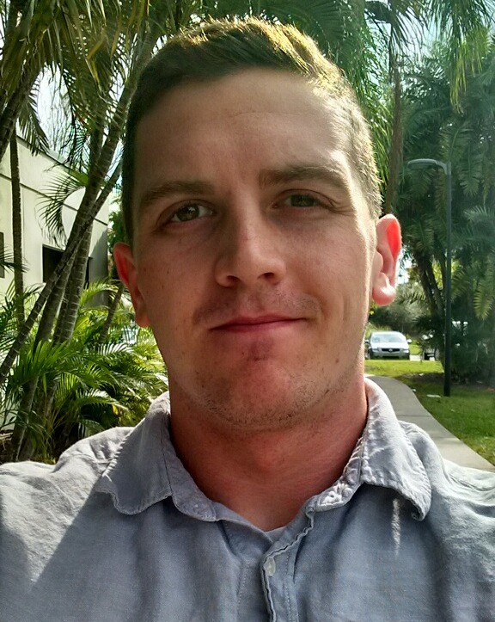
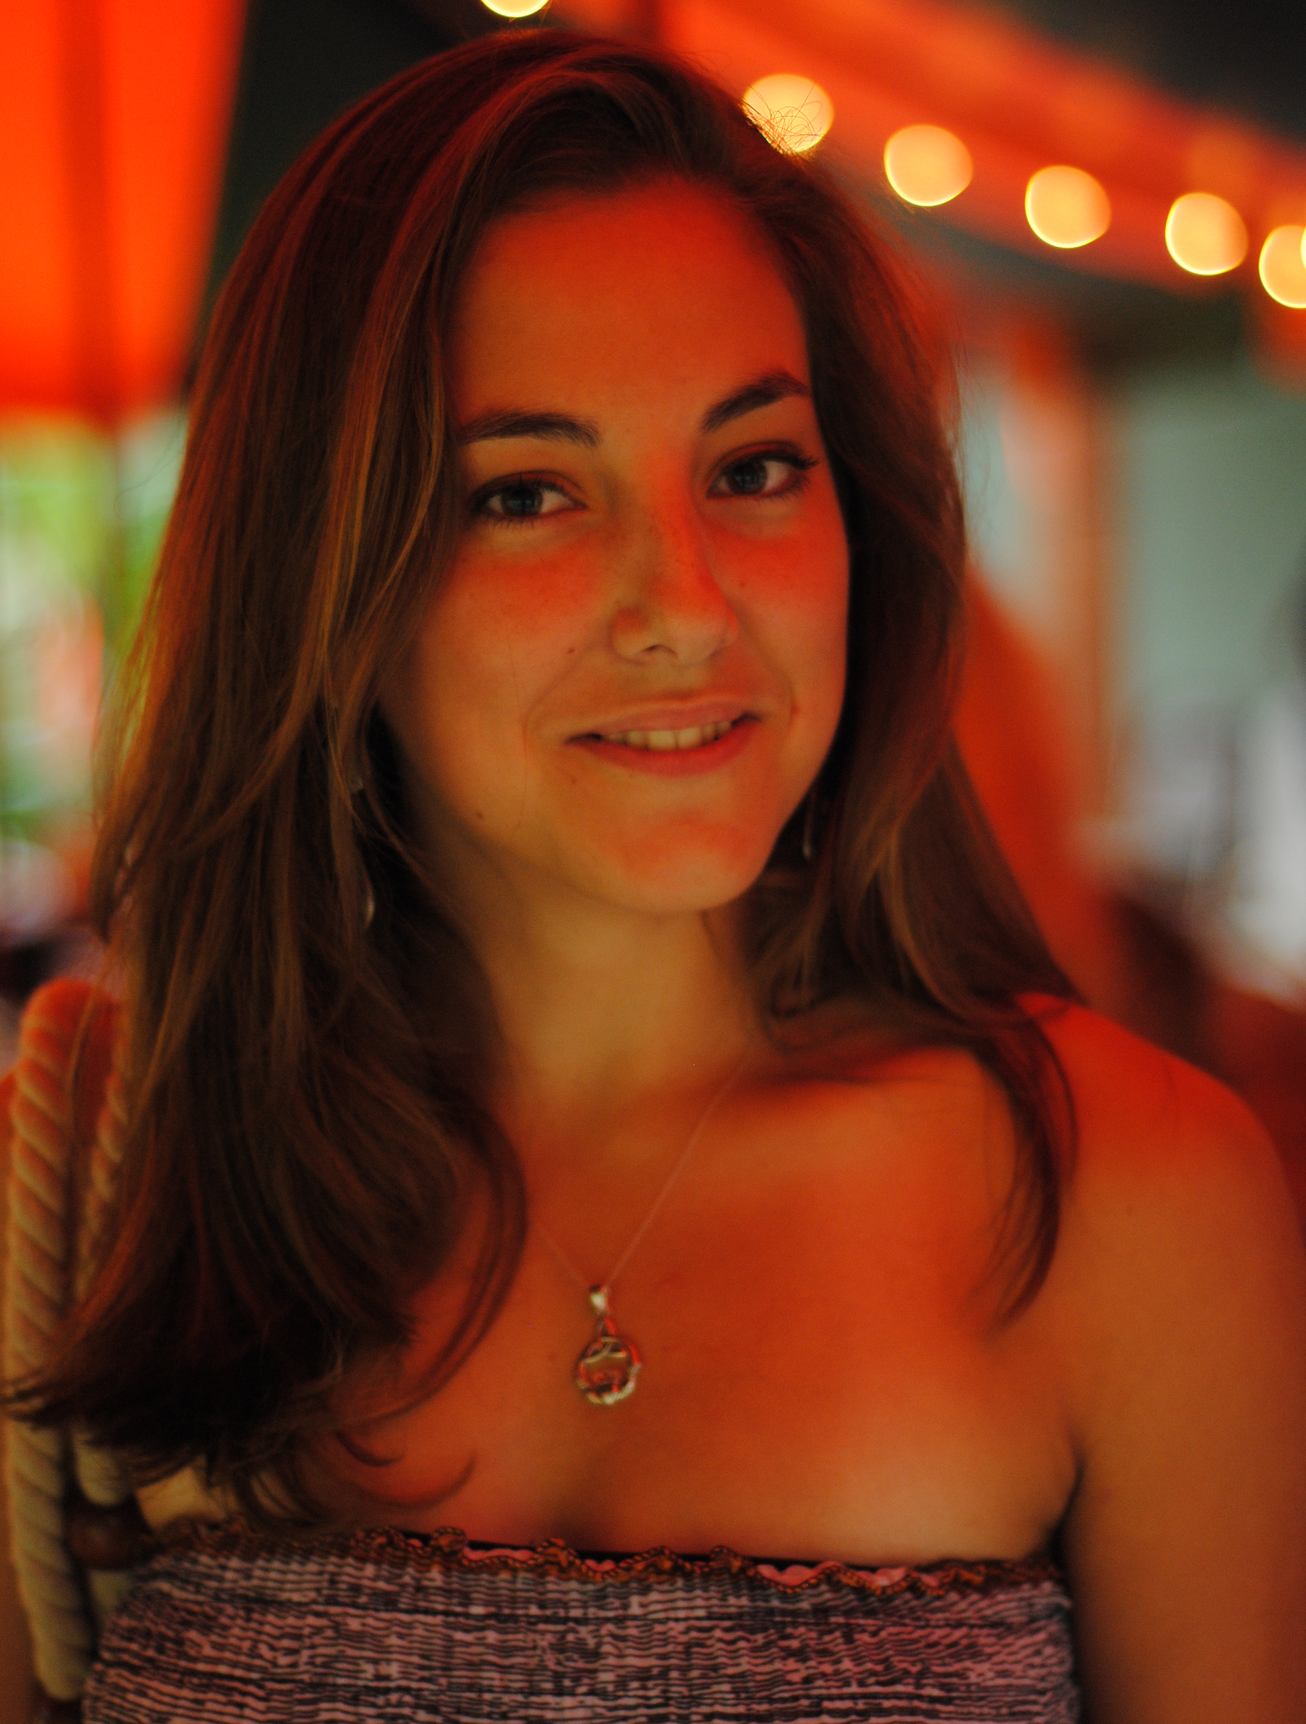
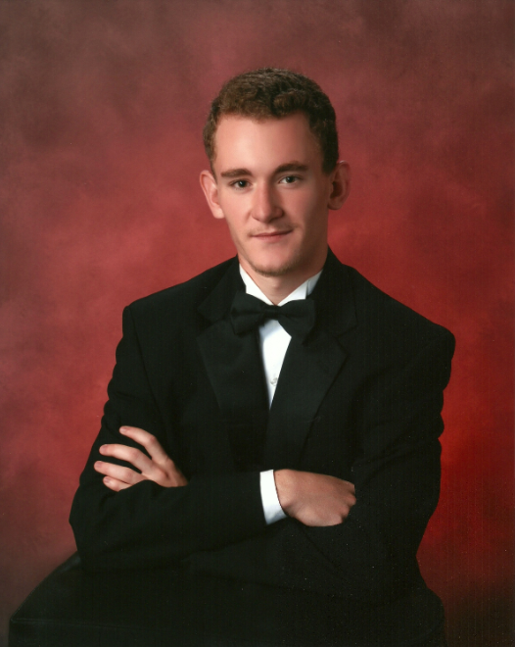
Student Officers
President:
Joseph Hereau jhereau2011@my.fit.edu
Vice President & Canoe Co-Captain:
Alexis Miller alexis2011@my.fit.edu
Secretary:
Nicholas Miller nmiller2012@my.fit.edu
Not Pictured
Notes:
Photos!

Slide 4
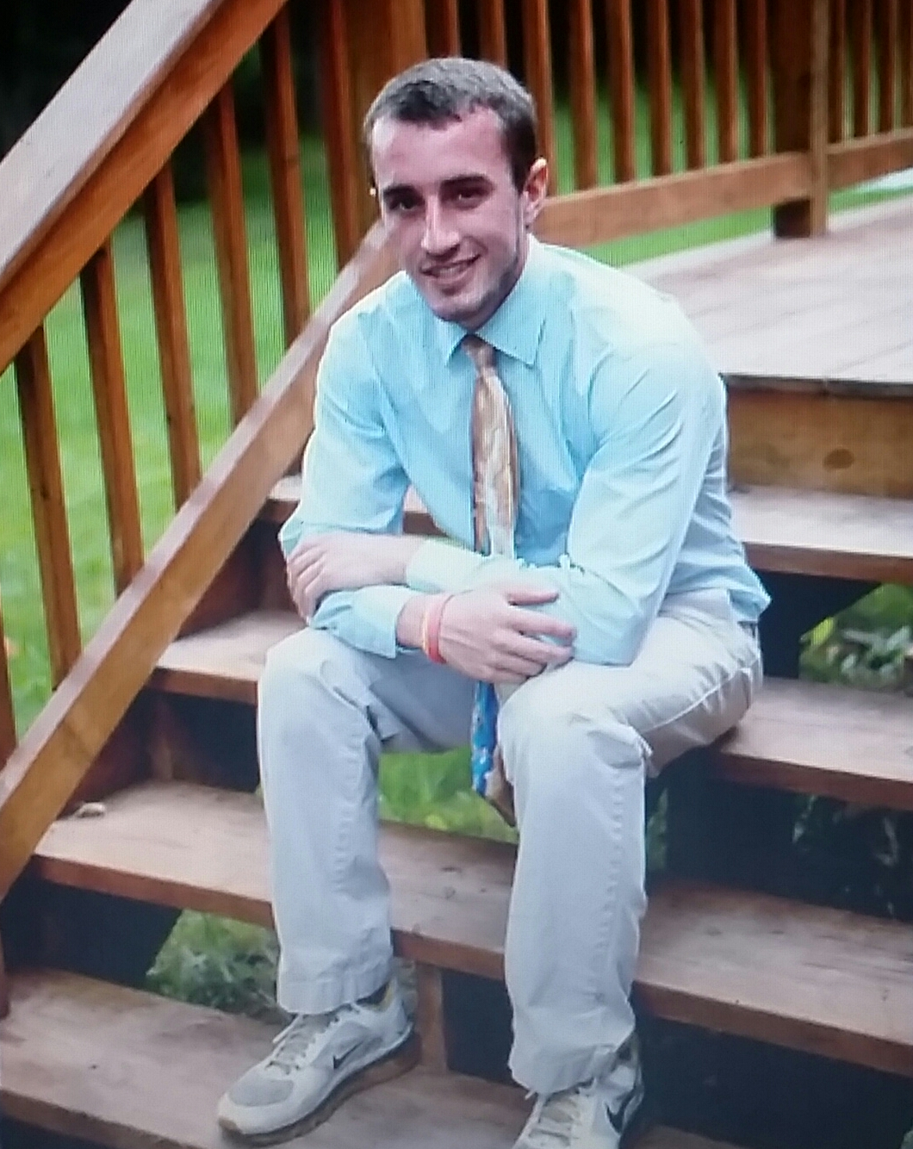
Student Officers
Treasurer:
Spencer Hinkley shinkley2013@my.fit.edu
Historian & Bridge Co-Captain:
Spenser Puffenbarger spuffenbarge2012@my.fit.edu
Regionals Coordinator:
Elijah Ginsburg eginsburg2013@my.fit.edu
Not Pictured
Not Pictured
Notes:
Photos!

Slide 5
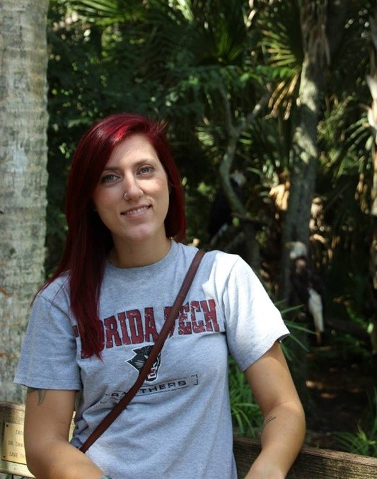
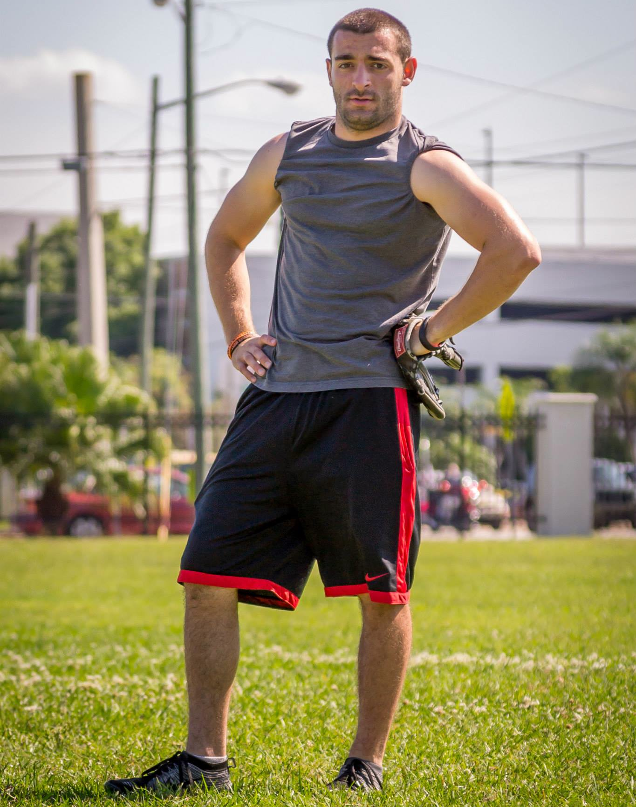
Student Officers
Social Coordinator & Bridge Co-Captain
Ashley Akins aakins2011@my.fit.edu
Social Coordinator
Joshua Michalski jmichalski2010@my.fit.edu
Canoe Co-Captain:
Peter Zappala pzappala2011@my.fit.edu
Notes:
Photos!

Slide 6
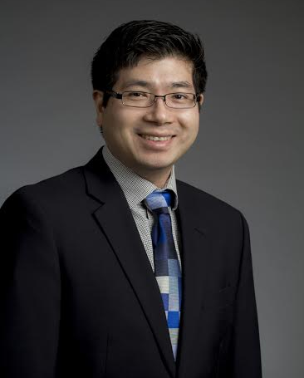
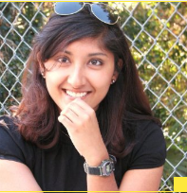
Advisors
Faculty Advisors:
Dr. Nakin Suksawang
321-674-7504
nsuksawang@fit.edu
Practitioner Advisors:
Pryanka Prakash
321-254-7666
pprakash@brph.com
Not Pictured
Notes:
Photos!

Slide 7
Financial Summary
Dues: ($5/semester)
Fiscal Year, 2014
Total income: $12,874.87
Total expenditures: $9,952.47
Cash balance: $2,922.40
Accounts receivable: $0
Accounts payable: $0

Slide 8
Goals and Objectives
This year, the Florida Tech ASCE Chapter is looking to increase awareness of the chapter and its members.
Goal 1: Increase student chapter enrollment by 5% over last year’s total student enrollment within the chapter
Goal 2: Co-host at least 2 events with similar FIT organizations
Goal 3: Accumulate at least 50 man-hours of chapter community service
Notes:
Three goals are suggested, add more if you wish

Slide 9
Increase Student Chapter Enrollment by 5% Over Last Year’s Total Student Enrollment Within the Chapter
Action plan:
Announce first general meeting campus-wide.
Keep members (current and potential) informed by holding general meetings monthly.
Give members (current and potential) weekly opportunities to be active and have fun by holding weekly team meetings/events.
Assessment:
Unknown. It is difficult to compare our current enrollment with last year’s because this year, it was decided that attendance would not be mandatory to be a part of the organization. While it seems like enrollment increased, a numerical comparison would not be valid because no statistics are available on the number of inactive members last year.
Follow-up plan for the future:
Request feedback from new members at the end of the spring semester with regards to what held their interest in the chapter.
This feedback will be used next year to continue increasing student enrollment.
Make attendance mandatory again next year and keep it that way!

Slide 10
Co-Host At Least 2 Events with Similar FIT Organizations
Action plan:
Meet with officers of Chi Epsilon, ABC, and Tau Beta Pi to discuss potential events.
Schedule at least 2 multi-organizational events, whether led by ASCE or another organization.
Push for student members to attend the event(s) and actively participate.
Assessment:
Fair. Chapter officers were able arrange two joint projects with ABC and were able to get Chi Epsilon involved with many aspects of the projects as well. Plans to coordinate with Tau Beta Pi are in place, but no joint operations have currently been established. More cooperative operations would have been better.
Follow-up plan for the future:
When elections take place for next year’s ASCE officers, have their first task to be to meet with those other organizations to begin discussing potential events in advance.

Slide 11
Accumulate At Least 50 Man-Hours of Chapter Community Service
Action plan:
Meet among ASCE Officers to discuss potential opportunities.
Discuss Officer thoughts with chapter members to gauge interest.
If interest is significant, arrange community service event with the appropriate bodies (Habitat for Humanity, Relay for Life, etc.)
Schedule at least one community service event per semester, whether led by ASCE or another organization.
Push for student members to attend the event(s) and actively participate.
Assessment:
Near sufficient. We were not able to meet our goal, totaling only 26 community service hours thus far. However, this semester is just beginning and last semester alone, we met half the goal/
Follow-up plan for the future:
Maintain contacts with the appropriate bodies (as described above) to schedule regular community service events or special events next year.
Begin plans for another Habitat build and really push members to take part!

Slide 12
Membership Statistics
143 members total
41 ASCE National Society-level members
29% of members are Society-level members (Society-level/total members)
49 members with Junior and Senior status
84 Juniors and Seniors eligible to join ASCE (CE declared majors)
58% of eligible Juniors and Seniors that are members (Jr&Sr members / Jr&Sr eligible)
Notes:
Fill in numbers (from Statistical Data tab in excel sheet) where words are underlined.

Slide 13
Meeting Statistics
1 professional meeting with an invited speaker
0 student talks and papers
1 professional licensure and ethics topics presented
1 field trip
5 social functions
19 Officer and General Meetings
3 Professionally Hosted ASCE Meetings Attended
0 Chapter Presentations to Other Organizations
0 National ASCE Meetings Attended
2 Group Collaboration Events
Notes:
Fill in numbers (from Statistical Data tab in excel sheet) where words are underlined.

Slide 14
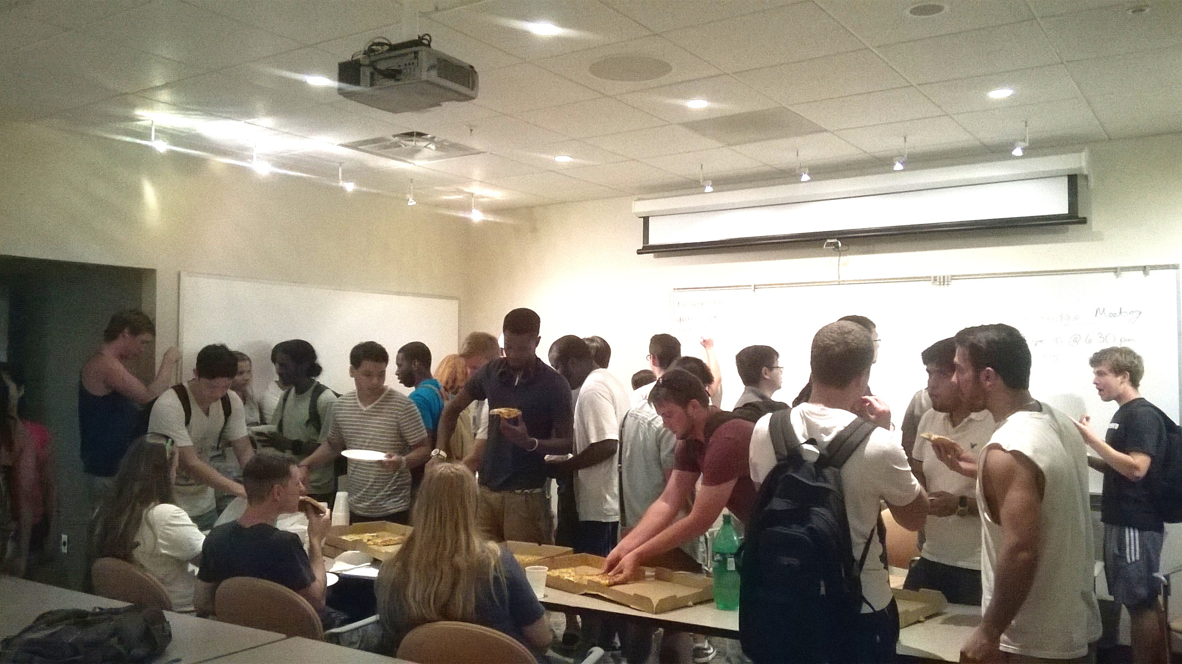
Kickoff Meeting
First general meeting of the 2014-15 year.
ASCE officers and advisor welcome new and returning members
Explain what ASCE is about and what we plan to do this year
37 attendees, including officers and advisor
Notes:
Use photos, logos, etc and describe each meeting

Slide 15
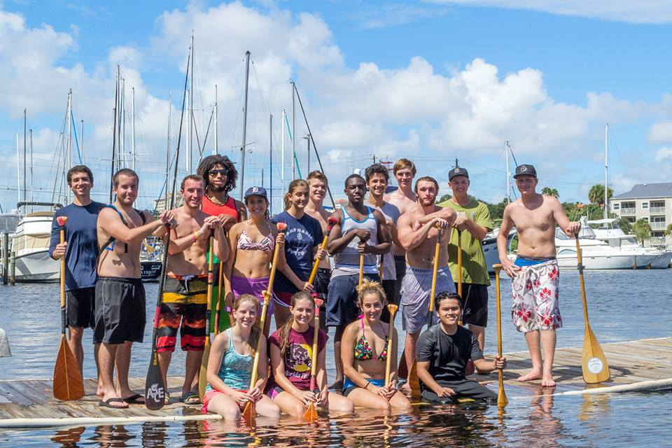
Sunday Paddling
Concrete canoe invites all civil engineering majors to come paddling with the team.
Dates: 9/28, 10/5, 10/19, 10/26, 10/31

Slide 16
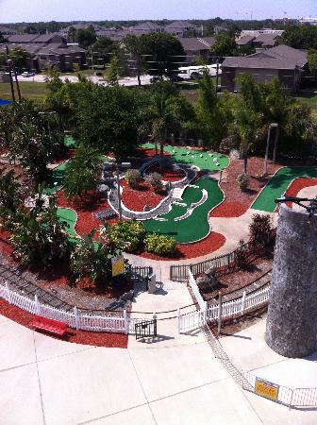
Minigolfing with ASCE
Minigolf Tournament with the ASCE Florida Section Cape Canaveral Branch
Held at Andretti Theme Park, Melbourne, FL
September 25, 2014
6 students attended

Slide 17
Student Conference
Southeast Student Conference
University of South Florida
March 27-29, 2014
21 students attended
Competition Placement
Balsa – 24
Concrete Shuffleboard – 21
Hydraulic Jump – 24
Mortar Cubes – 24
Environmental – 24
Geotechnical – 24
Mystery – 24
Plans Reading – 4
Professional Paper – 14
Surveying – 8
T-Shirt – 24
Visual Display – 24
Steel Bridge Overall – 6
Concrete Canoe Overall – 4
Overall Conference – 22
Notes:
Add slides as necessary to highlight results

Slide 18
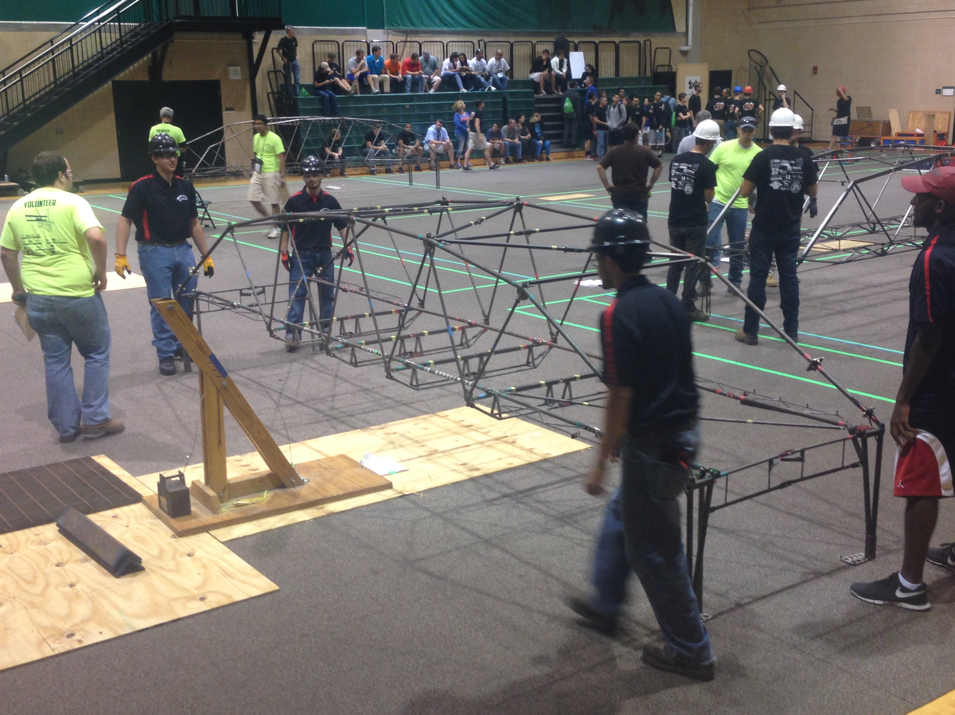
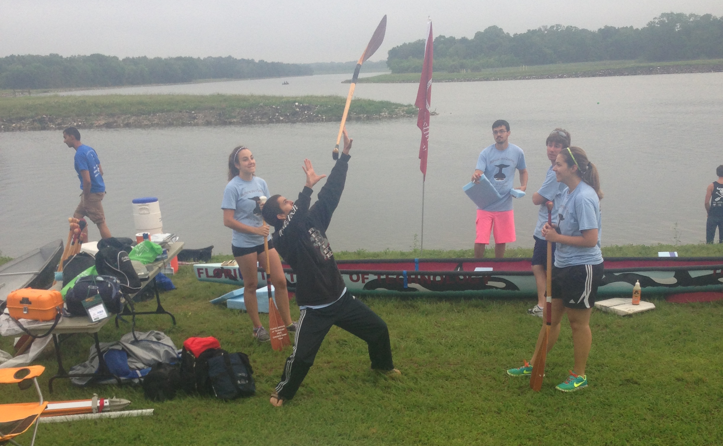
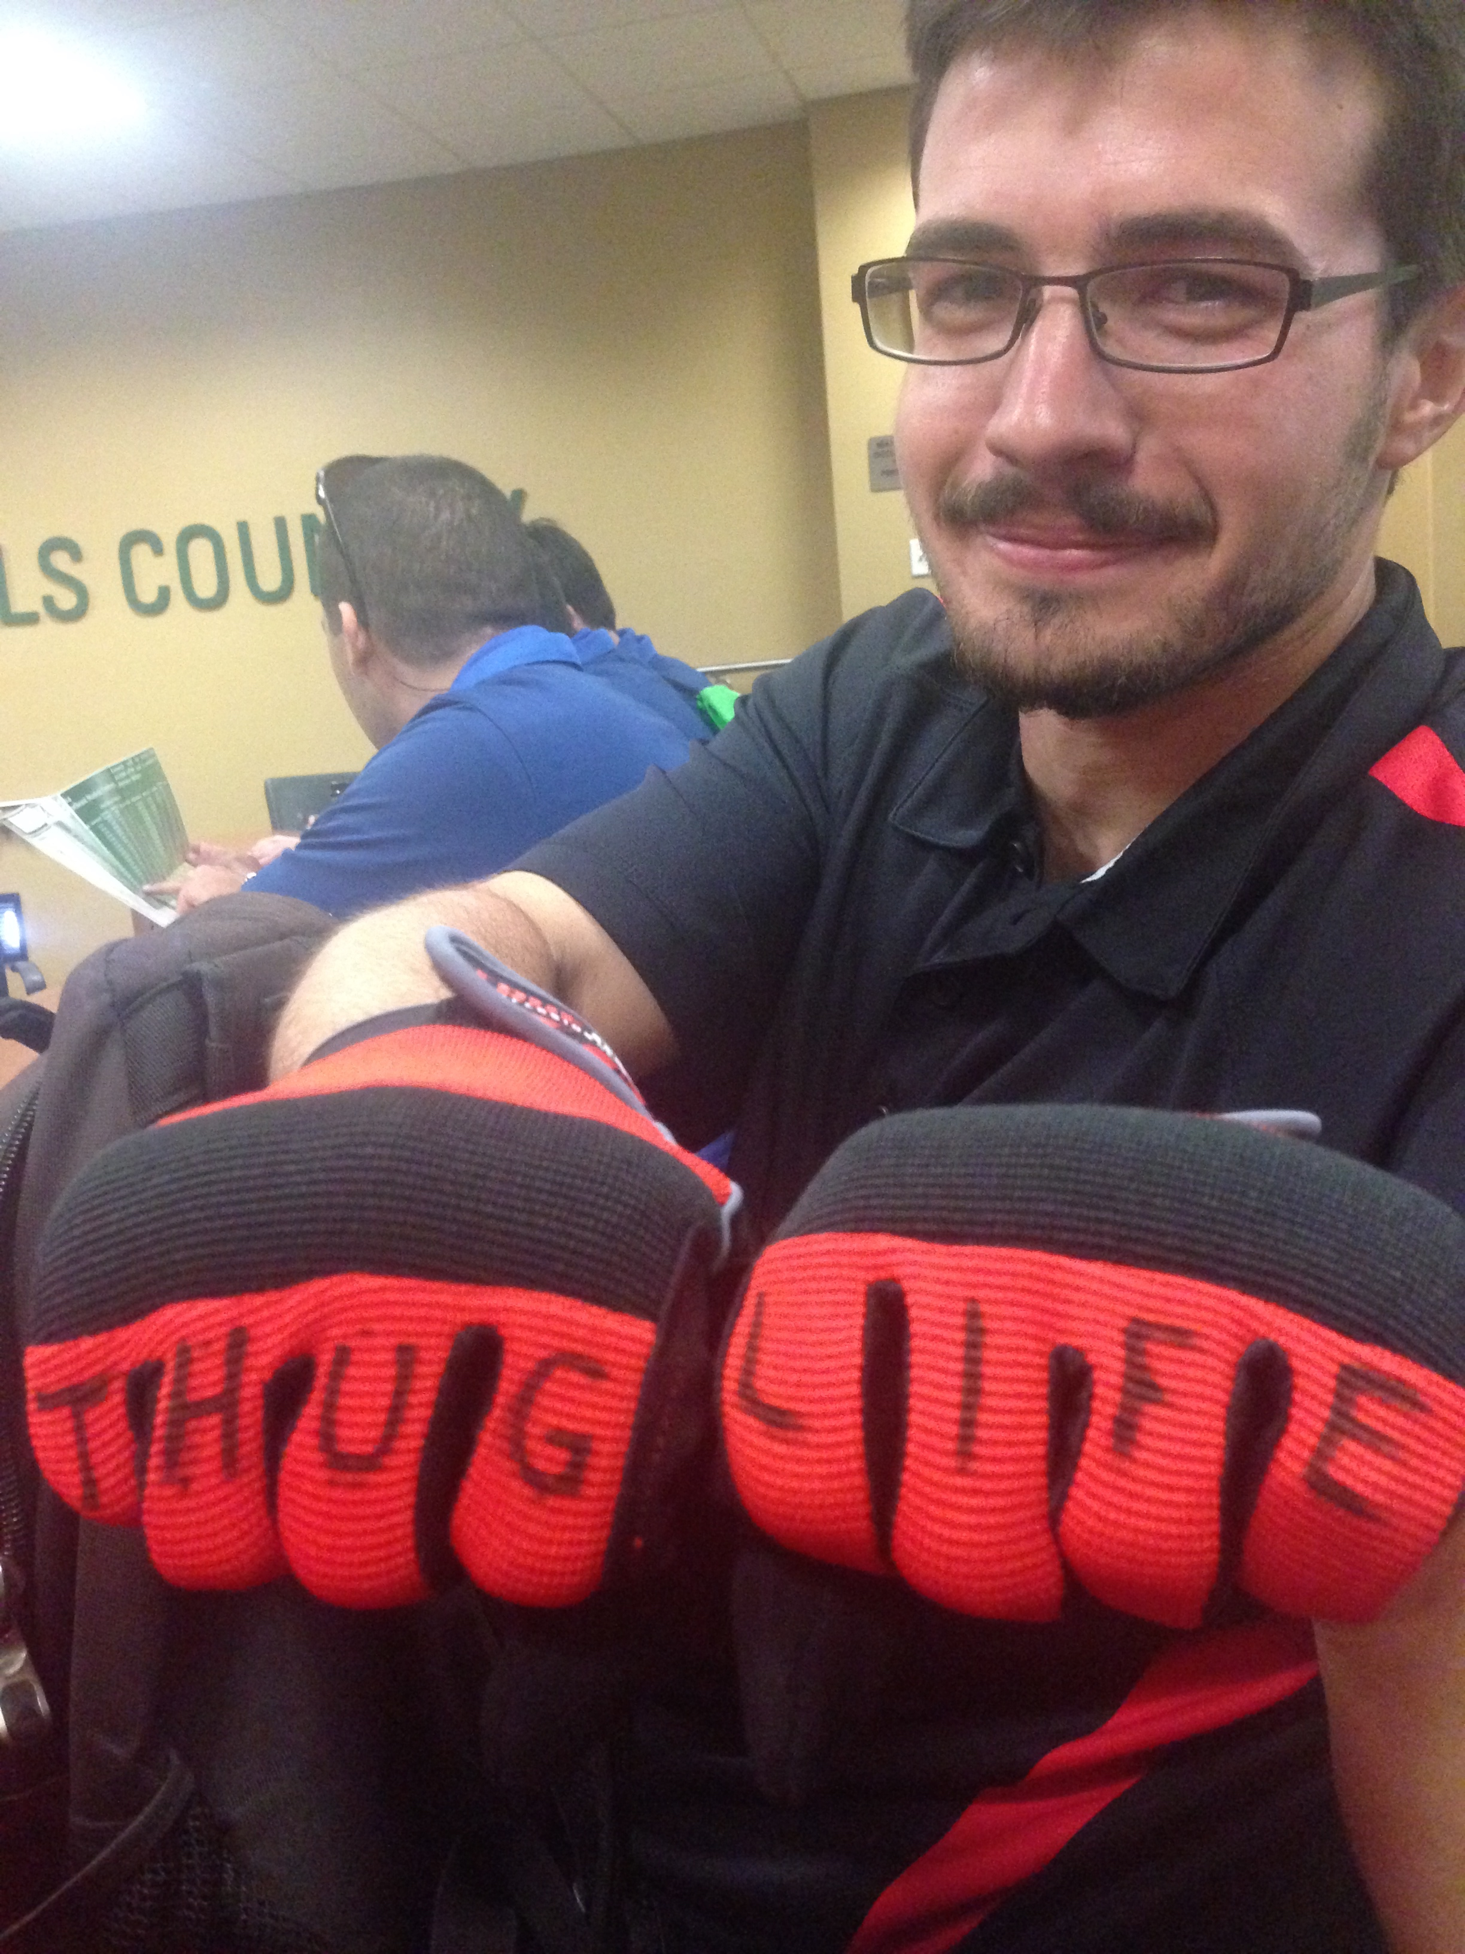
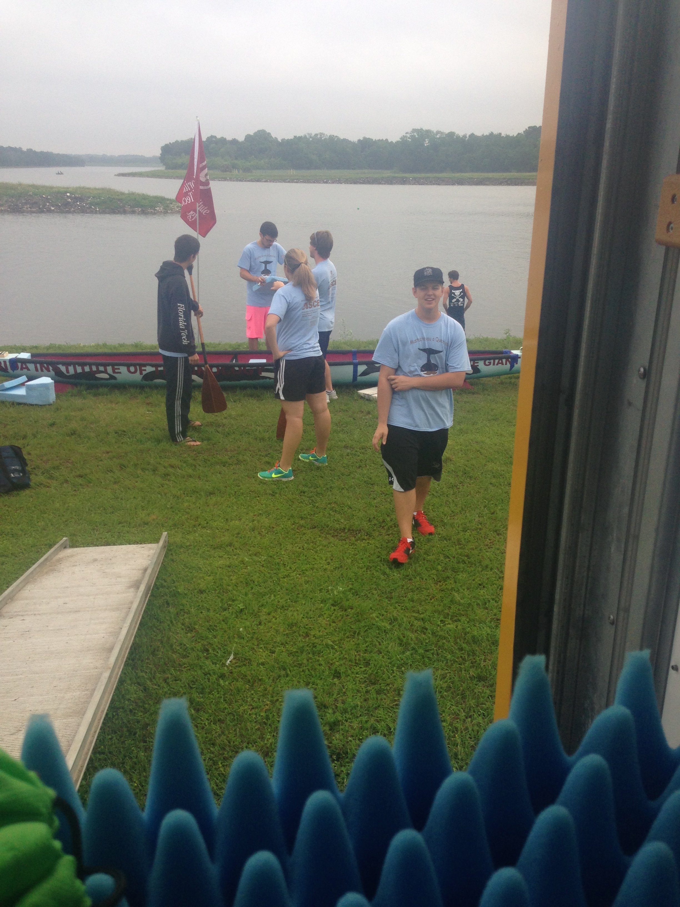
Student Conference
Notes:
Add slides as necessary to highlight results

Slide 19
Leadership Development
Workshop for Student Chapter Leaders (WSCL)
Miami, FL
January 9-10, 2015
2 students attended
Notes:
Add a slide for each activity or conference attended. Other activities besides WSCL may be presented as well.

Slide 20
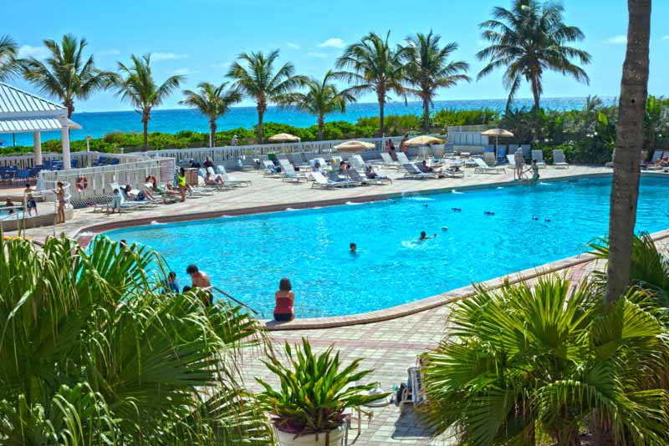
2014 Florida Section ASCE Annual Conference
Miami Beach, FL
July 17-19, 2014
4 students attended
Notes:
Add a slide for each conference attended

Slide 21
Special Projects
Tutoring at Imagine Charter School
Habitat for Humanity
Notes:
This slide is just a description of acceptable special projects

Slide 22
Tutoring at Imagine Charter School
Participation
3 students have worked on the project
0 faculty and practitioners involved
12 total volunteer-hours recorded for the project
Description
Primary objective is to help students with their studies in a local school.
Secondary objective is to get other organizations involved as well, increasing effectiveness of the project.
Tutoring at the local school will increase community awareness of ASCE and other STEM groups. Our chapter has also succeeded in getting the Florida Tech ABC chapter involved too
Engineering component
Communication skills, which are vital in the engineering world in order to present findings and work to the engineering and/or public community, will be used thoroughly in this project
Project impact
Short term: Students at Imagine Charter School will receive the help they need to succeed in their classes and move forward with their education
Long term: Interest in STEM will likely be increased with the help of our ASCE tutors. This may lead to more engineering students here at Florida Tech in the future and more engineers in the nation later, which will be important with our nation’s decaying infrastructure.
Notes:
Use as many slides as necessary to adequately describe each special project

Slide 23
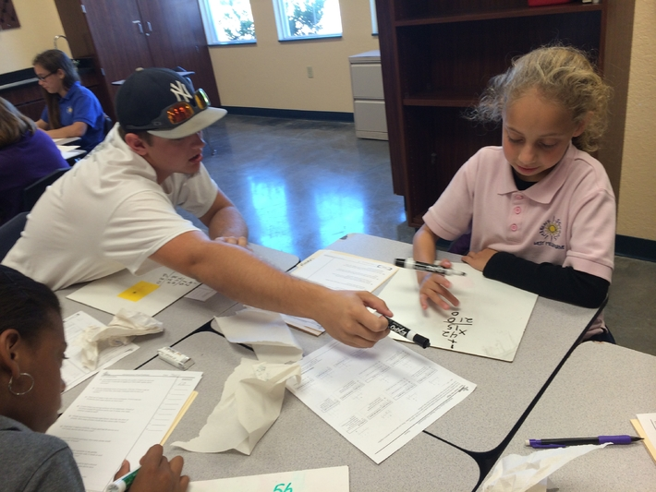
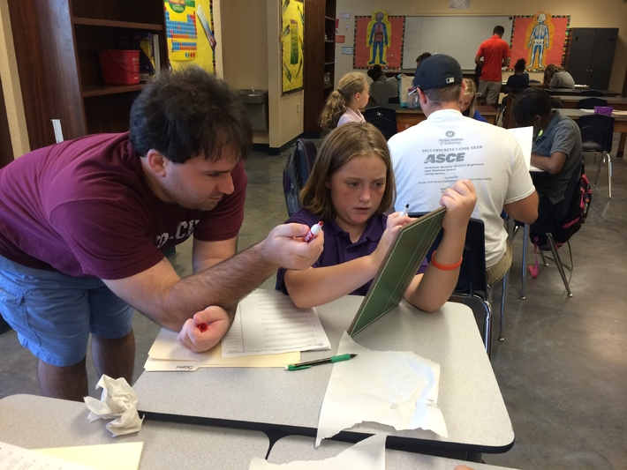
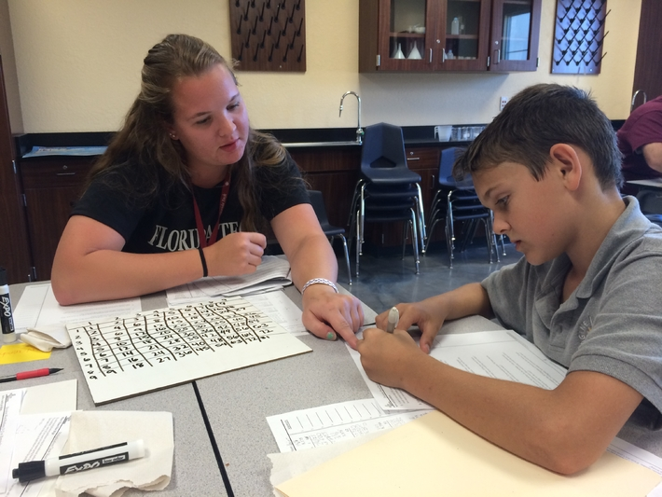
Tutoring at Imagine Charter School

Slide 24
Habitat for Humanity
Participation
27 student members attended informational meeting
1 faculty advisor participant attended informational meeting
2 hour presentation conducted by Habitat for Humanity Representatives
3 student members attended first build
0 faculty/practitioner participants attended first build
14 man hours conducted among participating members on the one-day build
Description
Primary objective is to construct homes for those citizens who can’t afford one.
Secondary objective is to get other organizations involved as well, increasing effectiveness of the project.
Helping with the Habitat builds in Brevard county will widely spread our chapter influence. Our chapter has also succeeded in getting the Florida Tech ABC and Chi Epsilon chapters involved. In addition, many prospective new members this year expressed great interest in Habitat for Humanity for Humanity builds.
Engineering component
Participants will learn about all aspects of construction, from job-site safety and drawings to contractor relations and general construction work.
Project impact
Short Term: putting a roof over someone’s head who really needs it!
Long Term: participating members get hands on experience that they will never forget. This is something you cant learn in a classroom!
Notes:
Use as many slides as necessary to adequately describe each special project

Slide 25
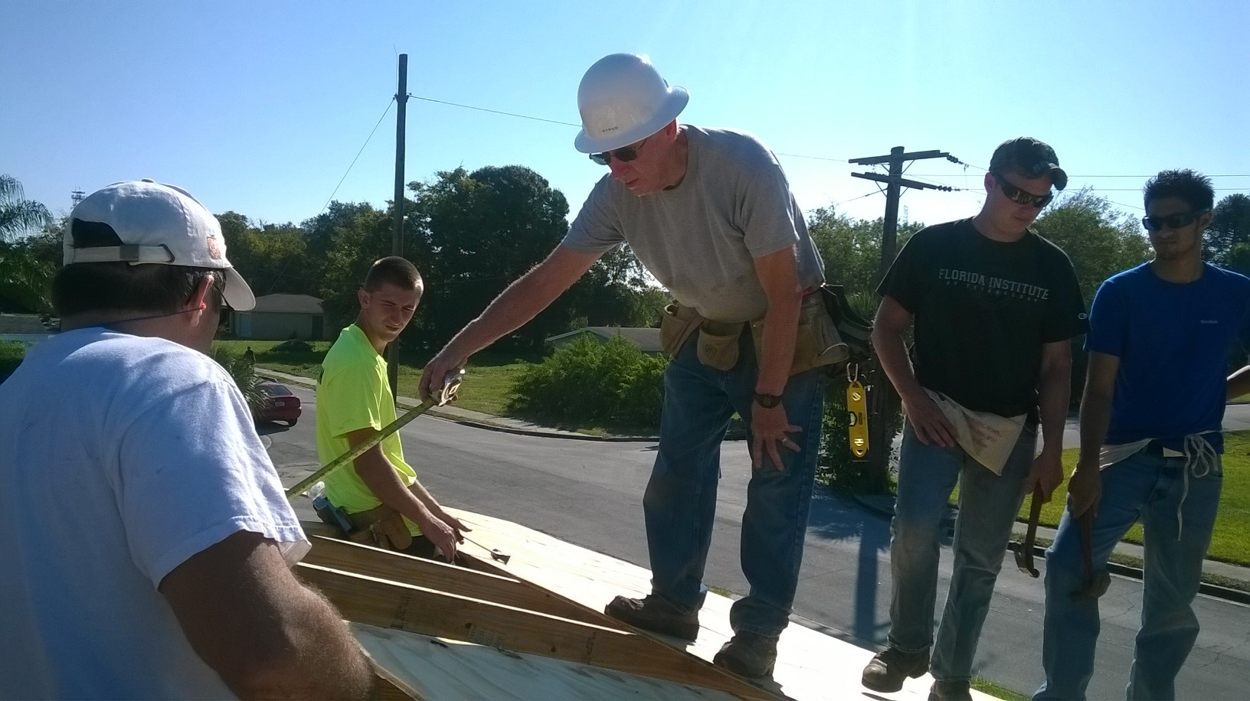
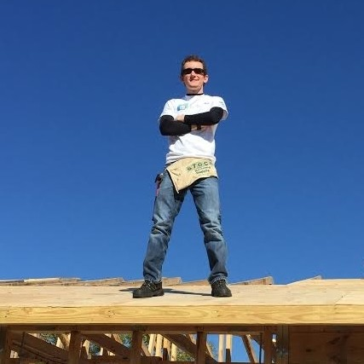
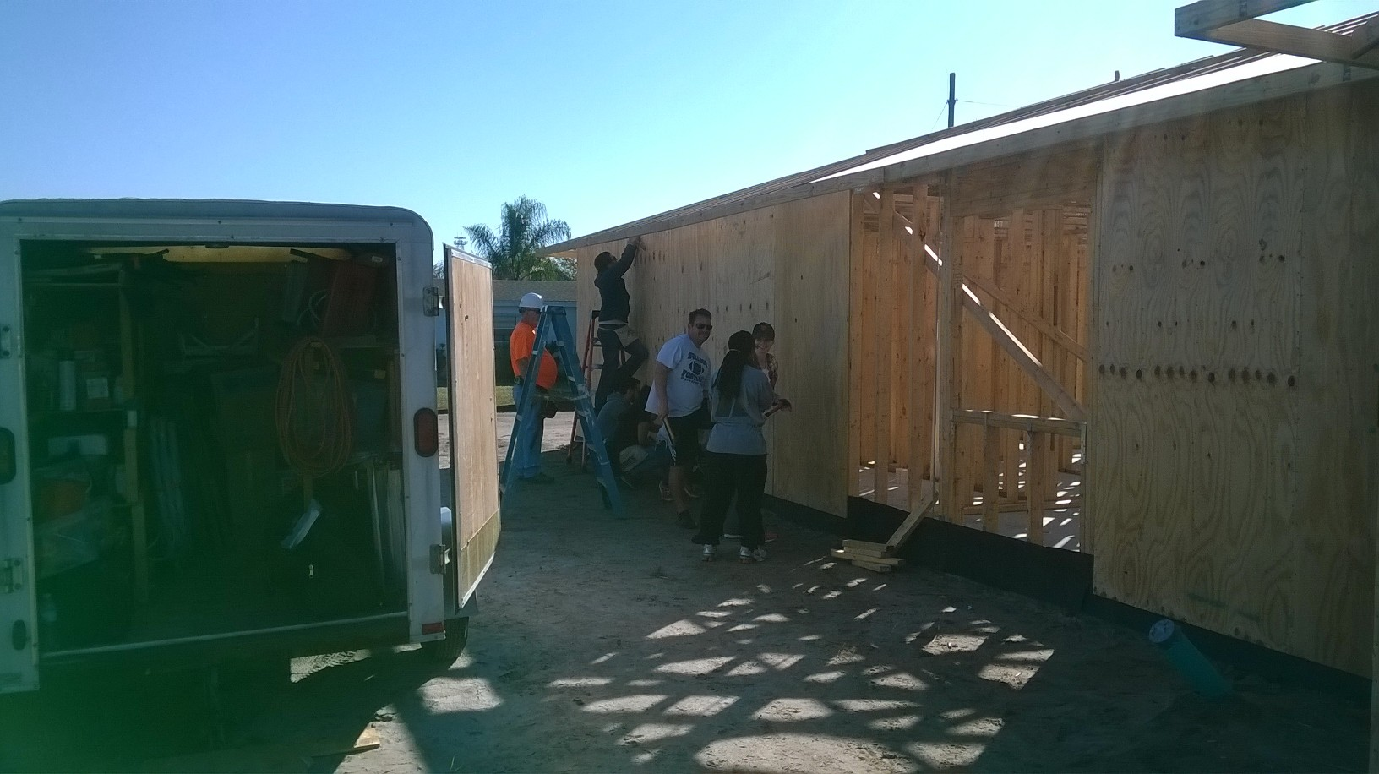
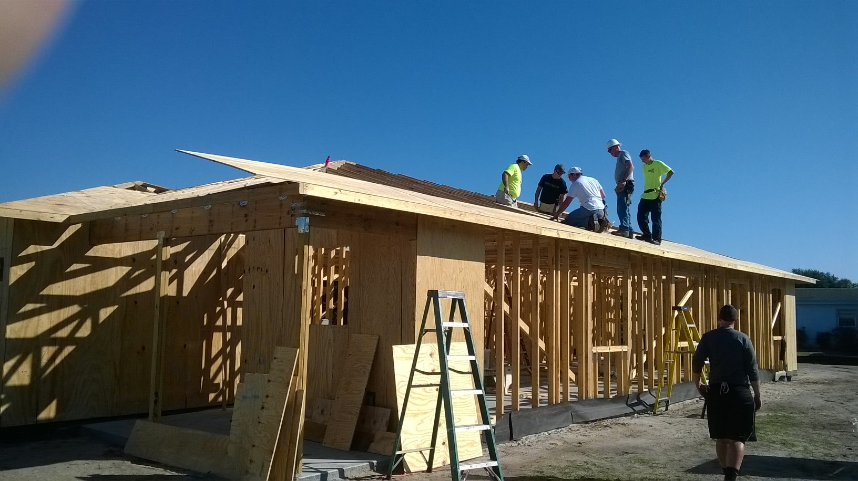
Habitat for Humanity

Slide 26
Summary and Questions
Significant events of the year:
2014 Student Conference
Minigolfing social with Cape Canaveral Branch
Started Tutoring Project
Arranged Habitat Project
Significant challenges faced:
Lost a lot of members last year
Participation among members has grown weak
Recent influx of members due to success with goals thus far has created new administrative problems
Representation for lowerclassmen in the organization is lacking
QUESTIONS?
Notes:
We would prefer that you limit to 60 slides or less, but if you have more that’s ok. When actually presenting to other groups, reorder the slides (instead of deleting, move extras to the end so you have them if questions come up) to only present a reasonable amount in the time you are given.

