Slide 1
Recursos Hídricos de Bolivia, Integración de Procesos del Ciclo Hidrológico, Desafíos de Cambio Climático, Adaptación y Oportunidades Profesionales
Miguel A. Medina, Jr., Professional Hydrologist,
Fellow, ASCE, Professor Emeritus of
Civil and Environmental Engineering, Duke University
miguel.medina@duke.edu
Former President, American Institute of Hydrology
Member, Executive Committee, ASCE CACC
Committee on Adaptation to Climate Change (CACC)
COLEIC 2021
Tarija, Bolivia
14-20 de noviembre de 2021

Slide 2
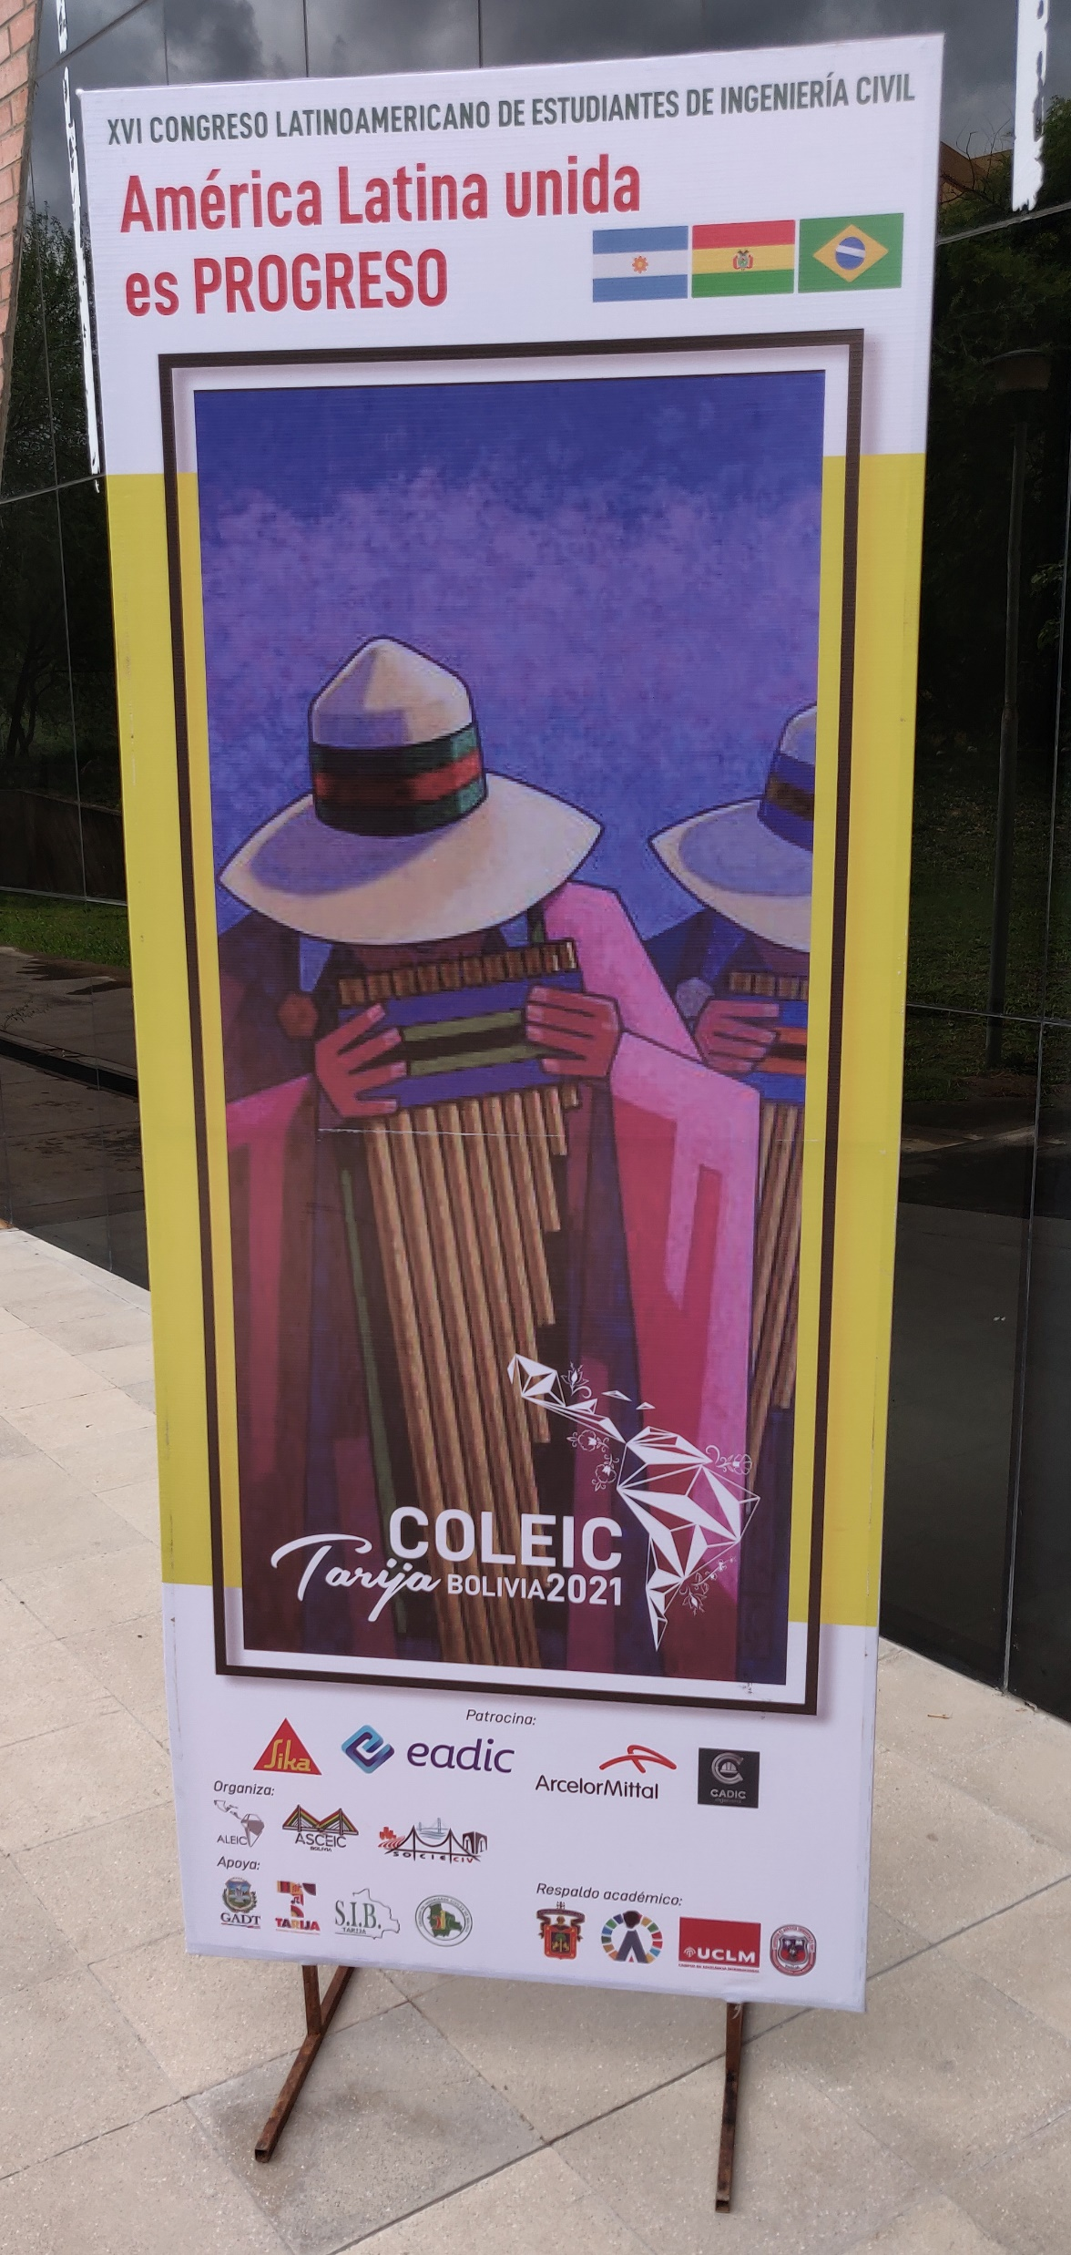
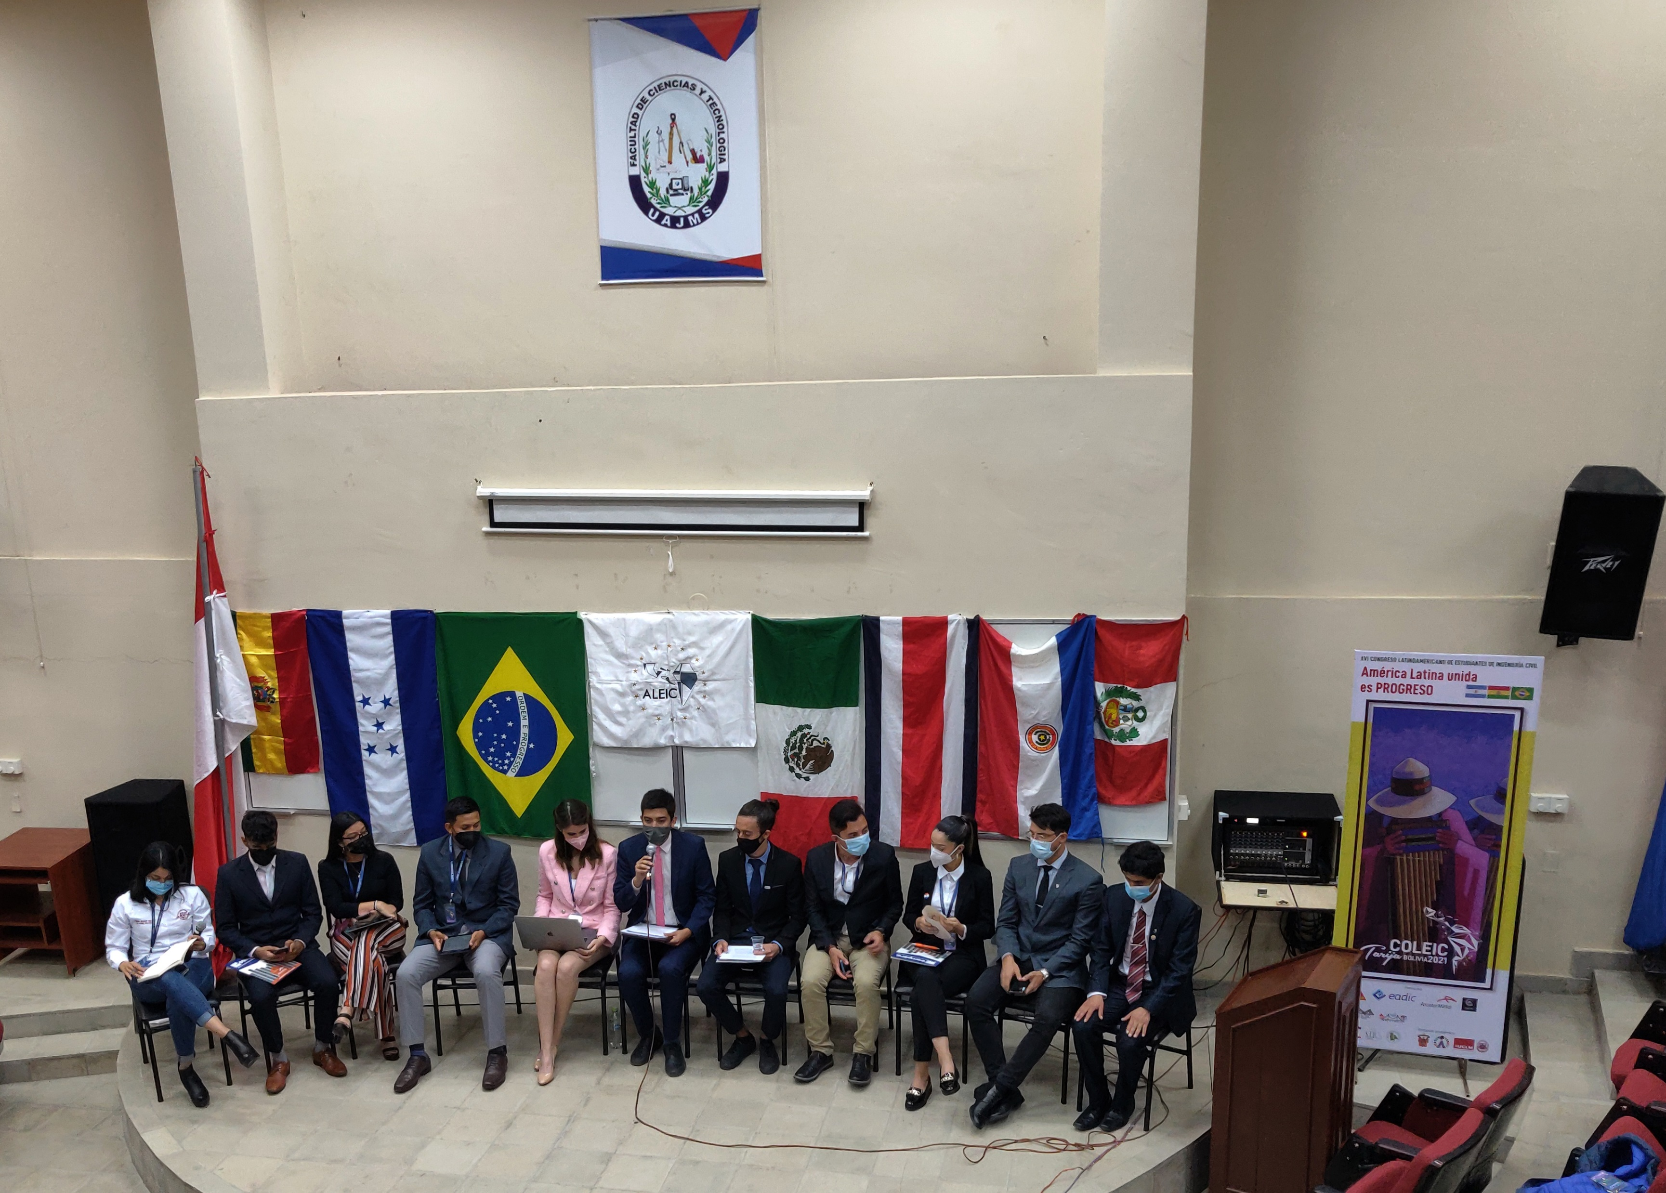

Slide 3
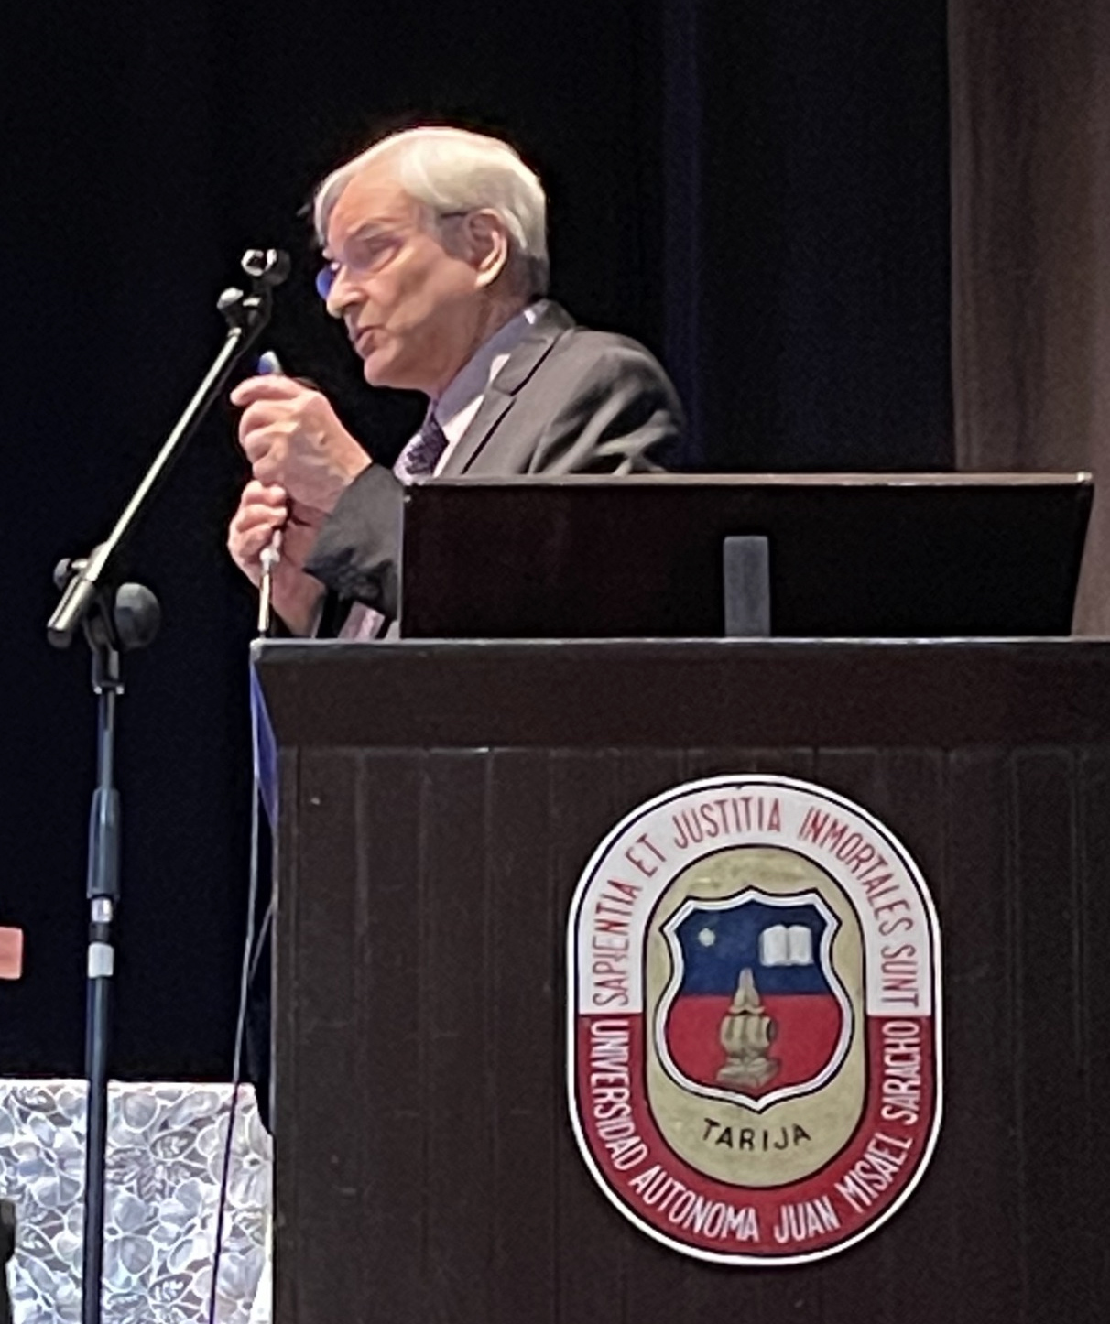
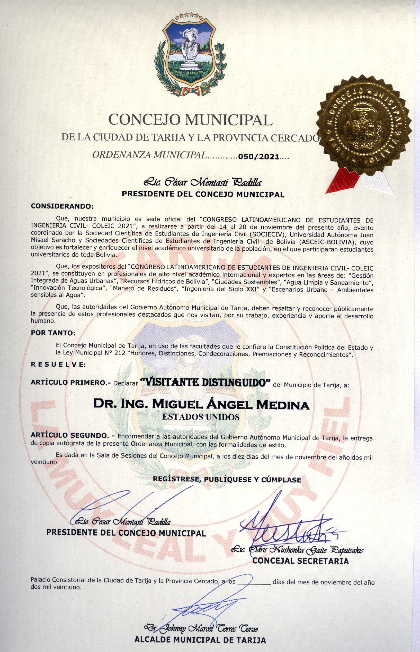

Slide 4
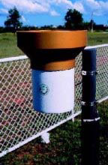
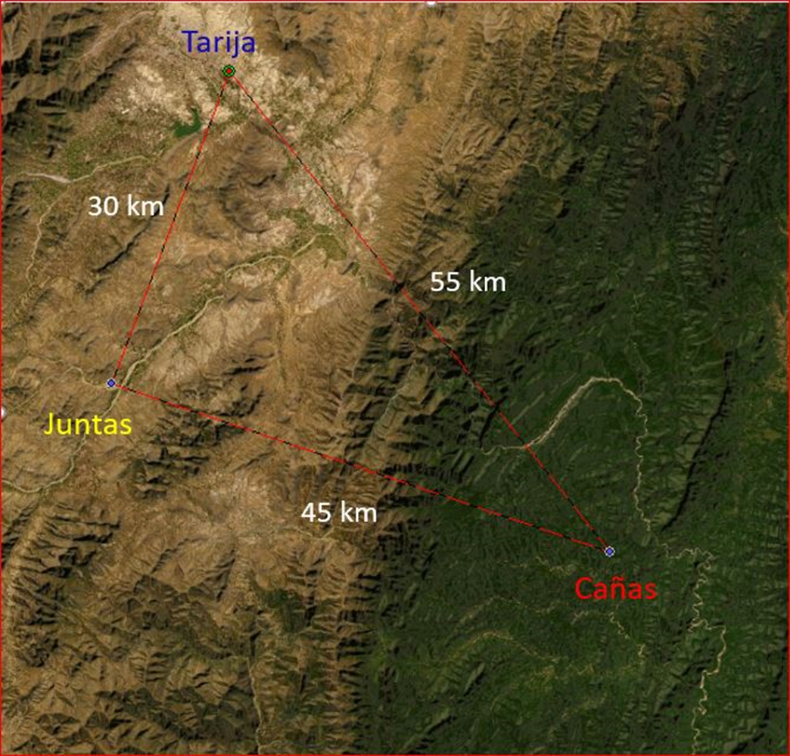
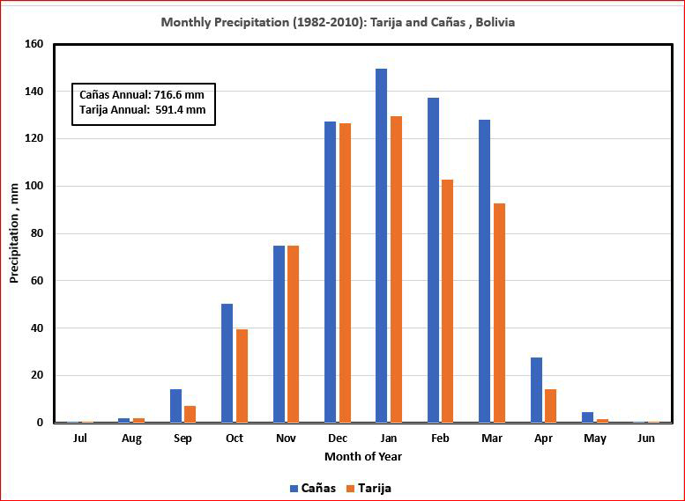
Precipitation Stations
Tarija
(pluviómetros)

Slide 5
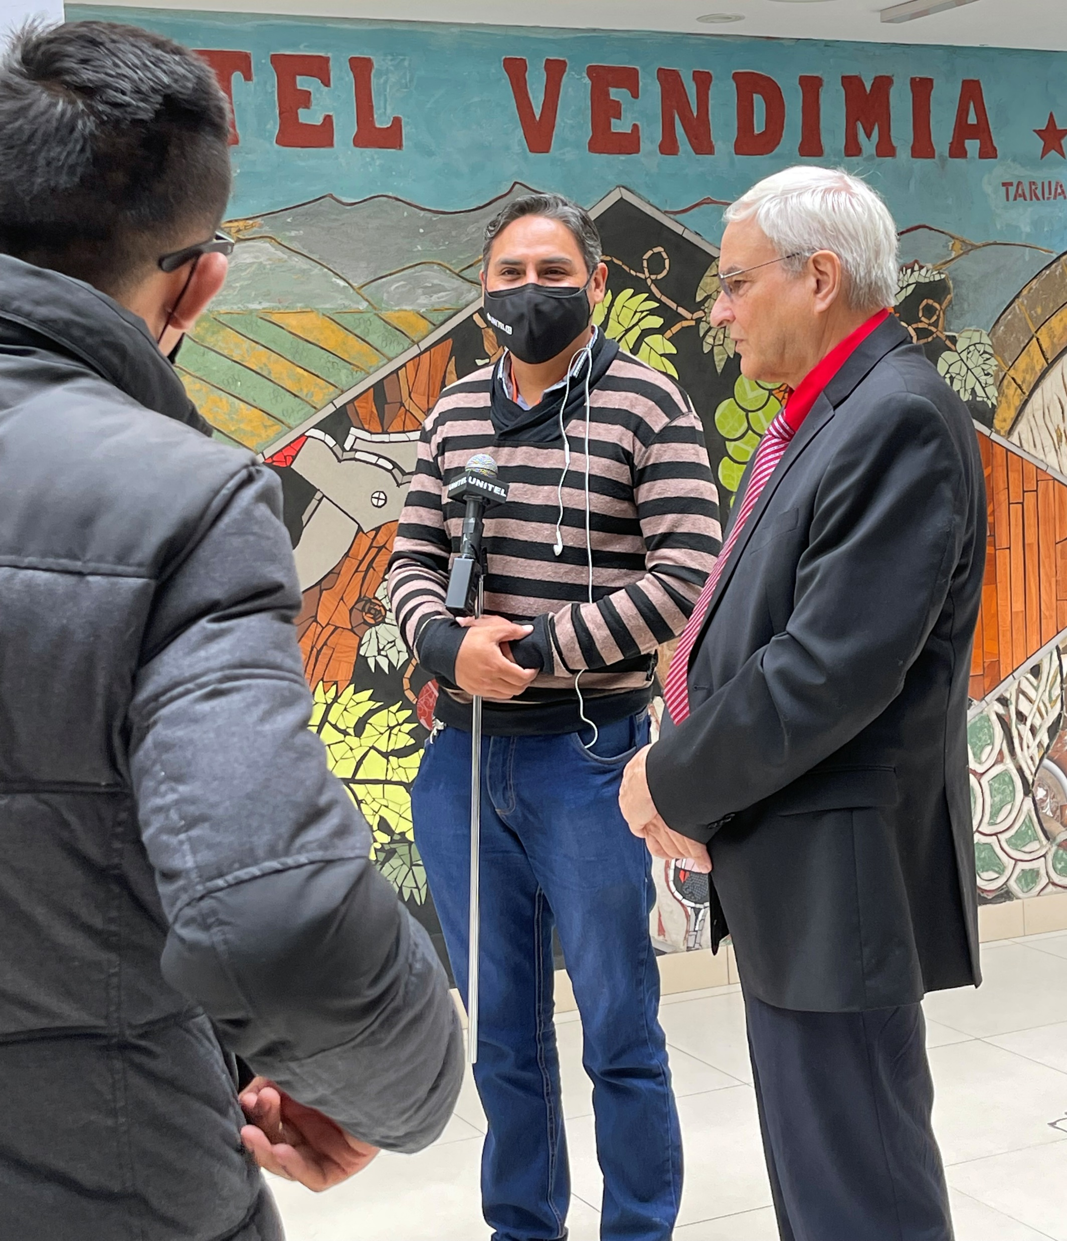
National Bolivian TV Network UNITEL
news crew interviews Dr. Medina live
at the Hotel Vendimia lobby on
November 18, 2021 in Tarija, Bolivia

