Slide 1
NEASCE K-12 Outreach

Slide 2
NEASCE K-12 Outreach
Past Activities
Plans for 2014 – 2015
Resources Available

Slide 3
Past Activities
OPS Career Fair
Booth & Displays
Avery Elementary Career Fair
Presentation
Benson High School Career Fair
Booth & Displays
Activity
PKI/UNO Open House
Booth & Displays
Presentation
Activity
Omaha Children’s Museum Exhibition
Activity
Beadle Middle School Summer Program
Presentation
Activity
Notes:
`

Slide 4
Plans For 2014 - 2015
PKI Open House
Fall Open House a Success!
March 2015
Benson High School Career Fair
March 2015
E-Week School Blitz
Feb. 22 – 28, 2015
Community Engineering Day
E-Week, Feb. 2015

Slide 5
E-WEEK School Blitz
5 – 6 Classrooms (Teacher Contacts)
10 – 12 Volunteers for Presentations
1 – 2 Volunteers to Organize Handouts
1 – 2 Volunteers to Support Preparation

Slide 6
E-WEEK School Blitz
Presenters:
Coordinate final scheduling with Teachers
Tailor presentation to classroom
Age Range
Allotted Time
Teacher Recommendations
Plan an activity
Present during E-Week
Other Volunteers:
Make an initial contact with the teacher
Provide a previously used presentation
Provide handouts

Slide 7
Resources Available
Outreach Kits
Training Videos
Activities Information
YouTube!

Slide 8
Outreach Kits
Self contained “introduction to engineering”
Nebraska Section outreach effort
Three Plastic Totes with Activities
Bridge Kit
“Building Big” DVDs

Slide 9
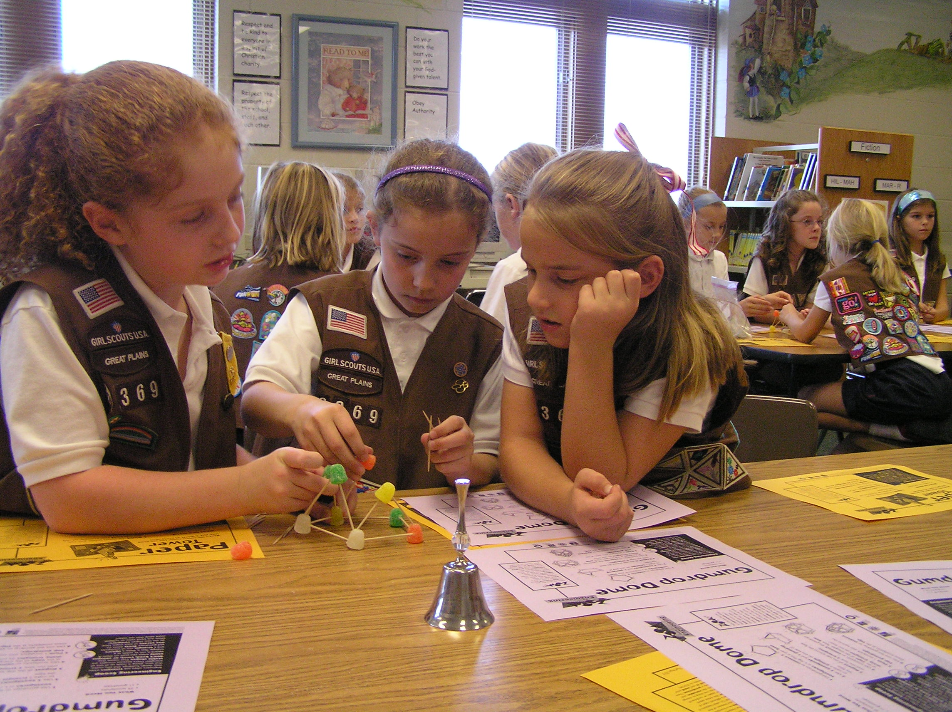
Zoom Into Engineering Kit (K-3)
Flinker
Gumdrop Dome
Paper Tower

Slide 10
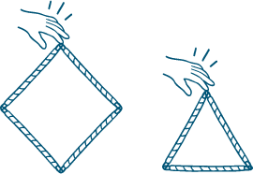
Building Big Kit (4-6)
Paper Bridge
Straw Shapes
Suspension Bridge
Hands On Glossary

Slide 11
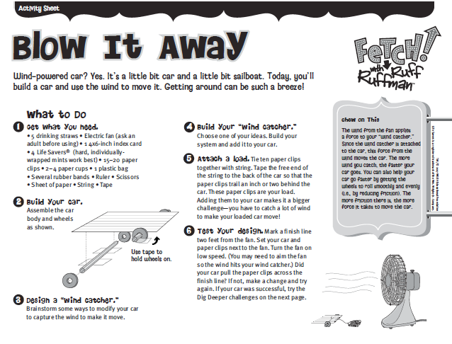
Mixed Ages Kit
Paper Tower (Zoom)
Straw Shapes (Building Big)
Blow It Away (Fetch)
Hang Time (Fetch)

Slide 12
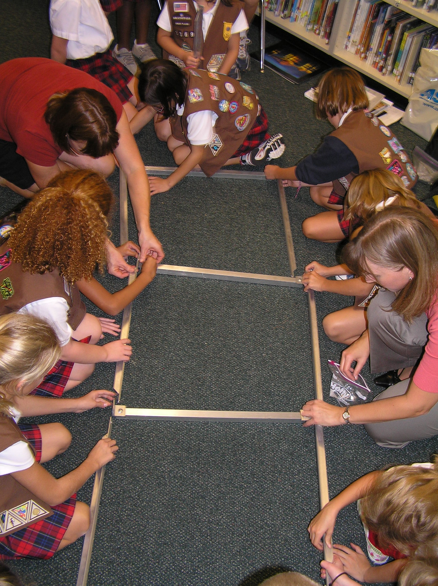
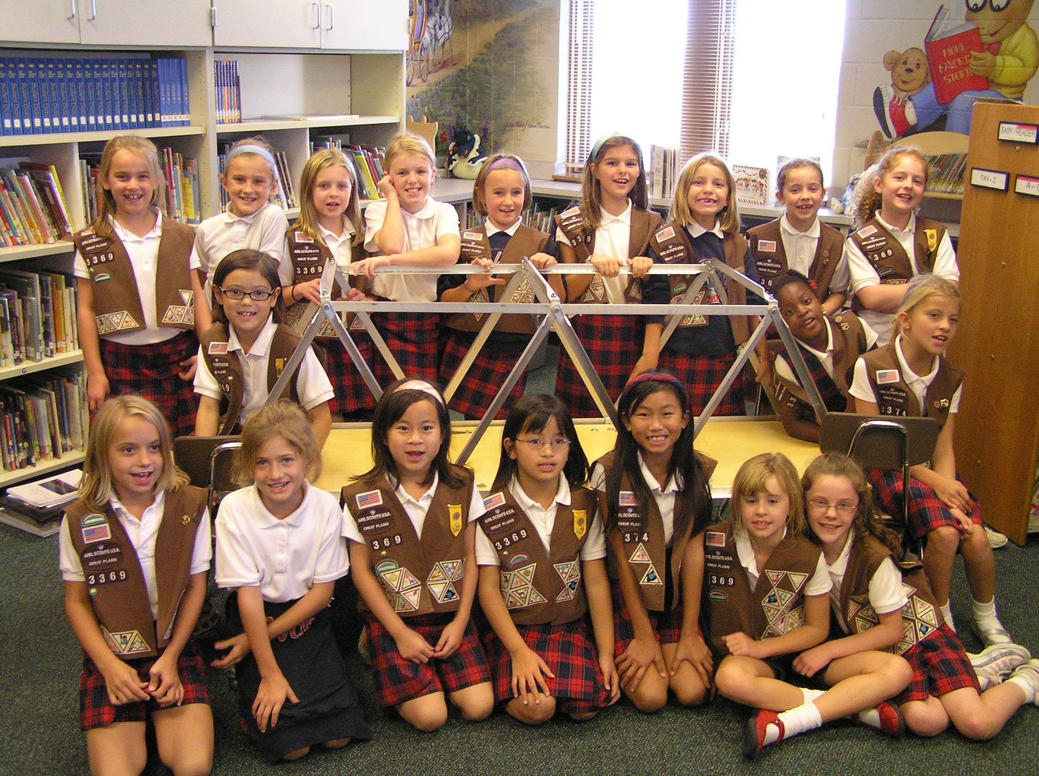
Bridge Kit
6-ft. long through truss bridge
Structurally sound up to 175-lb
Aluminum members (~2-ft. long)
Hinged plywood deck
Stored in a softball bag
Purchased from Professor at Missouri University of Science & Technology

Slide 13
Training & Activities
ASCE
www.asce.org/pre-college_outreach/
www.asceville.org/activities.html
DiscoverE
www.discovere.org/volunteers-educators
www.discovere.org/our-activities
PBS Design Squad
Teach Engineering

Slide 14
Primary Outreach Contact:
John Smith, NEASCE Vice President
John.Smith@hdrinc.com , 402-399-1007
Other Contacts:
Joe Flaxbeard, NEASCE President Elect
Joe.Flaxbeard@LRA-INC.com , 402-496-2498
Or any NEASCE Board Member

