Slide 1
GEOTECHNICAL INSTRUMENTATION INSTALLATION & MONITORING

Slide 2
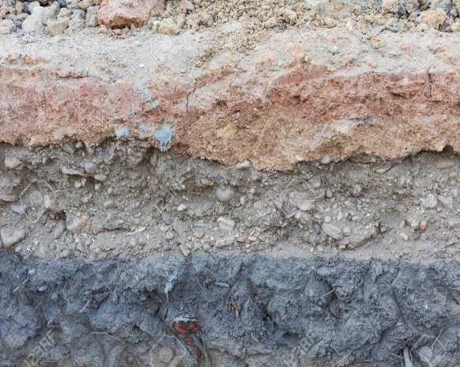
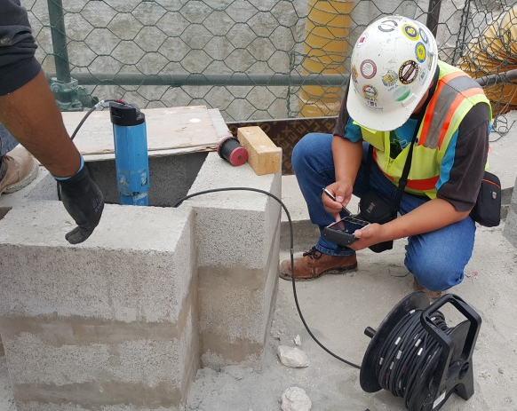
Geo-technical instruments are used to monitor the ground and water behavior.
Geo-Technical Instruments
1.INCLINOMETER
PURPOSE
The inclinometer casing is used in conjunction with inclinometer probe to monitor stability of embankments, slopes, rock cuts, foundations and excavation walls, piles. Coffer dams etc.
Underground horizontal layers movement at different depth can be identified and monitored.

Slide 3
Geo-technical instruments are used to monitor the ground and water behavior.
Geo-Technical Instruments
1.INCLINOMETER
The purpose of inclinometer monitoring is to observe and monitor any lateral movements within structures or strata and analyze whether remedial works are required to subdue any such movements.
Applications for vertical inclinometers include:
Monitoring slopes and landslides to detect zones of movement and establish whether movement is constant, accelerating, or responding to remedial measures.
Monitoring secant pile, diaphragm walls and sheet piles to check that deflections are within design limits; that struts and anchors are performing as expected, and that adjacent buildings are not affected by ground movements.
Monitoring dams, dam abutments, and upstream slopes for movement during and after impoundment.
Monitoring the effects of tunneling operations to ensure that adjacent structures are not damaged by ground movements.

Slide 4
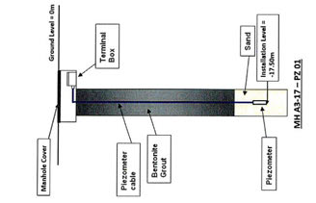
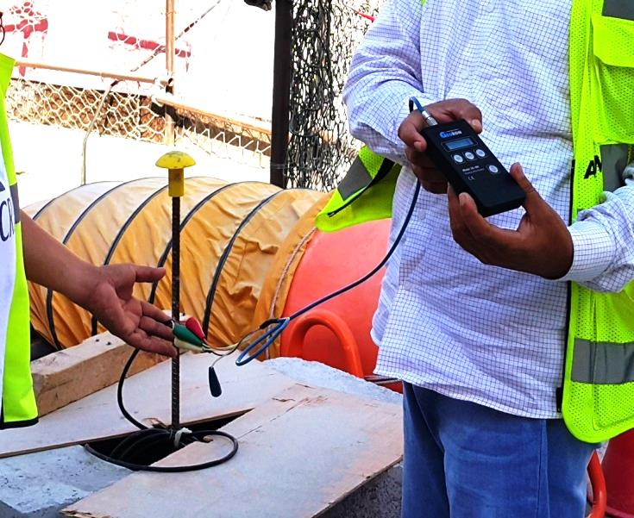
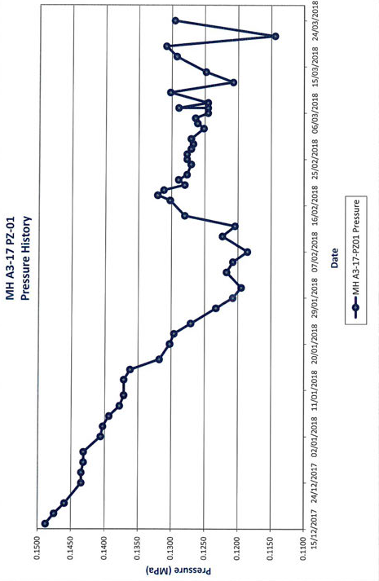
2. PIEZOMETER
Geo-Technical Instruments
PURPOSE
To measure followings:
Water pressure ( through closed type Piezometer)
Water level (through open type Piezometer)
Sudden variation of water level due to any leakage in shaft or ongoing dewatering near by construction site/zone area.

Slide 5
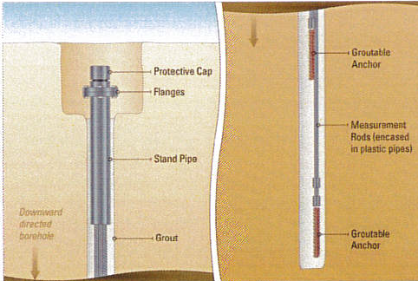
Geo-Technical Instrument s
3. Extensometer
Extensometer is specially used for Micro-Tunneling operation .
Extensometer should be installed before micro-tunneling operation.
It should be installed above center of tunnel line.
It should be 50 cm above from the top of pipe.
PURPOSE
To monitor followings:
over cut during micro-Tunneling operation
Internal settlement

Slide 6
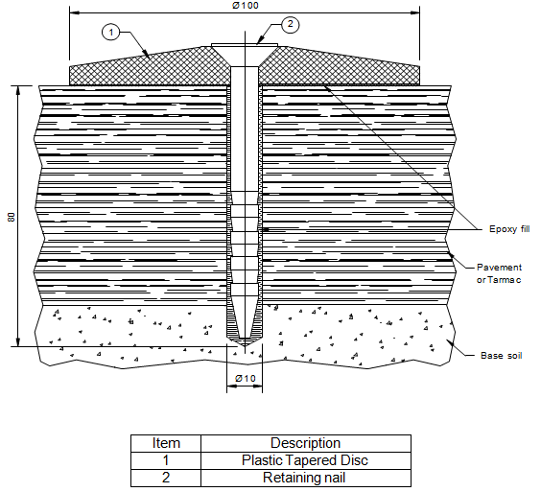
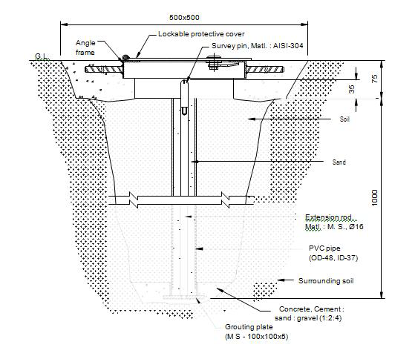
Geo-Technical Instrument s
4. Surface Settlement Point (paved/unpaved area)
Paved
The ground settlement point is used to monitor the vertical settlement on the surface of embankments, soil, masses, etc. It may also serve as a deep ground settlement point for monitoring of vertical displacement of utilities and in some cases as a benchmark.
PURPOSE
To monitor ground vertical settlement/road settlement around shaft and along the micro-tunneling line in paved or unpaved area.
UnPaved

Slide 7
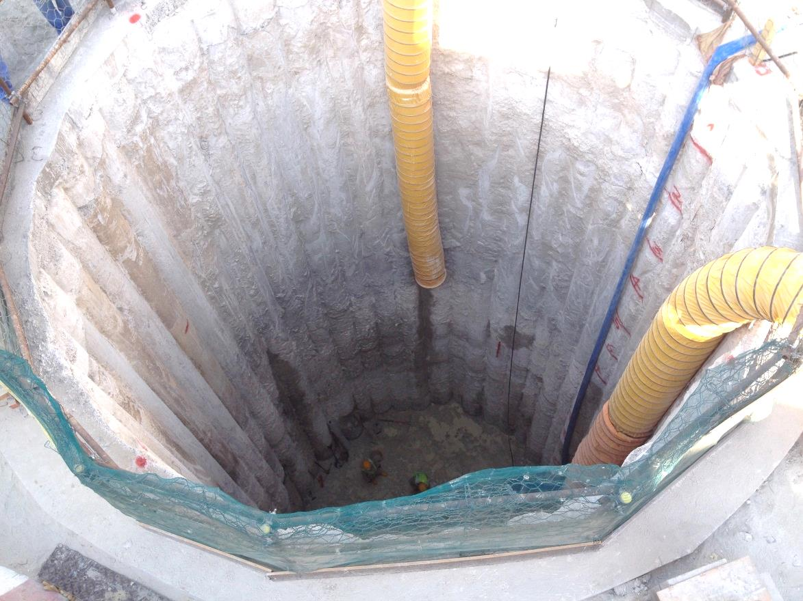
Geo-Technical Instrument s
5. Convergence Point
Convergence point is used inside the shaft or
Diaphragm wall to monitor followings:
shaft deflection (internal /external)
Tilting of shaft

Slide 8
Geo-Technical Instrument s
6. Zone Station
Zone station can monitor any changes in the ground around the construction area.
Zone station shall be installed for each TBM performance.
The zone station area should be16 meter and in this area followings to be installed:
Inclinometer- 4 Nos.
Piezometer-1 No.
Extensometer- 3 Nos.
Surface settlement points- 21 Nos.

Slide 9
Dilapidation/ Pre-construction condition survey

Slide 10
Dilapidation/ Pre-construction condition survey
1. Where we conduct:
The dilapidation survey is carried out on existing structures such as
Building, Villa, School, Mosque, Sub-station etc., that falls within the Zone of influence of construction activity.
2. Importance of dilapidation:
The dilapidation survey is carried out to know the effect on existing structures during
construction and micro-tunneling activities through installation and monitoring of
dilapidation instruments.

Slide 11
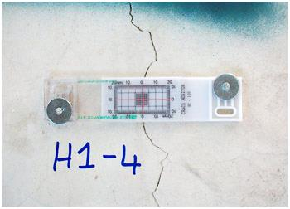
Dilapidation/ Pre-construction condition survey
1. Crack meter/Crack guage
The system consists of two plates that overlap for part of their length.
One plate is calibrated in millimeters and the overlapping plate is transparent and marked with a hairline cursor. As the crack width opens or closes, one plate moves relative to the other.
The relationship of the cursor to the scale represents the amount of movement occurring.
These gauges are monitored over time, whilst being kept as far away from human disturbance as possible, to develop an understanding in the width and direction of movement of the crack.

Slide 12
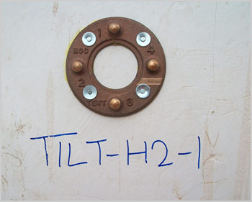
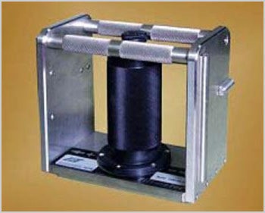
Dilapidation/ Pre-construction condition survey
2. Tilt Plate/ Tilt meter
Portable tilt meters are mainly used to monitor buildings, structures, utilities, etc. as well as the inclination and rotation of retaining walls, dams, piers, piles, etc. It may also be used to evaluate the performance of bridges, struts and the stability of structures in land slide areas.
Tilt Plate
The portable tilt meter is suitable for monitoring change in inclination of a structure. Tilt meter consists of a basic sensor housed in a rugged frame with machined surfaces that facilitate accurate positioning on the tilt plate. The bottom surface is used with horizontally mounted tilt plates and the side surfaces are used with vertically-mounted tilt plates.
Tilt meter

Slide 13
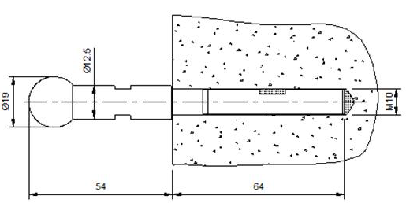
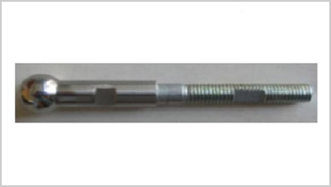
Dilapidation/ Pre-construction condition survey
3. Building settlement point
The building settlement point is to be embedded / fixed to a vertical member to monitor the vertical settlement / movement of any structure.
It consists of a male anchor fitted onto the anchor socket which in place is usually embedded / fixed in a column / wall of thickness greater than 80mm.
These points are best monitored using digital level equipment for the most precise readings.

Slide 14
THANK YOU
ASCE

