Slide 1
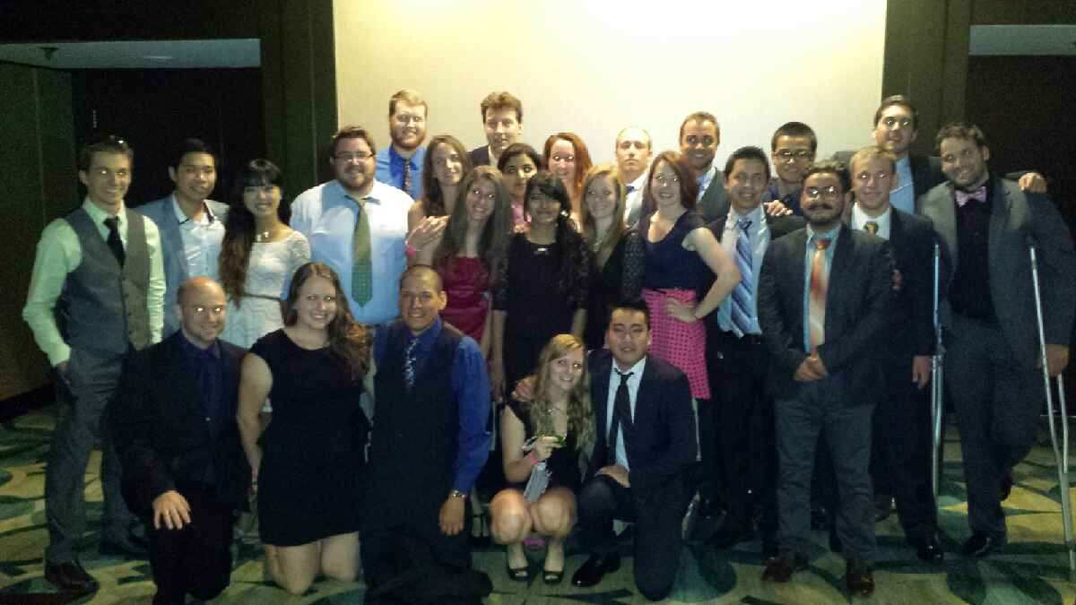
American Society of Civil Engineers Student Chapter
UNIVERSITY OF NORTH FLORIDA

Slide 2
Contact Information
Mailing address: 1 UNF Drive Jacksonville, FL 32224
Email addresses: unfasce@gmail.com
Web site: http://ospreyasce.weebly.com
Facebook: https://www.facebook.com/asceunf

Slide 3
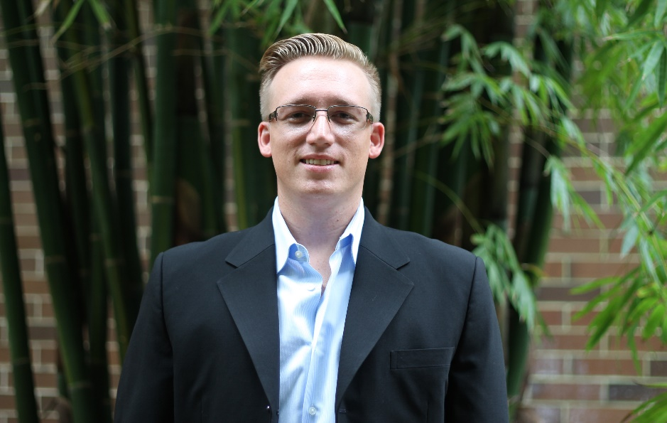
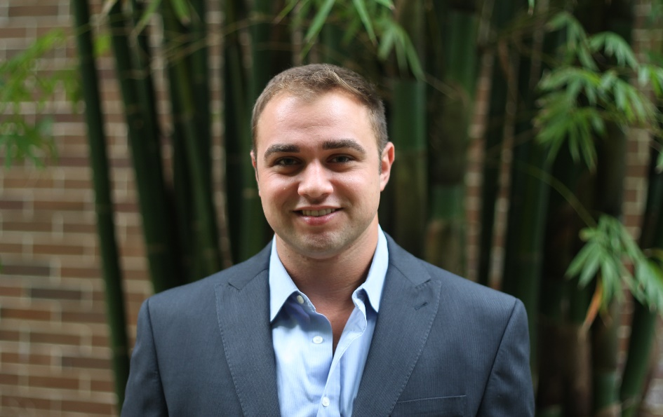
Student Officers
President
Vice President
Jeff Bessent
Email: n00164205@ospreys.unf.edu Phone Number: (904)-887-4338
Ryan Pucker
Email: n00905085@ospreys.unf.edu Phone Number: (954)-931-5460

Slide 4
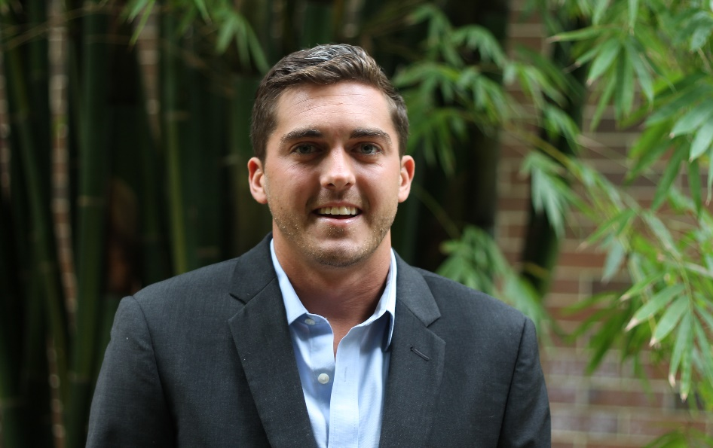
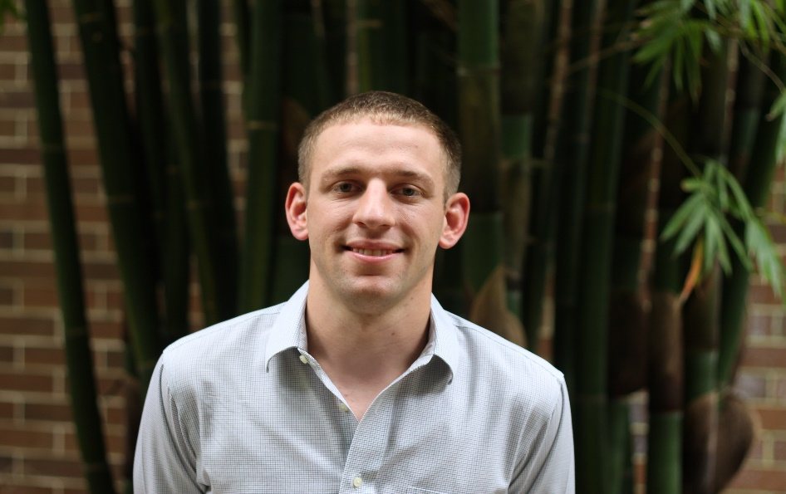
Student Officers
Treasurer
Secretary
Jason Williams
Email: n00919157@ospreys.unf.edu
Phone Number: (850)-642-1429
James Pugh
Email: n00908033@ospreys.unf.edu
Phone Number: (904)-742-5651

Slide 5
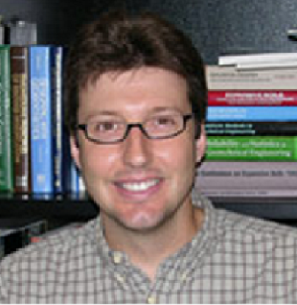
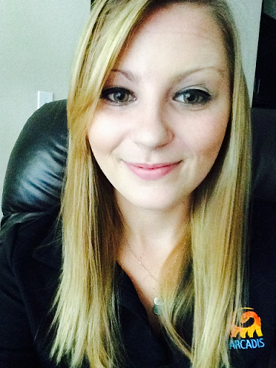
Advisors
Faculty Advisor
Practitioner Advisor
Dr. Nick Hudyma
Email: nhudyma@unf.edu
Phone Number: (904)-620-2195
Kari Bishop
Email: kari_bishop@yahoo.com
Phone Number: (904)-424-3989

Slide 6
Financial Summary
Dues ($30/year, $15 semester)
As of December 31, 2013
Total income: $13,985.00
Total expenditures: $14,110.00
Cash balance: -$125.00
Accounts receivable: $11,450.00
Accounts payable: $16,100.00

Slide 7
Goals and Objectives
UNF ASCE Student Chapter is a dynamic organization, that continuously strives to become a better organization through milestones per given year
GOALS FOR 2014
Increase Number of Officer Meetings Compared to Year 2013
Increase in Number of Professional Meetings
Increase Funding

Slide 8
INCREASE OF ANNUAL OFFICER MEETINGS
UNF ASCE Chapter plans to increase the annual number of officer meetings of 5 per year compared to 2 per year in 2013
To achieve this goal, we plan to meet once a month to increase continuity and organization among the club
We exceeded our initial goal to a total number of 8 officer meetings this year
The plan was a success and should be implemented in future years

Slide 9
Increase Number of Professional Meetings
UNF ASCE Chapter plans to increase the total number of professional meetings from 1 in 2013 to 5 this year
To achieve this goal, we plan to reach out to local companies that will provide insight and expertise to student members
We reached our goal of providing 5 professional guest speakers this year
The plan was a success and should be implemented in future years to continuously provide expertise to the organization and members

Slide 10
Increase Funding
UNF ASCE Chapter plans to increase funding by $1000 this year compared 2013
To reach this goal, we plan to provide merchandise in-house. Additionally, we plan to reach out to local companies for funding in return for sponsorships
We reached our goal through increasing chapter funding by 44%.
The plan was a success, and should be implemented in future years to allow the organization to gain opportunity and growth

Slide 11
Membership Statistics
44 members
19 ASCE National Society-level members
43% of members are Society-level members (Society-level/total members)
44 members with Junior and Senior status
118 Juniors and Seniors eligible to join ASCE (CE declared majors)
37% of eligible Juniors and Seniors are members (Jr&Sr members / Jr&Sr eligible)

Slide 12
Meeting Statistics
5 professional meetings with an invited speaker
3 student talks and papers
0 professional licensure and ethics topics presented
0 field trips
4 social functions

Slide 13
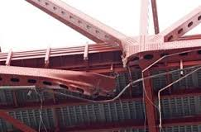
Matthews BRIDGE REPAIR
Steven Fowler and Maria Ruiz from RS&H gave a presentation on the Matthews Bridge Repair
The presentation provided members insight on expedient and innovative engineering methods and applications used to attain an engineering solution
20 members attended
The Matthews Bridge repair was popular due to its groundbreaking solution significant impact on the city of Jacksonville

Slide 14
Engineering Panel
Corey Chaissen (AMEC), Sonya Johnson (RS&H), Brian McGarity (Superior Construction), and Brett Manzie (CH2M-HILL) provided members insight on ‘life as an engineer’ of the various fields.
The panel also discussed the transition between college and their career fields
30 members attended
The engineering panel was popular due to the broad range of civil engineering fields, which pertained to a larger audience

Slide 15
Student conference
Location: University of South Florida
March 27-29, 2014
23 students attended

Slide 16
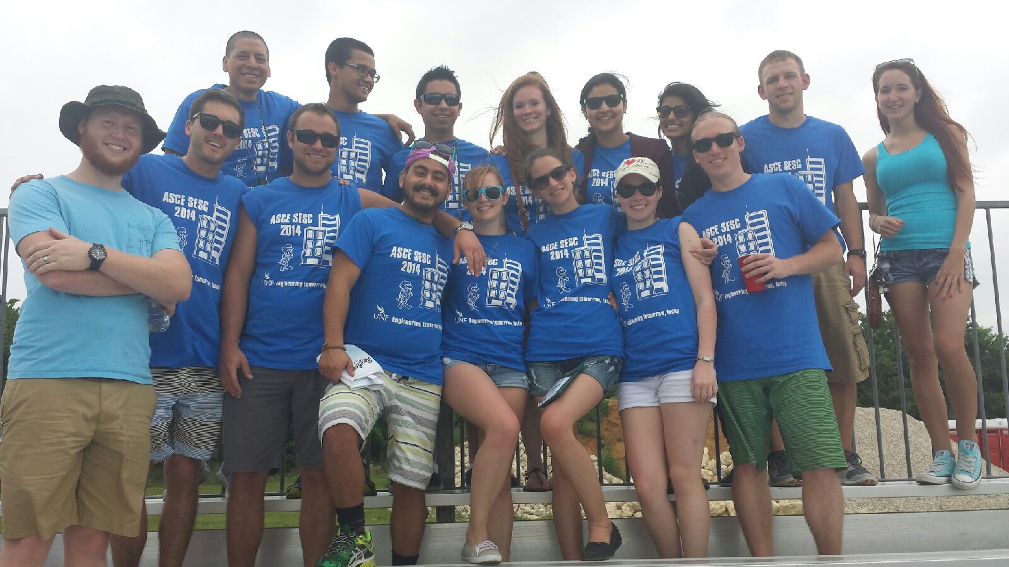
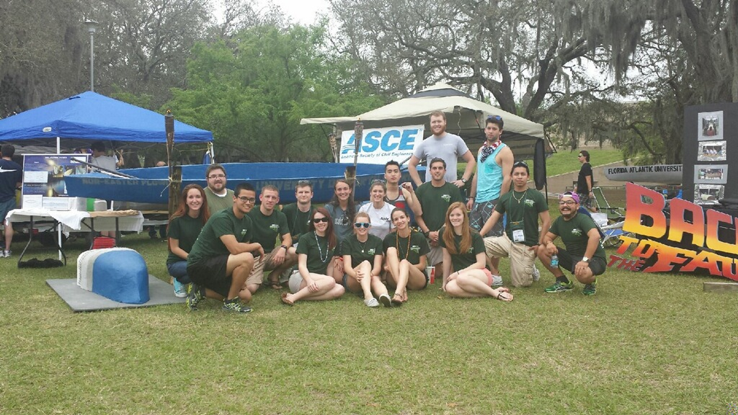
2014 Southeast Conference results
Geotechnical (18th)
Plans Reading (4th)
Hydraulic Jump (14th)
T-Shirt (14th)
Visual Display (17th)
Surveying (9th)
Concrete Canoe (16th)
Steel Bridge (24th)
Shuffle Board (3rd)
Environmental (9th)
Balsa Wood Pyramid (17th)
Professional Paper (4th)

Slide 17
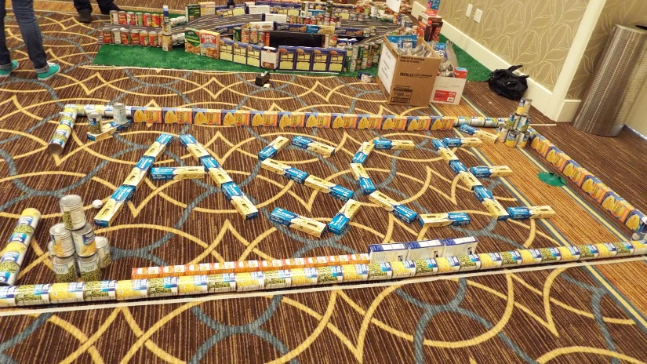
PETERS YAFFEE: BUILD, Putt, and give food and scholarship drive
Participation
10 student members participated in the event
23% of total membership were involved
1 Faculty/Practitioner advisor attended
An average of 6 hours were invested per member
Description
Student members were paired with local engineering companies to design/build a miniature golf hole from a food drive
The food was donated to Second Harvest Food Bank

Slide 18
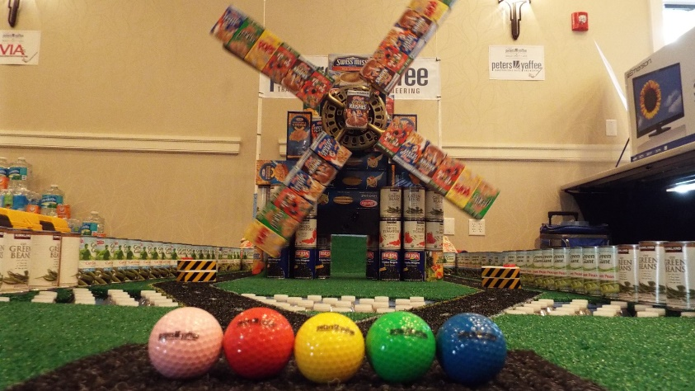
PETERS YAFFEE: BUILD, Putt, and give food and scholarship drive
Goals
Donate as much food possible
Allow members to network with local companies
Present creativity in design/build of miniature golf hole
The project goals coincided with our chapter goals by increasing local company involvement with our chapter
Project Impact
The project provided food for hungry families in the immediate future
The project set an example for the local community to pay it forward and make our society a better place

Slide 19
Summary and Questions
What were the most significant events of the year?
-Build, Putt, Give Food and Scholarship Drive
-Joint ASCE/COPRI Rope’s Course
What were the most significant challenges?
-Increasing national membership
-Getting Freshman and Sophomores involved

