Slide 1
ASCE Engineer & Survey Staking Tomorrow Leonard H. Gabrielson, P.L.S August 13, 2020
ASCE Can Help You Engineer Tomorrow Kenneth H. Rosenfield, P.E., F.ASCE, Env SP
Introduction
Surveying & Civil Engineers Guiding Standards
The Importance of Surveying and Engineers Interaction
Surveying & Civil Engineers Interaction Tools
Examples
The future?
Questions

Slide 2
What Do They Do?
A land surveyor takes precise measurements to identify the boundaries of a parcel of land and prepares reports, maps, and plots that are used for construction, deeds, or other legal documents.
The precise location of roads, buildings, and other features that are used to determine any changes to the property line, restrictions on what may be built on a property or where new structures must be located, how large structures may be, and the appropriate building depths for foundations.
Existing corner records, records of survey, and maps are used by a land surveyor to help locate your property line/corners, and other survey related monuments.
https://sonomacounty.ca.gov/PRMD/Eng-and-Constr/Surveyor/Land-Surveyor/

Slide 3
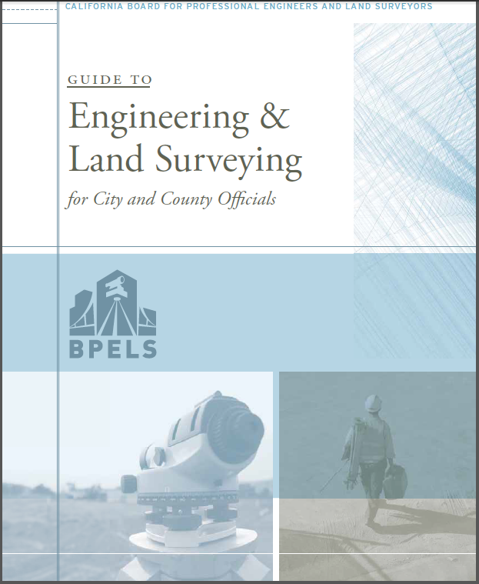
Surveying & Civil Engineers Guiding Standards
Notes:
The Board of Professional Engineer & Land Surveyors is the professional engineering organization to have developed the scholarly work defining the regulation that govern survey and staking.
The Civil Engineering Body of Knowledge defines the knowledge, skills, and attitudes necessary to exercise responsible charge in the practice of Surveying. It provides guidance to surveyor. The Body of Knowledge will continue to evolve to reflect the rapidly changing environment in which we practice.
The third edition of the Body of Knowledge, was published in 2019, and is available as a free download on the ASCE website.

Slide 4
Where can I get a copy of the laws dealing with engineers and land surveyors?
The powers and duties of the Board rest with the authority given in the Professional Engineers Act (Business and Professions Code §§ 6700 - 6799), the Professional Land Surveyors Act (Business and Professions Code §§ 8700 - 8805), and the Board’s regulations as codified in Title 16, California Code of Regulations, §§ 400 – 476 (often referred to as the “Board Rules”). The laws are available on the Board’s Web site at www.pels.ca.gov.
Reference: https://www.bpelsg.ca.gov/pubs/local_officials_guide.pdf

Slide 5
The Importance of Surveying and Engineers Interaction
Surveyor provides Engineer existing condition data
Engineer provides design to Surveyor for staking
Surveyor stake design
All staking should be offset from the work it is intended to control and in such a manner that the construction work can be completed using common hand tools. Staking should remain undisturbed during construction so that continual control of work can be maintained.
The Contractor is responsible for protecting stakes throughout the time they are needed. Should it become necessary to destroy stakes or monuments, the Project Engineer or Party Chief will be notified and given lead time to allow referencing the stakes for later use.
Here are the construction stake categories that may be susceptible to being disturbed and/ or destroyed by tractors, diggers or vandals:
Road Projects
Clearing and grubbing stakes
Rough grade stakes
Slope stakes
Pavement stakes
Curb stakes
Sidewalks
Wall stakes and Retaining Wall Stakes
Storm Drain and Sewers
Junction structures, chambers, and maintenance holes
Catch Basins
Drop inlets for sewers
Dry Utilities/ Non gravity flow utilities
Parking Lots
During Construction Surveyor provides Engineer data
After construction complete Surveyor provides data to Engineer for Record Drawings

Slide 6
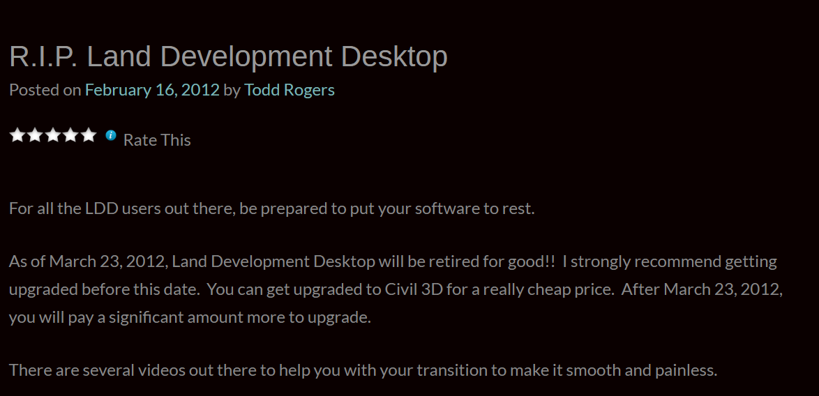
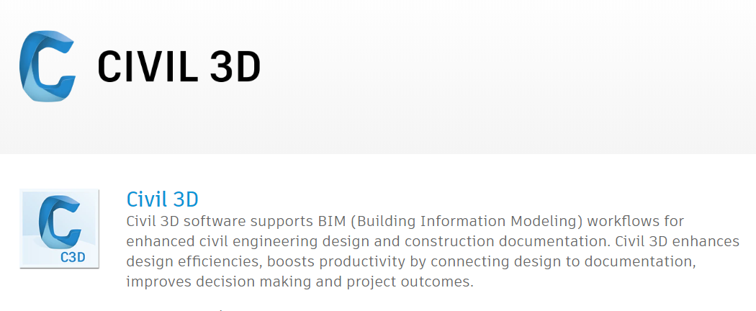
Surveying & Civil Engineers Interaction Tools
Land Development Desktop (LDD)
AutoCAD Land Desktop software simplifies time-consuming land planning tasks and combines centralized data management to streamline design and analysis collaboration. Built on AutoCAD 2009 and AutoCAD Map 3D 2009 software platforms, AutoCAD Land Desktop enables land development professionals to create maps, model terrain, label COGO points, perform alignments, and define parcels quickly and easily
(https://landsurveyorsunited.com/hubs/landdesktopdevelopment)
https://civil3dj.wordpress.com/2012/02/16/r-i-p-land-development-desktop/
Notes:
The technology Surveying and Engineers use to interact (exchange data) is an evolving field. Companies have developed and continue to develop software that allows for faster and accurate data exchange. The main platform (software) group that has defined the way this field is evolving is AutoCad and this company continuously works to be the leaders in this industry. It is it up to the users of this software, the Surveyor and the Civil Engineer to utilize the available tools in a way that makes their interaction efficient.

Slide 7
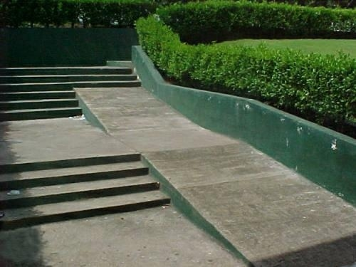
Examples….why it’s a team sport….

Slide 8
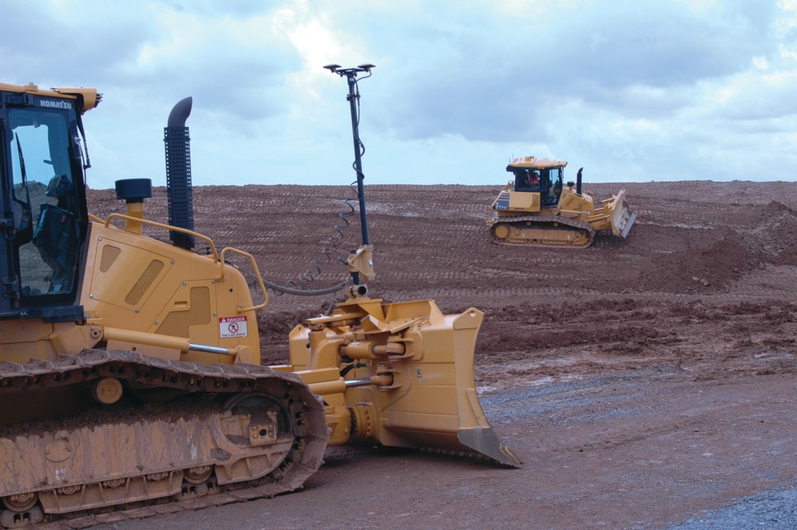
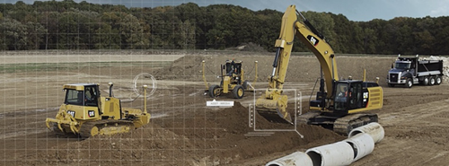
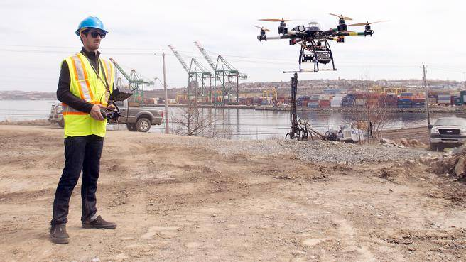
The future…
….but I only see one person…..

Slide 9
Questions?

