Slide 1
What is Engineering?
John Smith, NEASCE
Notes:
Introduction
Here to talk about engineering
Who can tell me what an engineer is?
Engineers change the world all the time by dreaming up solutions to problems people encounter every day. Engineers work in teams to invent, design and create things that people can use!
Hopefully by the end of the presentation, when I ask the question again, you can give me lots of examples of the types of things engineers create and how they affect the world you live in.
I’m here because its Engineering Week. Do you know why this is engineering week?

Slide 2
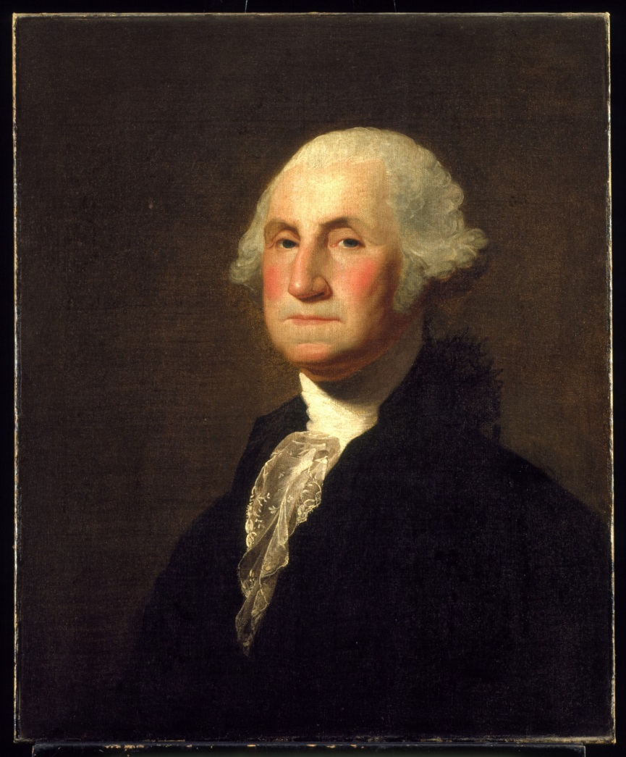
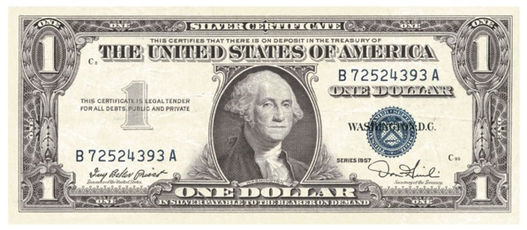
GEORGE WASHINGTON
Notes:
Who can tell me who this guy is?
George Washington was an engineer, did you know that? And since his birthday was Feb 22nd, this is engineers week.

Slide 3
NASA Video
Notes:
I’m going to show you a video that will tell you a little more about engineering.
From this video, what did you learn about engineering?
Start with a question. Work on problems.
Brainstorm ideas.
Develop a plan.
Create and Test.

Slide 4
Design Process
Identify Problem
Brainstorm
Design
Build – Test – Redesign
Share
Notes:
-This is called the design process. This is how engineers create things that work and help people out.
- Here’s an example of the design process. How many of you like football? How many of you know what football is?

Slide 5
Memorial Stadium in 1923
Notes:
Well all the way back in 1923 some engineers got together to solve a problem – how can thousands of people watch people play football, and how can we make it a memorial to Nebraskans who died fighting in World War 1?
They designed and built Memorial Stadium. I’m sure they went through lots of ideas before settling on this one.

Slide 6
Memorial Stadium in 1923
Notes:
- But in 1967, it was too small, so they had to redesign to add skyboxes

Slide 7
Notes:
- In 1994, they had to add four big screen TV’s
- In 2006 they wanted the “Biggest Big Screen” in the world (at the time) to watch replays on (North Stadium)

Slide 8
Memorial Stadium Today
Notes:
-2011 they needed a bigger and better stadium so they added the east stadium addition with more seats and twice as many skyboxes.

Slide 9
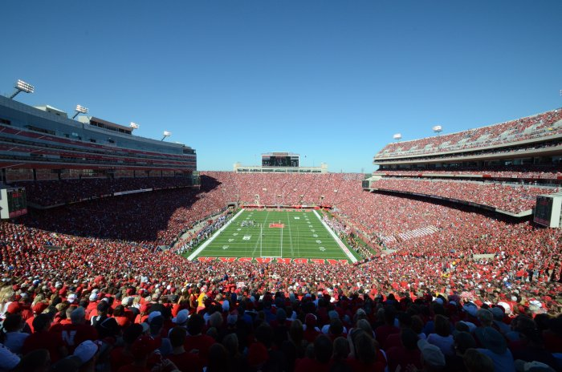
Memorial Stadium Today
Notes:
Now today Nebraska has one of the best football stadiums to watch a football game in and it all had to do with a team of engineers seeing a problem, coming up with a solution for that problem, designing the solution, and building it.
~ 10 Mins

Slide 10
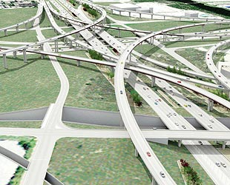
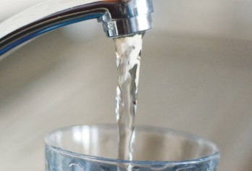
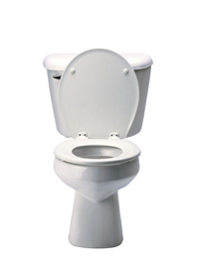
What is Civil Engineering?
The design and maintenance of public works such as roads, bridges, water and energy systems
Notes:
There are lots of type of engineers. Engineers that work with space, oceans, factories, robots, etc.
I’m a Civil Engineer – we work to solve problems you encounter when trying to create or live in a city –we work on things for the public.
Name a few public services you used this morning – I’ll give you an example – did anyone ride a bus to school today? Did that bus drive on a road? The city built that road so everyone can use it.
What other public works or public facilities can you think of?
These are all inventions that make your life’s better – clean water so you don’t get sick and don’t have to walk to a well, toilets that smell better than an outhouse, roads that aren’t bumpy, muddy or snowy, bridges to cross rivers.

Slide 11
WEST DODGE EXPRESSWAY
Notes:
In my job, I work mostly with roads – like the West Dodge Expressway – has anyone driven on or under this?
Who remembers the design process?
I help solve the problem of cars, busses, trucks and people getting from one place to another. I plan out and create instructions to build roads.
What about when two roads come together? How can you keep cars from running into each other?
How do you test your ideas without causing accidents – we use computers to develop simulations that are like video games

Slide 12
SCHUYLER ROUNDABOUT

Slide 13
COUNCIL BLUFFS SOUTH WATER TREATMENT PLANT
Notes:
Who can tell me where the water comes from that is in your faucet?
Starts out as rain, goes into a lake or river, but it is muddy and contaminated
That’s a problem, so teams of engineers create big factories that clean the water then pump it your house in underground pipes so you don’t have to come get it every day

Slide 14
NEBRASKA CITY POWER PLANT EXPANSION
Notes:
- Its similar with the electricity you use every day to cook food, heat your house, play video games.

Slide 15
Sunshine Skyway Bridge
Notes:
Engineers aren’t always building stuff. Sometimes we have to figure out how to take things down.
~ 20 mins

Slide 16
Paper Bridge - Construction
1 Sheet of paper and 5 paper clips are the only allowed materials
Materials are limited by cost and standard construction methods
The bridge must span 8 inches. No mid-span piers allowed – the only supports are the provided abutments
Bridge must provide enough clearance for water or other vehicles (boats, trains, cars, etc.)
Notes:
Ask for questions first.
Teams of 2
5 mins for brainstorming and planning – use your first piece of paper.
5 mins for construction – use your second piece of paper – you will use this bridge to test
Testing – when time is up, take turns, and test the bridges
Announce the winner
Discuss why some things worked and some didn’t
- What shapes worked the best?

Slide 17
Paper Bridge - Testing
The bridge cannot be attached to the books or table
The bridge will be loaded by placing pennies on top of the bridge, between the supports. Pennies cannot be placed inside the bridge in any way. Pennies may not be placed over the supports.
Pennies cannot support the structure.

Slide 18
Paper Bridge - Scoring
A participant’s score is the total number of pennies held before failure.
Testing will be ended if pennies fall off of the bridge during loading. Only those penning remaining on the bridge will be counted.
The cars have to be able to stay on the road!
When the bridge fails, the number of pennies already resting on the bridge will be counted. Pennies placed on the bridge during failure will not count.

Slide 19
QUESTIONS?

