Slide 1
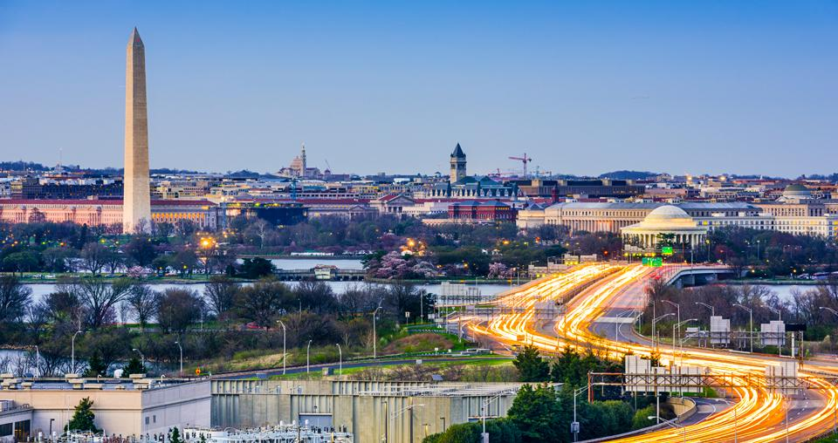
TRANSITIONING FROM THEORY TO PRACTICE

Slide 2
Meet the Young Professional Council
Josh Szmergalski
Project Engineer, Chair
Mary Taylor
Project Engineer
Cody Largent
Engineer in Training
Allyson Smith
Project Engineer
Greg Lisowski
Project Engineer

Slide 3
What is the Young Professional Council?
“The Board of Governors of the Architectural Engineering Institute created the Young Professional Council (YPC) to bring young architectural engineering professionals together to engage the next generation of leaders and to strengthen the architectural engineering industry.”

Slide 4
Today’s Session
Panel Discussion - Being a Young Professional - Seasoned Professionals
Subgroup Discussion
Full Group Discussion - Q & A
How can the YPC help you achieve your goals - Live Polling
Notes:
7 Minutes - Introductions etc...
30 Minutes
15 Minutes
15 Minutes
15 Minutes
7 Minutes - Closing etc..

Slide 5
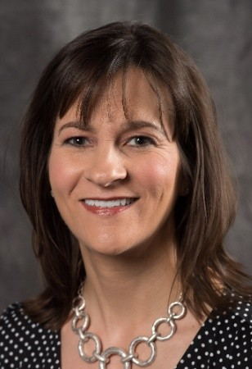
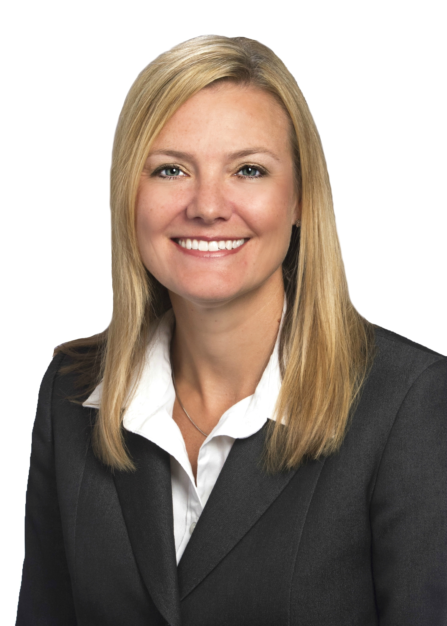
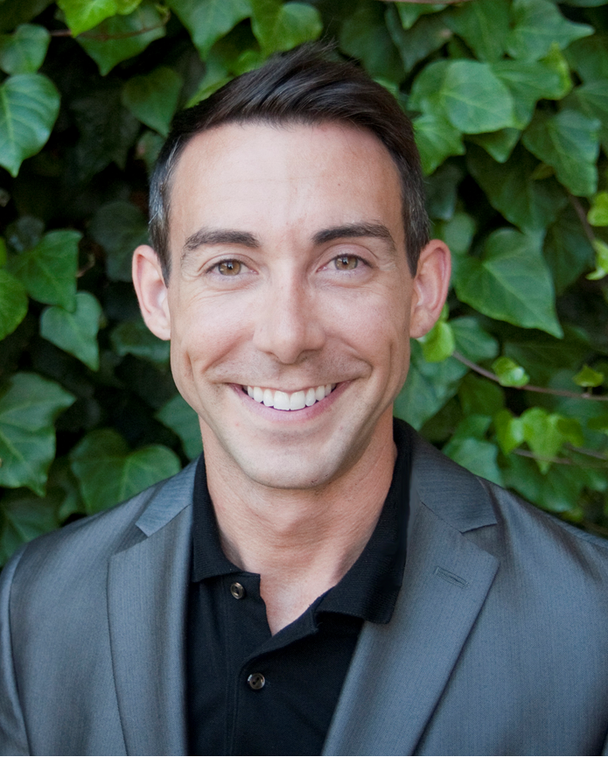
Meet Today’s Panel
Heather Wishart-Smith
Vice President
Jacobs
Jennifer Mitarotonda
Senior Associate
WSP Global
Wil Srubar
Assistant Professor
University of Colorado
Notes:
As a PM, what do I want my team to know coming in? What do I expect them learn?
Continuing education and professional registration/exams (PE, SE)
It's OK to ask questions/admit when you don't know something
How do I stay involved in prof orgs/AEI?

Slide 6
Subgroup Discussion
Networking/Introductions
Discussion Questions
What would you like to ask the panel?
Brainstorm how to get AEI & the YPC more involved.
What are some challenges you may face?
What are some of your experiences?
What are some of your questions of what may be around the corner?

Slide 7
Full Group Discussion
Key Takeaways to share with the full group
Questions that may interest the whole group
Collect ideas on engagement
Was there a consensus on some of the main questions everyone had?

Slide 8
Live Polling
Notes:
Geographic Areas
Interest in events:
Get together social events?
Webinars / technical groups?
Coordinating study groups for the PE?
Other Groups that you’re involved with?
How often do you participate with those groups?
What are some activities they do?
Joint activities with ASCE?
If we could engage the general pool of AEI members with AEI:
Local mentor - meet ups to talk and network about being a professional and the industry?
Networking events that interest a larger pool of the AEI membership
How often would you be willing to take part in AEI activities throughout the year?

Slide 9
Thank You!
Josh Szmergalski jszmergalski@csd-eng.com
Mary Taylor
Greg Lisowski glisowski@cdsmith.com

