Slide 1
Florida International University
American Society of Civil Engineers Student Chapter
Notes:
Use your own theme and layout (View-slide master or similar). Add photos, logos and graphics. Throughout this template file, text in italics should be replaced with more specific titles.

Slide 2
Contact Information
ASCE Student Organization Mailing Address: | 10555 West Flagler St. Room #3790 Miami, FL. 33174
ASCE Student Organization E-mail Address: | asce@fiu.edu
ASCE Student Organization web site: | http://asce.fiu.edu

Slide 3
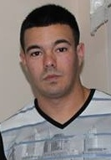
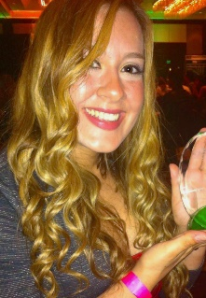
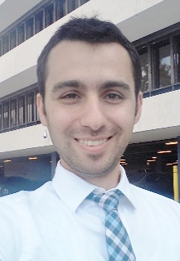
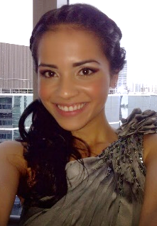
Student Officers
President | VP of Professional Affairs | VP of Student Affairs | Secretary | Treasurer
Camila Perez | Rolando Alvarez | Ana Holmann | Reza Sheykhi | Edna Pertuz
cpere112 @fiu.edu | ralva026 @fiu.edu | anakholmann @hotmail.com | rsheykhi @fiu.com | epert002 @fiu.edu
786-247-9503 | 786-499-9339 | 786-863-2464 | 786-505-0020 | 786-287-0497
Notes:
Photos!

Slide 4
Advisors
Faculty Advisor Name: | Hesham Ali
Faculty Advisor ASCE Member Number: | 292297
Faculty Advisor E-mail Address: | heaali@fiu.edu
Faculty Advisor Phone Number: | 954-224-8660
Faculty Advisor Fax Number: | 305-348-2802
Practitioner Advisor Name: | Daniel Suarez
Practitioner Advisor ASCE Member Number: | 9669613
Practitioner Advisor E-mail Address: | daniel.suarez@kimley-horn.com
Practitioner Advisor Phone Number: | 305-535-7730
Notes:
Photos!

Slide 5
Financial Summary
Dues ($/year, semester) | $10 one time
Total income | $7,405.00
Total expenditures | $5,807.20
Cash balance | $1,597.80

Slide 6
Goals and Objectives
Summary statement
It is FIU ASCE’s mission to encourage all civil engineering students at the university to become more involved within the university and the community. In order to help students become more involved, FIU ASCE will work hard to increase active membership in ASCE at FIU (Goal #1). This will be accomplished by improving the chapter’s communication system by maintaining an up-to-date website and making use of social media (Goal #2).
Through this website and social media, the e-board will be able to notify students about events, scholarships, internships, and jobs with ease. Moreover, the chapter will work to improve professional involvement with FIU ASCE members (Goal #3).
Every year FIU ASCE participates in the ASCE South East Conference. FIU ASCE will strive to increase participation in the conference (Goal #4) with hopes of creating a culture of capable engineers willing to put their ideas on the line by competing against other universities. Sponsorship is a big obstacle that we will face when preparing to participate in the conference and so the chapter will work hard to meet the financial obligations (Goal #5). In order to make the conference a big success, FIU ASCE will need the help of many FIU faculty and staff and so it is important that the chapter maintains a strong presence within the FIU community (Goal #6).
Notes:
Three goals are suggested, add more if you wish

Slide 7
Goals and Objectives
Goal 1 | Increase membership in the chapter by 25 percent.
Goal 2 | Increase FIU ASCE’s online presence.
Goal 3 | Improve professional involvement with FIU ASCE members.
Goal 4 | Increase participation and number of registered members in the ASCE Southeast Student Conference.
Goal 5 | Meet the sponsorship goal set for preparing the ASCE Southeast Student Conference 2015.
Goal 6 | Increase the organization’s involvement in the main campus.
Notes:
Three goals are suggested, add more if you wish

Slide 8
Goal 1. Increase membership in the chapter by 25 percent.
Action plan | Visit entry level civil engineering courses to inform students about the benefits that come from joining ASCE. Set up display tables at the EC on the first week of each semester.
Assessment | Through the use of the updated FIU ASCE website, students were able to sign up as members and pay the new membership fee. Through the use of Facebook, members were able to stay updated on the upcoming and latest events. The website, asce.fiu.edu, was officially improved in August. A webmaster was appointed in order to keep the site upto date. There was a marked increase in attendance on events that were also advertised through Facebook. The use of a payment system in the website for Conference fees helped the members pay on time.
Follow-up plan for the future | The chapter should continue following this action plan in order to increase membership even more. However, attention should be paid to making members more active in the organization since many of the new recruits are not very active.

Slide 9
Goal 2. Increase FIU ASCE’s online presence.
Action plan | The new e-board will improve the chapter’s website and will regularly update it to ensure that information is readily available to members. The e-board will also make use of social media, such as Facebook.
Assessment | During the Summer and Fall semesters, ASCE is expecting 25 new members. This is being done through visiting courses such as Statics and Computer Tools, and more introductory courses. The goal was accomplished and surpassed all expectations. Due to the recruiting reports, an outstanding 45 new members were recruited in the summer and fall semesters in 2014. This was achieved due to visiting Mechanics of Materials, Dynamics, and Computer Tools for CE class. Although tabling is a great way of increasing the organization’s visibility on campus, it is not nearly as effective as visiting classes.
Follow-up plan for the future | In order to increase traffic on the chapter website, new internship/job/scholarship announcements should lead members to the website for details rather than containing all of the information within the email. This tactic forced members to visit our site and see what we have to offer. Many members became regular visitors on our site after this change was implemented.

Slide 10
Goal 3. Improve professional involvement with FIU ASCE members.
Action plan | The chapter will work to improve professional involvement with FIU ASCE members. This can be achieved through Career Fairs and professional presentations from individual firms.
Assessment | The chapter hosted an initiation ceremony for new and returning members, where hard-hats were given to members to encourage fieldtrips and civil engineering involvement outside of class. Part of the Miami Dade Branch and Faculty attended this event. The Career Fair is being planned to invite about 10 companies who are searching for students or recent graduates. The involvement of the professional branch was accomplished by hosting the FIU ASCE Career Fair during the Fall Semester of 2014. This was an opportunity to improve the participation of the members and the student chapter with professional firms.
Follow-up plan for the future | Professional activities are very motivational for all students and ASCE members, thus the Career Fair and professional presentations gather a large number of members together. This is a great tactic to maintain a united and motivated organization for the following years.

Slide 11
Goal 4. Increase in the ASCE Southeast Student Conference.
Action plan | The chapter will have conference meetings starting in the fall semester to introduce members to conference and make them excited.
Assessment | The Steel Bridge and Concrete Canoe teams began working by early October and teams for small competitions were finalized by December. As of January, FIU ASCE has +10 members registered for the upcoming conference, the ASCE SESC 2015. We expect that about 30 members will be registered by February. The teams for the small competitions have been finalized and much progress is being done. Teams are meeting weekly to have their best results for the conference.
Follow-up plan for the future | It is important to approach faculty members for guidance in the Steel Bridge and Concrete Canoe competitions. This should be done as early as possible.

Slide 12
Goal 5. Meet the sponsorship goals for preparing the ASCE Conference 2015.
Action plan | ASCE Southeast Student Conference will be hosted in Tennessee on 2015. The FIU chapter will need sponsorships to allow students to attend this conference and participate fully.
Assessment | The goal of the chapter is raising +$7000 to prepare the teams for the ASCE SESC 2015. The chapter will be in charge of approaching companies for sponsorship. "To date, the sponsorship committee has received or is expecting a total of $2,500 in sponsorship. The committee will continue to find sponsors in order to increase the quality of the conference. "
Follow-up plan for the future | Once conference is over, the e-board will continue to use the techniques learned here in order to secure sponsorship for the chapter in the future.

Slide 13
Goal 6. Increase the organization’s involvement in the main campus
Action plan | Since the engineering building is not located within the FIU main campus, it is hard to maintain close ties with therest of the FIU community. For that reason, FIU ASCE will participate in events in the main campus as often aspossible and will participate in the Council for Student Organization’s point system.
Assessment | FIU ASCE participated in many events at FIU’s main campus, including attending football games, attending professional presentations, participating in club fairs, and volunteering during Homecoming Week. Due to the chapter’s classification as “overly active”, FIU ASCE reached the status of “Gold Organization” within the Council of Student Organizations.
Follow-up plan for the future | Now that FIU ASCE is a “Gold Organization”, it will be easier for the upcoming eboard to obtain funding from the university. This status should be kept by the upcoming e-board and so it is important to maintain an active presence in the main campus.

Slide 14
Membership Statistics
114 members
114 ASCE National Society-level members
100% of members are Society-level members (Society-level/total members)
103 members with Junior and Senior status
250 Juniors and Seniors eligible to join ASCE (CE declared majors)
42% of eligible Juniors and Seniors that are members (Jr&Sr members / Jr&Sr eligible)
Notes:
Fill in numbers (from Statistical Data tab in excel sheet) where words are underlined.

Slide 15
Meeting Statistics
3 professional meetings with an invited speaker
7 student talks and papers
2 professional licensure and ethics topics presented
1 field trips
5 social functions
Notes:
Fill in numbers (from Statistical Data tab in excel sheet) where words are underlined.

Slide 16
Initiation Ceremony
In September, ASCE-FIU had its Initiation Ceremony with more than 40 chapter members attending. In this ceremony, Mr. Barton Fye, the ASCE Miami-Dade Branch President officially installed the new E-board. In addition, chapter hosted two other speakers, Ms. Maria Porrata (branch director) and Mr. Josenrique Cueto (branch president-elect) at its initiation ceremony. This meeting was a good opportunity for students to know new FIU chapter board and Miami-Dade branch board officers. They also obtained information about chapter activities and received hard hats.
Notes:
Use photos, logos, etc and describe each meeting

Slide 17
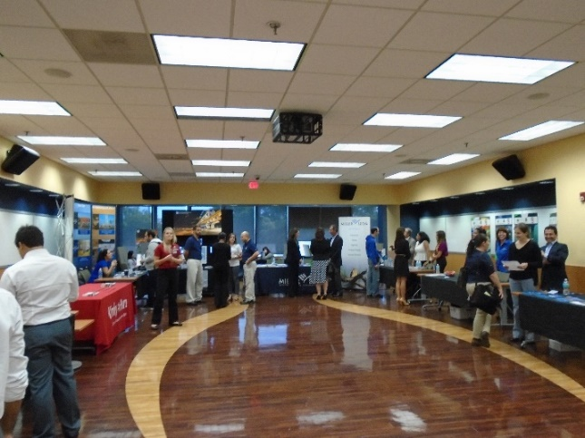
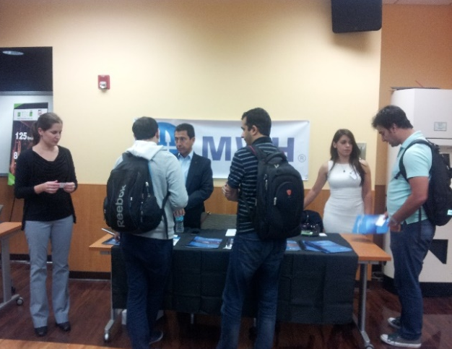
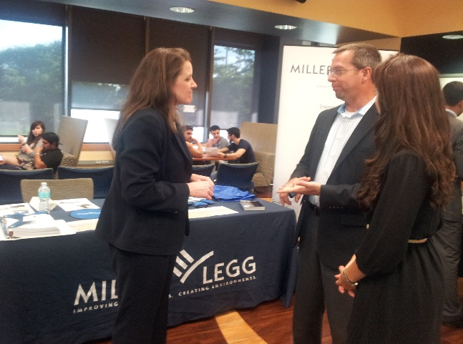
Career Fair
ASCE FIU Career Fair was a great opportunity for FIU students (especially Civil Engineering) to expose themselves to a set of high ranked companies in South Florida, such as MWH Global, Tetra Tech, Kimley-Horn, BCC Engineering, 300 Engineering, Miller Legg and Target Engineering Group. More than 100 FIU students used this opportunity to get in touch with real-world job opportunities and submitted their resumes to the companies. 2014 Career Fair was the best of its kind within the recent years in terms of number of the companies, number of attending students, size and location of the venue, and quality of the service offered to attending companies.
Notes:
Use photos, logos, etc and describe each meeting

Slide 18
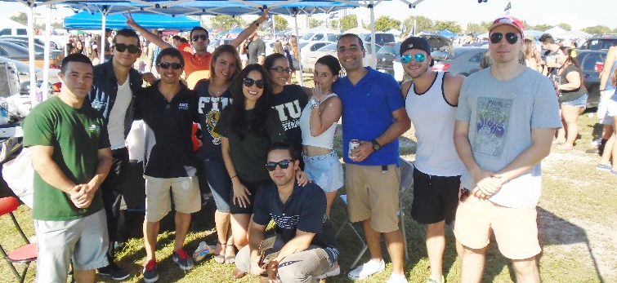
Homecoming Tailgate
In FIU Homecoming week, ASCE chapter participated in homecoming tailgate party along with other organizations and students. More than 20 ASCE FIU members and hundreds of other students attended this event.
Notes:
Use photos, logos, etc and describe each meeting

Slide 19
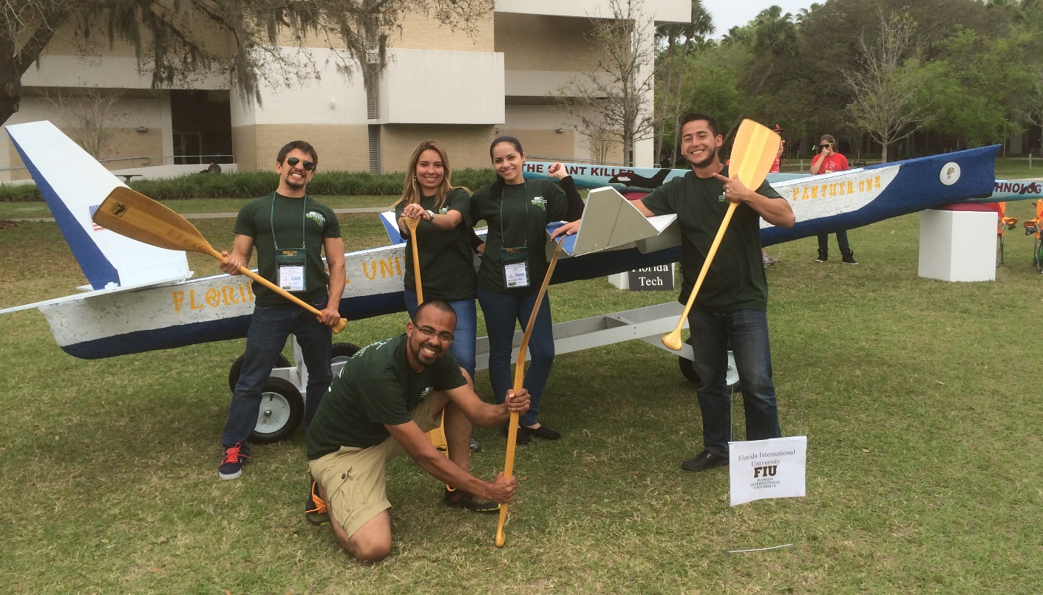
Student Conference
Name of Conference: ASCE Southeast Student Conference 2014
Location: University of South Florida, Tampa, Florida
Dates: March 28-29, 2014
Notes:
Add slides as necessary to highlight results

Slide 20
Leadership Development
Workshop for Student Chapter Leaders (WSCL)
Hyatt Regency, Miami, FL
January 10, 2015
Number of students and advisors that attended: 1
Notes:
Add a slide for each activity or conference attended. Other activities besides WSCL may be presented as well.

Slide 21
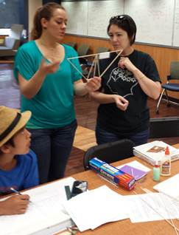
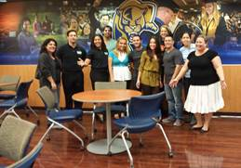
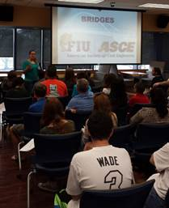
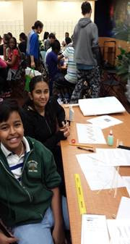
Special Project: Presentation in the SECME Bridge Seminar 2014, FIU
Participation
Number of students and percent of total membership that worked on the project: 12
Number of faculty and practitioners: 1
Total person-hours spent on the project: 20
Description
To awaken the interest of young students in civil engineering, and present to them the benefits of becoming involved in an associations of their concentration.
These young students are working on their team-work skills, while creating one design to defend itself in competition. ASCE seeks the same goals – to compromise with multiple on one winning design.
Notes:
Use as many slides as necessary to adequately describe each special project

Slide 22
Special Project: Presentation in the SECME Bridge Seminar 2014, FIU
Engineering component
We gathered as teams, discussed the presented problem and tackled it step by step. When a plan was made, ASCE members helped these young students create a winning design for their balsa bridge, which was later taken to competitions.
Project impact
As young students are very impressionable, most were highly motivated when passionate engineering students shared conversations over mathematics and design. This competition is for most of them the first time they will create their own design, and possibly win a first place prize for it. These experiences are never forgotten, and these prices are the foundation of knowledge, confident engineers.
Notes:
Use as many slides as necessary to adequately describe each special project

Slide 23
Summary and Questions
What were the most significant events of the year?
What were the most significant challenges?
Offer to answer any questions
It is suggested that you present this slideshow
To a student chapter meeting, particularly at the beginning of each year
To your local ASCE Section or Branch officers, and/or one of their regular meetings
Other audiences as appropriate
Notes:
We would prefer that you limit to 60 slides or less, but if you have more that’s ok. When actually presenting to other groups, reorder the slides (instead of deleting, move extras to the end so you have them if questions come up) to only present a reasonable amount in the time you are given.

