Slide 1
University of South Florida
American Society of Civil Engineers Student Chapter
Annual Report January 2014- December 2014
Notes:
Use your own theme and layout (View-slide master or similar). Add photos, logos and graphics. Throughout this template file, text in italics should be replaced with more specific titles.

Slide 2
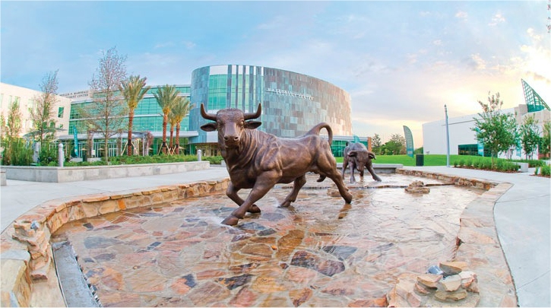
Contact Information
ASCE USF Student Chapter
University of South Florida
Department of Civil and Environmental Engineering
4202 East Fowler Ave. ENC 3300
Tampa, FL 33620
Like us on Facebook!
www.facebook.com/ASCE.USF

Slide 3
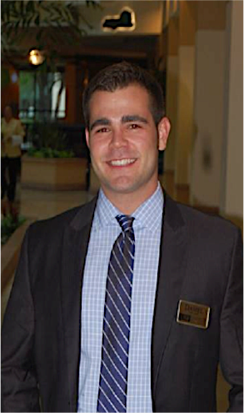
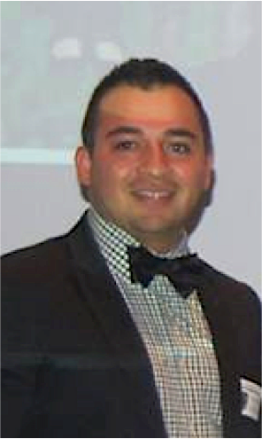
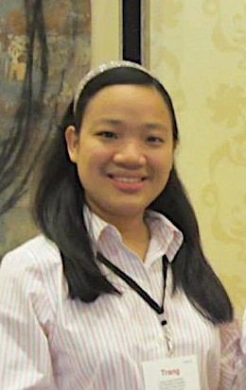
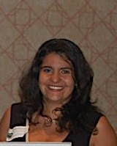
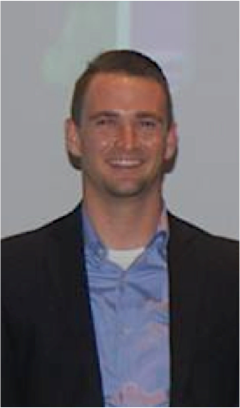
Student Officers
Daniel Happel
President
Gerson Monroy
Vice President
Trang Luong
Vice President
Of Activities
Ana Perez Martin
Secretary
Joe Troescher
Treasurer
APRIL 2013-APRIL 2014
Notes:
Photos!

Slide 4
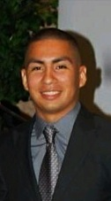
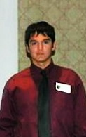
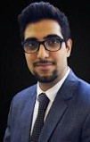
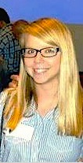
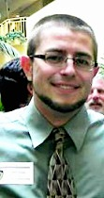
Student Officers
Franki Vallejo
President
Jeremy Castello
Vice President
Shayan Yazdani
Vice President
Of Activities
Caitlin McHale
Secretary
Adam Zions
Treasurer
APRIL 2014-APRIL 2015
Notes:
Photos!

Slide 5
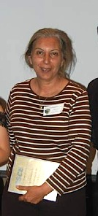
Advisors
Dr. Abla Zayed, PhD
Faculty Advisor
zayed@usf.edu
Notes:
Photos!

Slide 6
Financial Summary
Dues: $0, Our chapter does not charge members to join.
As of December 31, 2014
Total income: $22,835.60
Total expenditures: $19,016.14
Cash balance: $3,819.46
Accounts receivable: 0
Accounts payable: 0

Slide 7
Goals and objectives
The mission of the USF student chapter of ASCE is to enhance the personal and professional development of civil engineering students, to promote the College of Engineering, and to serve the community. This mission is accomplished through technical, professional, and civic activities by active participation in professional meetings, technical presentations and tours, community service, and competition in the annual Southeast Regional Conference.
Notes:
Three goals are suggested, add more if you wish

Slide 8
Goal 1
Expose ASCE members to engineering applications.
Action Plan: Executive board will conduct meetings with local firms to discuss tours and site visits.
Assessment: We have had many opportunities to visit a couple sites on the construction side of Civil Engineering, but we are working on including more trips with other focuses such as Water Quality and Transportation.
Follow-up plan for the future: Keep record of site tour coordinator. This will help plan more trips for ASCE and members get to see the project grow with time.

Slide 9
Goal 2
Get more members involved in leadership roles.
Action Plan: Create different opportunities for members such as event planning or coordinating.
Assessment: Since people like to have a sense of ownership in projects, we have seen a high demand for chair positions. As new opportunities arise, we continue to see new faces become new leaders. Roles are still a bit fluid, so we will definitely be defining roles and positions to avoid any confusions or overlapping in leadership.
Follow-up plan for the future: Finalize a set of chair positions that could become available as permanent positions in years to come.

Slide 10
Goal 3
Retain more members at chapter meeting attendance.
Action: Make it a top priority to have a guest speaker at each of our meetings. This will keep members engaged and wanting to return.
Assessment: This has proved to be very successful. Our numbers do not have a significant drop from meeting to meeting.
Follow-up plan for the future: Request feedback from members to assure the presenters are keeping everyone engaged, and make sure we have a mixture in topic focuses.

Slide 11
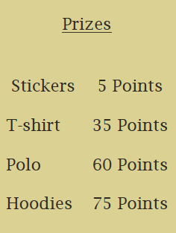
Goal 4
Increase member participation at all events.
Action: The newly elected executive board created an incentive program that awards points for each event a member attends. In turn, these points could be used to redeem merchandise.
Assessment: This has proved to be very successful. Members are constantly asking how many points will be rewarded for upcoming events.

Slide 12
Goal 4
Follow-up plan for the future: While we are happy with the results of the program, we hope that members come to events because they genuinely want to participate. The incentive program serves as the first step. Now, it is up to each individual to determine what they want to gain from his or her ASCE membership.

Slide 13
Membership statistics
119 members
84 ASCE National Society-level members
70% of members are Society-level members (Society-level/total members)
71 members with Junior and Senior status
248 Juniors and Seniors eligible to join ASCE (CE declared majors)
29% of eligible Juniors and Seniors that are members (Jr&Sr members / Jr&Sr eligible)
Notes:
Fill in numbers (from Statistical Data tab in excel sheet) where words are underlined.

Slide 14
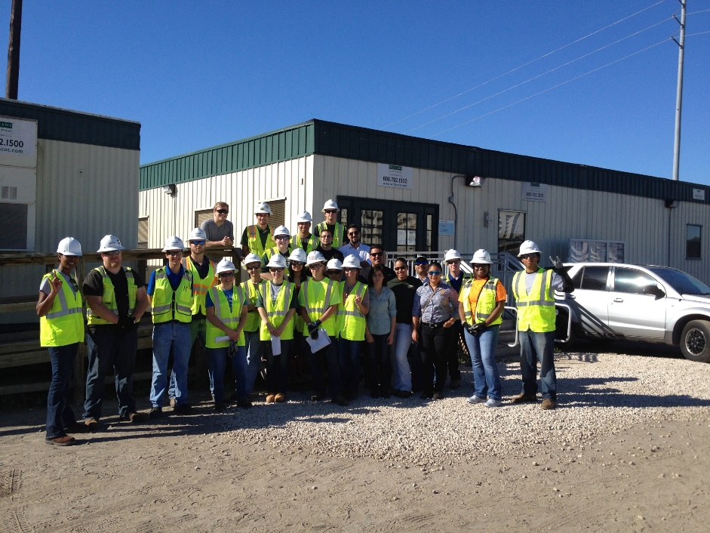
Meeting statistics
7 professional meetings with an invited speaker.
0 student talks and papers.
1 professional licensure and ethics topic presented.
2 field trips.
4 social functions.
Notes:
Fill in numbers (from Statistical Data tab in excel sheet) where words are underlined.

Slide 15
Guest Speakers
Notes:
Use photos, logos, etc and describe each meeting

Slide 16
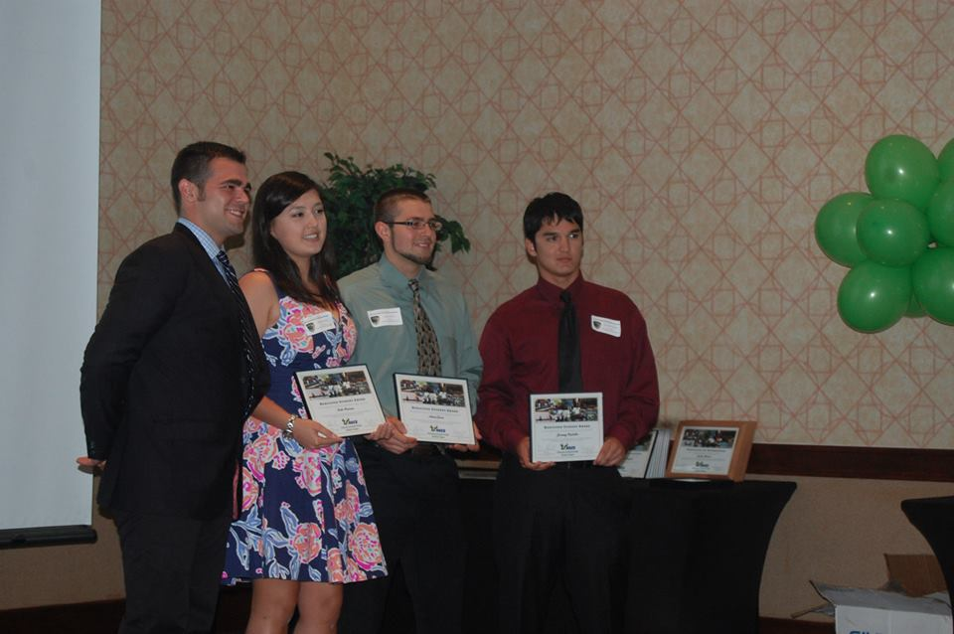
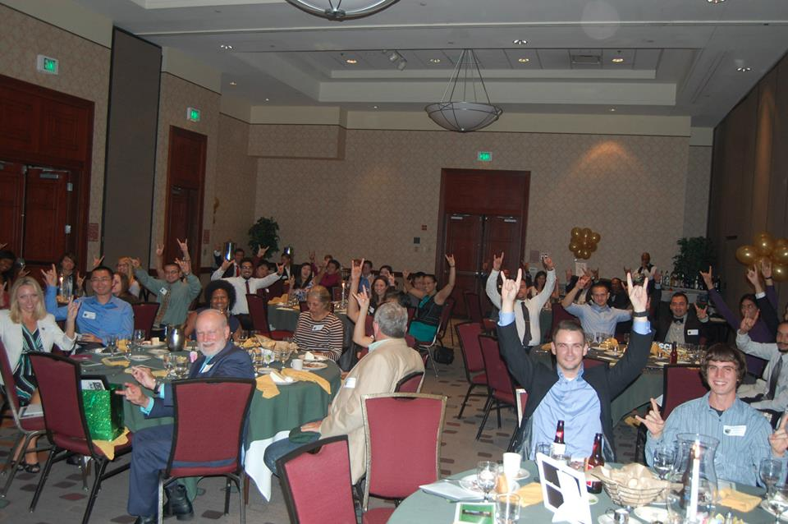
Spring Banquet
Both students and professionals gathered at the Embassy Suites to celebrate the accomplishments of the student chapter.
Guest speaker: Ray Chiaramonte, Executive Director of Hillsborough County Planning Commission, presented “Imagine 2040", a comprehensive transportation plan for Tampa, Temple Terrace, Plant City, and Hillsborough County.
Presentation of awards and installment of new officers.
Notes:
Use photos, logos, etc and describe each meeting

Slide 17
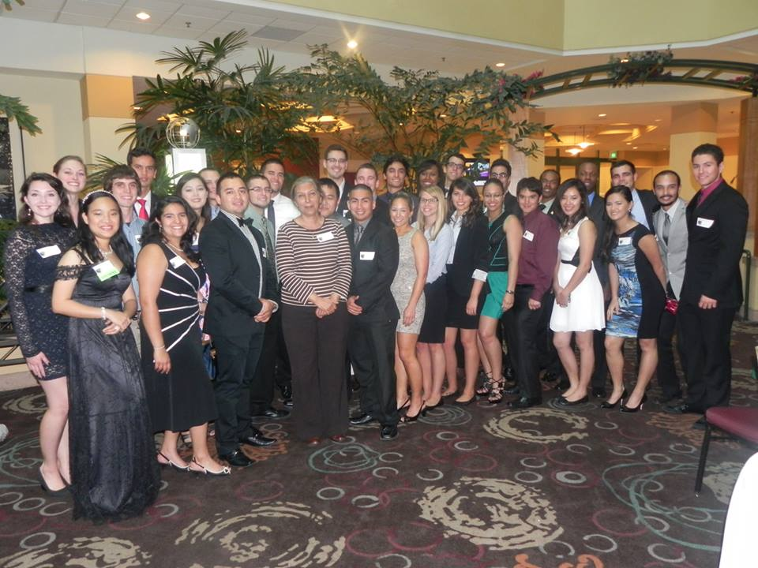
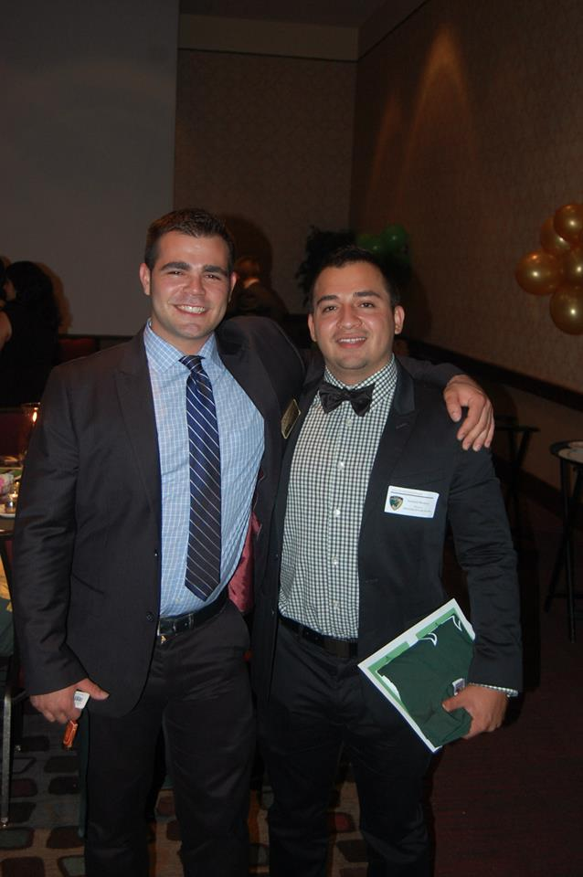
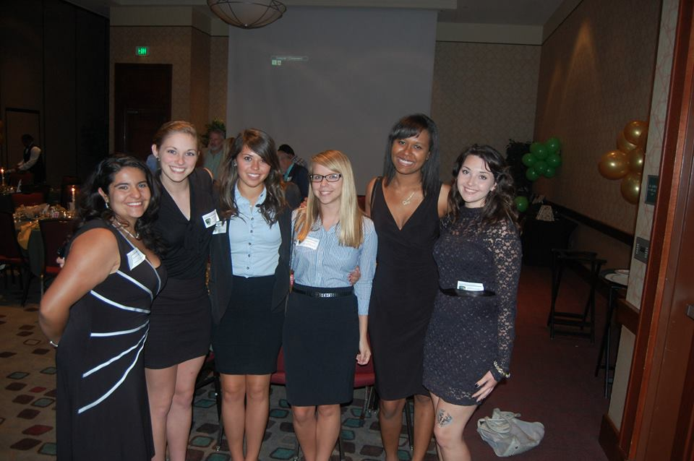
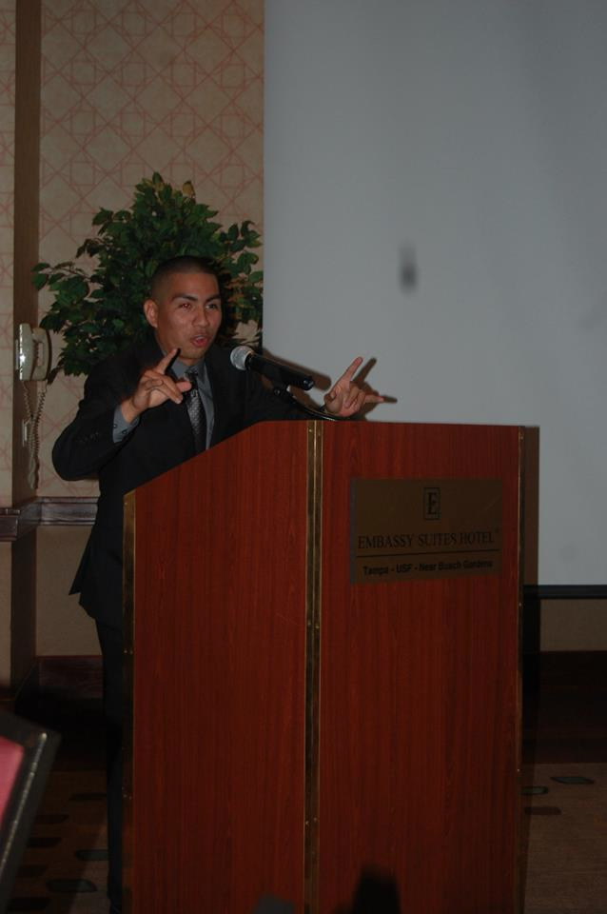
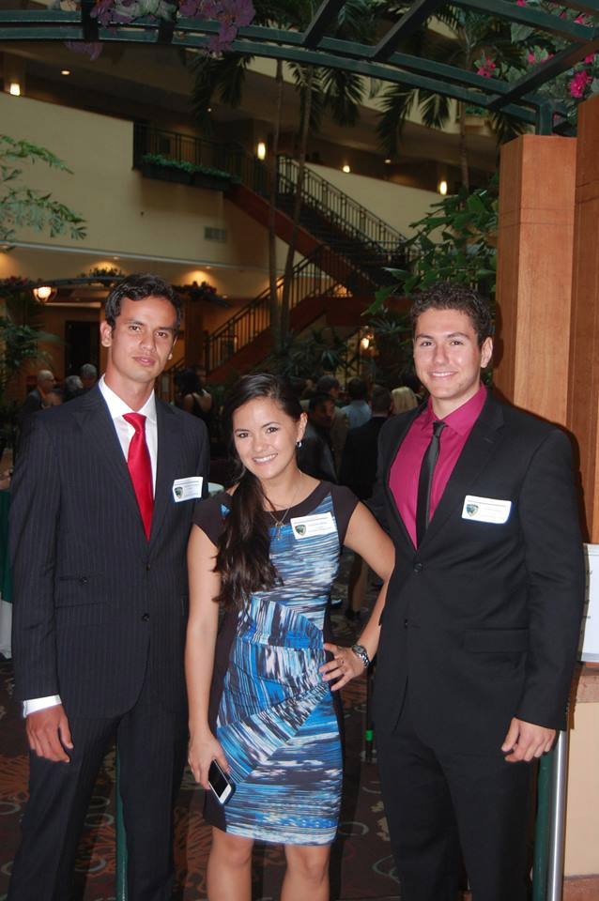
Spring Banquet
Notes:
Use photos, logos, etc and describe each meeting

Slide 18
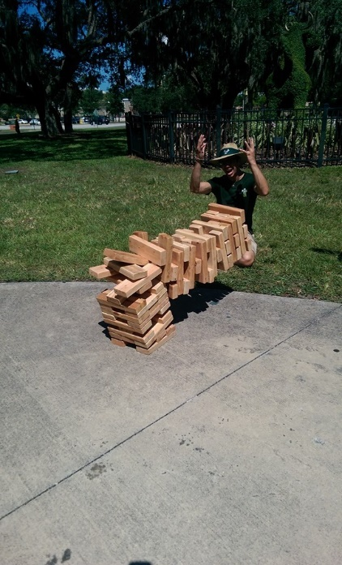
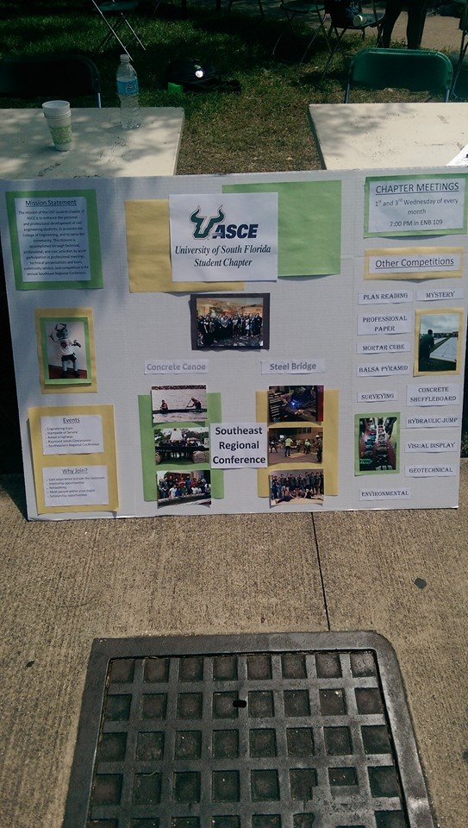
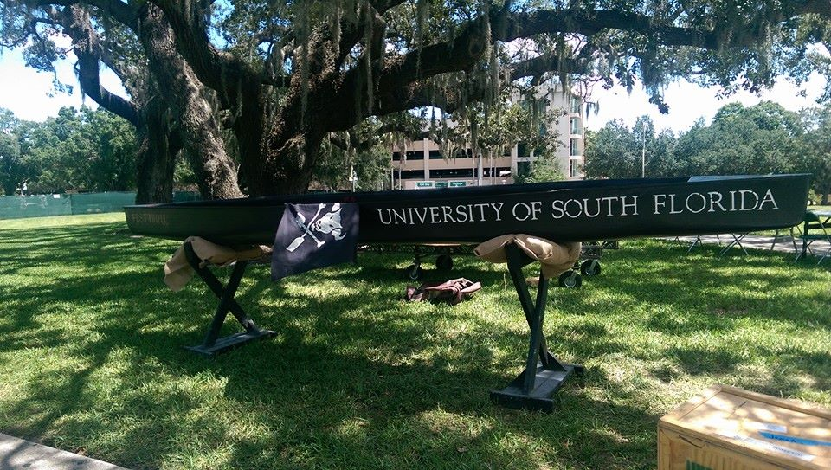
Bulls go green event
Event to promote sustainability in partner with the Student Environmental Association.
Food catered by Taco Bus.
Recruited 5 new members.
Participants had a blast playing Jenga and viewing the 2014 Concrete Canoe.
Notes:
Use photos, logos, etc and describe each meeting

Slide 19
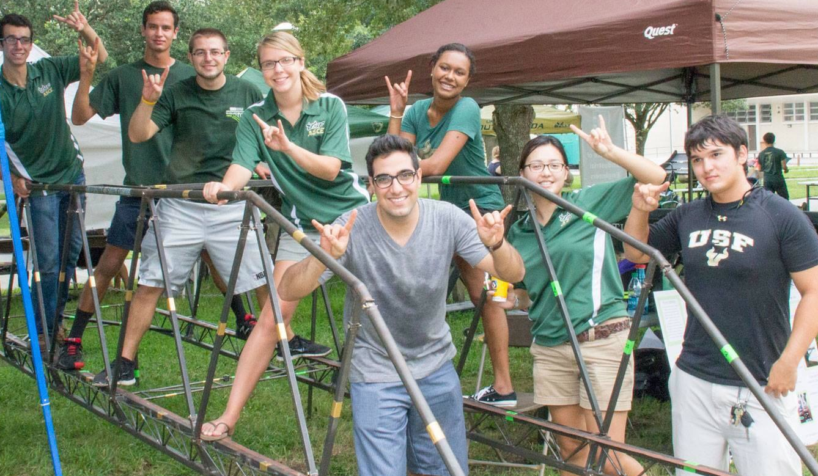
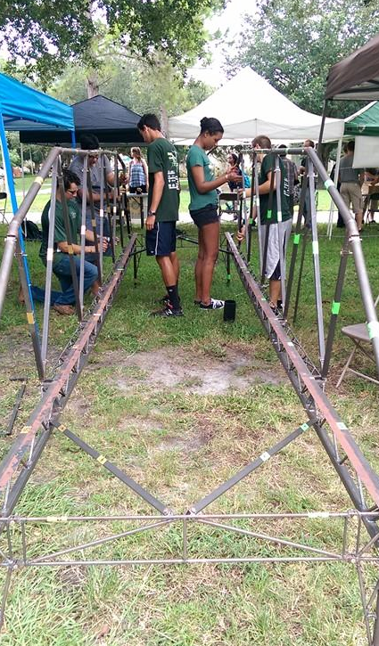
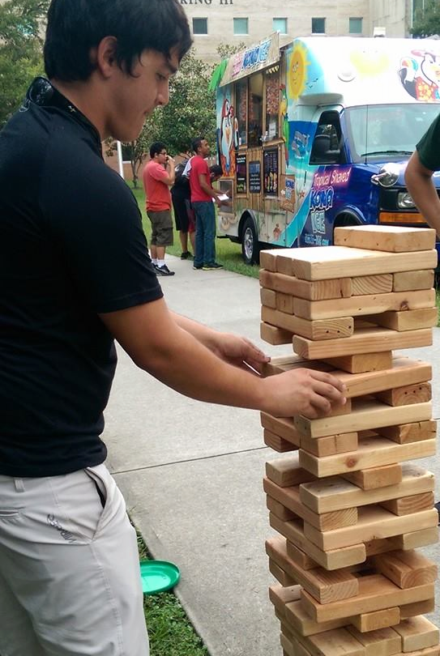
50th anniversary event
The USF College of Engineering hosted a week of welcome BBQ that also served as an event to celebrate the school’s 50th anniversary.
Steel bridge and concrete canoe on display.
10 new members recruited.
Notes:
Use photos, logos, etc and describe each meeting

Slide 20
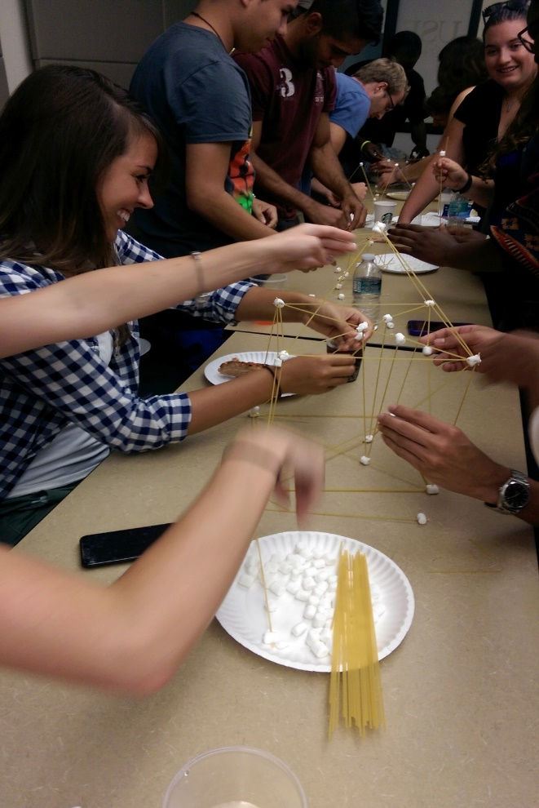
Pasta structures
First chapter meeting of the 2014 Fall semester.
36 members in attendance.
Icebreaker required members to build the tallest structure using spaghetti and marshmallows.
Notes:
Use photos, logos, etc and describe each meeting

Slide 21
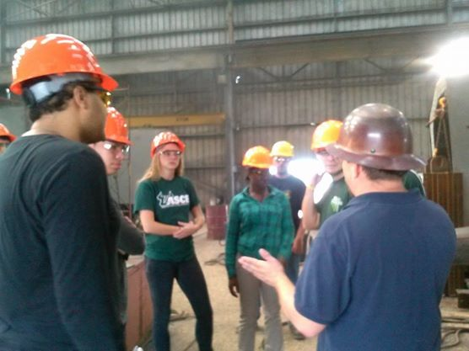
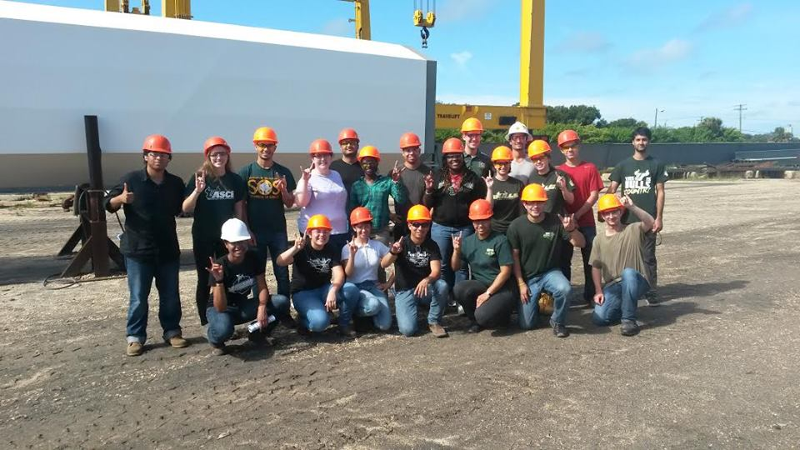
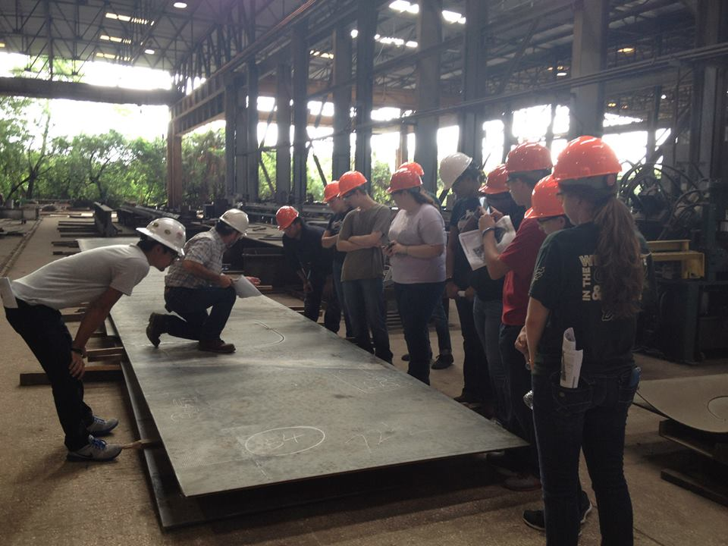
Tampa steel erecting company site tour
22 members in attendance.
Notes:
Use photos, logos, etc and describe each meeting

Slide 22
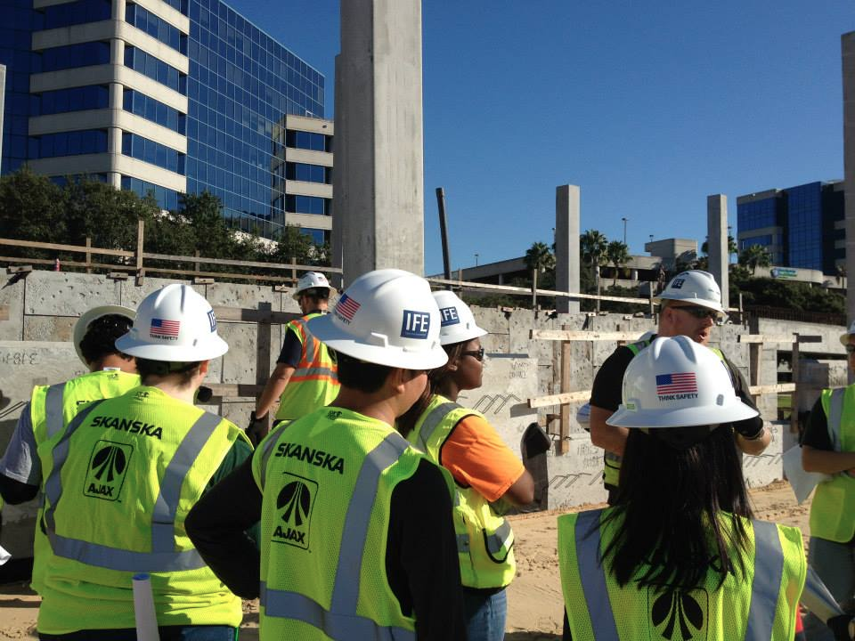
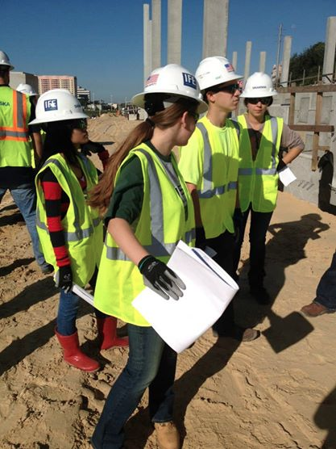
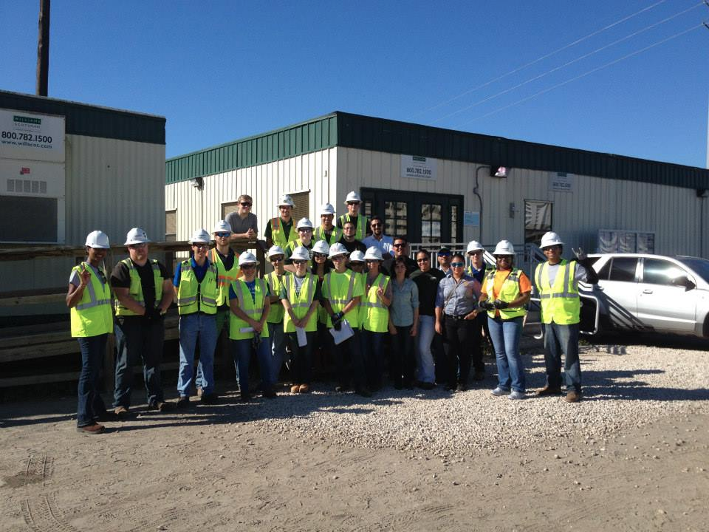
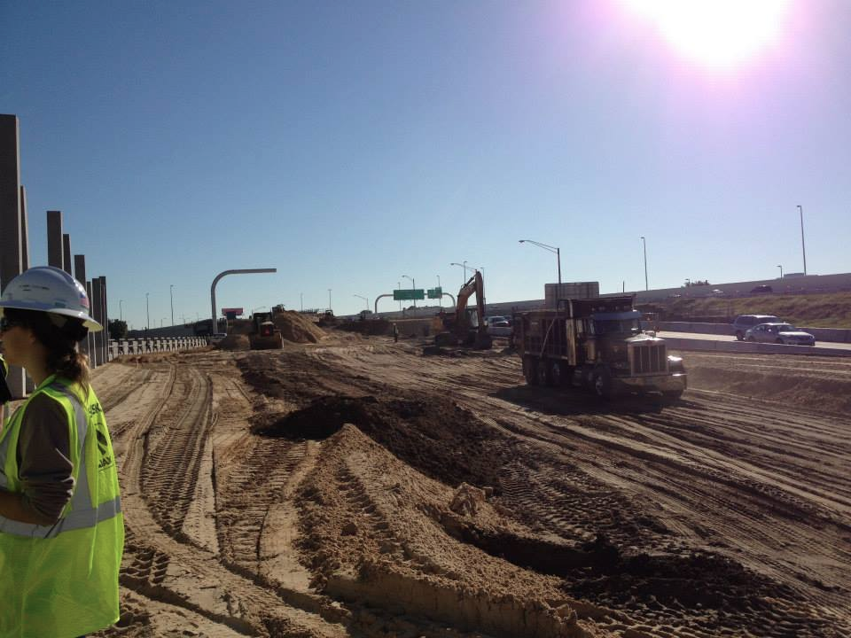
Skanska i-275 Widening site tour
24 members in attendance.
Notes:
Use photos, logos, etc and describe each meeting

Slide 23
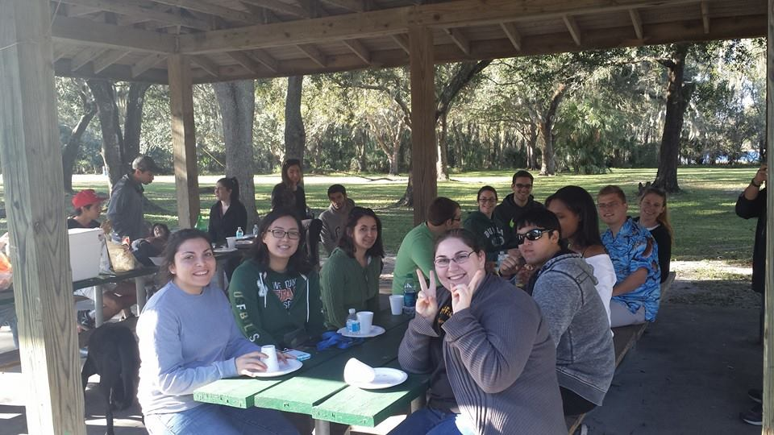
Riverfront park social
BBQ event for ASCE members, family and friends.
Held at USF Riverfront Park.
20 members attended.
Notes:
Use photos, logos, etc and describe each meeting

Slide 24
Student conference
2014 Southeast Regional Conference
University of South Florida, Tampa, FL
March 27-29, 2014
64 students attended
Notes:
Add slides as necessary to highlight results

Slide 25
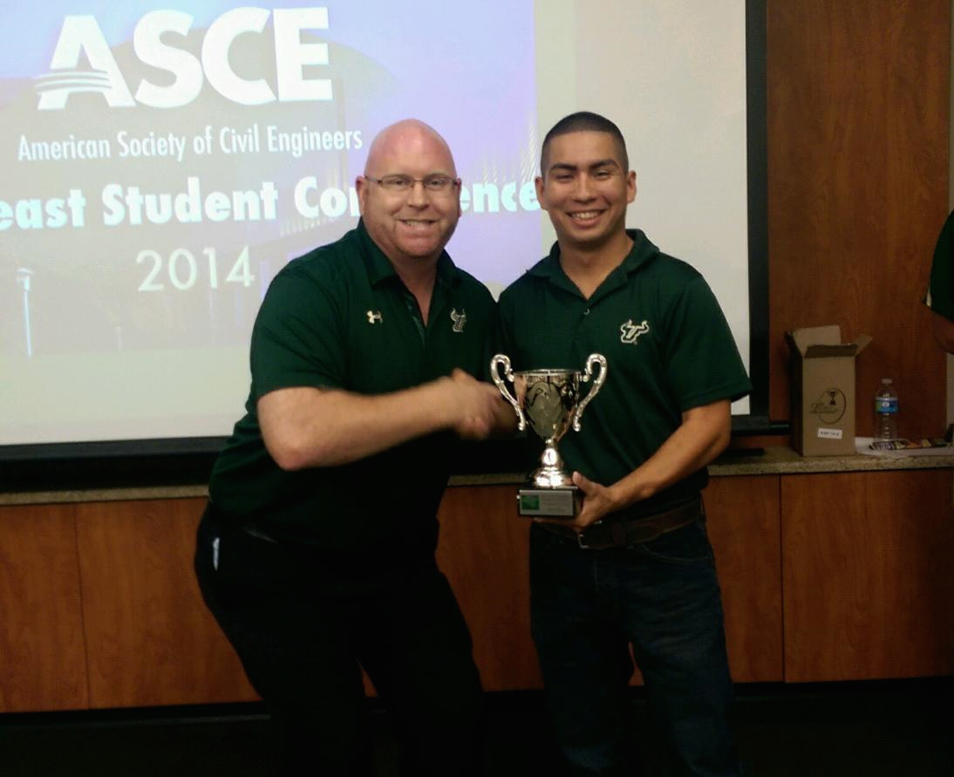
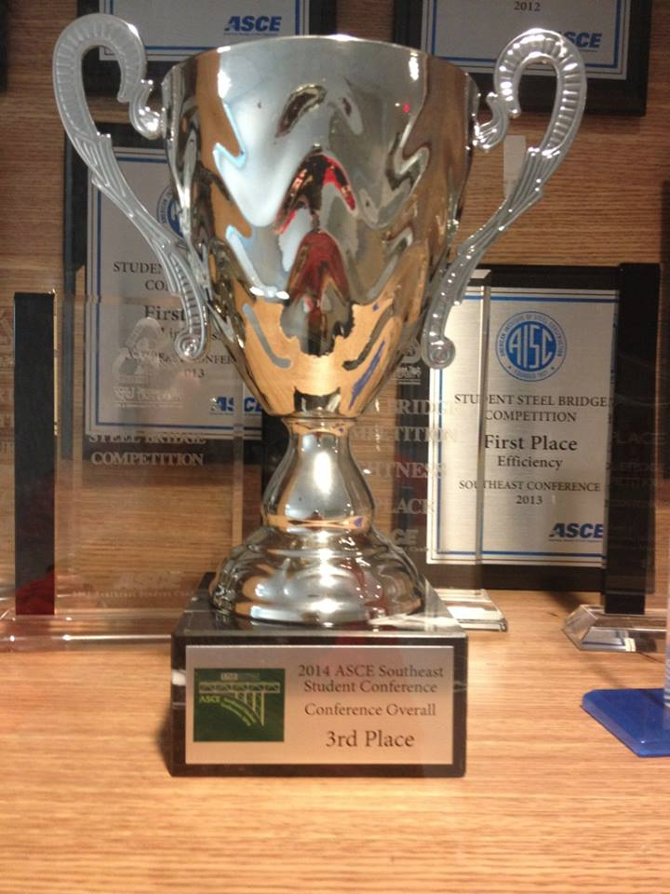
Conference highlights
3rd Place Overall
1st place Mortar Cube.
3rd place Balsa Tower.
7th place Concrete Shuffleboard

Slide 26
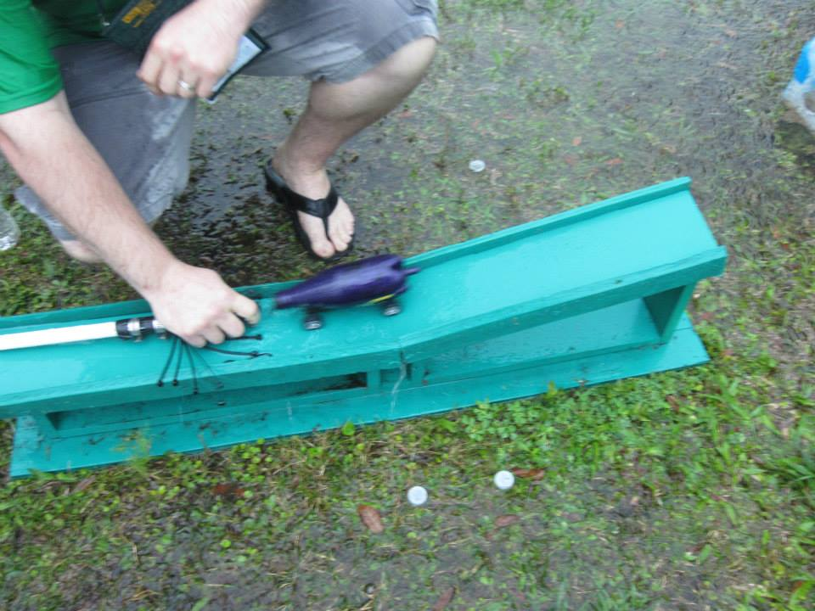
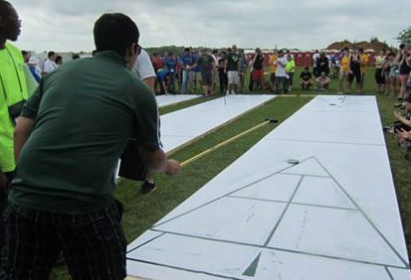
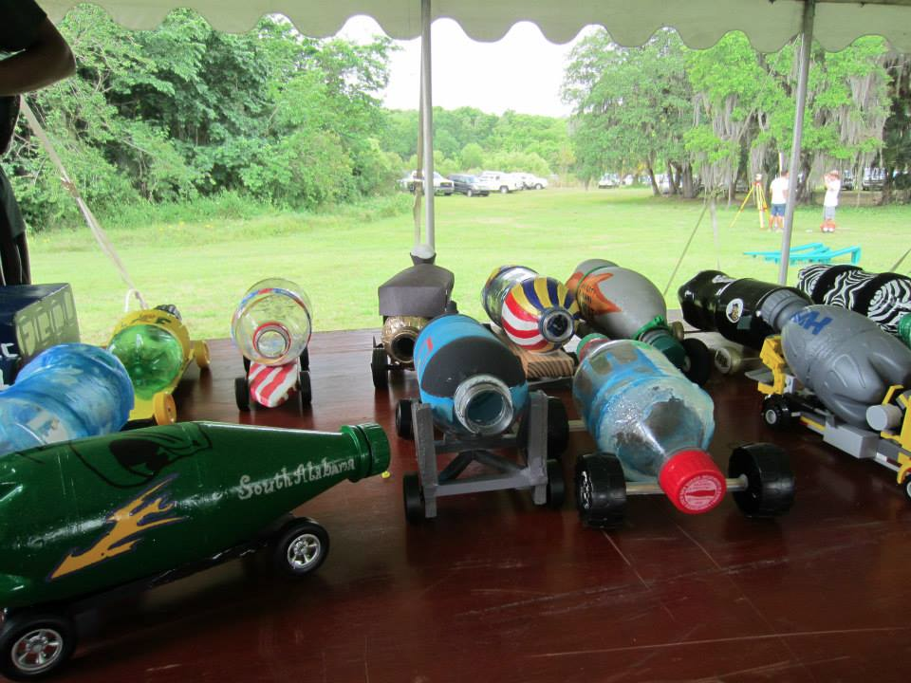
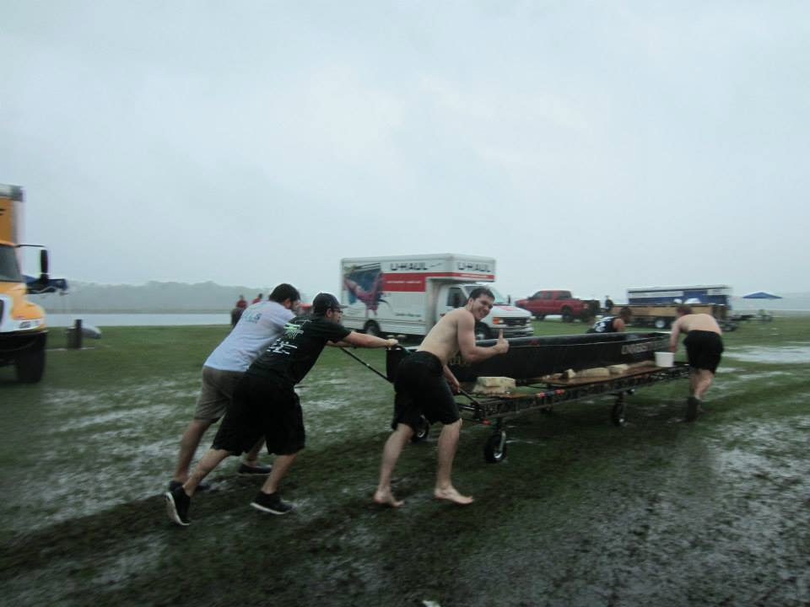
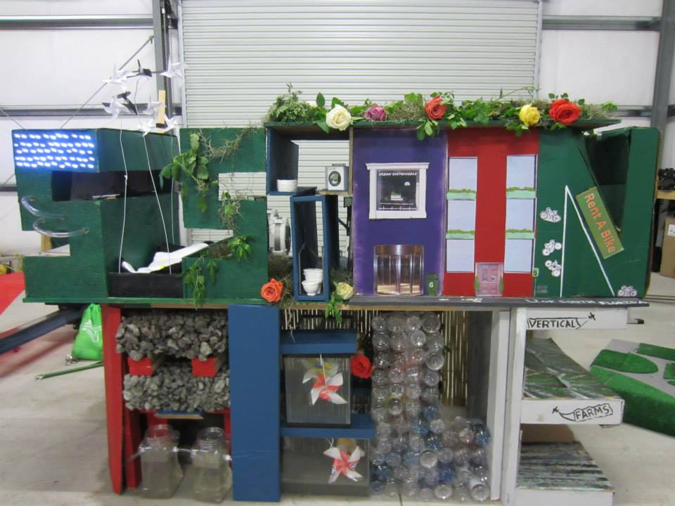
Conference highlights

Slide 27
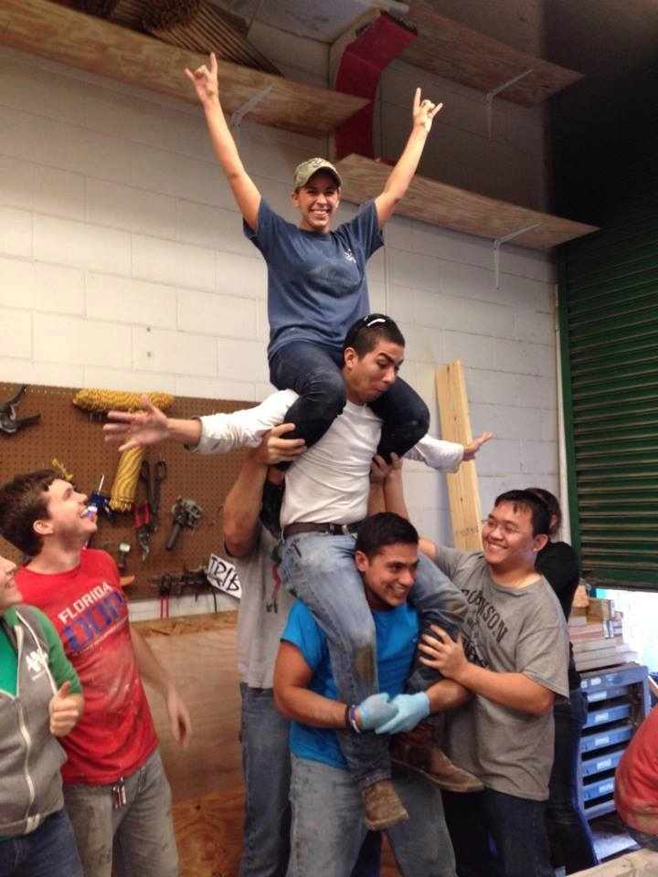
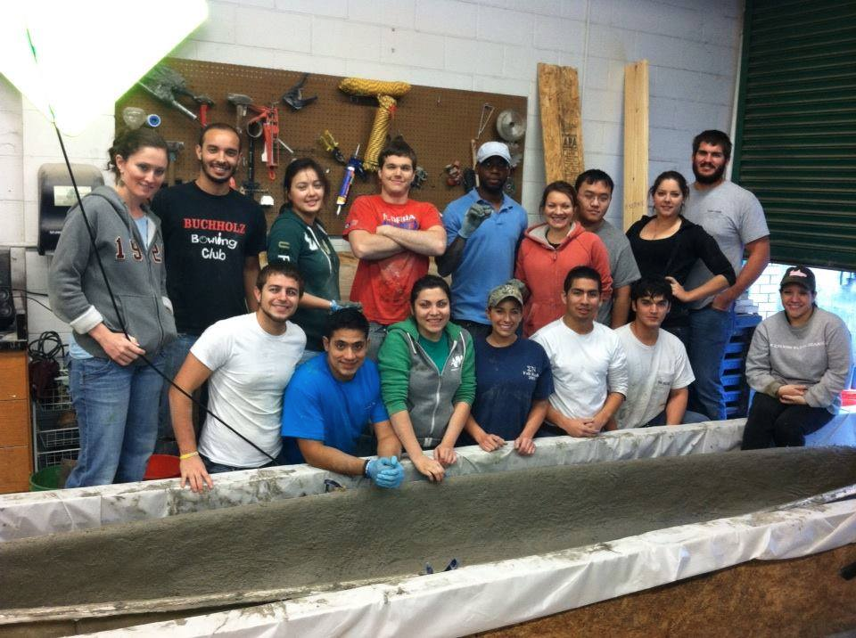
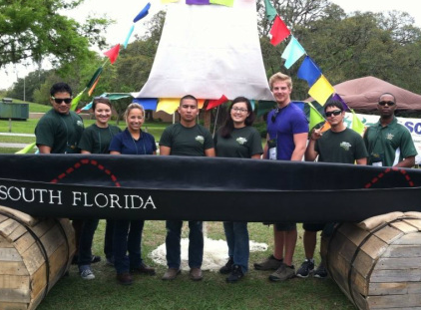
Student conference: concrete canoe
Captain: Franki Vallejo
Co Captain: Gabi Vella
10th place overall.

Slide 28
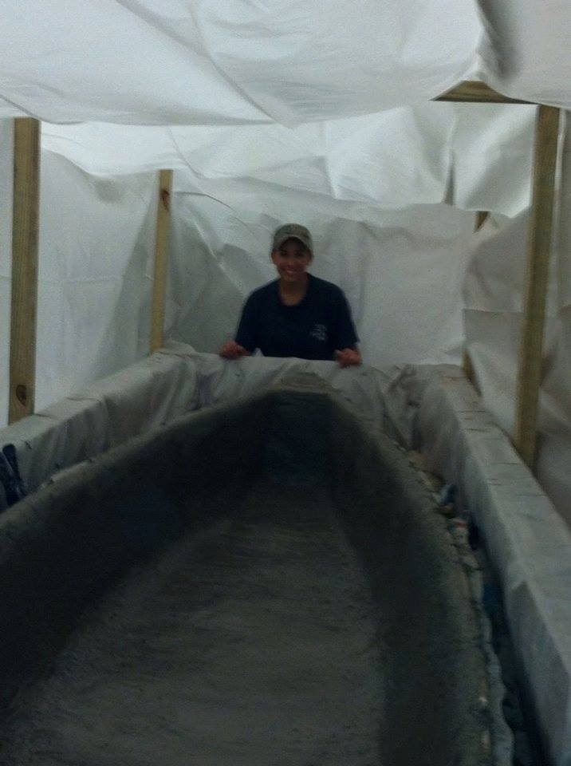
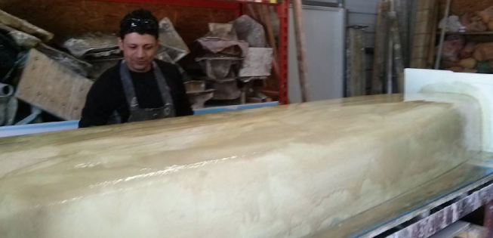
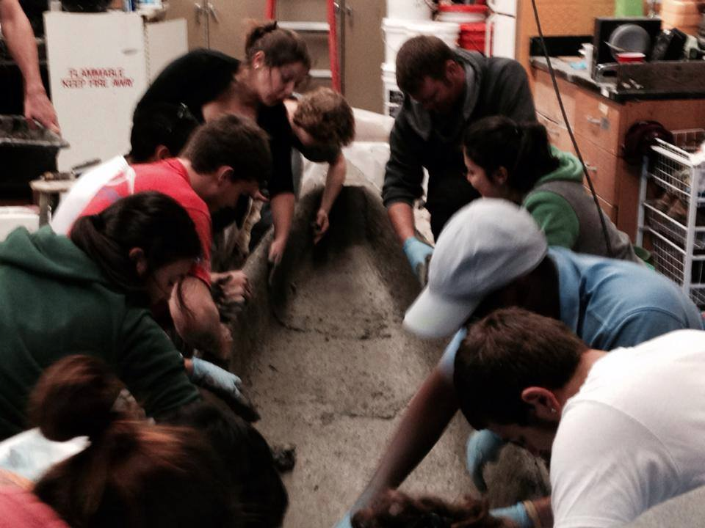
Student conference: concrete canoe

Slide 29
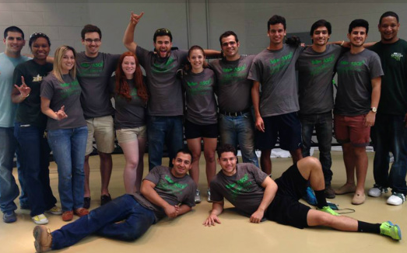
Student conference: steel bridge
Captain: Andres Rodriguez
Co Captain: Gerson Monroy
4th place stiffness.
8th place construction speed.
10th place overall.

Slide 30
Student conference: steel bridge

Slide 31
Leadership development
Workshop for Student
Chapter Leaders (WSCL)
INDIANAPOLIS, IN
FEBRUARY 7-8, 2014
4 STUDENTS ATTENDED
Notes:
Add a slide for each activity or conference attended. Other activities besides WSCL may be presented as well.

Slide 32
Workshop for student leaders
Notes:
Add a slide for each activity or conference attended. Other activities besides WSCL may be presented as well.

Slide 33
Special projects
It is appropriate for ASCE Student Organizations to undertake special projects that will fit in with the “people serving” role of civil engineering. The project should be directed toward community service or a project on campus or in the community that is for the benefit of people outside the ASCE Student Organization and ASCE.
The most desirable activities are those requiring engineering expertise, although other service efforts are also worthwhile.
Construction of a concrete canoe, steel bridge, or a fundraising project for your ASCE Student Organization do not qualify as “Special Projects”. However, hosting a Student Conference, National Concrete Canoe Competition, or National Student Steel Bridge Competition involves community participation and does qualify as a special project.
Other examples include community service projects, National Engineers Week activities, outreach to K-12 students, and other activities that benefit more than the ASCE Student Organization
Special prizes may be awarded in recognition of outstanding special projects at the ASCE Student Organization level by the Committee on Student Members.
You may include more than one special project.
Notes:
This slide is just a description of acceptable special projects

Slide 34
Engineering Expo
Participation
15 students participated; 12% of chapter.
0 faculty and practitioners
20+ hour project (Aside from the days of Expo, months of planning contributed to the success of the event.)
The goal of this project is to teach the community, have fun, and meet new people.
This project involved assigning an Engineering Expo Chairperson, who served as the primary contact for the event. This chairperson ensured that chapter representatives were present each day of the event
Notes:
Use as many slides as necessary to adequately describe each special project

Slide 35
Engineering expo
Engineering component
This project demonstrated teamwork, time management skills, and the ability to work with power tools. Members planned out the task of building the canoe tank, for example, and were successful in it’s execution.
Notes:
Use as many slides as necessary to adequately describe each special project

Slide 36
Engineering expo
The student chapter hopes that children from the community come to this annual event eager to learn about opportunities in STEM. This results in the long term success of bright, creative minds in the future.
Notes:
Use as many slides as necessary to adequately describe each special project

Slide 37
Engineering expo
Notes:
Use as many slides as necessary to adequately describe each special project

Slide 38
Keeping Tampa bay beautiful: coastal cleanup
Participation
9 students participated; 7% of chapter.
0 faculty and practitioners.
4 hour time commitment.
Description
The goal of this project was to partner with the Younger Members Group in an effort to keep the Tampa Bay Community Clean.
Notes:
Use as many slides as necessary to adequately describe each special project

Slide 39
Keeping Tampa bay beautiful: coastal cleanup
Engineering component
This project demonstrated teamwork. The group divided into teams in order to cover the grounds of the park. Within these groups, each member had a role. Some picked up trash, while others recorded what we collected.
Project impact
Although the objective of this event focused on the short term cleanliness of the park, we hope that we set an example for others to continue our efforts in the future.
Notes:
Use as many slides as necessary to adequately describe each special project

Slide 40
Keeping Tampa bay beautiful: coastal cleanup
Notes:
Use as many slides as necessary to adequately describe each special project

Slide 41
We asked the Chapter…
What were the most significant events of the year?
“The 2014 Southeast Regional Conference. Being the host school, it was an honor being able to welcome other universities into our ‘home’.”
“I believe that our Riverfront social was a good event because we never had any event like that before. A lot of people showed up and everyone had lots of fun, whether it was playing games or socializing with others.”
“Banquet is one because of the installment of new officers And transition into a new school year.”
Notes:
We would prefer that you limit to 60 slides or less, but if you have more that’s ok. When actually presenting to other groups, reorder the slides (instead of deleting, move extras to the end so you have them if questions come up) to only present a reasonable amount in the time you are given.

Slide 42
We asked the Chapter…
What were the most significant challenges?
“One of our most significant challenges was definitely getting people excited to the point were they would want to be part of events and volunteer for them.”
“Completing everything in an orderly fashion while making our members, superiors, and other students enjoy ASCE.”
Notes:
We would prefer that you limit to 60 slides or less, but if you have more that’s ok. When actually presenting to other groups, reorder the slides (instead of deleting, move extras to the end so you have them if questions come up) to only present a reasonable amount in the time you are given.

Slide 43
Questions?

