Slide 1
ENGINEERING

Slide 2
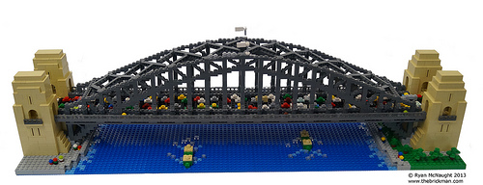
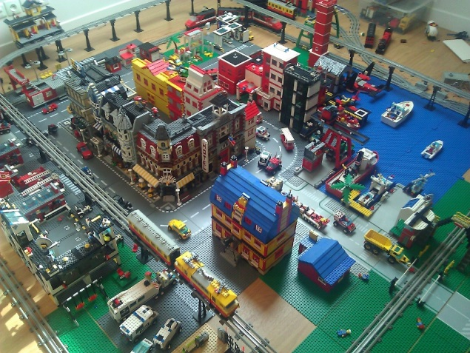
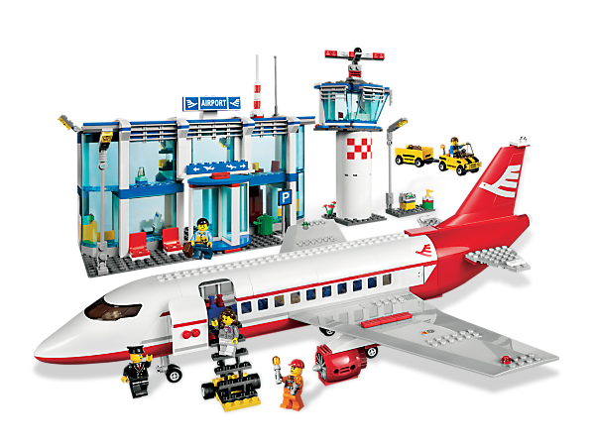
LEGOS!

Slide 3
CITIES!

Slide 4
TRAINS!

Slide 5
AIRPLANES!

Slide 6
STREETS!

Slide 7
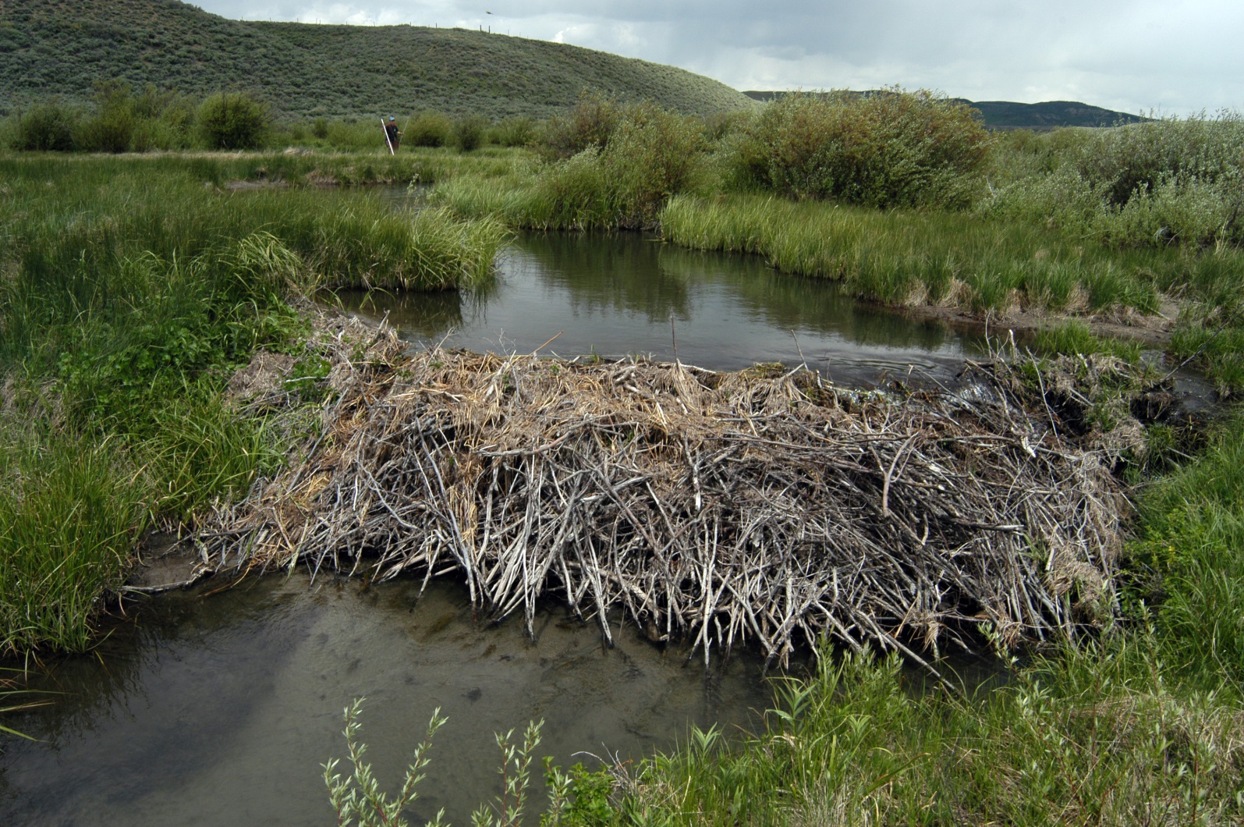
BEAVER!
BEAVER DAMS

Slide 8
HUMAN DAMS

Slide 9
SKYSCRAPERS!

Slide 10
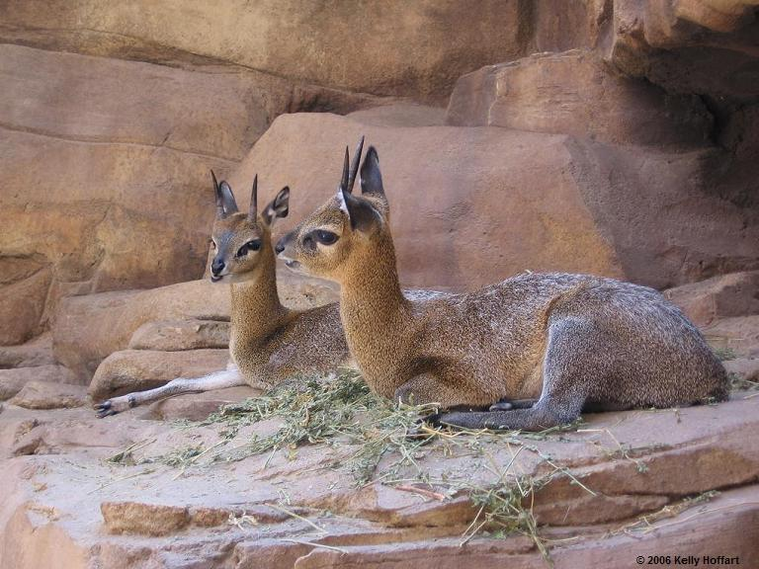
DOMES!

Slide 11
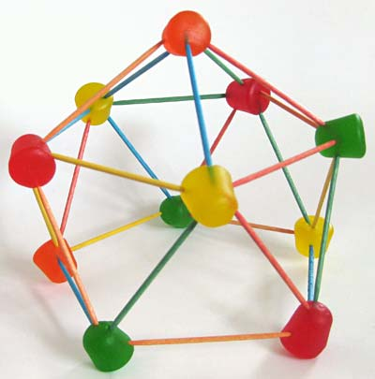
CREATE & BUILD!

