Slide 1
A Sustainable Approach to Assess the Resilience of Perforated Wood Shear Walls
Elizabeth Berry, EIT
California State University, Fresno, CA
Behnam Shadravan, Ph.D.
Florida A&M University, Tallahassee, FL
Fariborz M. Tehrani, Ph.D., PE, ENV SP, PMP, SAP
California State University, Fresno, CA

Slide 2
Overview
Significance
Methodology
Results
FMTehrani, 2005
Notes:
This presentation is based on an in-progress work to find a balance between various architectural and structural needs of ordinary buildings.

Slide 3
Significance
Assess performance of perforated wood shear walls with large openings
Develop relationship between architectural and structural characteristics
Integrity
Light
Strength
Ventilation
Access
Labor
Energy
Safety
Materials
FMTehrani, 2005
Notes:
The conflict between various needs is an opportunity to optimize performance measures, such as materials and labor, manifested in energy and emissions.

Slide 4
Envision
Complete framework for assessing and rating infrastructure projects
Accounts for social, environmental, and economic benefits
Institute for Sustainable Infrastructure (2012)

Slide 5
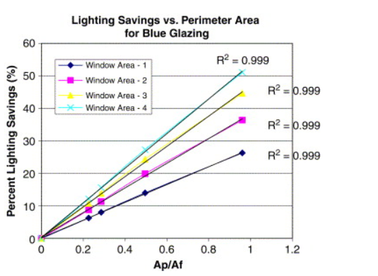
Uses of Openings
Ventilation
Daylight
Energy
Krati, Rickson, and Hillman (2005)
Notes:
Essential to health of residents
Energy Savings as a function of perimeter

Slide 6
Current Design Practices
Empirical relationships
Hysteresis behavior of shear walls
Analytical studies
Increasing size of openings reduces the stiffness and the strength of shear walls
Douglas and Sugiyama (1994)

Slide 7
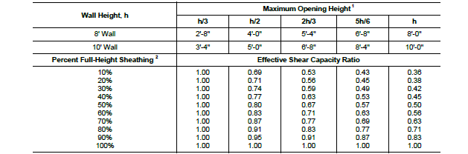
AWC Restrictions on Shear Capacity
American Wood Council (2015)
Notes:
Table 4.3.3.5 Shear Capacity Adjustment Factor Co

Slide 8
ENVISION’s Performance Measures
Scores Per Reductions of the Resources
Resource Reductions Per Level of Achievement
After Institute for Sustainable Infrastructure (2012)
After Institute for Sustainable Infrastructure (2012)
Notes:
The amount of points earned in each credit depends on the Level of Achievement:
Improved: Performance that is above conventional.
Enhanced: Sustainable performance that is on the right track. Indications that superior performance is within reach.
Superior: Sustainable performance that is noteworthy.
Conserving: Performance that has achieved essentially zero impact.
Restorative: Performance that restores natural or social systems.

Slide 9
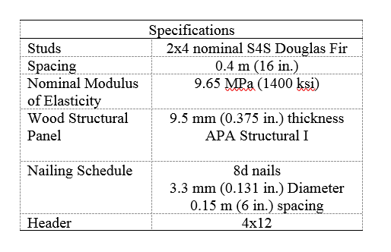
Models
5 models were created in accordance with California Building Code

Slide 10
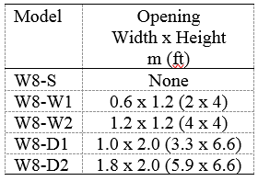
Models

Slide 11
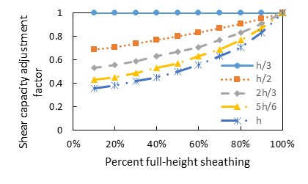
Shear Capacity Adjustment for Various Opening Height Ratios
After American Wood Council (2015)

Slide 12
Energy Input and Carbon Dioxide Emissions
Wall Components
Framing
Sheathing
Header
Measured Values
Materials
Labor-Hour
Energy
Emissions
Labor-Hour
17.391 hour/mbf (7,369 hr/m³) Framing
0.013 hour/sf (0.15 hr/m²) Sheathing
0.043 hour/ft (0.14 hr/m) Door Framing
21.053 hour/mbf (8,921 hr/m³) Header
Energy
609 MJ/m³ Framing Labor
3578 MJ/m³ Sheathing Labor
7.4 MJ/kg Framing Materials
15 MJ/kg Sheathing Materials
Emissions
0.58 kg/kg Framing
1.07 kg/kg Sheathing
After Pimentel (1973), RSMeans (2009), Hammond and Jones (2011), and, Monahan and Powell (2011)

Slide 13
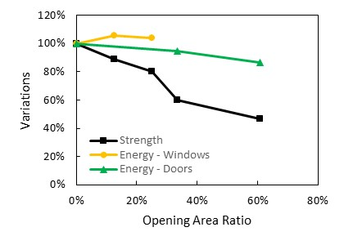
Energy Input and Carbon Dioxide Emissions
Variations of Performance Measures
Energy Input and Carbon Dioxide Emissions

Slide 14
Carbon Dioxide in Construction
Monahan and Powell (2011)

Slide 15
Conclusions and Future Studies
Reduction in shear strength of wall is greater than the change in embodied energy
With the same shear strength, perforated shear walls have greater embodied energy than solid walls
Structural solutions to strengthen perforated shear walls without obstructing openings will likely result in higher sustainability ratings
Enhancement of force transfer around openings in perforated shear walls
Broadening the impact of studies for complete units to include HVAC and lighting systems
Life cycle analysis of energy and emissions to include operation, maintenance, and demolition efforts

Slide 16
Acknowledgements

