Slide 1
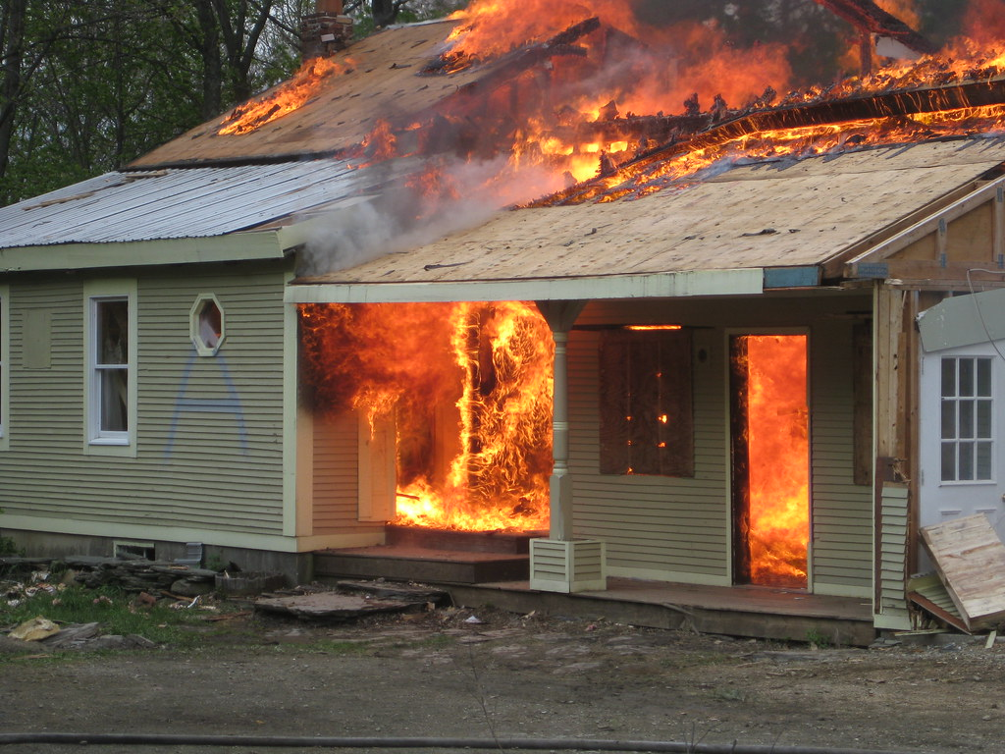
Infrequent Disasters Happen: Are You Ready? TM American Society of Quality (ASQ) 2023 ROC Excellence Conference November 15, 2023
Human Systems Engineering Consultant™
W. M. Hayden Jr., PhD, PE (inactive), CMQ/OE; Fellow, ASCE; Sr. M., ASQ & PMI
Denise M. Hayden, BS, MS, RN & CPA (inactive)
Management Quality By Design, Inc. © 2023
This Photo by Unknown Author is licensed under CC BY

Slide 2
Infrequent Disasters Happen: Are You Ready? TM “Dedication”
In 1978 while completing my M.S.C.E. at the Polytechnic Institute of Brooklyn, New York, I learned (CE7591) from my professor Dr. Paul De Cicco about the real-world challenges of fire evacuation.
Dr. De Ciccio conducted fire tests of a stairwell smoke control system in a 22-story building in Manhattan, New York.
Exposure to this fact-based analysis of the challenges of implementing and managing reliable fire evacuation within buildings led me to:
“Meeting Fire Evacuation Regulatory Codes Are Necessary, But Not Sufficient.”

Slide 3
Infrequent Disasters Happen: Are You Ready? TM There is no higher goal for quality than the protection of the public’s safety, health, and welfare.
Learning Objectives:
Discuss the common-sense approach used by Fire Evacuation Safety programs at large institutions, private and public sector, and their compliance with code and regulatory requirements.
Share how these programs are based on meeting appropriate governmental, insurance company, and “Design For Safety” requirements and protocols.
Describe findings from a review of unrelated cases wherein construction site accidents and fatalities occurred despite their compliance with the laws, regulations, and “Design For Safety” protocols.
Discuss why, in the year 2023 and beyond in a “World of Uncertainty,” we need to re-engineer our focus for “Fire Evacuation Safety” using “Un-common Sense,” based on the “Prevention Through Collaboration” strategy.
Management Quality By Design, Inc. © 2023

Slide 4
Infrequent Disasters Happen
“If You Always Do What You’ve Always Done, You’ll
Always Get What You’ve Always Got”
~ Henry Ford
Management Quality By Design, Inc. © 2023

Slide 5
Infrequent Disasters Happen
“Divided responsibility means that nobody is responsible.”
-W. Edwards Deming, PhD
Management Quality By Design, Inc. © 2023

Slide 6
Infrequent Disasters Happen
Cost To Society of “Specialization”…
“They simply do not look at anything else!”
Management Quality By Design, Inc. © 2023

Slide 7
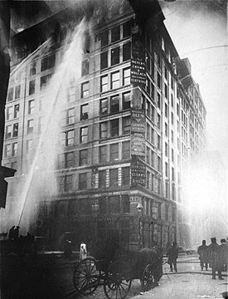
Triangle Shirtwaist Factory Fire
Infrequent Disasters Happen
Saturday, March 25, 1911
Greenwich Village Manhattan, New York City
It was the deadliest industrial disaster in the history of the city, and one of the deadliest in U.S. history.
Management Quality By Design, Inc. © 2023

Slide 8
Infrequent Disasters Happen
Triangle Shirtwaist Factory Fire (continued)
The doors to the stairwells and exits were locked– a common practice at the time to prevent workers from taking unauthorized breaks and to reduce theft– many of the workers could not escape from the burning building and jumped from the high windows.
The fire led to legislation requiring improved factory safety standards and helped spur the growth of the International Ladies’ Garment Workers’ Union (ILGWU), which fought for better working conditions for sweatshop workers.
Source: https://en.Wikipedia.org/wiki/Triangle Shirtwaist Factory Fire
What had to happen FIRST to have the fire safety protocols revised?
Management Quality By Design, Inc. © 2023

Slide 9
Theater Sellout Arena “Willie Nelson” ~1980s~
Infrequent Disasters Happen
While the band was playing and Willie strumming,
I left the seat and went to walk around the outside of the auditorium seating inside the walled arena.
To my shock, I noted that every access-door to leave the arena was chain-bolted shut.
After immediately locating the security guard and manager to have them unlock the exit-access doors, they said:
“No way. If we do that, people will
just come in without paying!”
Management Quality By Design, Inc. © 2023

Slide 10
“How reliable is your fire evacuation plan?”
Infrequent Disasters Happen
The most frequent answer to this question:
“It meets code!
Management Quality By Design, Inc. © 2023

Slide 11
Occupant characteristics in decision-making for simulation of fire evacuation:
Infrequent Disasters Happen
Evacuation Modes and Critical Human Behaviors
Three basic evacuation modes and eight critical human behaviors have been identified and coded.
Three basic evacuation modes
Staying in the current region, which is represented by random walking behavior;
Taking single evacuation (i.e., not following a leader and choosing one’s own path and exits);
Taking group evacuation (i.e., following a leader);
Source: Tristan Planchais, 2010
Management Quality By Design, Inc. © 2023

Slide 12
Occupant characteristics in decision-making for simulation of fire evacuation:
Infrequent Disasters Happen
Evacuation Modes and Critical Human Behaviors
The Eight critical human behaviors are:
Heading to other rooms for refuge;
Going back to the previous region;
Taking the route with the minimum fire hazards when the occupant is familiar with the current building environment;
Following the crowd when the occupant is not familiar with the current building environment;
Wandering around in heavy smoke;
Heading to the wall and moving along it in heavy smoke.
Helping disabled occupants
Investigating (i.e., moving toward the fire)
Management Quality By Design, Inc. © 2023

Slide 13
Occupant characteristics in decision-making for simulation of fire evacuation:
Infrequent Disasters Happen
These actions are basic human behaviors since they don’t result from much-elaborated decision-making processes but are nevertheless fundamental because they govern a realistic occupants’ movement simulation.
Saunders (2001) showed that males and females exhibited differences in preparedness and response to fire emergencies.
Bryan (1981) suggested social roles or feelings of responsibility could override gender effect. A review of literature consequently needed to be carried out, to identify the occupants' and environmental parameters involved in emergency situations decision-making, and how they interact with each other
Source: Tristan Planchais, 2010
Management Quality By Design, Inc. © 2023

Slide 14
Alarms, Lights, Buzzers Start: “It’s just a drill . . .No need to be concerned.”
Infrequent Disasters Happen
“Is that smoke I smell?”
“Where/how do I get out?”
“Who else is in harm’s way?”
“Is this my day or evening class?”
“I’m in the bathroom, what’s up?”
“Why sounds of running feet?”
“Desks knocked over.”
“Not sure which way to go.”
“Everyone is just running.”
“Some are screaming for help, but I can’t see them.”
Management Quality By Design, Inc. © 2023

Slide 15
Infrequent Disasters Happen
Question:
What’s the “Missing Link” to raise the level of fire evacuation safety?
Answer:
The lack of inter-organizational/ interdisciplinary harmony within and across traditional public and private organizational boundaries!

Slide 16
System of Collaborative Safety: Roles, Responsibilities, & Authority

Slide 17
Infrequent Disasters Happen
Future Goal:
To Successfully Collaborate.
Current Reality:
“What we’ve got here is failure to communicate.”
– Captain, ‘Cool Hand Luke’

Slide 18
Infrequent Disasters Happen: Becoming Interdisciplinary adjective: in·​ter·​dis·​ci·​plin·​ary: involving two or more academic, scientific, or artistic disciplines
Collaboration Skills:
Teamwork behaviors
Proactive listening
Ability to suspend judgment
Leadership behaviors
Ability to be a team player.
Communication Skills:
Cultural openness
Interaction skills
Articulation of one’s ideas
Written clarity
Discovery skills

Slide 19
Infrequent Disasters Happen Perspectives By Design™
The Way We Were
Improve performance by raising employee production quotas.
Ignore employee’s short-cuts to make bonus goals.
When external problems rise, blame employees and posture executives as blameless.
Prevention Through Collaboration™
Q. What can the various involved organizations’ leaders do to transform safety culture from “We’ve been doing our best for years” to a synergistic process based on:
<> Excellence
<> Caring
<> Justice
<> Faith

Slide 20
Infrequent Disasters Happen: Are You Ready?™ What Requires Collaborative “Soft Skills?”
Goals, objectives, priorities, deadlines, tasks, risks, and timeline.
Implementation plans
Action, monitor project performance, analyze results, and decide next steps.
Communication with client, regulatory agencies, functional managers, …
and stakeholders.

Slide 21
Infrequent Disasters Happen Conclusion
Stop
Make time to understand the risks and how to spot potential problems.
Think
Watch for warning signs and consider how your actions could impact safety.
Connect
Enjoy your interdisciplinary relationships with greater confidence, knowing you’ve taken the right steps to assure safety during fire evacuation.
Going Beyond Meeting Code Requirements
To Assure Buildings Are A Safer Place

Slide 22
Infrequent Disasters Happen
Escape Plans
Because fire is a risk in every building — whether you* sleep, study, or work there — you* should always have an escape plan. You* may need to escape within a few minutes of a fire’s start, so your* safe exit depends on immediate warning from smoke alarms and advance planning of escape routes.
Escape Plan Basics
Include two ways out of every room** in all escape plans
* “You” includes students who may not understand the escape plan, do not speak English, or may be disabled
** If located in a series of basement-level classrooms, “Escaping” a room is necessary but not even close to enough!
Source: University of Texas, Austin, https://fireprevention.utexas.edu/

Slide 23
A “CALL-TO-ACTION” PROPOSAL: To protect the public’s safety, health & welfare
Because Fire Evacuation Safety is a shared responsibility!
“Fire Evacuation Safety Task Force”
PREVENTION THROUGH COLLABORATION

Slide 24
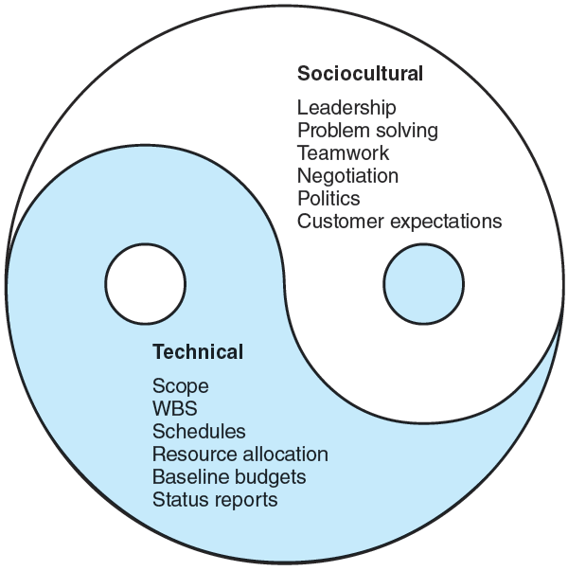
Prevention Through Collaboration™
Interdisciplinary Collaboration,
Cooperation, and Communication
Within and Across Multiple
Management & Agency
Boundaries.
“Project Management: A Strategic Managerial Approach,” Meredith & Safer, 2022.
Notes:
“Project Management: The Managerial Process, 8e,” McGraw-Hill

Slide 25
Infrequent Disasters Happen: Are You Ready? TM REVIEWERS:
Mark Hjalmarson, MSc, BSc, ITIL, CISA – Instructor and Risk Management Analyst
Sam Spata: Adjunct Professor, Clarkson University; Design Manager, Exyte
Anita McReynolds-Lidbury, CMQ/OE, CQA, ISO Lead Auditor
Patricia Caro, RN
Chad Morrison, P.E., F. ASCE - morrisonrocks@outlook.com
Steven DiIoia: ProAxiom, Inc. - Certified John Maxwell Trainer, Certified DISC Consultant, Gestalt Trained Coach, SSMBB

Slide 26
References “A Review of Risk Perception in Building Fire Evacuation,” NIST Technical Note 1840, January 2014 by Max T. Kinateder, Erica D. Kuligowski, Paul A. Reneke Richard D. Peacock, “Evacuation Processes Versus Evacuation Models: ‘‘Quo Vadimus’’? Rodrigo Machado Tavares*, OPTSEG—Optimal Safety Engineering, Research Department, GEDIPE—Grupo de Estudos sobre DInaˆmica de PEdestres, F. 13, Mackworth House, Augustus Street, Regents Park, NW1 3RE London, UK Received: 25 March 2008/Accepted: 16 June 2008 Abstract. This paper promotes a discussion about evacuation models “How to initiate evacuation movement in public buildings,” Proulx, G., Facilities, 17, 9/10, pp. 331-335, 1999 “Human behavior and evacuation movement in smoke,” Proulx, G., and Fahy, Rita, ASHRAE 2008, Trans. V.114, Part 2 “Incorporating Individual Behavior, Knowledge, and Roles in Simulating Evacuation,” Mei Ling Chu*, Department of Civil and Environmental Engineering, Stanford University, Y2E2 Building, 473 Via Ortega, Stanford, CA 94305-4020, USA Kincho H. Law, Department of Civil and Environmental Engineering, Stanford University, Y2E2 Building, 473 Via Ortega, Stanford, CA 94305-4020, USA Received: 24 August 2017/Accepted: 16 June 2018 “Movement on Stairs During Building Evacuations,” R. D. Peacock*, P. A. Reneke, E. D. Kuligowski and C. R. Hagwood, National Institute of Standards and Technology, Gaithersburg, MD 20899, USA Received: 13 January 2016/Accepted: 14 May 2016 “The Process of Verification and Validation of Building Fire Evacuation Models,” Ronchi, E., Kuligowski, E. D., Reneke, P. A., Peacock, R. D., & Nilsson, D. (2013). (NIST Technical Note; Vol. 1822). National Institute of Standards and Technology. http://nvlpubs.nist.gov/nistpubs/technicalnotes/NIST.TN.1822.pdf “The Variation of Pre-movement Time in Building Evacuation,” Martin Forssberg and Axel Mossberg , Brandskyddslaget AB, Box 9196, 102 73 Stockholm, Sweden Jesper Kjellstro¨m , PE Teknik & Arkitektur AB, So¨dermalmsalle´n 36, 118 28 Stockholm, Sweden Ha˚kan Frantzich* , Division of Fire Safety Engineering, Lund University, PO Box 118, 221 00 Lund, Sweden Daniel Nilsson , Department of Civil and Natural Resources Engineering, University of Canterbury, 69 Creyke Rd., Christchurch, New Zealand Received: 28 June 2018/Accepted: 14 June 2019
Management Quality By Design, Inc. © 2023

Slide 27
References (continued) Human behaviors for infrequent fire evacuation https://scholar.google.com/scholar?hl=en&as_sdt=0%2C33&q=human+behaviors+for+infrequent+fire+evacuation+&btnG= “bystander effect fire evacuation” https://scholar.google.com/scholar?hl=en&as_sdt=0%2C33&q=bystander+effect+fire+evacuation&oq=by “Exit choice in an emergency evacuation scenario is influenced by exit familiarity and neighbor behavior,” Max Kinatedera,b,1,⁎ , Brittany Comunalea,1 , William H. Warrena “From Empathy to Apathy: The Bystander Effect Revisited,” Ruud Hortensius1 and Beatrice de Gelder2,3 “Pursuing behavioral realism in Virtual Reality for fire evacuation research,” Silvia Arias1 | Jonathan Wahlqvist1 | Daniel Nilsson2 | Enrico Ronchi1 | Håkan Frantzich1 “Social Influence on Evacuation Behavior in Real and Virtual Environments,” Max Kinateder, William H. Warren
Management Quality By Design, Inc. © 2023

Slide 28
References (continued) “Developing and validating evacuation models for fire safety engineering,” Enrico Ronchi Department of Fire Safety Engineering, Lund University, Lund, Sweden. Fire Safety Journal. Volume 120, March 2021, 103020 “The Process of Verification and Validation of Building Fire Evacuation Models,” Enrico Ronchi, Erica D Kuligowski, Paul A Reneke, Richard D Peacock, Daniel Nilsson - 2013 Division of Fire Safety Engineering, Lund Universirty Abstract: To date, there is no International standard on procedures and tests to assess the verification and validation (V&V) of building fire evacuation models. Often it is the case that model testers adopt inconsistent procedures, or tests designed for other model uses or they do not test them for all features embedded in their model. “Risk perception in fire evacuation behavior revisited: definitions, related concepts, and empirical evidence,” Fire Science Reviews volume 4, Article number: 1 (2015) Max T Kinateder, ,Erica D Kuligowski, Paul A Reneke & Richard D Peacock “Helping People on Their Own Terms: Developing Inclusive Emergency Procedures,” Steven M. V. Gwynne , Fire Technology volume 44, pages439–461 (2008)
Management Quality By Design, Inc. © 2023

Slide 29
Infrequent Disasters Happen Six Hats of Critical Thinking! Source: https://www.debonogroup.com/services/core-programs/six-thinking-hats/
Blue Hat: "the Conductor's Hat"
When you or your team are in blue hat mode, you focus on controlling your thinking and managing the decision-making process. You have an agenda, ask for summaries, and reach conclusions.
Green Hat: "the Creative Hat"
The green hat represents creative thinking. When you're "wearing" this hat, you explore a range of ideas and possible ways forward.
Red Hat: "the Hat for the Heart"
This hat represents feelings and instincts. When you're engaged in this type of thinking, you can express your feelings without having to justify them logically.
Yellow Hat: "the Optimist's Hat"
With yellow hat thinking, you look at issues in the most positive light possible. You accentuate the benefits and the added value that could come from your ideas.
Black Hat: "the Judge's Hat"
This hat is about being cautious and assessing risks. You employ critical judgment and explain exactly why you have concerns.
White Hat: "the Factual Hat"
The white hat represents information gathering. Think about the knowledge and insights that you've collected already – but also the information you're missing, and where you can go to get it.
Management Quality By Design, Inc. © 2023

Slide 30
Infrequent Disasters Happen Find Out More About Biases*
Representativeness Bias
Anchoring Bias
Confirmation Bias
Courtesy Bias
*Source: Incident Investigation Resources(CRSA) colorado.edu
Fundamental Attribution Error
Conservatism in Belief Revision
Availability Bias

Slide 31
Going Forward: Perspectives By DESIGN TM YESTERDAY → TOMORROW

Slide 32
Fire Evacuation Safety Starts Before Fire Begins! ™
“Safety Through Design”
versus
PREVENTION THROUGH COLLABORATION™
Q. What do you think our next step needs to be?
Management Quality By Design, Inc. © 2023

Slide 33
Infrequent Disasters Happen WHO IS MISSING FROM THE TABLE?

Slide 34
Infrequent Disasters Happen: Are You Ready? TM To use part or all these notes and slides:
Request written permission from:
William M. Hayden Jr., PhD, PE (inactive)
CMQ/OE; Fellow, ASCE; Sr.M., ASQ & PMI
Human Systems Engineering Consultant™
wmhayden1@gmail.com

