Slide 1
2023 ROC Excellence Conference Fundamentals Forward!!! RIT Convention Center 5257 W Henrietta Rd Henrietta, NY 14467 15NOV2023
“Infrequent Disasters Happen: Are You Ready™”
BY
Human Systems Engineering Consultant™
W. M. Hayden Jr., Ph.D., Engineering Management, P.E. (retired), CMQ/OE, Fellow, ASCE, Sr. M., ASQ & PMI
and Denise M. Hayden, BS, MS, RN & CPA (retired)
Amherst, New York
wmhayden1@gmail.com
Management Quality By Design, Inc. © 2023

Slide 2
There is no higher goal for quality than the protection of the public’s safety, health, and welfare.
“Fire Evacuation Safety” programs at large institutions, private and public sector, have applied “Common Sense” along with their compliance to code and regulatory requirements. Their programs are based on meeting appropriate governmental, insurance company, and “Design For Safety” requirements, codes, and protocols.
After reviewing unrelated cases wherein construction site accidents and fatalities occurred, it became clear that compliance with the laws, regulations, and “Design For Safety” protocols were necessary, but inadequate.
I will present and discuss why, in the year 2023 and beyond in a “World of Uncertainty,” we need to re-engineer our focus for “Fire Evacuation Safety” using “Un-common Sense,” based on “Prevention Through Collaboration.™”
Management Quality By Design, Inc. © 2023

Slide 3
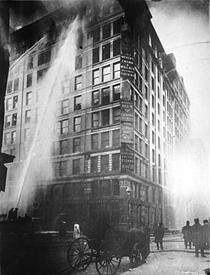
Triangle Shirtwaist Factory fire in the Greenwich Village neighborhood of Manhattan, New York City, on Saturday, March 25, 1911, was the deadliest industrial disaster in the history of the city, and one of the deadliest in U.S. history.^{[1]}

Slide 4
Triangle Shirtwaist Factory fire (continued)
Because the doors to the stairwells and exits were locked^{[1][8]} – a common practice at the time to prevent workers from taking unauthorized breaks and to reduce theft^{[9]} – many of the workers could not escape from the burning building and jumped from the high windows.
The fire led to legislation requiring improved factory safety standards and helped spur the growth of the International Ladies' Garment Workers' Union (ILGWU), which fought for better working conditions for sweatshop workers.
Q. What had to happen FIRST to have the fire safety protocols revised?
https://en.wikipedia.org/wiki/Triangle_Shirtwaist_Factory_fire

Slide 5
“If You Always Do What You’ve Always Done, You’ll Always Get What You’ve Always Got.” ~ Henry Ford
Management Quality By Design, Inc. © 2023

Slide 6
Theater Sellout Arena “Willie Nelson” ~1980s~
While the band was playing and Willie strumming,
I left the seat and went to walk around the outside of the auditorium seating inside the walled arena.
To my shock, I noted that every access-door to leave the arena
was chain-bolted shut.
After immediately locating the security guard and manager to have them unlock the exit-access doors, they said:
“No way. If we do that, people will
just come in without paying!”

Slide 7
― W. Edwards Deming
“Divided responsibility means that nobody is responsible.”
https://deming.org/

Slide 8
Occupant characteristics in decision-making for simulation of fire evacuation by Tristan Planchais. ©2010
Evacuation Modes and Critical Human Behaviors
Three basic evacuation modes and eight critical human behaviors have been identified and coded.
1. Staying in the current region, which is represented by random walking behavior;
2. Taking single evacuation (i.e., not following a leader and choosing one’s own path and exits);
3. Taking group evacuation (i.e., following a leader);
https://www.proquest.com/docview/518480358/fulltextPDF?parentSessionId=bsAO58BtXyE47TlCfkV7DpijYQJaNlDPpItBF6WbRns%3D&accountid=14169

Slide 9
Occupant characteristics in decision-making for simulation of fire evacuation (continued) by Tristan Planchais. ©2010
The 8 Critical human behaviors are:
Heading to other rooms for refuge;
Going back to the previous region;
Taking the route with the minimum fire hazards when the occupant is familiar with the current building environment;
Following the crowd when the occupant is not familiar with the current building environment;
Wandering around in heavy smoke;
Heading to the wall and moving along it in heavy smoke;
Helping disabled occupants; and,
Investigating (i.e., moving toward the fire)

Slide 10
Occupant characteristics in decision-making for simulation of fire evacuation by Tristan Planchais. ©2010 (Continued)
These actions are basic human behaviors since they don’t result from much elaborated decision-making processes but are nevertheless fundamental because they govern a realistic occupants’ movement simulation.
Saunders (2001) showed that males and females exhibited differences in preparedness and response to fire emergencies. On the other hand, Bryan (1981) suggested social role or feeling of responsibility could override gender effect. A review of literature consequently needed to be carried out, to identify the occupants' and environmental parameters involved in emergency situations decision making, and how they interact with each other

Slide 11
The most frequent answer to the question “How reliable is your fire evacuation plan?:”
“It meets code!

Slide 12
Cost To Society of “Specialization”
“They simply do not look at anything else!”
Management Quality By Design, Inc. © 2023

Slide 13
Q. What’s the “Missing Link” to raise the level of fire evacuation safety?
A. The lack of interorganizational/ interdisciplinary
harmony within and across traditional
public & private organizational boundaries!
Management Quality By Design, Inc. © 2023

Slide 14
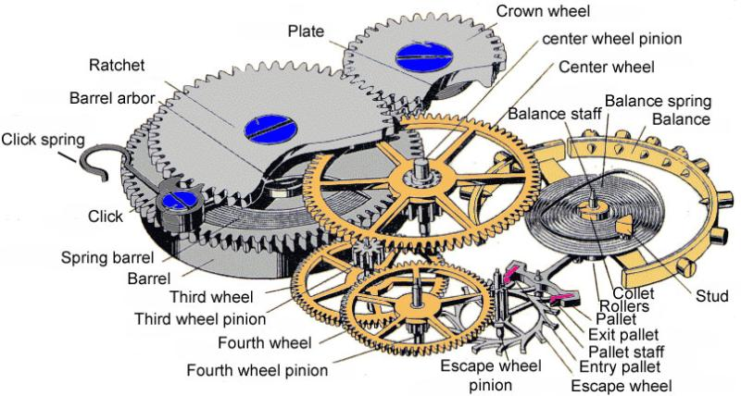
System of Collaborative Safety: Roles, Responsibilities, and Authority

Slide 15
Future Goal: “To Successfully Collaborate.”
Current Reality:
“What we’ve got here is failure to communicate.”
– Captain, ‘Cool Hand Luke’
Management Quality By Design, Inc. © 2023

Slide 16
“Becoming Interdisciplinary” adjective: in·​ter·​dis·​ci·​plin·​ary ˌ: involving two or more academic, scientific, or artistic disciplines
Collaboration Skills:
Leadership Behaviors
Teamwork behaviors
Proactive listening
Ability to suspend judgment
Ability to be a team player.
Management Quality By Design, Inc. © 2023
Communication Skills:
Leadership Behaviors
Cultural openness
Interaction skills
Articulation of one’s ideas
Discovery skills

Slide 17
Perspectives By Design™
“The Way We Were”
Improve performance by raising employee production quotas.
Ignore employee’s short-cuts to make bonus goals.
When external problems rise, blame employees and posture executives as blameless.
Management Quality By Design, Inc. © 2023
Prevention Through Collaboration™
Q. What can the various involved organizations’ leaders do to transform safety culture from “We’ve been doing our best for years” to a synergistic process based on:
Excellence
Caring
Justice
Faith

Slide 18
“Infrequent Disasters Happen: Are You Ready™”
Q. What Requires Collaborative “Soft Skills?”
Goals, objectives, strategies, priorities, deadlines, tasks, risks, and timeline.
Implementation plans:
Action, monitor project performance, analyze results, and decide next steps.
Communication with client, regulatory agencies, functional managers,
and stakeholders.
Management Quality By Design, Inc. © 2023

Slide 19
Alarms, Lights, Buzzers Start: “It’s just a drill . . .No need to be concerned.”
“Is that smoke I smell?”
“Where/how do I get out?”
“Who else is in harm’s way?”
“Is this my day or evening class?”
“I’m in the bathroom, what’s up?”
“Why sounds of running feet?”
“Desks knocked over.”
“Not sure which way to go.”
“Everyone is just running.”
“Some are screaming for help,
but I can’t see them.”

Slide 20
UT, Austin, Texas: Evacuation Training
Escape Plans
Because fire is a risk in every building — whether you* sleep, study, or work there — you* should always have an escape plan. You* may need to escape within a few minutes of a fire’s start, so your* safe exit depends on immediate warning from smoke alarms and advance planning of escape routes.
Escape Plan Basics
Include two ways out of every room** in all escape plans
“You” includes students who may not understand the escape plan, do not speak English, may be handicapped, somewhat disabled.
** If located in a series of basement-level classrooms, “Escaping” a room is necessary but
not even close to enough!
https://fireprevention.utexas.edu/

Slide 21
PLAN – What are we planning to do?
-What do we anticipate is going to happen?
DO - What happened?
-Perform the “Plan” that the team has outlined above and be sure to study and document what happened along the way.
STUDY – What did we learn?
-Compare baseline data to the data we collected from our experiment.
ACT – What’s next?
-Given the results of the experiment, what will the team do next?
https://www.healthteamworks.org/resource/pdsa-worksheet-template

Slide 22
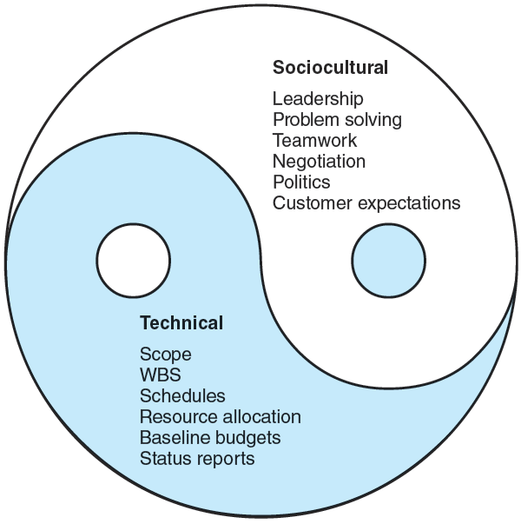
Prevention Through Collaboration™
Interdisciplinary Collaboration,
Cooperation, and Communication
Within and Across Multiple
Management & Agency
Boundaries.
Notes:
“Project Management: The Managerial Process, 8e,” McGraw-Hill

Slide 23
Conclusion
STOP → THINK → CONNECT
Stop: Make time to understand the risks and how to
spot potential problems.
Think: Watch for warning signs and consider how your actions
could impact safety.
Connect: Enjoy your interdisciplinary relationships with greater
confidence, knowing you’ve taken the right steps to
assure safety during fire evacuation.
<>Going Beyond Meeting Code Requirements
To Assure Buildings Are A Safer Place<>
©
Management Quality By Design, Inc. © 2023

Slide 24
A “CALL-TO-ACTION” PROPOSAL: To protect the public’s safety, health & welfare.
Because fire evacuation safety is a
shared responsibility!
“Fire Evacuation Safety Task Force TM“
PREVENTION THROUGH COLLABORATION
Management Quality By Design, Inc. © 2023

Slide 25
“Go The Distance!

Slide 26
To use part or all of these notes & slides:
First, you must obtain written permission.
From
Human Systems Engineering Consultant™
William M. Hayden Jr., Ph.D., Engineering Management, CMQ/OE
wmhayden1@gmail.com
Management Quality By Design, Inc. © 2023

Slide 27
REVIEWERS
Mark Hjalmarson, MSc, BSc, ITIL, CISA – Instructor and Risk Management Analyst
Sam Spata: Adjunct Professor, Clarkson University; Design Manager, Exyte
Anita McReynolds-Lidbury, CMQ/OE, CQA, ISO Lead Auditor
Patricia Caro, RN

Slide 28
References “A Review of Risk Perception in Building Fire Evacuation,” NIST Technical Note 1840, January 2014 by Max T. Kinateder, Erica D. Kuligowski, Paul A. Reneke Richard D. Peacock, “Evacuation Processes Versus Evacuation Models: ‘‘Quo Vadimus’’? Rodrigo Machado Tavares*, OPTSEG—Optimal Safety Engineering, Research Department, GEDIPE—Grupo de Estudos sobre DInaˆmica de PEdestres, F. 13, Mackworth House, Augustus Street, Regents Park, NW1 3RE London, UK Received: 25 March 2008/Accepted: 16 June 2008 Abstract. This paper promotes a discussion about evacuation models “How to initiate evacuation movement in public buildings,” Proulx, G., Facilities, 17, 9/10, pp. 331-335, 1999 “Human behavior and evacuation movement in smoke,” Proulx, G., and Fahy, Rita, ASHRAE 2008, Trans. V.114, Part 2 “Incorporating Individual Behavior, Knowledge, and Roles in Simulating Evacuation,” Mei Ling Chu*, Department of Civil and Environmental Engineering, Stanford University, Y2E2 Building, 473 Via Ortega, Stanford, CA 94305-4020, USA Kincho H. Law, Department of Civil and Environmental Engineering, Stanford University, Y2E2 Building, 473 Via Ortega, Stanford, CA 94305-4020, USA Received: 24 August 2017/Accepted: 16 June 2018 “Movement on Stairs During Building Evacuations,” R. D. Peacock*, P. A. Reneke, E. D. Kuligowski and C. R. Hagwood, National Institute of Standards and Technology, Gaithersburg, MD 20899, USA Received: 13 January 2016/Accepted: 14 May 2016 “The Process of Verification and Validation of Building Fire Evacuation Models,” Ronchi, E., Kuligowski, E. D., Reneke, P. A., Peacock, R. D., & Nilsson, D. (2013). (NIST Technical Note; Vol. 1822). National Institute of Standards and Technology. http://nvlpubs.nist.gov/nistpubs/technicalnotes/NIST.TN.1822.pdf “The Variation of Pre-movement Time in Building Evacuation,” Martin Forssberg and Axel Mossberg , Brandskyddslaget AB, Box 9196, 102 73 Stockholm, Sweden Jesper Kjellstro¨m , PE Teknik & Arkitektur AB, So¨dermalmsalle´n 36, 118 28 Stockholm, Sweden Ha˚kan Frantzich* , Division of Fire Safety Engineering, Lund University, PO Box 118, 221 00 Lund, Sweden Daniel Nilsson , Department of Civil and Natural Resources Engineering, University of Canterbury, 69 Creyke Rd., Christchurch, New Zealand Received: 28 June 2018/Accepted: 14 June 2019

Slide 29
References (continued)
Human behaviors for infrequent fire evacuation
https://scholar.google.com/scholar?hl=en&as_sdt=0%2C33&q=human+behaviors+for+infrequent+fire+evacuation+&btnG=
“bystander effect fire evacuation”
https://scholar.google.com/scholar?hl=en&as_sdt=0%2C33&q=bystander+effect+fire+evacuation&oq=by
“Exit choice in an emergency evacuation scenario is influenced by exit familiarity and neighbor behavior,”
Max Kinatedera,b,1,⁎ , Brittany Comunalea,1 , William H. Warrena
“From Empathy to Apathy: The Bystander Effect Revisited,”
Ruud Hortensius1 and Beatrice de Gelder2,3
“Pursuing behavioral realism in Virtual Reality for fire evacuation research,”
Silvia Arias1 | Jonathan Wahlqvist1 | Daniel Nilsson2 | Enrico Ronchi1 | Håkan Frantzich1
“Social Influence on Evacuation Behavior in Real and Virtual Environments,”
Max Kinateder, William H. Warren

Slide 30
Six Hats of Critical Thinking! https://www.debonogroup.com/services/core-programs/six-thinking-hats/
Blue Hat: "the Conductor's Hat"
When you or your team are in blue hat mode, you focus on controlling your thinking and managing the decision-making process. You have an agenda, ask for summaries, and reach conclusions.
Green Hat: "the Creative Hat"
The green hat represents creative thinking. When you're "wearing" this hat, you explore a range of ideas and possible ways forward.
Red Hat: "the Hat for the Heart"
This hat represents feelings and instincts. When you're engaged in this type of thinking, you can express your feelings without having to justify them logically.
Yellow Hat: "the Optimist's Hat"
With yellow hat thinking, you look at issues in the most positive light possible. You accentuate the benefits and the added value that could come from your ideas.
Black Hat: "the Judge's Hat"
This hat is about being cautious and assessing risks. You employ critical judgment and explain exactly why you have concerns.
White Hat: "the Factual Hat"
The white hat represents information gathering. Think about the knowledge and insights that you've collected already – but also the information you're missing, and where you can go to get it.

Slide 31
“Find Out More About Biases” *
Representativeness Bias
Anchoring Bias
Confirmation Bias
Courtesy Bias
Fundamental Attribution Error
Conservatism in Belief Revision
Availability Bias
*Incident Investigation Resources | CSRA (colorado.edu)

Slide 32
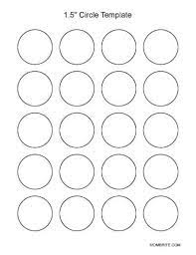
Going Forward: Perspective By DESIGN TM “Yesterday” “TOMORROW “

Slide 33
WHO IS MISSING FROM THE TABLE?

Slide 34
Fire Evacuation Safety STARTS BEFORE BEGINS! ™
“Safety Through Design”
versus
PREVENTION THROUGH COLLABORATION™
Q. What do you think our next step needs to be?
Management Quality By Design, Inc. © 2023

